Slide 1
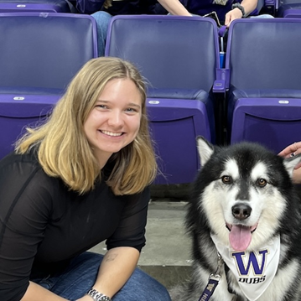
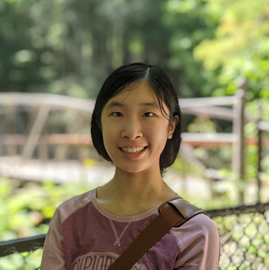
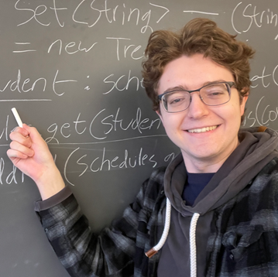
CSE 121 Lesson 15: Array Patterns and Exam Review
Simon Wu
Summer 2024
TAs:
Trey | Hannah | Mia | Vivian | Jolie | Colton | Ziao
sli.do #cse121

Slide 2
Announcements, Reminders
Quiz 2 Feedback will be released by Monday at the latest
Tip: Make sure you are reviewing your quizzes when preparing for the final!
R6 and R7 released!
Extra Resubmission Cycle – any assignment can be resubmitted for both!
Programming Assignment 3 due next Tuesday
Final Exam: Friday, 8/16 from 12:00-1:00 in PCAR 290
See Ed post for more information
No more make-ups for the final exam
Final Reflection feedback deadline TONIGHT!

Slide 3
(2D)ays Above Average: readData()
How many days' data would you like to input? 3
Next day's data:
Temperature in Seattle? 44
Temperature in Tacoma? 40
Temperature in Bothell? 43
Next day's data:
Temperature in Seattle? 42
Temperature in Tacoma? 40
Temperature in Bothell? 44
Next day's data:
Temperature in Seattle? 42
Temperature in Tacoma? 41
Temperature in Bothell? 43
…
 | Seattle | Tacoma | Bothell
1 | 44 | 40 | 43
2 | 42 | 40 | 44
3 | 42 | 41 | 43

Slide 4
(2D)ays Above Average: readData()
How many days' data would you like to input? 3
Next day's data:
Temperature in Seattle? 44
Temperature in Tacoma? 40
Temperature in Bothell? 43
Next day's data:
Temperature in Seattle? 42
Temperature in Tacoma? 40
Temperature in Bothell? 44
Next day's data:
Temperature in Seattle? 42
Temperature in Tacoma? 41
Temperature in Bothell? 43
…
 | Seattle | Tacoma | Bothell
1 | 44 | 40 | 43
2 | 42 | 40 | 44
3 | 42 | 41 | 43

Slide 5
(2D)ays Above Average: readData()
How many days' data would you like to input? 3
Next day's data:
Temperature in Seattle? 44
Temperature in Tacoma? 40
Temperature in Bothell? 43
Next day's data:
Temperature in Seattle? 42
Temperature in Tacoma? 40
Temperature in Bothell? 44
Next day's data:
Temperature in Seattle? 42
Temperature in Tacoma? 41
Temperature in Bothell? 43
…
 | Seattle | Tacoma | Bothell
1 | 44 | 40 | 43
2 | 42 | 40 | 44
3 | 42 | 41 | 43

Slide 6
(2D)ays Above Average: readData()
How many days' data would you like to input? 3
Next day's data:
Temperature in Seattle? 44
Temperature in Tacoma? 40
Temperature in Bothell? 43
Next day's data:
Temperature in Seattle? 42
Temperature in Tacoma? 40
Temperature in Bothell? 44
Next day's data:
Temperature in Seattle? 42
Temperature in Tacoma? 41
Temperature in Bothell? 43
…
 | Seattle | Tacoma | Bothell
1 | 44 | 40 | 43
2 | 42 | 40 | 44
3 | 42 | 41 | 43

Slide 7
(2D)ays Above Average: readData()
How many days' data would you like to input? 3
Next day's data:
Temperature in Seattle? 44
Temperature in Tacoma? 40
Temperature in Bothell? 43
Next day's data:
Temperature in Seattle? 42
Temperature in Tacoma? 40
Temperature in Bothell? 44
Next day's data:
Temperature in Seattle? 42
Temperature in Tacoma? 41
Temperature in Bothell? 43
…
 | Seattle | Tacoma | Bothell
1 | 44 | 40 | 43
2 | 42 | 40 | 44
3 | 42 | 41 | 43

Slide 8
(2D)ays Above Average: readData()
How many days' data would you like to input? 3
Next day's data:
Temperature in Seattle? 44
Temperature in Tacoma? 40
Temperature in Bothell? 43
Next day's data:
Temperature in Seattle? 42
Temperature in Tacoma? 40
Temperature in Bothell? 44
Next day's data:
Temperature in Seattle? 42
Temperature in Tacoma? 41
Temperature in Bothell? 43
…
 | Seattle | Tacoma | Bothell
1 | 44 | 40 | 43
2 | 42 | 40 | 44
3 | 42 | 41 | 43

Slide 9
(2D)ays Above Average: readData()
How many days' data would you like to input? 3
Next day's data:
Temperature in Seattle? 44
Temperature in Tacoma? 40
Temperature in Bothell? 43
Next day's data:
Temperature in Seattle? 42
Temperature in Tacoma? 40
Temperature in Bothell? 44
Next day's data:
Temperature in Seattle? 42
Temperature in Tacoma? 41
Temperature in Bothell? 43
…
 | Seattle | Tacoma | Bothell
1 | 44 | 40 | 43
2 | 42 | 40 | 44
3 | 42 | 41 | 43

Slide 10
(2D)ays Above Average: readData()
How many days' data would you like to input? 3
Next day's data:
Temperature in Seattle? 44
Temperature in Tacoma? 40
Temperature in Bothell? 43
Next day's data:
Temperature in Seattle? 42
Temperature in Tacoma? 40
Temperature in Bothell? 44
Next day's data:
Temperature in Seattle? 42
Temperature in Tacoma? 41
Temperature in Bothell? 43
…
 | Seattle | Tacoma | Bothell
1 | 44 | 40 | 43
2 | 42 | 40 | 44
3 | 42 | 41 | 43

Slide 11
(2D)ays Above Average: readData()
How many days' data would you like to input? 3
Next day's data:
Temperature in Seattle? 44
Temperature in Tacoma? 40
Temperature in Bothell? 43
Next day's data:
Temperature in Seattle? 42
Temperature in Tacoma? 40
Temperature in Bothell? 44
Next day's data:
Temperature in Seattle? 42
Temperature in Tacoma? 41
Temperature in Bothell? 43
…
 | Seattle | Tacoma | Bothell
1 | 44 | 40 | 43
2 | 42 | 40 | 44
3 | 42 | 41 | 43

Slide 12
(2D)ays Above Average: readData()
How many days' data would you like to input? 3
Next day's data:
Temperature in Seattle? 44
Temperature in Tacoma? 40
Temperature in Bothell? 43
Next day's data:
Temperature in Seattle? 42
Temperature in Tacoma? 40
Temperature in Bothell? 44
Next day's data:
Temperature in Seattle? 42
Temperature in Tacoma? 41
Temperature in Bothell? 43
…
 | Seattle | Tacoma | Bothell
1 | 44 | 40 | 43
2 | 42 | 40 | 44
3 | 42 | 41 | 43

Slide 13
(2D)ays Above Average: computeAverages()
How many days' data would you like to input? 3
…
The average values for each location were [42.666666666666664, 40.333333333333336, 43.333333333333336]
 | Seattle | Tacoma | Bothell
1 | 44 | 40 | 43
2 | 42 | 40 | 44
3 | 42 | 41 | 43
42.667 | 40.333 | 43.333
Average of Seattle temperatures
(44 + 42 + 42) / 3

Slide 14
Questions?

Slide 15
(PCM) Counting Elements that Meet a Condition
"one" | "two" | "three" | "six" | "seven" | "eight" | "ten"
public static int evenLength(String[] list) {
int countEven = 0;
for (int i = 0; i < list.length; i++) {
if ( ) {
countEven++;
}
}
return countEven;
}

Slide 16
(PCM) Modifying Elements of an Array
4 | 8 | 15 | 16 | 23 | 42
public static void clamp(int min, int max, int[] list) {
for (int i = 0; i < list.length; i++) {
if ( > max) {
= max;
} else if ( < min) {
= min;
}
}
}

Slide 17
(PCM) Searching for an Element
"one" | "two" | "three" | "six" | "seven" | "eight" | "ten"
public static int indexOfIgnoreCase(String phrase, String[] list) {
for (int i = 0; i < list.length; i++) {
if ( ) {
return ;
}
}
return ;
}

Slide 18
(PCM) Shifting Elements
9.6 | -88.0 | 4.815 | 0.009 | 7.0184 | 42.9
public static void rotateRight(double[] list) {
double lastElement = list[list.length - 1];
for (int i = list.length - 1; i > 0; i--) {
list[i] = list[i - 1];
}
}

Slide 19
(PCM) Looking at Multiple Elements in an Array
0 | 1 | 9 | 1 | 0
public static boolean isPalindrome(int[] list) {
for (int i = 0; i < list.length / 2; i++) {
if (list[i] != list[list.length - 1 - i]) {
return ;
}
}
return ;
}

Slide 20
(PCM) Array of Counters or "Tallying"
8 3 0 1 2 2 0 7 2
public static int[] numCount(Scanner input) {
int[] counts = ;
while (input.hasNextInt()) {
int num = input.nextInt();
}
return counts;
}

