Slide 1
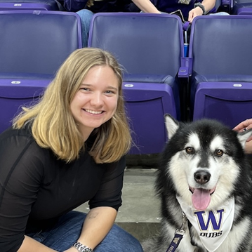
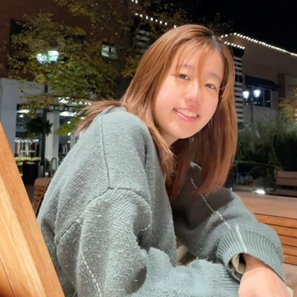
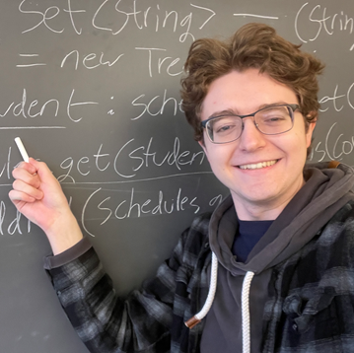
CSE 121 Lesson 14: 2D Arrays
Simon Wu
Summer 2024
TAs:
Trey | Hannah | Mia | Vivian | Jolie | Colton | Ziao
sli.do #cse121

Slide 2
Announcements, Reminders
Quiz 2 tomorrow!
Quiz 1 grades released on Monday, see details on Ed
Study lecture examples in the past two weeks! You may see one show up on the quiz :)
R5 due tomorrow, R6 released tomorrow
Programming Assignment 3 releasing later today – last assignment!
Final Exam: Friday, 8/16 from 12:00-1:00 in PCAR 290
See Ed post for more information
Final Reflection feedback deadline this Friday!

Slide 3
Final Exam Details (1/2)
Final Exam: Friday, 8/16 from 12:00-1:00 in PCAR 290
In-person, on paper, completed individually
Please bring ID – we will be taking attendance
Open Note, Open Book
We will provide you one “reference sheet”, and
You may as many paper notes as you wish
Will have 3 problems worth 2 grades each, all similar in style to the quizzes
Focus is on behavior (not code style) – minor syntax errors are allowed

Slide 4
Final Exam Details (2/2)
Next week will be focused on Final Exam review and preparation
Many resources will be available, including:
dedicated section time for final exam review!
multiple previous actual finals + practice finals
online final exam review session (Wednesday 8/14 from 4:30 – 6 PM)
More details on course website

Slide 5
public static void main(String[] args) {
int x = 0;
int[] a = new int[4];
x++;
mystery(x, a);
System.out.println(x + " " + Arrays.toString(a));
x++;
mystery(x, a);
System.out.println(x + " " + Arrays.toString(a));
}
public static void mystery(int x, int[] a) {
x++;
a[x]++;
System.out.println(x + " " + Arrays.toString(a));
}
Four lines of output would be produced by this code. What would those four lines be?

Slide 6
public static void main(String[] args) {
int x = 0;
int[] a = new int[4];
x++;
mystery(x, a);
System.out.println(x + " " + Arrays.toString(a));
x++;
mystery(x, a);
System.out.println(x + " " + Arrays.toString(a));
}
public static void mystery(int x, int[] a) {
x++;
a[x]++;
System.out.println(x + " " + Arrays.toString(a));
}

Slide 7
(PCM) 2D Arrays (1/3)
An array of arrays!
The ElementType of the array is another array itself!
Your first example of “nested data structures”
There will be more in CSE 122!
int[][]
String[][]
double[][]
boolean[][]
char[][]

Slide 8
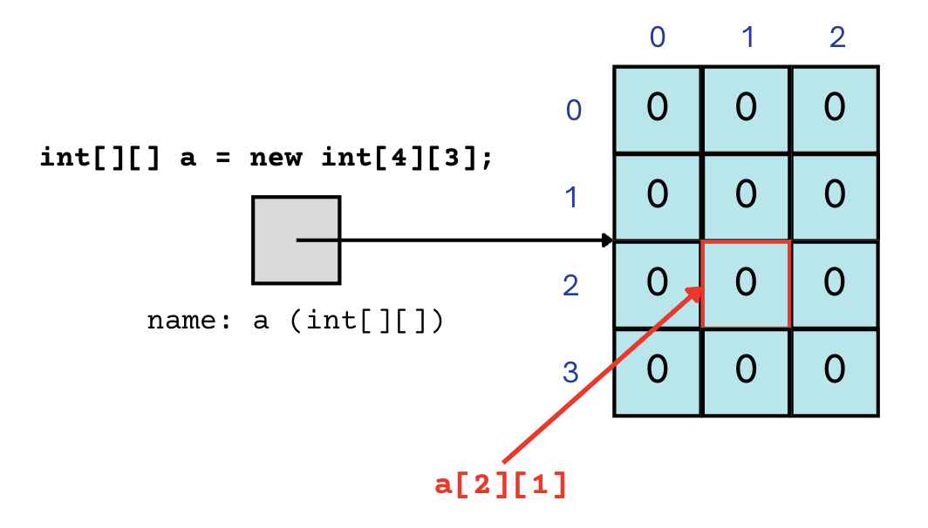
(PCM) 2D Arrays (2/3)
An array of arrays!
The two dimensions are “rows” and “columns”
0
1
2
0
int[][] a = new int[4][3];
1
2
3

Slide 9
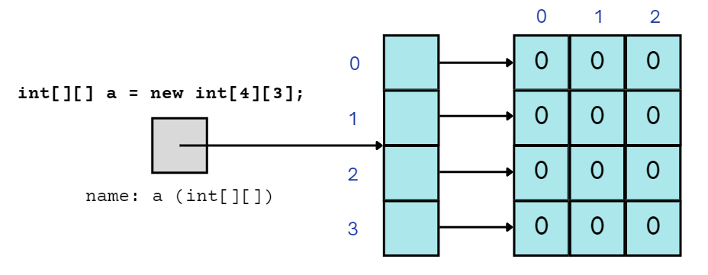
(PCM) 2D Arrays (3/3)
A slightly more accurate view…
reference semantics
0
1
2
0
int[][] a = new int[4][3];
1
2
3

Slide 10
(PCM) 2D Array Traversals
for each row…
for (int i = 0; i < list.length; i++) {
for (int j = 0; j < list[i].length; j++) {
// do something with list[i][j]
}
}
for each element within a row…

Slide 11
Arrays Utility Class
Method | Description
Arrays.toString(array); | Returns a String representing the array, such as "[10, 30, -25, 17]"
Arrays.fill(array, value); | Sets every element to the given value
Arrays.equals(array1, array2); | Returns true if the two arrays contain the same elements in the same order
Arrays.deepToString(array); | Returns a String representing the array; if the array contains other arrays as elements, the String represents their contents, and so on. For example, "[[99, 151], [30, 5]]"
Arrays.deepEquals(array1, array2); | Returns true if the two arrays contain the same elements in the same order; if the array(s) contain other arrays as elements, their contents are tested for equality, and so on.

Slide 12
Applications of 2D Arrays
Matrices
Useful in various applications requiring complex math!
Fundamental to machine learning & AI
P3 is a real-life application of this!
Board games
e.g., chess/checkerboard, tic tac toe, sudoku
Representing information in a grid or table
e.g., scorekeeping, gradebook, census data
Image processing

Slide 13
matrixAdd
23 | 96 | 18 | 4 | 64
45 | 40 | 18 | 44 | 34
92 | 13 | 77 | 71 | 12
93 | 169 | 84 | 83 | 103
136 | 115 | 91 | 143 | 81
119 | 77 | 98 | 105 | 13
70 | 73 | 66 | 79 | 39
91 | 75 | 73 | 99 | 47
27 | 64 | 21 | 34 | 1

Slide 14
matrixAdd
23 | 96 | 18 | 4 | 64
45 | 40 | 18 | 44 | 34
92 | 13 | 77 | 71 | 12
i: 0
j: 0
93 | 169 | 84 | 83 | 103
136 | 115 | 91 | 143 | 81
119 | 77 | 98 | 105 | 13
70 | 73 | 66 | 79 | 39
91 | 75 | 73 | 99 | 47
27 | 64 | 21 | 34 | 1

Slide 15
matrixAdd
23 | 96 | 18 | 4 | 64
45 | 40 | 18 | 44 | 34
92 | 13 | 77 | 71 | 12
i: 0
j: 0
93 | 169 | 84 | 83 | 103
136 | 115 | 91 | 143 | 81
119 | 77 | 98 | 105 | 13
70 | 73 | 66 | 79 | 39
91 | 75 | 73 | 99 | 47
27 | 64 | 21 | 34 | 1

Slide 16
matrixAdd
23 | 96 | 18 | 4 | 64
45 | 40 | 18 | 44 | 34
92 | 13 | 77 | 71 | 12
i: 0
j: 1
93 | 169 | 84 | 83 | 103
136 | 115 | 91 | 143 | 81
119 | 77 | 98 | 105 | 13
70 | 73 | 66 | 79 | 39
91 | 75 | 73 | 99 | 47
27 | 64 | 21 | 34 | 1

Slide 17
matrixAdd
23 | 96 | 18 | 4 | 64
45 | 40 | 18 | 44 | 34
92 | 13 | 77 | 71 | 12
i: 0
j: 2
93 | 169 | 84 | 83 | 103
136 | 115 | 91 | 143 | 81
119 | 77 | 98 | 105 | 13
70 | 73 | 66 | 79 | 39
91 | 75 | 73 | 99 | 47
27 | 64 | 21 | 34 | 1

Slide 18
matrixAdd
23 | 96 | 18 | 4 | 64
45 | 40 | 18 | 44 | 34
92 | 13 | 77 | 71 | 12
i: 0
j: 3
93 | 169 | 84 | 83 | 103
136 | 115 | 91 | 143 | 81
119 | 77 | 98 | 105 | 13
70 | 73 | 66 | 79 | 39
91 | 75 | 73 | 99 | 47
27 | 64 | 21 | 34 | 1

Slide 19
matrixAdd
23 | 96 | 18 | 4 | 64
45 | 40 | 18 | 44 | 34
92 | 13 | 77 | 71 | 12
i: 0
j: 4
93 | 169 | 84 | 83 | 103
136 | 115 | 91 | 143 | 81
119 | 77 | 98 | 105 | 13
70 | 73 | 66 | 79 | 39
91 | 75 | 73 | 99 | 47
27 | 64 | 21 | 34 | 1

Slide 20
matrixAdd
23 | 96 | 18 | 4 | 64
45 | 40 | 18 | 44 | 34
92 | 13 | 77 | 71 | 12
i: 1
j: 0
93 | 169 | 84 | 83 | 103
136 | 115 | 91 | 143 | 81
119 | 77 | 98 | 105 | 13
70 | 73 | 66 | 79 | 39
91 | 75 | 73 | 99 | 47
27 | 64 | 21 | 34 | 1

Slide 21
matrixAdd
23 | 96 | 18 | 4 | 64
45 | 40 | 18 | 44 | 34
92 | 13 | 77 | 71 | 12
i: 1
j: 1
93 | 169 | 84 | 83 | 103
136 | 115 | 91 | 143 | 81
119 | 77 | 98 | 105 | 13
70 | 73 | 66 | 79 | 39
91 | 75 | 73 | 99 | 47
27 | 64 | 21 | 34 | 1

Slide 22
matrixAdd
23 | 96 | 18 | 4 | 64
45 | 40 | 18 | 44 | 34
92 | 13 | 77 | 71 | 12
i: 1
j: 2
93 | 169 | 84 | 83 | 103
136 | 115 | 91 | 143 | 81
119 | 77 | 98 | 105 | 13
70 | 73 | 66 | 79 | 39
91 | 75 | 73 | 99 | 47
27 | 64 | 21 | 34 | 1

Slide 23
matrixAdd
23 | 96 | 18 | 4 | 64
45 | 40 | 18 | 44 | 34
92 | 13 | 77 | 71 | 12
i: 1
j: 3
93 | 169 | 84 | 83 | 103
136 | 115 | 91 | 143 | 81
119 | 77 | 98 | 105 | 13
70 | 73 | 66 | 79 | 39
91 | 75 | 73 | 99 | 47
27 | 64 | 21 | 34 | 1

Slide 24
matrixAdd
23 | 96 | 18 | 4 | 64
45 | 40 | 18 | 44 | 34
92 | 13 | 77 | 71 | 12
i: 1
j: 4
93 | 169 | 84 | 83 | 103
136 | 115 | 91 | 143 | 81
119 | 77 | 98 | 105 | 13
70 | 73 | 66 | 79 | 39
91 | 75 | 73 | 99 | 47
27 | 64 | 21 | 34 | 1

Slide 25
matrixAdd
23 | 96 | 18 | 4 | 64
45 | 40 | 18 | 44 | 34
92 | 13 | 77 | 71 | 12
i: 2
j: 0
93 | 169 | 84 | 83 | 103
136 | 115 | 91 | 143 | 81
119 | 77 | 98 | 105 | 13
70 | 73 | 66 | 79 | 39
91 | 75 | 73 | 99 | 47
27 | 64 | 21 | 34 | 1

Slide 26
matrixAdd
23 | 96 | 18 | 4 | 64
45 | 40 | 18 | 44 | 34
92 | 13 | 77 | 71 | 12
i: 2
j: 1
93 | 169 | 84 | 83 | 103
136 | 115 | 91 | 143 | 81
119 | 77 | 98 | 105 | 13
70 | 73 | 66 | 79 | 39
91 | 75 | 73 | 99 | 47
27 | 64 | 21 | 34 | 1

Slide 27
matrixAdd
23 | 96 | 18 | 4 | 64
45 | 40 | 18 | 44 | 34
92 | 13 | 77 | 71 | 12
i: 2
j: 2
93 | 169 | 84 | 83 | 103
136 | 115 | 91 | 143 | 81
119 | 77 | 98 | 105 | 13
70 | 73 | 66 | 79 | 39
91 | 75 | 73 | 99 | 47
27 | 64 | 21 | 34 | 1

Slide 28
matrixAdd
23 | 96 | 18 | 4 | 64
45 | 40 | 18 | 44 | 34
92 | 13 | 77 | 71 | 12
i: 2
j: 3
93 | 169 | 84 | 83 | 103
136 | 115 | 91 | 143 | 81
119 | 77 | 98 | 105 | 13
70 | 73 | 66 | 79 | 39
91 | 75 | 73 | 99 | 47
27 | 64 | 21 | 34 | 1

Slide 29
matrixAdd
23 | 96 | 18 | 4 | 64
45 | 40 | 18 | 44 | 34
92 | 13 | 77 | 71 | 12
i: 2
j: 4
93 | 169 | 84 | 83 | 103
136 | 115 | 91 | 143 | 81
119 | 77 | 98 | 105 | 13
70 | 73 | 66 | 79 | 39
91 | 75 | 73 | 99 | 47
27 | 64 | 21 | 34 | 1

Slide 30
matrixAdd
23 | 96 | 18 | 4 | 64
45 | 40 | 18 | 44 | 34
92 | 13 | 77 | 71 | 12
93 | 169 | 84 | 83 | 103
136 | 115 | 91 | 143 | 81
119 | 77 | 98 | 105 | 13
70 | 73 | 66 | 79 | 39
91 | 75 | 73 | 99 | 47
27 | 64 | 21 | 34 | 1

Slide 31
(2D)ays Above Average: readData()
How many days' data would you like to input? 3
Next day's data:
Temperature in Seattle? 44
Temperature in Tacoma? 40
Temperature in Bothell? 43
Next day's data:
Temperature in Seattle? 42
Temperature in Tacoma? 40
Temperature in Bothell? 44
Next day's data:
Temperature in Seattle? 42
Temperature in Tacoma? 41
Temperature in Bothell? 43
…
 | Seattle | Tacoma | Bothell
1 | 44 | 40 | 43
2 | 42 | 40 | 44
3 | 42 | 41 | 43

Slide 32
(2D)ays Above Average: readData()
How many days' data would you like to input? 3
Next day's data:
Temperature in Seattle? 44
Temperature in Tacoma? 40
Temperature in Bothell? 43
Next day's data:
Temperature in Seattle? 42
Temperature in Tacoma? 40
Temperature in Bothell? 44
Next day's data:
Temperature in Seattle? 42
Temperature in Tacoma? 41
Temperature in Bothell? 43
…
 | Seattle | Tacoma | Bothell
1 | 44 | 40 | 43
2 | 42 | 40 | 44
3 | 42 | 41 | 43

Slide 33
(2D)ays Above Average: readData()
How many days' data would you like to input? 3
Next day's data:
Temperature in Seattle? 44
Temperature in Tacoma? 40
Temperature in Bothell? 43
Next day's data:
Temperature in Seattle? 42
Temperature in Tacoma? 40
Temperature in Bothell? 44
Next day's data:
Temperature in Seattle? 42
Temperature in Tacoma? 41
Temperature in Bothell? 43
…
 | Seattle | Tacoma | Bothell
1 | 44 | 40 | 43
2 | 42 | 40 | 44
3 | 42 | 41 | 43

Slide 34
(2D)ays Above Average: readData()
How many days' data would you like to input? 3
Next day's data:
Temperature in Seattle? 44
Temperature in Tacoma? 40
Temperature in Bothell? 43
Next day's data:
Temperature in Seattle? 42
Temperature in Tacoma? 40
Temperature in Bothell? 44
Next day's data:
Temperature in Seattle? 42
Temperature in Tacoma? 41
Temperature in Bothell? 43
…
 | Seattle | Tacoma | Bothell
1 | 44 | 40 | 43
2 | 42 | 40 | 44
3 | 42 | 41 | 43

Slide 35
(2D)ays Above Average: readData()
How many days' data would you like to input? 3
Next day's data:
Temperature in Seattle? 44
Temperature in Tacoma? 40
Temperature in Bothell? 43
Next day's data:
Temperature in Seattle? 42
Temperature in Tacoma? 40
Temperature in Bothell? 44
Next day's data:
Temperature in Seattle? 42
Temperature in Tacoma? 41
Temperature in Bothell? 43
…
 | Seattle | Tacoma | Bothell
1 | 44 | 40 | 43
2 | 42 | 40 | 44
3 | 42 | 41 | 43

Slide 36
(2D)ays Above Average: readData()
How many days' data would you like to input? 3
Next day's data:
Temperature in Seattle? 44
Temperature in Tacoma? 40
Temperature in Bothell? 43
Next day's data:
Temperature in Seattle? 42
Temperature in Tacoma? 40
Temperature in Bothell? 44
Next day's data:
Temperature in Seattle? 42
Temperature in Tacoma? 41
Temperature in Bothell? 43
…
 | Seattle | Tacoma | Bothell
1 | 44 | 40 | 43
2 | 42 | 40 | 44
3 | 42 | 41 | 43

Slide 37
(2D)ays Above Average: readData()
How many days' data would you like to input? 3
Next day's data:
Temperature in Seattle? 44
Temperature in Tacoma? 40
Temperature in Bothell? 43
Next day's data:
Temperature in Seattle? 42
Temperature in Tacoma? 40
Temperature in Bothell? 44
Next day's data:
Temperature in Seattle? 42
Temperature in Tacoma? 41
Temperature in Bothell? 43
…
 | Seattle | Tacoma | Bothell
1 | 44 | 40 | 43
2 | 42 | 40 | 44
3 | 42 | 41 | 43

Slide 38
(2D)ays Above Average: readData()
How many days' data would you like to input? 3
Next day's data:
Temperature in Seattle? 44
Temperature in Tacoma? 40
Temperature in Bothell? 43
Next day's data:
Temperature in Seattle? 42
Temperature in Tacoma? 40
Temperature in Bothell? 44
Next day's data:
Temperature in Seattle? 42
Temperature in Tacoma? 41
Temperature in Bothell? 43
…
 | Seattle | Tacoma | Bothell
1 | 44 | 40 | 43
2 | 42 | 40 | 44
3 | 42 | 41 | 43

Slide 39
(2D)ays Above Average: readData()
How many days' data would you like to input? 3
Next day's data:
Temperature in Seattle? 44
Temperature in Tacoma? 40
Temperature in Bothell? 43
Next day's data:
Temperature in Seattle? 42
Temperature in Tacoma? 40
Temperature in Bothell? 44
Next day's data:
Temperature in Seattle? 42
Temperature in Tacoma? 41
Temperature in Bothell? 43
…
 | Seattle | Tacoma | Bothell
1 | 44 | 40 | 43
2 | 42 | 40 | 44
3 | 42 | 41 | 43

Slide 40
(2D)ays Above Average: readData()
How many days' data would you like to input? 3
Next day's data:
Temperature in Seattle? 44
Temperature in Tacoma? 40
Temperature in Bothell? 43
Next day's data:
Temperature in Seattle? 42
Temperature in Tacoma? 40
Temperature in Bothell? 44
Next day's data:
Temperature in Seattle? 42
Temperature in Tacoma? 41
Temperature in Bothell? 43
…
 | Seattle | Tacoma | Bothell
1 | 44 | 40 | 43
2 | 42 | 40 | 44
3 | 42 | 41 | 43

Slide 41
(2D)ays Above Average: computeAverages()
How many days' data would you like to input? 3
…
The average values for each location were [42.666666666666664, 40.333333333333336, 43.333333333333336]
 | Seattle | Tacoma | Bothell
1 | 44 | 40 | 43
2 | 42 | 40 | 44
3 | 42 | 41 | 43
42.667 | 40.333 | 43.333
Average of Seattle temperatures
(44 + 42 + 42) / 3

