Slide 1
CSE 121 Lesson 13: More Arrays, Reference Semantics
Simon Wu
Summer 2024
TAs:
Trey | Hannah | Mia | Vivian | Jolie | Colton | Ziao
sli.do #cse121

Slide 2
Reminders & Announcements
C2* (the old C3) was released on Wednesday, due next Tuesday
R5 released yesterday, due next Thursday (8/8)
Quiz 2 next Thursday in section
topics: everything up until Arrays on Wednesday (i.e. not today’s material)
Quiz 1 grades will be released on Monday
In the future: Final Exam (Friday, 8/16 in lecture)
more logistical details coming soon!
Final Reflection Assignment due 8/16 @ 11:59 pm

Slide 3
Last Time: Arrays
Elements (must all be the same type)
Indices (starting at 0)
Must decide size when created!
arr.length to get arr's length
Arrays.toString(arr) to get a nice String version

Slide 4
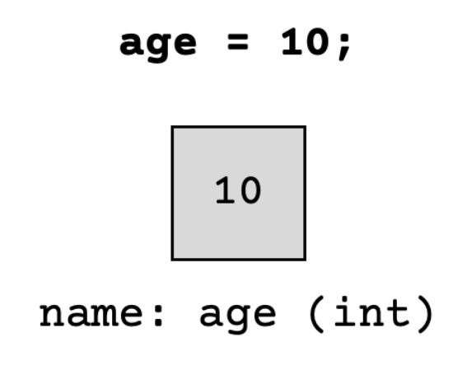
(PCM) Value Semantics vs. Reference Semantics
Applies when working with primitive types
Variables/parameters hold a copy of the actual value
Applies when working with objects
Variables/parameters hold a reference to the object

Slide 5
(PCM) Value Semantics vs. Reference Semantics
int a = 3;
int b = a;
a = 99;
int[] list1 = {4, 8, 15, 16, 23};
int[] list2 = list1;
list1[1] = 99;

Slide 6
Reference Semantics are a walk in the park!

Slide 7
(PCM) Value Semantics vs. Reference Semantics
boolean test = true;
flipValue(test);
public static void flipValue(boolean b) {
b = !b;
}
boolean[] tests =
{true, true, false, true, false, false};
flipValues(tests);
public static void flipValues(boolean[] b) {
for (int i = 0; i < b.length; i++) {
b[i] = !b[i];
}
}

Slide 8
(PCM) null
The absence of a reference!
Sort of like a "zero-equivalent" for references!
Default value for “object types” (e.g. Random, Turtle, Scanner…)
NullPointerExceptions are an error that happen when you ask null to “do something”
call .toUpperCase() on null? NullPointerException!
get .nextInt() from null? NullPointerException!
many, many more

Slide 9
null: the “billion dollar mistake”
From Sir Tony Hoare (“inventor” of null, Turing award winner):
“I call it my billion-dollar mistake… […] But I couldn’t resist the temptation to put in a null reference, simply because it was so easy to implement. This has led to innumerable errors, vulnerabilities, and system crashes, which have probably caused a billion dollars of pain and damage in the last forty years.” (quote from 2009 talk)

Slide 10
(PCM) avoiding NullPointerException
if (strs[i] != null) {
System.out.println(strs[i].toUpperCase());
} else {
System.out.println("element " + i + " is null.");
}

