Slide 1
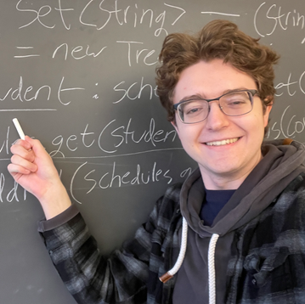
CSE 121 Lesson 12: Arrays
Simon Wu
Summer 2024
TAs:
Trey | Hannah | Mia | Vivian | Jolie | Colton | Ziao
sli.do #cse121

Slide 2
Announcements, Reminders
P2 due next Tuesday, 8/6 @ 11:59 pm
R4 released yesterday, due next Thursday @ 11:59 pm
Quiz 2 in section next Thursday
Quiz 1 grades will be released by Monday
Extra quiz drop to account for quiz 2 difficulty (updated syllabus and grade calculator)
Final Reflection Assignment Released
Double check gradescope!
More information in Ed post

Slide 3
(PCM) Arrays
Elements (must all be the same type)
Indices (starting at 0)
Must decide size when created!
arr.length to get arr's length
Arrays.toString(arr) to get a nice String version

Slide 4
How can we get the last element of an array arr?
arr[arr.length()]
arr[length()]
arr[arr.length]
arr[arr.length() - 1]
arr[arr.length - 1]

Slide 5
(PCM) Array Traversal Pattern
for (int i = 0; i < arr.length; i++) {
// do something with arr[i]
}

Slide 6
What would the array a store at the end of this arrayMystery method if {-20, 20, 26, 32, 50, 3} was passed in?
public static void arrayMystery(int[] a) {
for (int i = a.length - 1; i >= 1; i--) {
if (a[i] > a[i - 1] + 10) {
a[i - 1] = a[i - 1] + 5;
}
}
}
{-20, 20, 26, 32, 50, 3}
{-15, 25, 31, 37, 55, 8}
{-15, 25, 31, 37, 50, 3}
{-15, 20, 26, 37, 50, 3}
error (index out of bounds)

