Slide 1
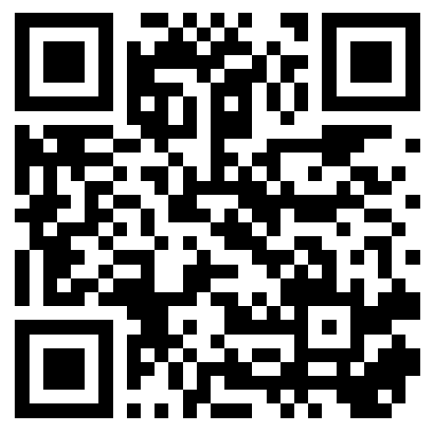
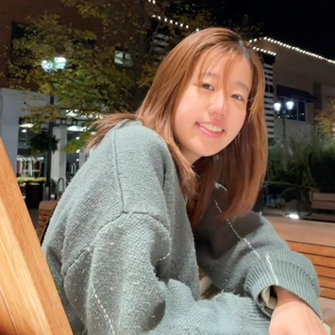
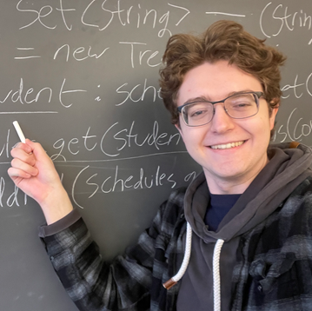
CSE 121 Lesson 11: Putting it All Together
Simon Wu
Summer 2024
TAs:
Trey | Hannah | Mia | Vivian | Jolie | Colton | Ziao
sli.do #cse121

Slide 2
Announcements and Reminders
P2 due next Tuesday, May 14th @ 11:59 pm
R4 released yesterday, due next Thursday @ 11:59 pm
Reminders: we have two more “exam” dates!
Quiz 2 on 8/8 in section
Final Exam on 8/16 in lecture
Please reach out to me ASAP if you can’t make the Final Exam time!
The only alternate final date will be on 8/9

Slide 3
Announcements and Reminders
Quiz 1 was difficult!
Maybe a little too difficult (oops)
Staff will decide what to do about Quiz 1 grades later today, I’ll send out an announcement over the weekend with updates
Might entail minor changes to the syllabus
Final Reflection Assignment updates
Spec release postponed as we figure out grading details for the quiz
Will also be released some time this weekend
Due dates may be adjusted to compensate for a late release

Slide 4
Last time: Scanner
An object that we can use to read in input
In the java.util “package”!
Methods | Description
nextInt() | Reads the next token from the user as an int and returns it.
nextDouble() | Reads the next token from the user as a double and returns it.
next() | Reads the next token from the user as a String and returns it.
nextLine() | Reads an entire line from the user as a String and returns it.

Slide 5
Edge Cases (and testing, debugging)
When writing a method that takes in input (e.g. parameters, Scanner), think carefully about the assumptions you can (and can’t) make!
Edge Case: a situation that is at the “edge” of an input’s valid values.
In today’s example:
are all possible months and days handled?
what about leap years?
are all possible combinations of months and days handled?

Slide 6
Edge Cases and Types
In languages like Java, it’s helpful to think of common edge cases related to the type of the value. For example,
for numbers (e.g. int, double) can you handle 0?
division is especially nasty!
for Strings, can you handle the empty string ""
charAt is especially nasty!
In future programming, you’ll learn about many more of these (e.g. “biggest” and “smallest” numbers, null, empty array).

