Slide 1
Welcome to CSE 121!
Simon Wu
Summer 2024
Use this QR code as one way to ask questions!
TAs:
Trey | Hannah | Mia | Vivian | Jolie | Colton | Ziao
sli.do #cse121

Slide 2
Agenda (1/3)
About us
About our class
What is this course?
Our learning model
Getting help
Syllabus questions
Writing our first java program!

Slide 3
Agenda (1/3)
About us
About our class
What is this course?
Our learning model
Getting help
Syllabus questions
Writing our first Java program!

Slide 4
Hi, I’m Simon! (he/they)
Just recently graduated (BS) from UW last quarter!
double-majored in CS and AES
TA’d for 7 quarters (5 were intro!)
Grew up in the Seattle area
Computer science interests: CS education, systems programming
non-CS interests: kpop, video games, aquariums

Slide 5
How did Simon discover CS?

Slide 6
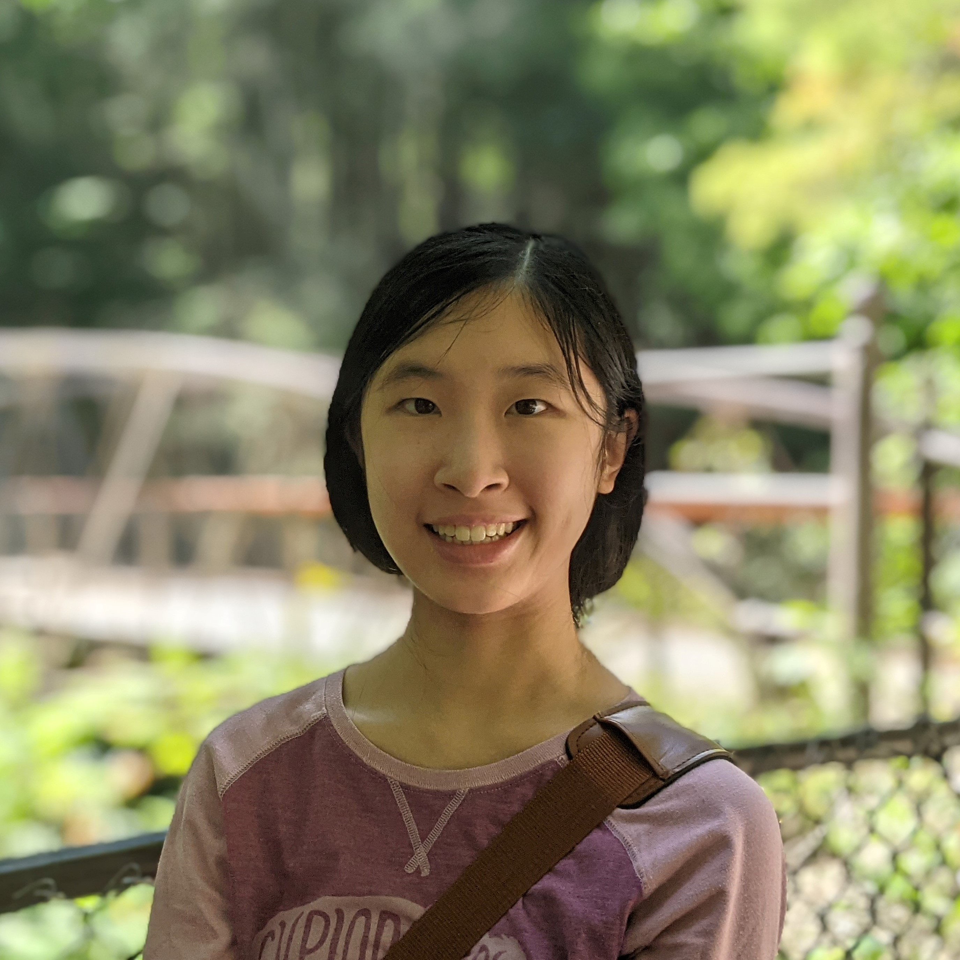
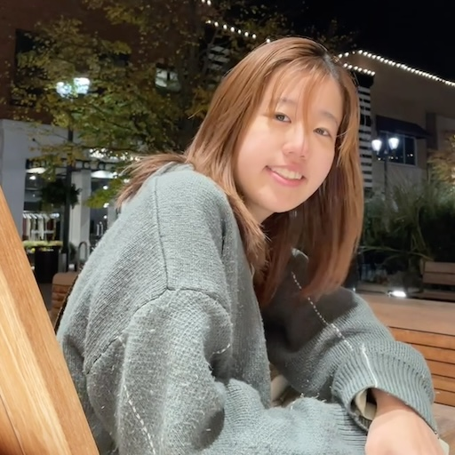
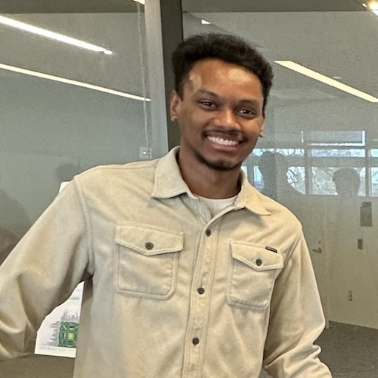
Meet your amazing TAs!

Slide 7
Agenda (2/3)
About us
About this course
What is this course?
Other learning model
Getting help
Syllabus questions
Writing our first Java program!

Slide 8
Learning Objectives
or, “What will I learn in this class?”
Computational Thinking
Code Comprehension
Code Writing
Communication
Testing
Debugging
Ethics & Societal Impact

Slide 9
Other Similar Courses
Course | Good choice if…
CSE 121 | You’ve never programmed before AND You are, or want to be, in a major such as CS, CE, ECE, Info, etc. that requires Java programming
CSE 122 | You’ve done some programming (roughly one course worth) in any programming language AND You are, or want to be, in a major such as CS, CE, ECE, Info, etc. that requires Java programming
CSE 123 | You’ve taken CSE 122 AND You are, or want to be, in a major such as CS, CE, ECE, Info, etc. that requires Java programming
CSE 160 | You’ve never programmed before AND You’re interested in data science and analysis OR You’d rather learn Python than Java* OR You are, or want to be, in a major such as Physics, Bio, Stat, etc. where analyzing data through programming is useful
Other courses of interest: CSE 154, CSE 163
See Guided Self-Placement and Introductory Courses for more info

Slide 10
Course Components
Meetings
LECTURES
SECTIONS
We’re here!
Introduce concepts, practice ideas, discuss applications.
Pre-class materials to prepare for class each day. Due before class.
Held in person
More practice, review, applications
TA advice, how to be an effective student
Preparation for quizzes / exams
Assessments
PROGRAMMING ASSIGNMENTS
(x4)
CREATIVE PROJECTS
(x4)
QUIZZES
(x3)
EXAM
(x1)
Structured assignments
Programming in Java
Applying & implementing course concepts
More open-ended
assignments
Explore new ideas and applications
Taken in quiz section
45 minutes on computer
Culminating exam
Fri, August 16th 12:00 – 1:00 PM

Slide 12
How Learning Works
Learning requires active participation in the process. It’s not as simple as sitting and listening to someone talk at you!
Requires deliberate practice in learning by doing
Benefits from collaborative learning
Does not work well if you cram everything!

Slide 13
Pre-Class Materials (1/3)
Core element of course: pre-class material
prepare for each lecture with readings & practice problems
should take ~30 minutes per lecture (why we don’t have Monday lectures!)
class will start with a brief recap, then pick off where we left off

Slide 14
Pre-Class Materials (2/3)
Core element of course: pre-class material
prepare for each lecture with readings & practice problems
should take ~30 minutes per lecture (why we don’t have Monday lectures!)
class will start with a brief recap, then pick off where we left off
Which means…
we can spend lecture diving deeper, answering questions, and think-pair-share
you can ask about pre-lecture material in class or quiz section!

Slide 15
Pre-Class Materials (3/3)
Core element of course: pre-class material
prepare for each lecture with readings & practice problems
should take ~30 minutes per lecture (why we don’t have Monday lectures!)
class will start with a brief recap, then pick off where we left off
Which means…
we can spend lecture diving deeper, answering questions, and think-pair-share
you can ask about pre-lecture material in class or quiz section!
Pre-class materials are ungraded, which means…
it’s okay if you find them challenging – that means you’re learning!
but, you should do them, and we will assume you’ve done them

Slide 16
Consistent and Active Participation (1/2)
Attendance is not graded. But, it’s strongly encouraged!
lectures & sections are not going to be just us talking at you!
ex: live in-class coding, debugging, think-pair-share, and problem-solving
spreading out ~ 1-2 hours each day over Tuesday – Friday is much more effective than cramming before the assignment is due!

Slide 17
Consistent and Active Participation (2/2)
Attendance is not graded. But, it’s strongly encouraged!
lectures & sections are not going to be just us talking at you!
ex: live in-class coding, debugging, think-pair-share, and problem-solving
spreading out ~ 1-2 hours each day over Tuesday – Friday is much more effective than cramming before the assignment is due!
Catching up:
all lectures are recorded on Panopto; slides are on our website.
section materials are on Ed, but section will not be recorded.

Slide 18
CS is hard!

Slide 19
Course Culture and Support: Live Support
Introductory Programming Lab (TA Office Hours – starting next week!)
#1 place to get help (and highly rated in the class!)
face-to-face help from TAs on any course questions – not just assignments
TA Section
Work through practice problems (this is how you learn!)
Get to know your TAs & peers!
Instructor Office Hours (in-person)
I don’t byte (most of the time)
Great for things from lecture, personal questions, or just to say hi!

Slide 20
Course Culture and Support: Ed & Email
Ed Board
Best for content and logistics questions – ~60 of you >> 7 of us!!
Feel free to make them public or private (and/or anonymous)
Answer other students’ questions – great way to learn!
Email
Best for personal circumstances and/or private questions
If unsure, always feel free to email Simon (at simonswu@uw.edu)
May politely ask you to post on Ed instead!

Slide 21
The World Around CSE 121 & Reaching Out
Our goal is to give you a great CSE 121 experience!
But CSE 121 does not exist in a vacuum – there’s a lot going on in the world right now that can impact your education.
We’ve designed course policies for maximum flexibility: resubmissions, dropping quiz/exam problems, asynchronous help & lecture recordings.
Please reach out ASAP if you’re struggling or have circumstances that require extra support. We’re happy to help – we just need to know!

Slide 22
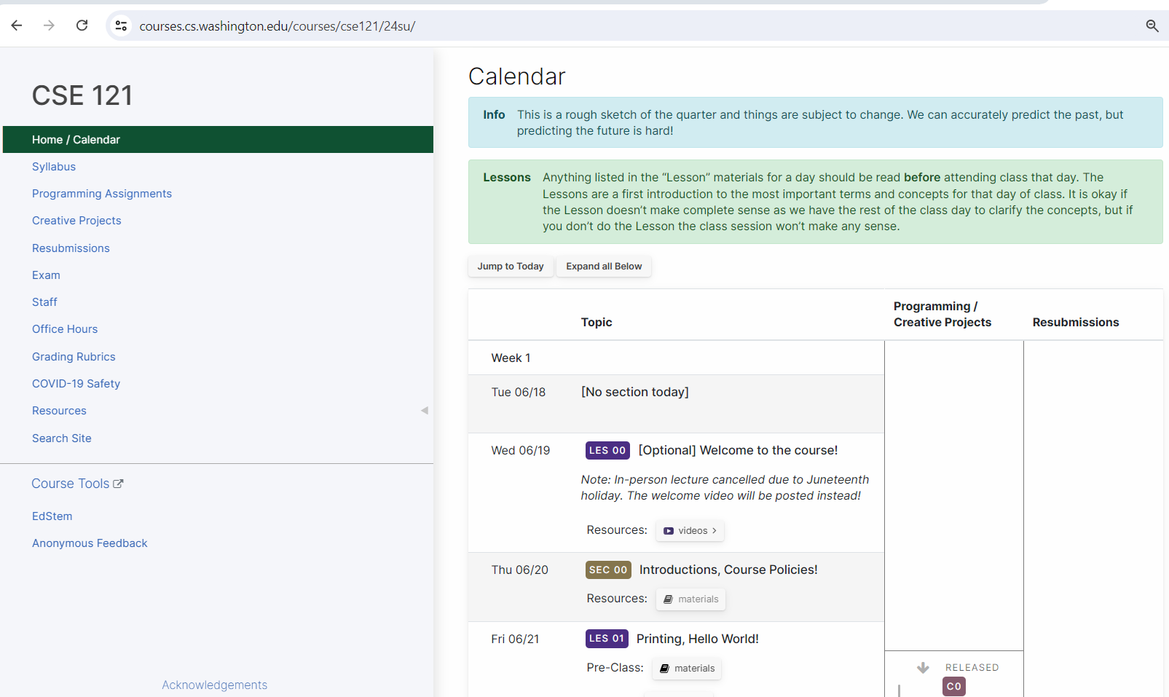
Course Website
cs.uw.edu/121
Primary source of course information (not Canvas)
Calendar will contain links to (almost) all resources

Slide 23
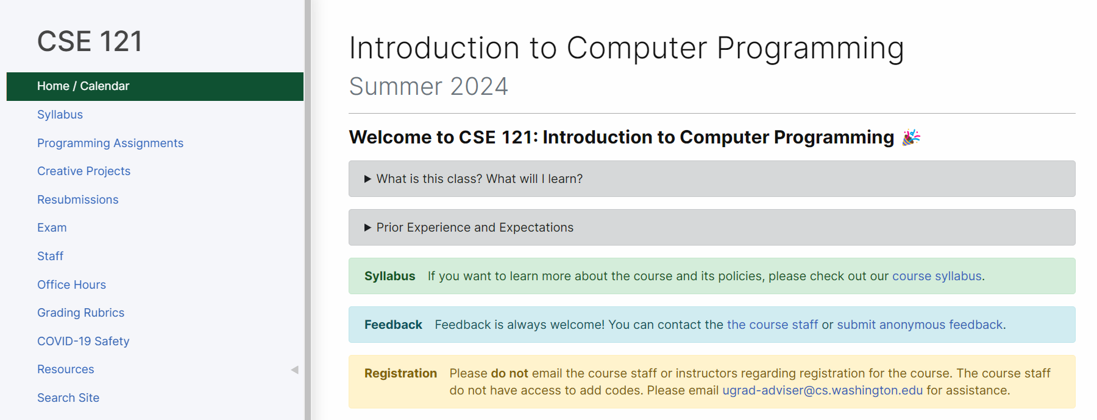
Syllabus (website)
Please review the syllabus ASAP.

Slide 24
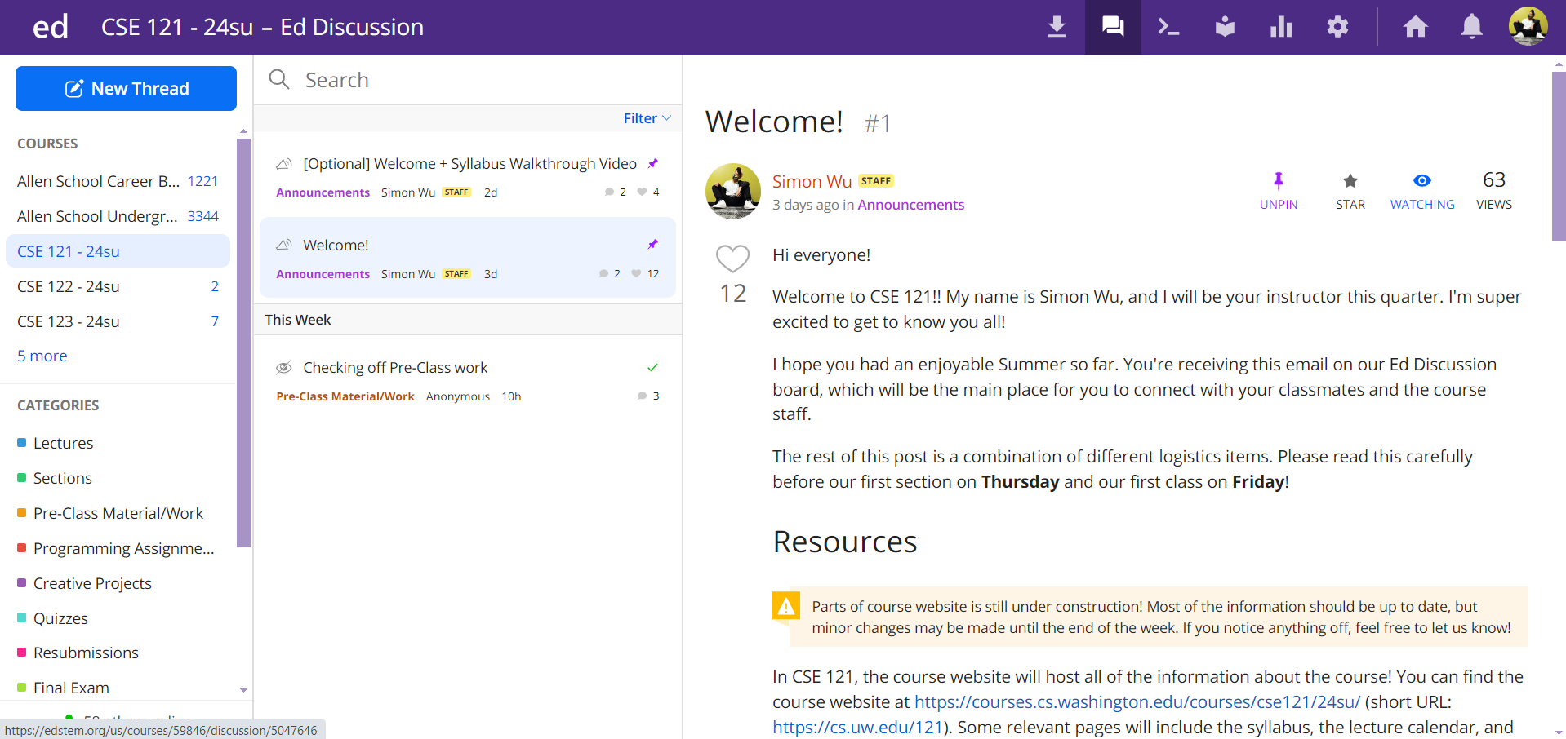
Ed
Our online learning platform
Lessons, sections, quizzes all here
Intro and walkthrough in Section 0
22

Slide 25
Help us improve!
CSE 121 is super new! We’ve worked hard to build a course that we think will be effective, supportive, and help you succeed.
But… we probably didn’t get it all right!
We appreciate your patience and understanding if we need to make adjustments during the quarter
Please give us lots of feedback!
Post on Ed
Mid and end-of-quarter feedback
Use CSE Anonymous Feedback Tool

Slide 26
Agenda (3/3)
About us
About our class
What is this course?
Our learning model
Getting help
Syllabus questions
Writing our first Java program!

Slide 27
Escape Sequences
escape sequence: A special sequence of characters used to represent certain special characters in a string.
\" to produce " in a String
\\ to produce \ in a String
\n to produce a new line character (or line break) in a String
And there are more!

Slide 28
How many lines of output would the following code produce?
System.out.println("hello");
System.out.print("hi");
System.out.print("yo");
System.out.println("greetings");
System.out.print("sup");
System.out.println("hey");
0 (error!)
1
2
3
5
6
sli.do #cse121

Slide 29
Homework for Next Time
Your first assignment (C0: Hello Bugs) is released!
Due next Wednesday at 11:59 pm
Start early and ask questions!

