Slide 1
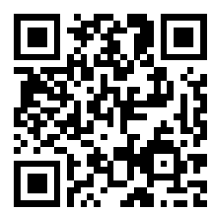
CSE 121 Lesson 9: Conditionals
Matt Wang
Spring 2024
TAs:
Andy | Anju | Archit | Arkita | Autumn | Christian
Hannah H | Hannah S | Heather | Hibbah | Janvi | Jessie
Jonus | Julia | Luke | Maria | Mia | Ritesh
Shayna | Simon | Trey | Vidhi | Vivian | Gumball?
sli.do #cse121-9
Today’s playlist: CSE 121 lecture beats 24sp

Slide 2
Announcements, Reminders
Creative Project 2 released, due Thursday May 2nd
Note: uses Javadoc!
R2 out yesterday, due Thursday May 2nd
Note: this is the last time C0 is eligible for resubmission!
Mid-Quarter Formative Feedback with Ken Yasuhara for part of class on Wednesday, May 1st
IPL tips!

Slide 3
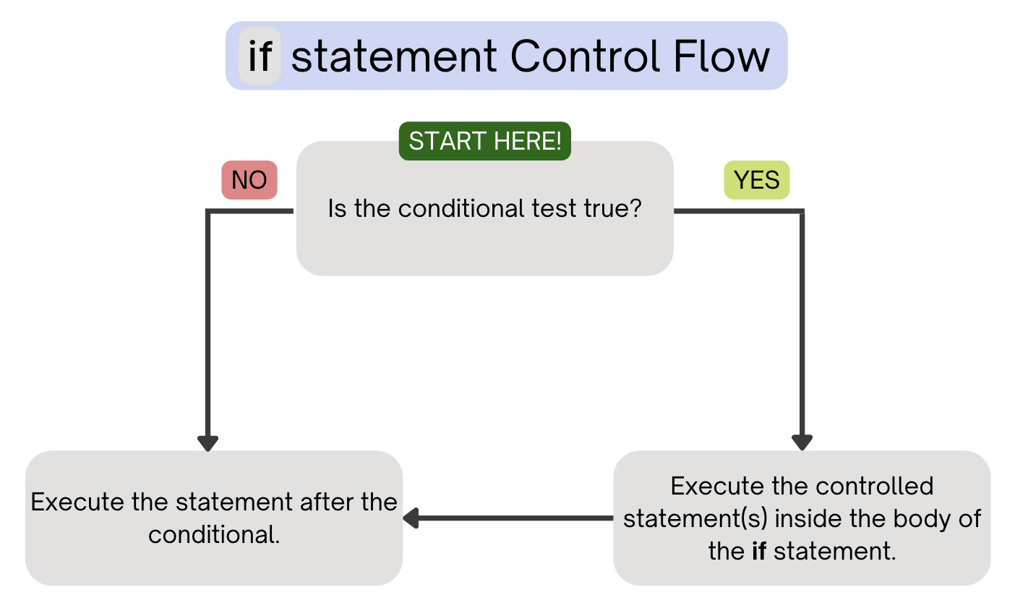
(PCM) Conditionals (1/4)
Executes a block of statements if and only if the test is true

Slide 4
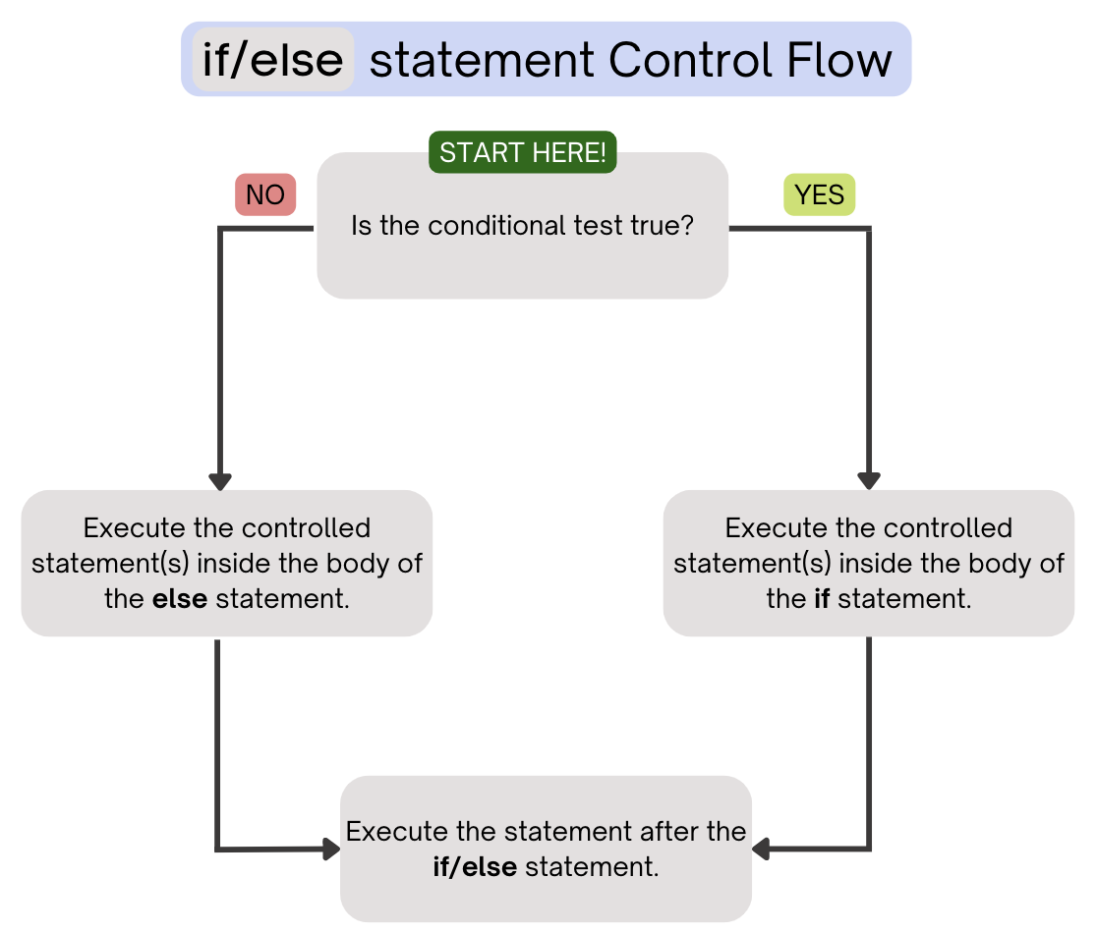
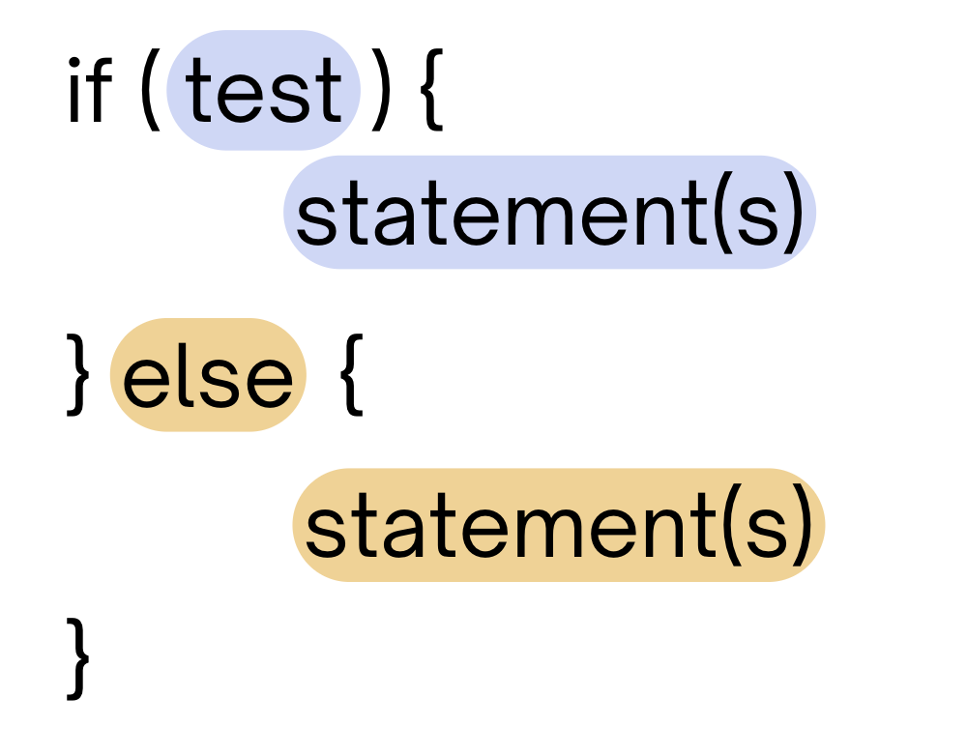
(PCM) Conditionals (2/4)
If the test is true: execute block of statements
If not, execute other block of statements

Slide 5
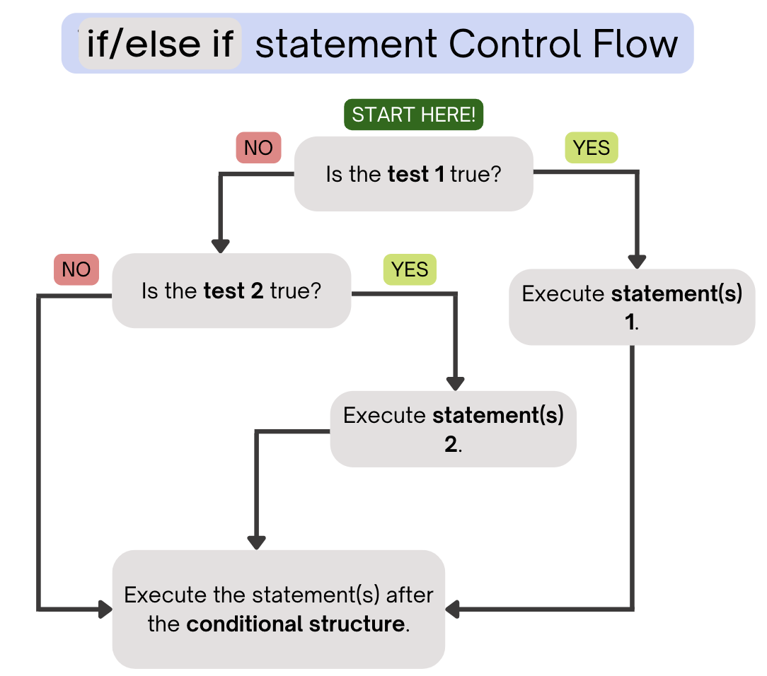
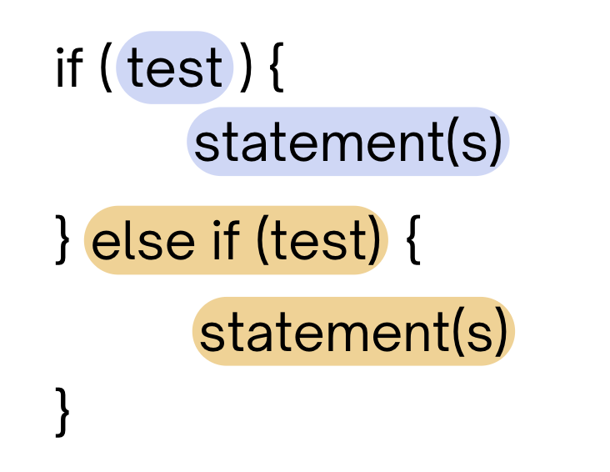
(PCM) Conditionals (3/4)
If the first test is true, execute that block
If not, proceed to the next test, and repeat
If none were true, don’t execute any blocks

Slide 6
(PCM) Conditionals (4/4)
With a large if-else-if-else chain,
if there is an ending else, exactly one block will execute
if there is no ending else, zero or one blocks will execute

Slide 7
public static void main(String[] args) {
for (int i = 1; i <= 3; i++) {
System.out.print(mystery(i));
}
}
public static String mystery(int n) {
if (n % 2 == 1) {
return "odd ";
} else if (n == 1) {
return "one ";
}
return "even ";
}
What does this program output?
A. odd even odd
B. one even odd
C. one even even
D. even even even

Slide 8
public static void main(String[] args) {
for (int i = 1; i <= 3; i++) {
System.out.print(mystery(i));
}
}
public static String mystery(int n) {
if (n % 2 == 1) {
return "odd ";
} else if (n == 1) {
return "one ";
}
return "even ";
}
This else if statement never runs!

Slide 9
int a = 7;
int b = -1;
int c = 12;
if (a < b) {
a *= 2;
} else if (b < a) {
a /= 2;
} else {
a = c;
}
if (c % 2 == 0) {
c += 1;
}
if (b > 0) {
b *= -1;
} else if (a < 0) {
a *= -1;
}
System.out.print(a + " " + b + " " + c);
What is the output produced by executing this code?
A. 7 -1 12
B. -3 -1 13
C. 3 -1 13
D. 12 1 12
E. -14 1 13

Slide 10
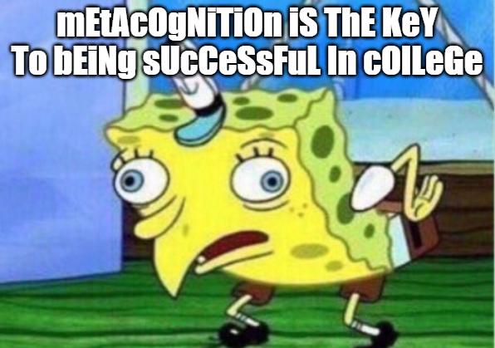

Slide 11
Common Problem-Solving Strategies
Analogy – Is this similar to another problem you've seen?
Brainstorming – Consider steps to solve problem before jumping into code
Try to do an example "by hand" → outline steps
Solve sub-problems – Is there a smaller part of the problem to solve?
Debugging – Does your solution behave correctly?
What is it doing?
What do you expect it to do?
What area of your code controls that part of the output?
Iterative Development – Can we start by solving a different problem that is easier?

Slide 12
Common Problem-Solving Strategies
Analogy – Is this similar to another problem you've seen?
Brainstorming – Consider steps to solve problem before jumping into code
Try to do an example "by hand" → outline steps
Solve sub-problems – Is there a smaller part of the problem to solve?
Debugging – Does your solution behave correctly?
What is it doing?
What do you expect it to do?
What area of your code controls that part of the output?
Iterative Development – Can we start by solving a different problem that is easier?

Slide 13
Common Problem-Solving Strategies
Analogy – Is this similar to another problem you've seen?
Brainstorming – Consider steps to solve problem before jumping into code
Try to do an example "by hand" → outline steps
Solve sub-problems – Is there a smaller part of the problem to solve?
Debugging – Does your solution behave correctly?
What is it doing?
What do you expect it to do?
What area of your code controls that part of the output?
Iterative Development – Can we start by solving a different problem that is easier?

Slide 14
🍓🌮☕ Food for Thought 🥑🍱🧋
This week’s food for thought is:
one of matt’s favourite areas of computer science
less related to tech & society than the others…
also the most ambitious, so don’t stress about it – sit back, enjoy the ride :)

Slide 15
Wouldn’t it be nice…
We’ve seen that some for loops go on forever:
for (int i = 0; i < 10; i--) {
System.out.println(i);
}
for (;true;) {
}
Wouldn’t it be nice if Java (or “the compiler”) could catch this for us? I mean, the loop “obviously” never ends…

Slide 16
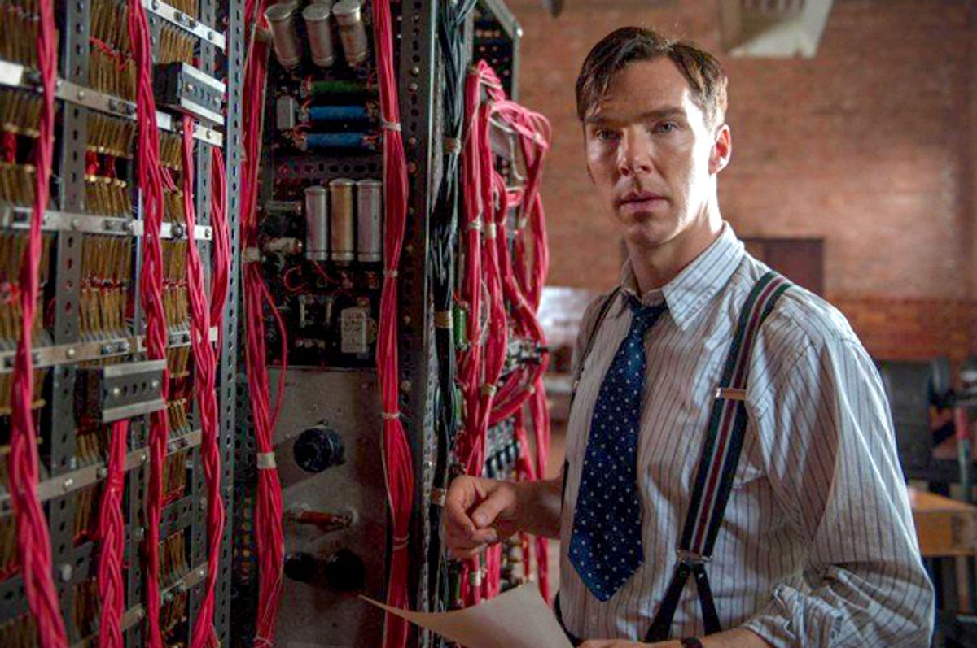
The Halting Problem (1/2)
Benedict Cumberbatch showed that it’s impossible to generally solve this problem.
Regardless of:
how good (big, fast) your computer is
how good your algorithm is
what people come up with the future!
Given a Java program, it is impossible to always know if it eventually stops (or loops infinitely).

Slide 17
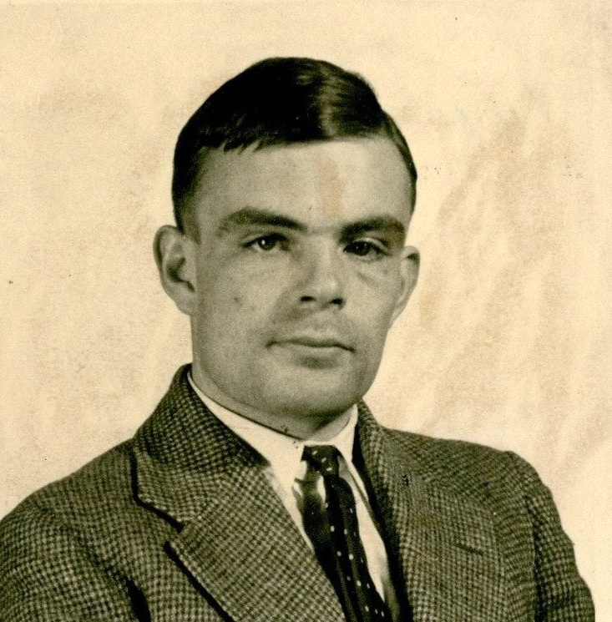
The Halting Problem (2/2)
Benedict Cumberbatch Alan Turing showed that it’s impossible to generally solve this problem.
Regardless of:
how good (big, fast) your computer is
how good your algorithm is
what people come up with the future!
Given a Java program, it is impossible to always know if it eventually stops (or loops infinitely).
Alan Turing at 24 (1936). He had a storied (if also very tragic and short) life.

Slide 18
Many, many problems are unsolvable.
I don’t mean “we currently don’t know how to solve them”.
I mean, “there is no algorithm that will ever solve them”.
Here are some related “undecidable” problems:
given a Java program, are all the types correct?
given a polynomial equation, does it have integer solution(s)?
given any Magic: The Gathering board, does either player have a guaranteed winning strategy?

Slide 19
“This statement is false”
In fact, there’s an even more concerning result: there is at least one math statement that we can’t prove true or false.
What is that statement? It looks something like…
“This statement is false”.

Slide 20
In search of perfection
Even though we know it’s “impossible”, we still:
try avoiding infinite loops
type-check our Java programs
play Magic: The Gathering (?)
try to prove things in (and do) math!

Slide 21
Dessert for Thought!
I argue there are two takeaways:
Don’t let perfection be the enemy of the good!
applies to you in CSE 121 and as a programmer :)
fundamental basis of much of computer science
Like thinking about these sorts of problems? This is also computer science! (not all CS is just coding…) See: CSE 311, CSE 417/431

