Slide 1
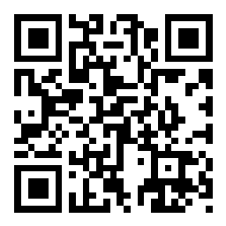
CSE 121 Lesson 7: Methods, Parameters, Returns
Matt Wang
Spring 2024
TAs:
Andy | Anju | Archit | Arkita | Autumn | Christian
Hannah H | Hannah S | Heather | Hibbah | Janvi | Jessie
Jonus | Julia | Luke | Maria | Mia | Ritesh
Shayna | Simon | Trey | Vidhi | Vivian | Gumball?
sli.do #cse121-7
Today’s playlist: CSE 121 lecture beats 24sp

Slide 2
Announcements, Reminders
Programming Assignment 1 is out, due Tuesday April 23rd
Start early! This one is tough!
Make use of the “development slides” and example code
Doing P1 is also studying for the quiz!
R1 released yesterday, due Thursday April 25
Quiz 0 is Thursday, Apr 25!
Big review opportunity: section on Tuesday, April 23
Optional review session on Tuesday, April 23 from 4:30-6:30 in JHN 102

Slide 3
(Review) Class Constants
A fixed value visible to the whole program (the entire class).
Value can be set only at declaration; cannot be reassigned (so the value is constant)
public static final type NAME_OF_CONSTANT = expression;

Slide 4
(Review) Parameters
Definition: A value passed to a method by its caller
public static void myMethod(String musicalAct) {
System.out.print(musicalAct + " is the best!");
...
}
Calling a method with a parameter…
myMethod("Laufey"); // Laufey is the best!

Slide 5
(Review) Scope – in for loops
The part of a program where a variable exists.
From its declaration to the end of the { } braces
Ex: a variable declared in a for loop only exists in that loop
for (int outerLoop = 1; outerLoop <= 5; outerLoop++) {
System.out.println("outer loop iteration #" + outerLoop);
for (int innerLoop = 1; innerLoop <= 3; innerLoop++) {
System.out.println(" inner loop iteration #" + innerLoop);
}
System.out.println(outerLoop);
}
innerloop’s scope
outerloop’s scope

Slide 6
(Review) Scope – in methods
The part of a program where a variable exists.
From its declaration to the end of the { } braces
Ex: a variable declared in a method exists only in that method
public static void example() {
System.out.println("hello");
int x = 3;
for (int i = 1; i <= 10; i++) {
System.out.print(x);
}
}
x's scope
i's scope

Slide 7
What will be the last line of output after this code has executed?
public static final int COUNT = 7;
public static void main(String[] args) {
int count = 5;
line(count);
System.out.println("count is: " + count);
}
public static void line(int count) {
for (int i = 1; i <= count; i++) {
System.out.print("*");
}
count++;
System.out.println();
}
A. count is: 1
B. count is: 5
C. count is: 6
D. count is: 7

Slide 8
What is the output of this program?
A. 2 and 4 9 and 3
B. 5 and -7 5 and -7
C. 9 and -3
5 and -7
D. I'm lost
public static void main(String[] args) {
int x = 9;
int y = 2;
int z = 5;
mystery(z, y, x);
mystery(y, x, z);
}
public static void mystery(int x, int z, int y) {
System.out.println(z + " and " + (y - x));
}

Slide 9
(PCM) Returns
Returns allow us to send values out of a method
public static <type> myMethod(int num) {
System.out.print(num + " is the best!");
... return <value of correct type>
}
Calling a method that returns a value…
<type> result = myMethod(42);
Evaluates the expression
Returns this value to where the method is called from
Method immediately exits

Slide 10
(Recall) String Methods Usage: <string variable>.<method>(…)
Method | Description
length() | Returns the length of the string.
charAt(i) | Returns the character at index i of the string
indexOf(s) | Returns the index of the first occurrence of s in the string; returns -1 if s doesn't appear in the string
substring(i, j) or substring(i) | Returns the characters in this string from i (inclusive) to j (exclusive); if j is omitted, goes until the end of the string
contains(s) | Returns whether or not the string contains s
equals(s) | Returns whether or not the string is equal to s (case-sensitive)
equalsIgnoreCase(s) | Returns whether or not the string is equal to s ignoring case
toUpperCase() | Returns an uppercase version of the string
toLowerCase() | Returns a lowercase version of the string
Notes:
Bomb = may get error if indexing int is out of bounds (e.g. negative index, or larger than the length of the string)
Safety guy = should return without error in usual case

Slide 11
Example of returns: Math class
Methods | Returns
Math.abs(value) | Absolute value of value
Math.ceil(value) | value rounded up
Math.floor(value) | value rounded down
Math.max(value1, value2) | Larger of the two given values
Math.min(value1, value2) | Smaller of the two given values
Math.round(value) | value rounded to the nearest whole number
Math.sqrt(value) | Square root of value
Math.pow(base, exp) | base to the exp power

Slide 12
To go from Celsius to Fahrenheit, you multiply by 1.8 and then add 32. Which of these correctly implements this logic as a method?
A.
public static void celsiusToF(double celsius) {
double fahrenheit = celsius * 1.8 + 32;
return fahrenheit;
}
B.
public static void celsiusToF(double celsius) {
double fahrenheit = celsius * 1.8 + 32;
}
public static double celsiusToF(double celsius) {
int fahrenheit = celsius * 1.8 + 32;
return fahrenheit;
}
C.
D.
public static double celsiusToF(double celsius) {
return celsius * 1.8 + 32;
}

Slide 13
What value is returned from this method?
A. -1
B. 0
C. 4
D. 5
public static int returnExample() {
for (int i = 0; i < 5; i++) {
return i;
}
return -1;
}

Slide 14
We loved your C1 reflections!
I read (skimmed?) all 199 of your responses! Some themes:
generally, not knowing how blind people programmed
“one minor addition and effort into making a program accessible can greatly impact the daily experience of those who need it”
debugging is already hard – debugging without accessible error messages sounds even harder!

Slide 15
… with great points on “accessiblePrinting”
Printing out what the Turtle does is better than nothing.
But, y’all said:
it is a ton of information – especially for complicated drawings
the information provided might not be the “right” type (not precise, not high-level enough, not aware of shapes)
does not describe what the drawing actually is

Slide 16
🍓🌮☕ Food for Thought 🥑🍱🧋
A weekly section where I introduce open problems related to our lecture topic(s) of the week.
Goals:
1. give you “conversational familiarity” with CS terminology
2. see how CS interacts with other fields and people!
3. point you in the direction of more CSE (or adjacent) classes
Note: not tested content. Just food for thought :)

Slide 17
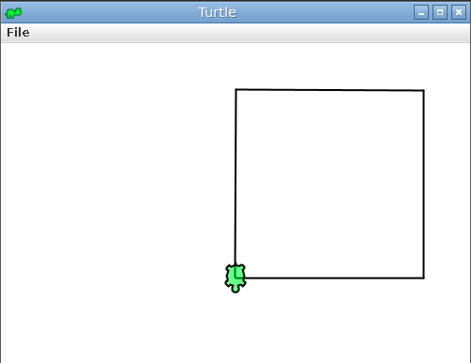
Describing images…
Which of these best describes this image?
A black square drawn by a Turtle
An image with a green cartoon turtle overlapping with a square
A screenshot of the Turtle library; the toolbar says “Turtle” and has a minimize, full-screen, and close buttons. The main canvas has a 200 by 200 square, drawn by a Turtle.
Instruction: MOVE FORWARD 200.0 Current Pos: (200.000, 0.000) …

Slide 18
Describing images requires context
“A black square drawn by a Turtle”
brief overview for someone who knows Turtle, doesn’t care about the art
“An image with a green cartoon turtle overlapping with a square”
short description focused on the core image – no Java-Turtle context assumed
“A screenshot of the Turtle library; the toolbar says “Turtle” and has a minimize, full-screen, and close buttons. The main canvas has a 200 by 200 square, drawn by a Turtle.”
longer caption, perhaps useful in a user design textbook or case study
And, many other reasonable alternative texts & captions!

Slide 19
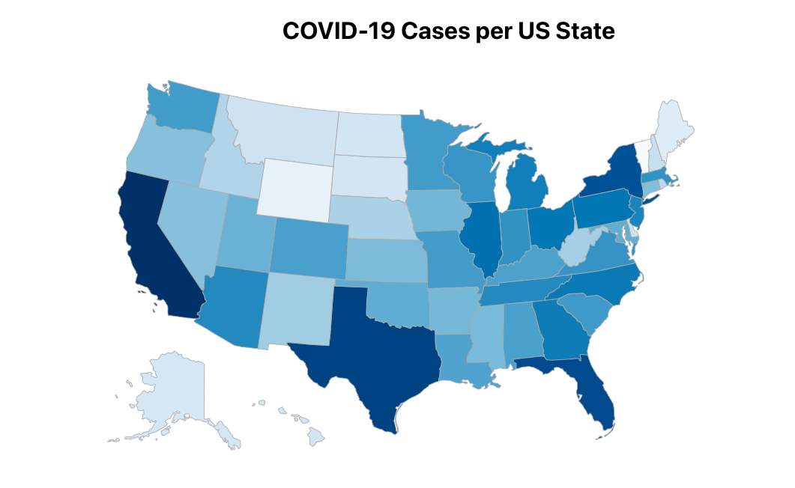
Active research – at UW!
Describing visualizations can be even harder!
How would you describe the visualization shown on the right?
could read out the data as a table – 50 rows!!
could summarize key points – loses data!
from UW CSE + iSchool: let users decide – and ask questions about data (min, max, average)
Paper: VoxLens: Making Online Data Visualizations Accessible with an Interactive JavaScript Plug-In., Ather Sharif, Olivia H. Wang, Alida T. Muongchan, Katharina Reinecke, and Jacob O. Wobbrock. CHI ‘22.

Slide 20
🍰 🍫 🍪 Desserts for Thought
Interested in accessibility? UW is an amazing place to be!
stellar professors in CSE – e.g. Jen Mankoff, who teaches CSE 493E: Accessibility
amazing folks across campus – e.g. Jacob Wobbrock (iSchool) from the paper!
people here do research, build tools, advocate for policy, and create community!
Many students mentioned that AI could be helpful. It’s … complicated.
“‘Without these tools, I’d be lost’: how generative AI aids in accessibility”
“No, ‘AI’ Will Not Fix Accessibility”

