Slide 1
CSE 121 Lesson 5: Nested For Loops, Math, Random
Matt Wang
Spring 2024
TAs:
Andy | Anju | Archit | Arkita | Autumn | Christian
Hannah H | Hannah S | Heather | Hibbah | Janvi | Jessie
Jonus | Julia | Luke | Maria | Mia | Ritesh
Shayna | Simon | Trey | Vidhi | Vivian | Gumball?
sli.do #cse121-5
Today’s playlist: CSE 121 lecture beats 24sp

Slide 2
Announcements, Reminders
Creative Project 1 is out, due Tue April 16th
Resubmission Cycle 0 released, due Thu Apr 18th
Eligible for submission: C0 & P0
Even if you're not resubmitting – read your feedback!!
Revisiting the minimum grade guarantees

Slide 3
Last time: for loops!
For loops are our first control structure
A syntactic structure that controls the execution of other statements.

Slide 4
Fencepost Pattern 1
Some task where one piece is repeated n times, and another piece is repeated n-1 times and they alternate
h-u-s-k-i-e-s

Slide 5
Fencepost Pattern 2
Some task where one piece is repeated n times, and another piece is repeated n-1 times and they alternate
h-u-s-k-i-e-s

Slide 6
(PCM) Nested for loops
for (int outerLoop = 1; outerLoop <= 5; outerLoop++) {
System.out.println("outer loop iteration #" + outerLoop);
for (int innerLoop = 1; innerLoop <= 3; innerLoop++) {
System.out.println(" inner loop iteration #" + innerLoop);
}
System.out.println(outerLoop);
}

Slide 7
What output is produced by the following code?
for (int i = 1; i <= 5; i++) {
for (int j = 1; j <= i; j++) {
System.out.print(i);
}
System.out.println();
}
1
12
123
1234
12345
i
ii
iii
iiii
iiiii
1
22
333
4444
55555
A. B. C.

Slide 8
What code produces the following output?
A.
B.
C.
D.
for (int i = 1; i <= 5; i++) {
for (int j = 1; j <= i; j++) {
System.out.print(i);
}
System.out.println();
}
for (int i = 1; i <= 5; i++) {
for (int j = 1; i <= j; j++) {
System.out.print(j);
}
System.out.println();
}
1
12
123
1234
12345
for (int i = 1; i <= 5; i++) {
for (int j = 1; j <= i; j++) {
System.out.print(j);
}
System.out.println();
}
for (int i = 1; i <= 5; i++) {
for (int j = 1; j <= i; i++) {
System.out.print(j);
}
System.out.println();
}

Slide 9
Pseudo-Randomness
Computers generate numbers in a predictable way using mathematical formulas.
Input may include current time, mouse position, etc.
True randomness is hard to achieve – we rely on natural processes
e.g., atmospheric noise, lava lamps

Slide 10
Why randomness?
Randomness is a core part of computer science! It powers:
cryptography
security
machine learning!
But true randomness is really hard. If we just use math, someone could “reverse” the formula.
So … lava lamps.
LavaRand: CloudFlare’s Wall of Lava Lamps

Slide 11
(PCM) Random
A Random object generates pseudo-random numbers.
The Random class is found in the java.util package
import java.util.*;
We can “seed” the generator to make it behave deterministically (helpful for testing!)
Method | Description
nextInt() | Returns a random integer
nextInt(max) | Returns a random integer in the range [0, max), or in other words, 0 to max-1 inclusive
nextDouble() | Returns a random real number in the range [0.0, 1.0)

Slide 12
Assuming you’ve declared: Random randy = new Random();
Which of these best models picking a random card? (1-13 inclusive)
randy.nextInt()
randy.nextInt(13)
randy.nextInt(13) + 1
randy.nextInt(14)

Slide 13
(PCM) Math
Calling:
Math.<method>(…)
Method | Description
Math.abs(value) | Returns the absolute value of value
Math.ceil(value) | Returns value rounded up
Math.floor(value) | Returns value rounded down
Math.max(value1, value2) | Returns the larger of the two values
Math.min(value1, value2) | Returns the smaller of the two values
Math.round(value) | Returns value rounded to the nearest whole number
Math.sqrt(value) | Returns the square root of value
Math.pow(base, exp) | Returns base raised to the exp power

Slide 14
🍓🌮☕ Food for Thought 🥑🍱🧋
This week’s food for thought is:
one of matt’s favourite areas of computer science
less related to tech & society than the others…
also the most ambitious, so don’t stress about it – sit back, enjoy the ride :)

Slide 15
Wouldn’t it be nice…
We’ve seen that some for loops go on forever:
for (int i = 0; i < 10; i--) {
System.out.println(i);
}
for (;true;) {
}
Wouldn’t it be nice if Java (or “the compiler”) could catch this for us? I mean, the loop “obviously” never ends…

Slide 16
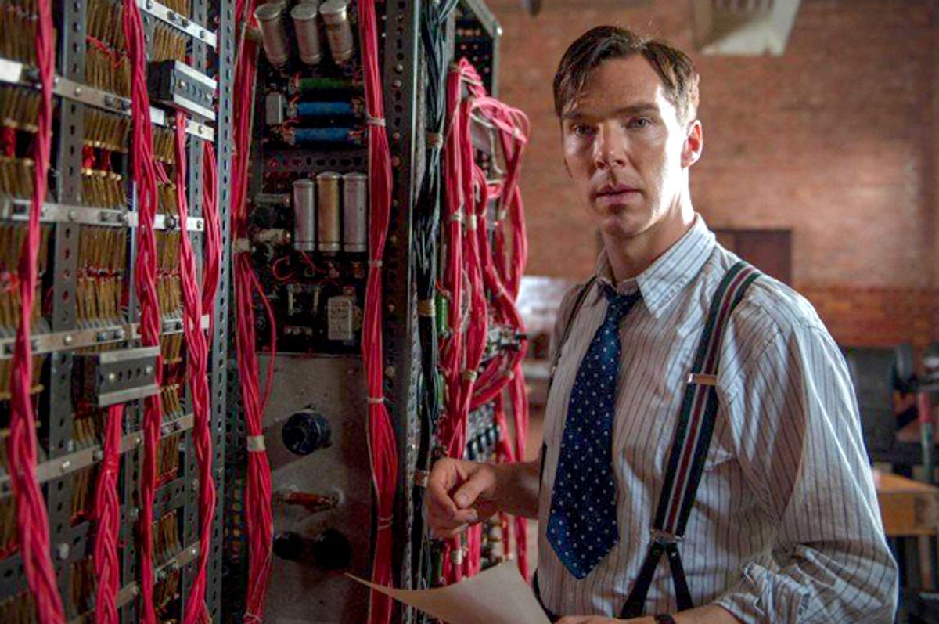
The Halting Problem (1/2)
Benedict Cumberbatch showed that it’s impossible to generally solve this problem.
Regardless of:
how good (big, fast) your computer is
how good your algorithm is
what people come up with the future!
Given a Java program, it is impossible to always know if it eventually stops (or loops infinitely).

Slide 17
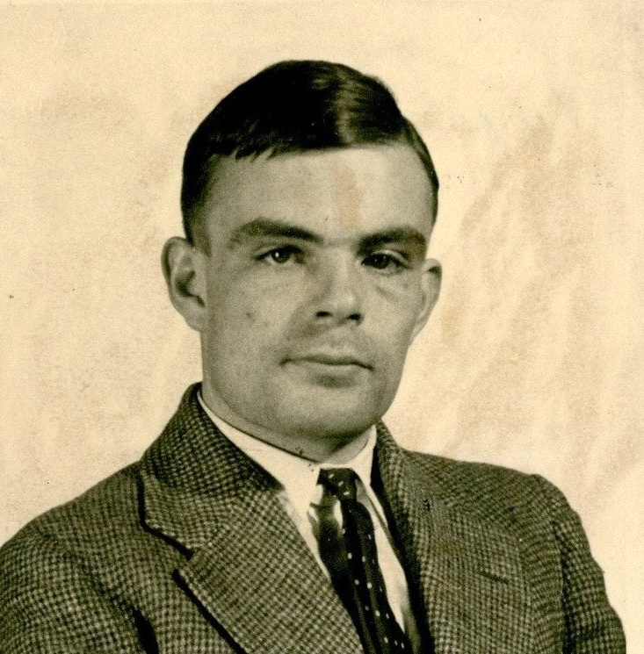
The Halting Problem (2/2)
Benedict Cumberbatch Alan Turing showed that it’s impossible to generally solve this problem.
Regardless of:
how good (big, fast) your computer is
how good your algorithm is
what people come up with the future!
Given a Java program, it is impossible to always know if it eventually stops (or loops infinitely).
Alan Turing at 24 (1936). He had a storied (if also very tragic and short) life.

Slide 18
Many, many problems are unsolvable.
I don’t mean “we currently don’t know how to solve them”.
I mean, “there is no algorithm that will ever solve them”.
Here are some related “undecidable” problems:
given a Java program, are all the types correct?
given a polynomial equation, does it have integer solution(s)?
given any Magic: The Gathering board, does either player have a guaranteed winning strategy?

Slide 19
“This statement is false”
In fact, there’s an even more concerning result: there is at least one math statement that we can’t prove true or false.
What is that statement? It looks something like…
“This statement is false”.

Slide 20
In search of perfection
Even though we know it’s “impossible”, we still:
try avoiding infinite loops
type-check our Java programs
play Magic: The Gathering (?)
try to prove things in (and do) math!

Slide 21
Dessert for Thought!
I argue there are two takeaways:
Don’t let perfection be the enemy of the good!
applies to you in CSE 121 and as a programmer :)
fundamental basis of much of computer science
Like thinking about these sorts of problems? This is also computer science! (not all CS is just coding…) See: CSE 311, CSE 417/431

