Slide 1
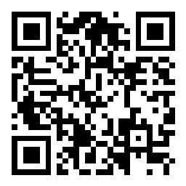
CSE 121 Lesson 15: Arrays and Reference Semantics
Matt Wang
Spring 2024
TAs:
Andy | Anju | Archit | Arkita | Autumn | Christian
Hannah H | Hannah S | Heather | Hibbah | Janvi | Jessie
Jonus | Julia | Luke | Maria | Mia | Ritesh
Shayna | Simon | Trey | Vidhi | Vivian | Gumball?
sli.do #cse121-15
Today’s playlist: CSE 121 lecture beats 24sp

Slide 2
Reminders & Announcements
C3 released Wednesday, due Tuesday May 21
R5 released yesterday, due Thursday May 23rd (last chance for P1)
Quiz 2 next Thursday, May 23rd
topics: everything up until Arrays on Wednesday (i.e. not today’s material)
see: Ed post on practice resources!
In the future: Final Exam (Wednesday June 5th from 2:30 – 4:20 PM)
more logistical details coming soon!

Slide 3
What would the array a store at the end of this arrayMystery method if {-20, 20, 26, 32, 50, 3} was passed in?
public static void arrayMystery(int[] a) {
for (int i = a.length - 1; i >= 1; i--) {
if (a[i] > a[i - 1] + 10) {
a[i - 1] = a[i - 1] + 5;
}
}
}
{-20, 20, 26, 32, 50, 3}
{-15, 25, 31, 37, 55, 8}
{-15, 25, 31, 37, 50, 3}
{-15, 20, 26, 37, 50, 3}

Slide 4
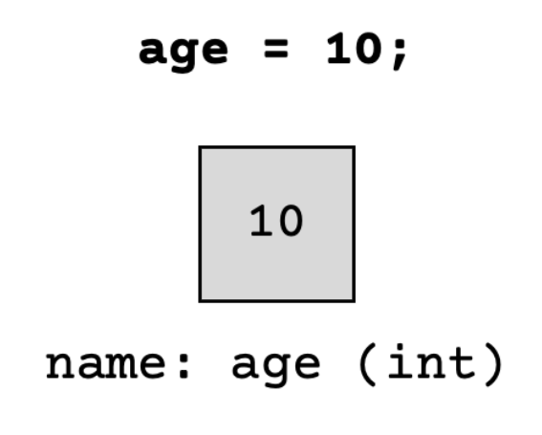
(PCM) Value Semantics vs. Reference Semantics
Applies when working with primitive types
Variables/parameters hold a copy of the actual value
Applies when working with objects
Variables/parameters hold a reference to the object

Slide 5
(PCM) Value Semantics vs. Reference Semantics
int a = 3;
int b = a;
a = 99;
int[] list1 = {4, 8, 15, 16, 23};
int[] list2 = list1;
list1[1] = 99;

Slide 6
Without knowing what someMethod does, what are the possible values of num?
int num = 42;
someMethod(num);
System.out.println(num);
anything!
just 42

Slide 7
Without knowing what anotherMethod does, what are the possible values of nums[0]?
int[] nums = {42, 43, 44};
anotherMethod(nums);
System.out.println(nums[0]);
anything!
just 42

Slide 8
(PCM) Value Semantics vs. Reference Semantics
boolean test = true;
flipValue(test);
public static void flipValue(boolean b) {
b = !b;
}
boolean[] tests =
{true, true, false, true, false, false};
flipValues(tests);
public static void flipValues(boolean[] b) {
for (int i = 0; i < b.length; i++) {
b[i] = !b[i];
}
}

Slide 9
(PCM) null
The absence of a reference!
Sort of like a "zero-equivalent" for references!
Default value for “object types” (e.g. Random, Turtle, Scanner…)
NullPointerExceptions are an error that happen when you ask null to “do something”
call .toUpperCase() on null? NullPointerException!
get .nextInt() from null? NullPointerException!
many, many more

Slide 10
null: the “billion dollar mistake”
From Sir Tony Hoare (“inventor” of null, Turing award winner):
“I call it my billion-dollar mistake… […] But I couldn’t resist the temptation to put in a null reference, simply because it was so easy to implement. This has led to innumerable errors, vulnerabilities, and system crashes, which have probably caused a billion dollars of pain and damage in the last forty years.” (quote from 2009 talk)

Slide 11
(PCM) avoiding NullPointerException
if (strs[i] != null) {
System.out.println(strs[i].toUpperCase());
} else {
System.out.println("element " + i + " is null.");
}

Slide 12
In reading P2 reflections…
I loved reading your P2 reflections (and some said hi to me directly!!).
A quick survey of some particularly interesting points:
many of you said that we should ignore zip codes & insurance
there are some laws that prohibit discrimination on insurance
but, there are practical reasons you need zip codes – how to balance this?
many great suggestions on what to change/include
e.g. prior medical conditions, disability status, family history
also: reweighting existing parameters (e.g. pain level and age)

