Slide 1
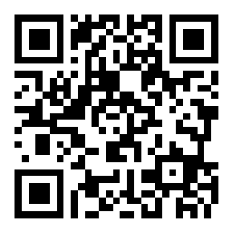
CSE 121 Lesson 11: User Input (Scanner) and while loops
Matt Wang
Spring 2024
TAs:
Andy | Anju | Archit | Arkita | Autumn | Christian
Hannah H | Hannah S | Heather | Hibbah | Janvi | Jessie
Jonus | Julia | Luke | Maria | Mia | Ritesh
Shayna | Simon | Trey | Vidhi | Vivian | Gumball?
sli.do #cse121-11
Today’s playlist: CSE 121 lecture beats 24sp

Slide 2
Announcements & Reminders
Quiz 1 is next Thursday, May 9th!
please see Ed announcement on study resources (including practice quizzes, review sessions, and suggested problems!)
Programming Assignment 2 will be released later tonight
Due Tuesday, May 14th
No pre-class work for Wednesday :)
Reminder: PracticeIt Problems!

Slide 3
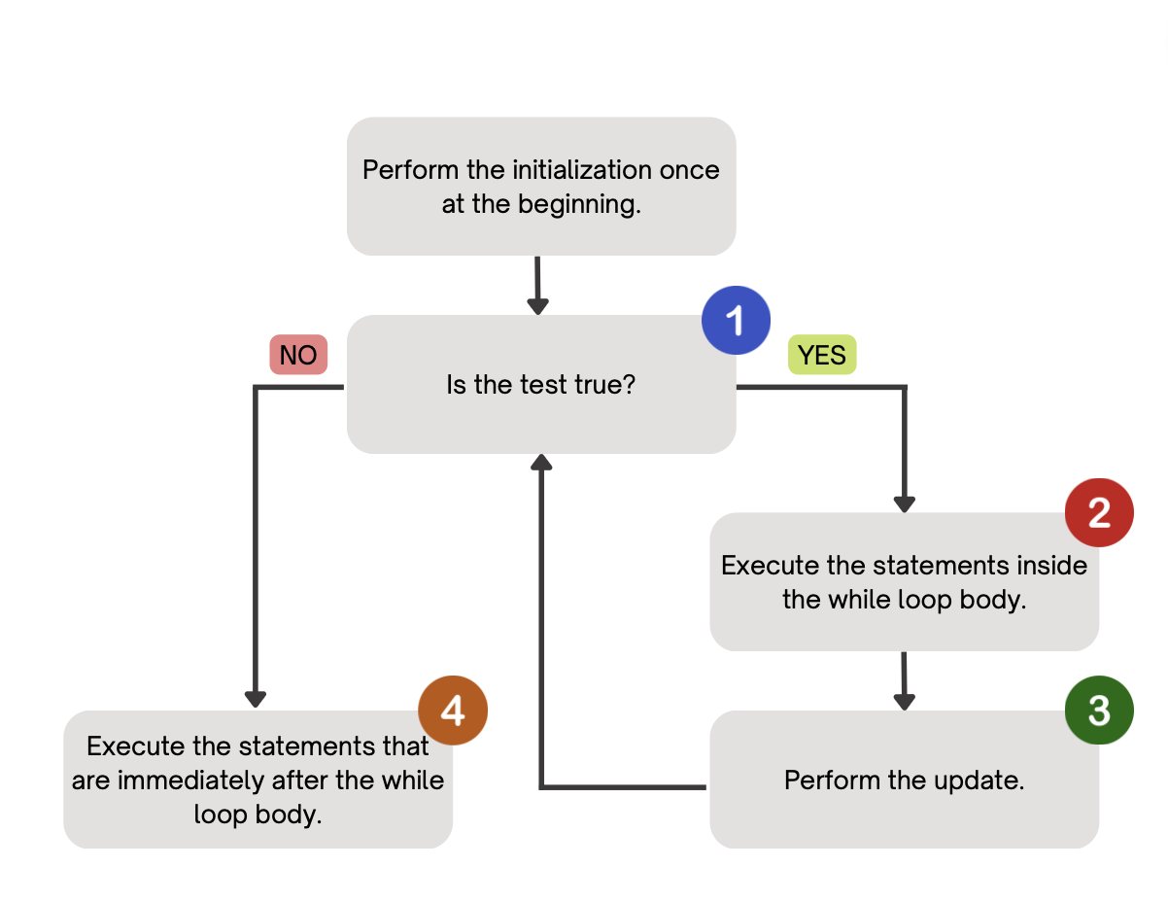
Last time: While Loops
Repeatedly executes its body as long as the logical test is true.

Slide 4
Last time: for loops vs. while loops ⚔️
For loops and while loops are quite similar! This is the first (but certainly not the last) time where you need to decide which to use!
There’s not always a “correct” answer, but some advice:
thinking of definite versus indefinite conditions
phrasing the problem out loud!
“I will do __ X times” or “for each __ I will __” : sounds like a for!
“I will do __ until __” or “while __ is true, do” : sounds like a while!

Slide 5
(PCM) Scanner
An object that we can use to read in input
In the java.util “package”!
Methods | Description
nextInt() | Reads the next token from the user as an int and returns it.
nextDouble() | Reads the next token from the user as a double and returns it.
next() | Reads the next token from the user as a String and returns it.
nextLine() | Reads an entire line from the user as a String and returns it.

Slide 6
(PCM) Tokens
A unit of user input, as read by the Scanner
Tokens are separated by whitespace (spaces, tabs, new lines)
23 John Smith
42.0 "Hello world" $2.50 " 19

Slide 7
When calling the following method, which of these user inputs would not cause an error? (choose multiple)
public static void cornbear() {
Scanner console = new Scanner(System.in);
int amt = console.nextInt();
String firstName = console.next();
String secondName = console.next();
double price = console.nextDouble();
}
6 Lucy’s Treats $12.48
3 Oatmilk Latte 16.47
2 The Hunger Games 21.98
4 Gigis 900.24
2 Grammy Awards 90095

Slide 8
Fencepost Pattern
Some task where one piece is repeated n times, and another piece is repeated n-1 times and they alternate
L-a-u-f-e-y-!

Slide 9
Quick Meals for Thought (Names)
What assumptions are we making here?
String firstName = console.next();
String lastName = console.next();
All first and last names have no spaces
All people only have one first or last name
All people have at least one first or last name
Interesting readings: Falsehoods Programmers Believe About Names, For Afghans, Name and Birthdate Census Questions Are Not So Simple

Slide 10
Quick Meals for Thought (Inputs)
Another assumption: all computer users have a keyboard & mouse!
many blind & low-vision users only use keyboards (no mice)
some users cannot use keyboards and use alternatives
e.g. “switch access” – famously used by Stephen Hawking
This isn’t “just” about disability:
your user might be on a phone, tablet, gaming console, or “smart” TV!
your user could be using text-to-speech!
your user’s keyboard or mouse might be broken!

Slide 11
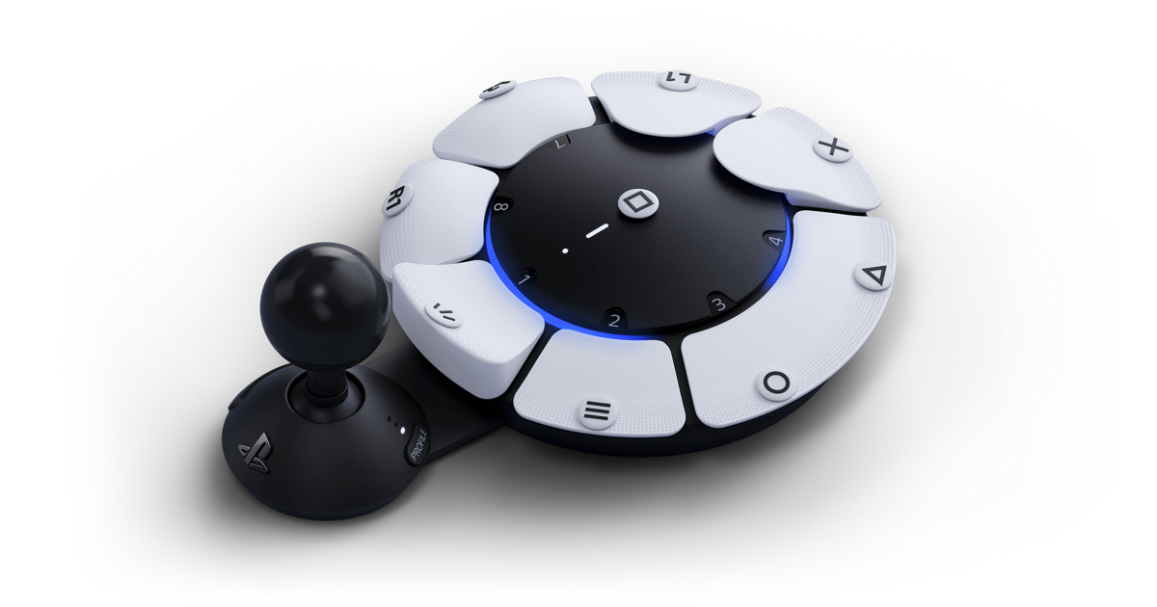
Recent Development: Accessible Controllers

