Slide 1
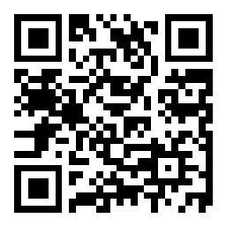
CSE 121 Lesson 10: While Loops
Matt Wang
Spring 2024
TAs:
Andy | Anju | Archit | Arkita | Autumn | Christian
Hannah H | Hannah S | Heather | Hibbah | Janvi | Jessie
Jonus | Julia | Luke | Maria | Mia | Ritesh
Shayna | Simon | Trey | Vidhi | Vivian | Gumball?
sli.do #cse121-10
Today’s playlist: CSE 121 lecture beats 24sp

Slide 2
The typical announcements & reminders
Creative Project 2 (C2) due tomorrow (May 2nd)
Resubmission Cycle 2 (R2) due tomorrow (May 2nd)
Eligible: C0, P0, C1, P1
R3 opens tomorrow, due May 9th; eligible: P0, C1, P1, C2
Programming Assignment 2 (P2) open Friday (May 3rd), due May 14th
Quiz 1 next week (May 9th); topics include up to while loops
more practice materials & resources coming soon!

Slide 3
Academic student employee strike (1/3)
There is an open question about how a potential university-wide academic student employee strike – which includes TAs – will affect the course, but it almost certainly will.
A reduction in the size of our operating course staff may impact:
TA office hour availability (IPL)
Grading timelines & quantity, quality of feedback
Quiz section administration
Ed discussion board answers

Slide 4
Academic student employee strike (2/3)
The situation is developing and the duration of a strike is unknown.
Please stay in communication with the course staff via the Ed message board (or, for private matters, email) if you encounter unexpected circumstances during this time. We (at minimum, Matt) will respond and do our best to work with and support you.
On my end, I will do my best to communicate changes in course logistics with you. Please actively check your email and the Ed board.

Slide 5
Academic student employee strike (3/3)
above all,
Please be kind.
We’re all doing our best to provide a good learning environment for students and to provide for ourselves.

Slide 6
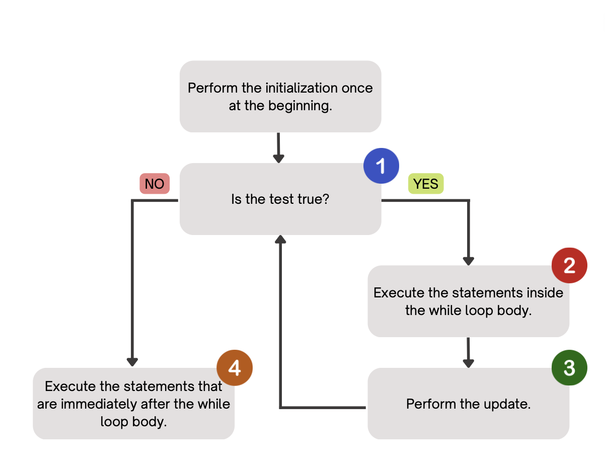
(PCM) While Loops
Repeatedly executes its body as long as the logical test is true.

Slide 7
for loops vs. while loops ⚔️
For loops and while loops are quite similar! This is the first (but certainly not the last) time where you need to decide which to use!
There’s not always a “correct” answer, but some advice:
thinking of definite versus indefinite conditions
phrasing the problem out loud!
“I will do __ X times” or “for each __ I will __” : sounds like a for!
“I will do __ until __” or “while __ is true, do” : sounds like a while!

Slide 8
for loops are while loops!!! (1/2)
for (int i = 0; i < bigYikes; i++) {
// ...
}
int i = 0;
while (i < bigYikes) {
// ...
i++;
}

Slide 9
for loops are while loops!!! (2/2)
for (int i = 0; i < bigYikes; i++) {
// ...
}
int i = 0;
while (i < bigYikes) {
// ...
i++;
}
*as a technical note, these aren’t exactly the same – there are some minor technical details that are different, most notably the scope of i

Slide 10
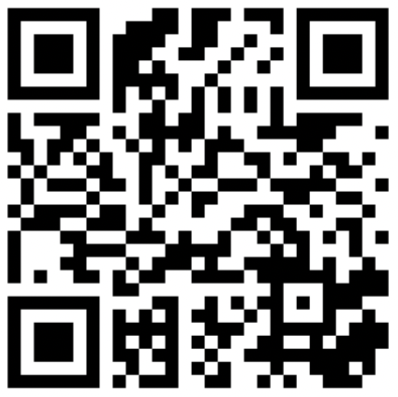
How would you describe what the variable x calculates?
The largest value rolled
The smallest value rolled
The last value rolled
The first value rolled
The sum of all values rolled
Error
-1
int roll = -1; // "priming" the loop
int x = -1;
while (roll != lucky) {
roll = randy.nextInt(sides) + 1;
if (x < roll) {
x = roll;
}
}
System.out.println(roll + ": my lucky number!");

