Slide 1
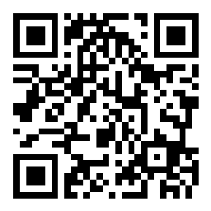
Welcome to CSE 121!
Matt Wang
Spring 2024
Use this QR code as one way to ask questions!
TAs:
Andy | Anju | Archit | Arkita | Autumn | Christian
Hannah H | Hannah S | Heather | Hibbah | Janvi | Jessie
Jonus | Julia | Luke | Maria | Mia | Ritesh
Shayna | Simon | Trey | Vidhi | Vivian | Gumball?
sli.do #cse121-0
Today’s playlist: CSE 121 lecture beats 24sp

Slide 2
Agenda (1/7)
About us
About this course
Learning objectives
Other similar courses
Course components
Our learning model
Tools and resources
Course Website
Ed
Assessment and grading
Collaboration

Slide 3
Agenda (2/7)
About us
About this course
Learning objectives
Other similar courses
Course components
Our learning model
Tools and resources
Course Website
Ed
Assessment and grading
Collaboration

Slide 4
Hi, I’m Matt! (he/him)
(new) Assistant Teaching Professor in the Allen School
grew up mostly in Toronto and sometimes Tokyo!
went to UCLA!
BS & MS in Computer Science
BS in Math-Economics
computer science interests: CS education, “open-source”, programming languages, accessibility
non-CS interests: reading, music (Laufey was my #1 this wrapped), video games, skiing & ice skating!

Slide 5
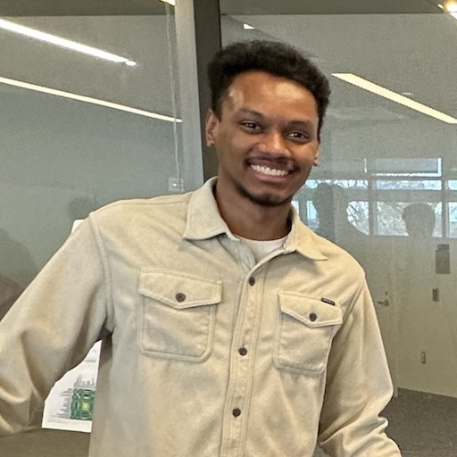
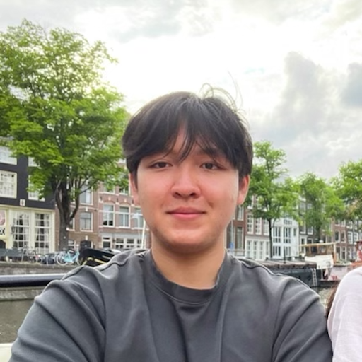
Meet your 23 TAs!

Slide 6
Agenda (3/7)
About us
About this course
Learning objectives
Other similar courses
Course components
Our learning model
Tools and resources
Course Website
Ed
Assessment and grading
Collaboration

Slide 7
Learning Objectives
or, “What will I learn in this class?”
Computational Thinking
Code Comprehension
Code Writing
Communication
Testing
Debugging
Ethics & Societal Impact
Notes:
matt

Slide 8
Other Similar Courses
Course | Good choice if…
CSE 121 | You’ve never programmed before AND You are, or want to be, in a major such as CS, CE, ECE, Info, etc. that requires Java programming
CSE 122 | You’ve done some programming (roughly one course worth) in any programming language AND You are, or want to be, in a major such as CS, CE, ECE, Info, etc. that requires Java programming
CSE 123 | You’ve taken CSE 122 AND You are, or want to be, in a major such as CS, CE, ECE, Info, etc. that requires Java programming
CSE 160 | You’ve never programmed before AND You’re interested in data science and analysis OR You’d rather learn Python than Java* OR You are, or want to be, in a major such as Physics, Bio, Stat, etc. where analyzing data through programming is useful
Other courses of interest: CSE 154, CSE 163
See Guided Self-Placement and Introductory Courses for more info
Notes:
matt

Slide 9
Course Components
Meetings
LECTURES
(x20)
SECTIONS
(x16)
We’re here!
Introduce concepts, practice ideas, discuss applications.
Pre-class materials to prepare for class each day. Due before class.
Held in person
More practice, review, applications
TA advice, how to be an effective student
Preparation for quizzes / exams
Assessments
PROGRAMMING ASSIGNMENTS
(x4)
CREATIVE PROJECTS
(x4)
QUIZZES
(x3)
EXAM
(x1)
Structured assignments
Programming in Java
Applying & implementing course concepts
More open-ended
assignments
Explore new ideas and applications
Taken in quiz section
45 minutes on computer
Culminating exam
Wed, June 5th 2:30 – 4:20 PM
Notes:
matt

Slide 10
Agenda (4/7)
About us
About this course
Learning objectives
Other similar courses
Course components
Our learning model
Tools and resources
Course Website
Ed
Assessment and grading
Collaboration
10

Slide 12
How Learning Works
Learning requires active participation in the process. It’s not as simple as sitting and listening to someone talk at you!
Requires deliberate practice in learning by doing
Benefits from collaborative learning
Does not work well if you cram everything!
Notes:
matt

Slide 13
Pre-Class Materials (1/3)
Core element of course: pre-class material
prepare for each lecture with readings & practice problems
should take ~30 minutes per lecture (why we don’t have Monday lectures!)
class will start with a brief recap, then pick off where we left off
Notes:
matt

Slide 14
Pre-Class Materials (2/3)
Core element of course: pre-class material
prepare for each lecture with readings & practice problems
should take ~30 minutes per lecture (why we don’t have Monday lectures!)
class will start with a brief recap, then pick off where we left off
Which means…
we can spend lecture diving deeper, answering questions, and think-pair-share
you can ask about pre-lecture material in class or quiz section!
Notes:
matt

Slide 15
Pre-Class Materials (3/3)
Core element of course: pre-class material
prepare for each lecture with readings & practice problems
should take ~30 minutes per lecture (why we don’t have Monday lectures!)
class will start with a brief recap, then pick off where we left off
Which means…
we can spend lecture diving deeper, answering questions, and think-pair-share
you can ask about pre-lecture material in class or quiz section!
Pre-class materials are ungraded, which means…
it’s okay if you find them challenging – that means you’re learning!
but, you should do them, and we will assume you’ve done them
Notes:
matt

Slide 16
Consistent and Active Participation (1/2)
Attendance is not graded. But, it’s strongly encouraged!
lectures & sections are not going to be just us talking at you!
ex: live in-class coding, debugging, think-pair-share, and problem-solving
spreading out ~ 1-2 hours each day over Tuesday – Friday is much more effective than cramming before the assignment is due!
Notes:
matt

Slide 17
Consistent and Active Participation (2/2)
Attendance is not graded. But, it’s strongly encouraged!
lectures & sections are not going to be just us talking at you!
ex: live in-class coding, debugging, think-pair-share, and problem-solving
spreading out ~ 1-2 hours each day over Tuesday – Friday is much more effective than cramming before the assignment is due!
Catching up:
all lectures are recorded on Panopto; slides are on our website.
section materials are on Ed, but section will not be recorded.
Notes:
matt

Slide 18
Metacognition
Metacognition: asking questions about your solution process.
Examples:
While debugging: explain to yourself why you’re trying this change.
Before running your program: make an explicit prediction of what you expect.
When working: be aware when you’re not making progress, so you can take a break or try a different strategy.
When designing:
Explain the tradeoffs with using a different data structure or algorithm.
If one or more requirements change, how would the solution change as a result?
Reflect on how you ruled out alternative ideas along the way to a solution.
When studying: what is the relationship of this topic to other ideas in the course?
Notes:
matt

Slide 19
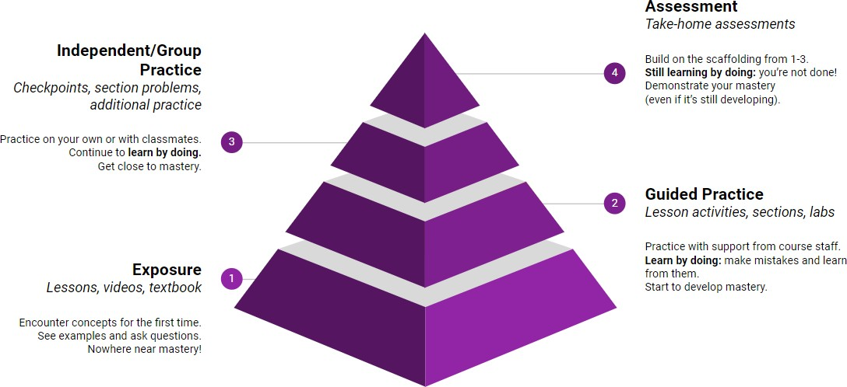
Learning in CSE 121 (or anywhere)
Notes:
matt

Slide 20
Course Culture and Support
Currently 231 students enrolled!
Almost none are CSE majors!
Wide range of backgrounds, interests, and goals
Everyone is new to programming
Support and help each other!
Form study groups
If you have a question, others almost certainly do too
Notes:
elba

Slide 21
Course Culture and Support: Live Support
Introductory Programming Lab (TA Office Hours – starting Week 2)
#1 place to get help (and highly rated in the class!)
face-to-face help from TAs on any course questions – not just assignments
TA Section
Work through practice problems (this is how you learn!)
Get to know your TAs & peers!
Instructor Office Hours (in-person & Zoom – schedule on website)
I don’t byte (most of the time)
Great for things from lecture, personal questions, or just to say hi!

Slide 22
Course Culture and Support: Ed & Email
Ed Board
Best for content and logistics questions – 231 of you >> 24 of us!!
Feel free to make them public or private (and/or anonymous)
Answer other students’ questions – great way to learn!
Email
Best for personal circumstances and/or private questions
If unsure, always feel free to email Matt (at mxw@cs.washington.edu)
May politely ask you to post on Ed instead!
Notes:
elba

Slide 23
The World Around CSE 121 & Reaching Out
Our goal is to give you a great CSE 121 experience!
But CSE 121 does not exist in a vacuum – there’s a lot going on in the world right now that can impact your education.
We’ve designed course policies for maximum flexibility: resubmissions, dropping quiz/exam problems, asynchronous help & lecture recordings.
Please reach out ASAP if you’re struggling or have circumstances that require extra support. We’re happy to help – we just need to know!
Notes:
elba

Slide 24
Agenda (5/7)
About us
About this course
Learning objectives
Other similar courses
Course components
Our learning model
Tools and resources
Course Website
Ed
Assessment and grading
Collaboration

Slide 25
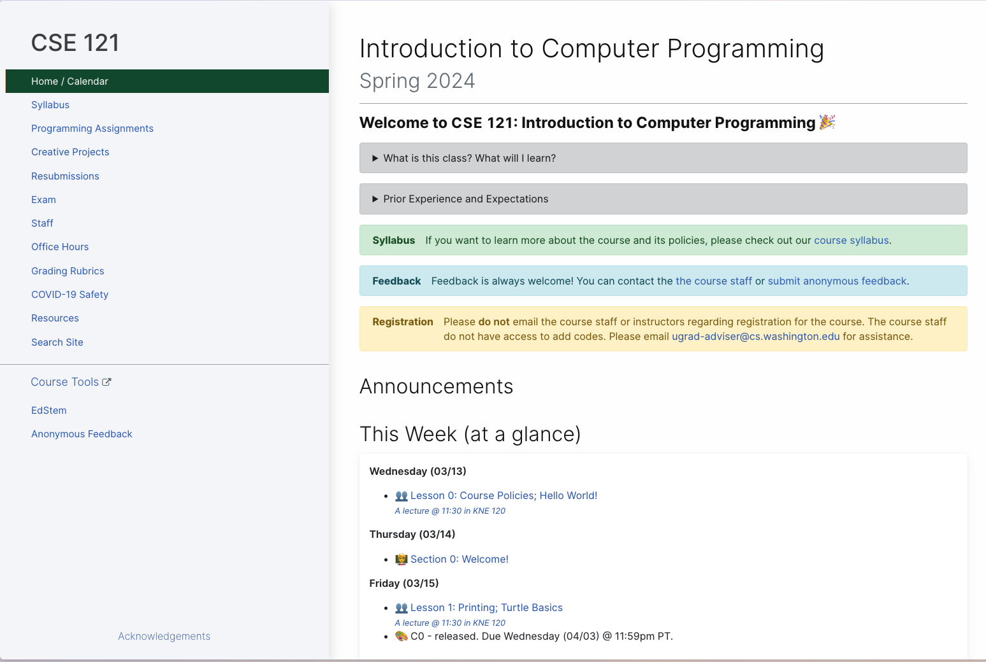
Course Website
cs.uw.edu/121
Primary source of course information (not Canvas)
Calendar will contain links to (almost) all resources
Notes:
matt

Slide 26
Syllabus (website)
Please review the syllabus ASAP.
Notes:
matt

Slide 27
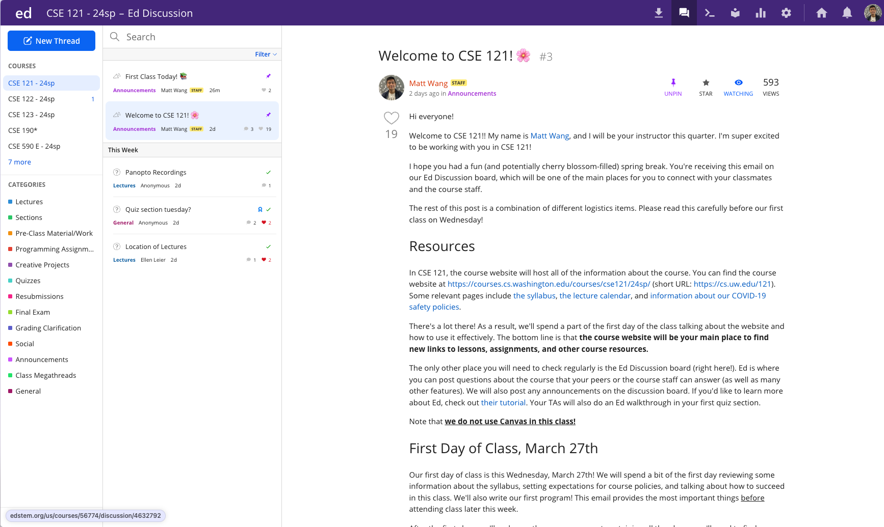
Ed
Our online learning platform
Lessons, sections, quizzes all here
Intro and walkthrough in Section 0
22
Notes:
matt

Slide 28
Other Course Tools (brief overview)
Canvas / Panopto
My Digital Hand
Queueing in office hours
Lecture recordings
Visual Studio Code
Sli.do
Not strictly necessary!
Develop offline
Debugger Tool
In-class activities (ungraded)
No account needed
Notes:
matt

Slide 29
Agenda (6/7)
About us
About this course
Learning objectives
Other similar courses
Course components
Our learning model
Tools and resources
Course Website
Ed
Assessment and grading
Collaboration

Slide 30
Assessment and Grading
Our goal in the course is for you to gain proficiency of the concepts and skills we teach
We assess your proficiency by asking you to apply the concepts and skills on tasks or problems
By necessity, we are assessing your work as a proxy for your proficiency
25
Notes:
elba

Slide 31
Grading
Grades should reflect proficiency in course objectives.
All assignments will be graded with “E/S/N” grading:
E (Excellent)
S (Satisfactory)
N (Not Yet)
Final grades are assigned based on amount of work at each level.
We’ll discuss this more when our first assignment is released. See syllabus for more details.

Slide 32
Resubmissions
Learning takes time, and doesn’t always happen on the first try!
Each week, one previous assignment or project can be resubmitted.
Must be accompanied by write-up explaining change (reflection!)
Grade on your resubmission replaces original grade
Assignments are only eligible for resubmission within 3 “cycles” following its grade being released
We’ll discuss this more when our first assignment is graded. See syllabus for more details.

Slide 33
Agenda (7/7)
About us
About this course
Learning objectives
Other similar courses
Course components
Our learning model
Tools and resources
Course Website
Ed
Assessment and grading
Collaboration
Notes:
elba

Slide 34
Collaboration Policy
You are encouraged to form study groups, work together on practice and review, and discuss your ideas & approaches at a high level.
Sharing ideas and working together is good – but, please cite them
Don’t copy work. In particular, never send someone else your code.
All work you submit must be predominantly and substantially your own.
Includes Generative AI tools! (see dedicated website page)
See syllabus for more details, including on the withdrawal policy.

Slide 35
Help us improve!
CSE 121 is super new! We’ve worked hard to build a course that we think will be effective, supportive, and help you succeed.
But… we probably didn’t get it all right!
We appreciate your patience and understanding if we need to make adjustments during the quarter
Please give us lots of feedback!
Post on Ed
Mid and end-of-quarter feedback
Use CSE Anonymous Feedback Tool

Slide 36
“Homework” for Next Time
First assignment will be released Friday, but there are some things to do in the meantime.
TODOs this week:
Fill out the introductory survey
Go meet your TA and classmates in Thursday’s quiz section
⭐Complete the pre-class material for Friday (see calendar)
Check over syllabus details
Notes:
elba

