Slide 1
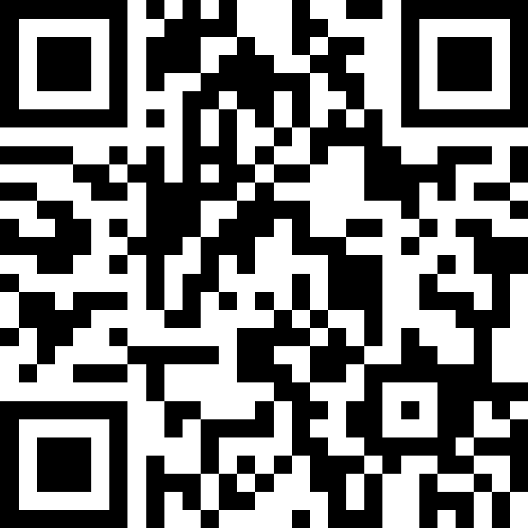
CSE 121 Lesson 9: Conditionals
Matt Wang & Brett Wortzman
Autumn 2024
Abby | Afifah | Ailsa | Alice | Aliyan | Arohan
Chloë | Christopher | Dalton | Derek | Elizabeth | Ethan
Hanna | Hannah | Heather | Hibbah | Janvi | Jasmine
Judy | Julia | Kelsey | Lucas | Luke | Mahima
Maitreyi | Maria | Merav | Minh | Neha | Ronald
Ruslana | Sahej | Sam | Samrutha | Sushma | Vivian
Yijia | Zachary
TAs:
sli.do #cse121
Today’s playlist: 121 24au lecture tunes

Slide 2
Announcements, Reminders
Creative Project 2 released, due Tuesday, Oct 29th
note: doable without conditionals, but you’re free to use them!
R2 out yesterday, due Thursday Oct 31st
Note: this is the last time C0 is eligible for resubmission!
Almost half-way through – feedback wanted!
Friday, Nov 1st – mid-quarter feedback, during lecture
next week during quiz section – quiz section & TA feedback

Slide 3
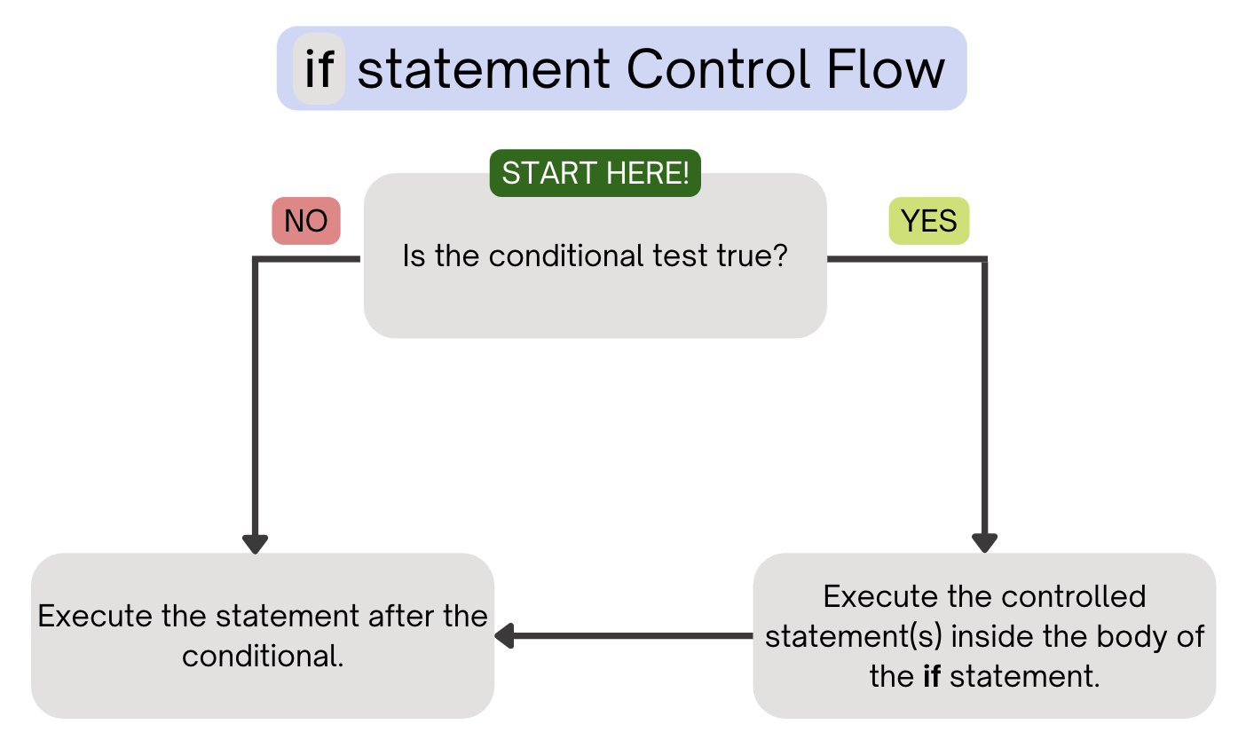
(PCM) Conditionals (1/4)
Executes a block of statements if and only if the test is true

Slide 4
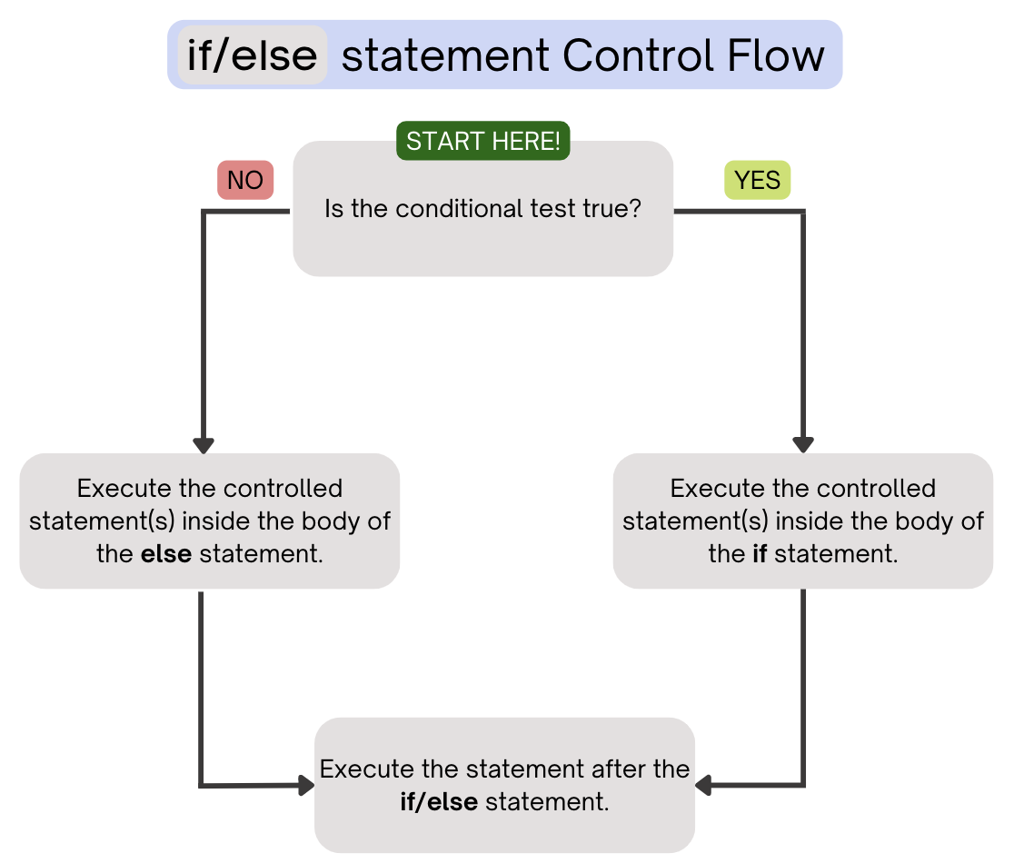
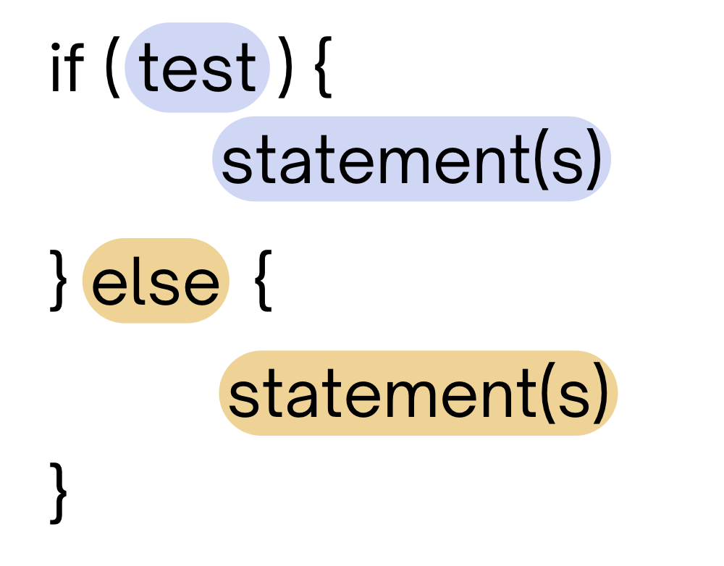
(PCM) Conditionals (2/4)
If the test is true: execute block of statements
If not, execute other block of statements

Slide 5
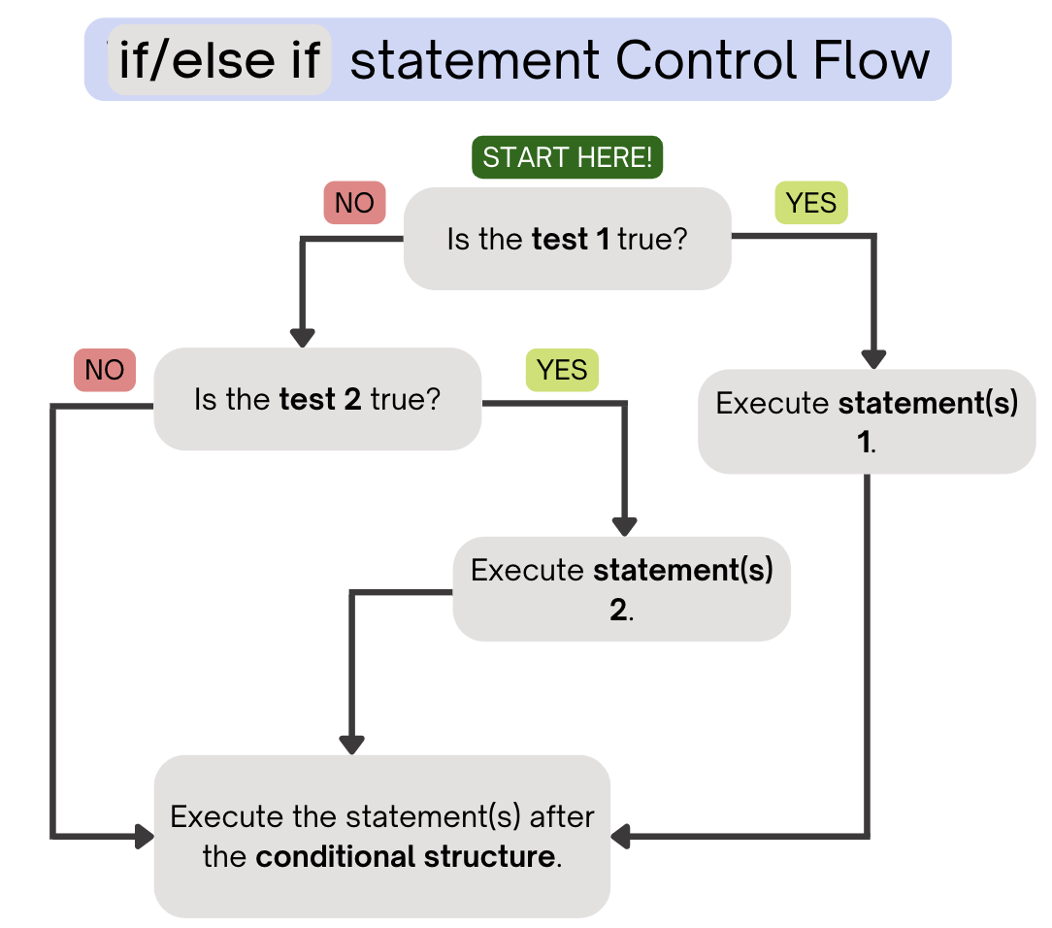
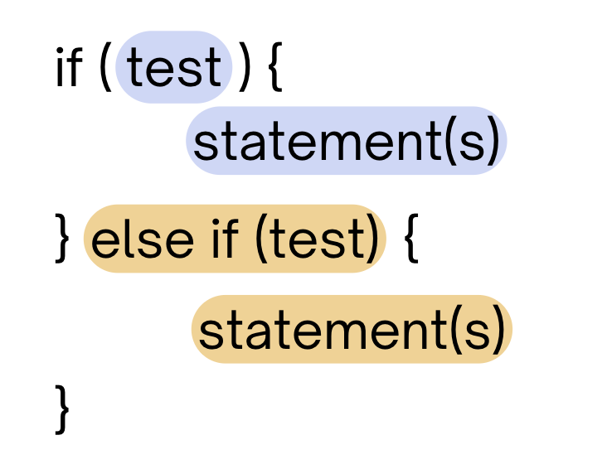
(PCM) Conditionals (3/4)
If the first test is true, execute that block
If not, proceed to the next test, and repeat
If none were true, don’t execute any blocks

Slide 6
(PCM) Conditionals (4/4)
With a large if-else-if-else chain,
if there is an ending else, exactly one block will execute
if there is no ending else, zero or one blocks will execute

Slide 7
What does this program output?
public static void main(String[] args) {
for (int i = 1; i <= 3; i++) {
System.out.print(mystery(i));
}
}
public static String mystery(int n) {
String response = "even ";
if (n % 2 == 1) {
response = "odd ";
} else if (n == 1) {
response = "one ";
}
return response;
}
A. odd even odd
B. one even odd
C. one even even
D. even even even

Slide 8
This else if statement never runs!
public static void main(String[] args) {
for (int i = 1; i <= 3; i++) {
System.out.print(mystery(i));
}
}
public static String mystery(int n) {
String response = "even ";
if (n % 2 == 1) {
response = "odd ";
} else if (n == 1) {
response = "one ";
}
return response;
}

Slide 9
Common Problem-Solving Strategies (1/4)
Analogy – Is this similar to another problem you've seen?
Brainstorming – Consider steps to solve problem before jumping into code
Try to do an example "by hand" → outline steps
Solve sub-problems – Is there a smaller part of the problem to solve?
Debugging – Does your solution behave correctly?
What is it doing?
What do you expect it to do?
What area of your code controls that part of the output?
Iterative Development – Can we start by solving a different problem that is easier?

Slide 10
Common Problem-Solving Strategies (2/4)
Analogy – Is this similar to another problem you've seen?
Brainstorming – Consider steps to solve problem before jumping into code
Try to do an example "by hand" → outline steps
Solve sub-problems – Is there a smaller part of the problem to solve?
Debugging – Does your solution behave correctly?
What is it doing?
What do you expect it to do?
What area of your code controls that part of the output?
Iterative Development – Can we start by solving a different problem that is easier?

Slide 11
Common Problem-Solving Strategies (3/4)
Analogy – Is this similar to another problem you've seen?
Brainstorming – Consider steps to solve problem before jumping into code
Try to do an example "by hand" → outline steps
Solve sub-problems – Is there a smaller part of the problem to solve?
Debugging – Does your solution behave correctly?
What is it doing?
What do you expect it to do?
What area of your code controls that part of the output?
Iterative Development – Can we start by solving a different problem that is easier?

Slide 12
Common Problem-Solving Strategies (4/4)
Analogy – Is this similar to another problem you've seen?
Brainstorming – Consider steps to solve problem before jumping into code
Try to do an example "by hand" → outline steps
Solve sub-problems – Is there a smaller part of the problem to solve?
Debugging – Does your solution behave correctly?
What is it doing?
What do you expect it to do?
What area of your code controls that part of the output?
Iterative Development – Can we start by solving a different problem that is easier?

