Slide 1
CSE 121 Lesson 5: Nested for loops, Random, Math
Matt Wang & Brett Wortzman
Autumn 2024
Abby | Afifah | Ailsa | Alice | Aliyan | Arohan
Chloë | Christopher | Dalton | Derek | Elizabeth | Ethan
Hanna | Hannah | Heather | Hibbah | Janvi | Jasmine
Judy | Julia | Kelsey | Lucas | Luke | Mahima
Maitreyi | Maria | Merav | Minh | Neha | Ronald
Ruslana | Sahej | Sam | Samrutha | Sushma | Vivian
Yijia | Zachary
TAs:
sli.do #cse121
Today’s playlist: 121 24au lecture tunes

Slide 2
Announcements, Reminders
Creative Project 1 is out, due Tue Oct 15th
Resubmission Cycle 0 released, due Thu Oct 17th
Eligible for submission: C0 & P0
Course logistics reminders:
“Extra Resources” on course website
Post-section work must be done by 11:59 that day
Brett’s office hours out now!

Slide 3
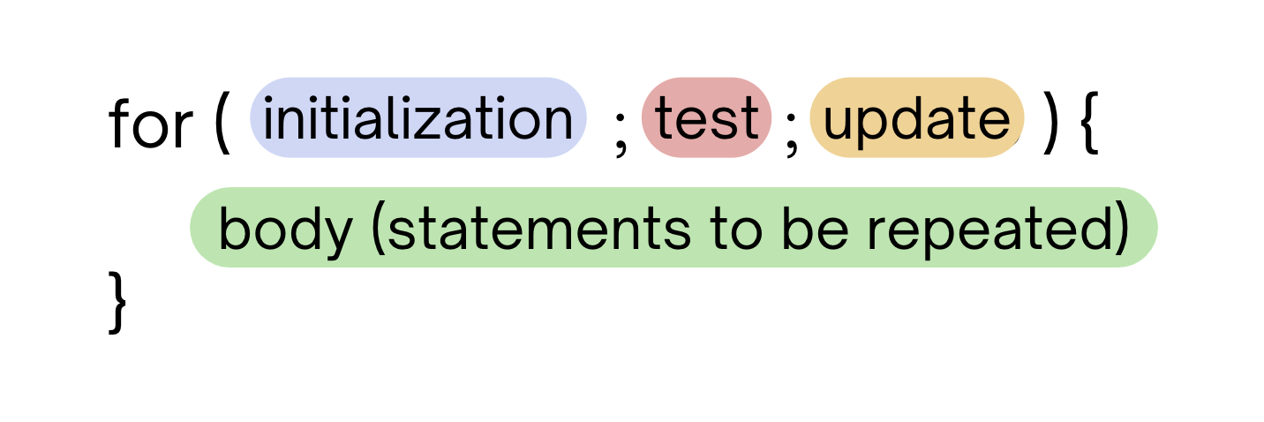
Last time: for loops!
For loops are our first control structure
A syntactic structure that controls the execution of other statements.

Slide 4
Fencepost Pattern 1
Some task where one piece is repeated n times, and another piece is repeated n-1 times and they alternate
h-u-s-k-i-e-s

Slide 5
Fencepost Pattern 2
Some task where one piece is repeated n times, and another piece is repeated n-1 times and they alternate
h-u-s-k-i-e-s

Slide 6
(PCM) Nested for loops (1/3)
for (int outerLoop = 1; outerLoop <= 5; outerLoop++) {
System.out.println("outer loop iteration #" + outerLoop);
for (int innerLoop = 1; innerLoop <= 3; innerLoop++) {
System.out.println(" inner loop iteration #" + innerLoop);
}
System.out.println(outerLoop);
}

Slide 7
(PCM) Nested for loops (2/3)
for (int outerLoop = 1; outerLoop <= 5; outerLoop++) {
System.out.println("outer loop iteration #" + outerLoop);
for (int innerLoop = 1; innerLoop <= 3; innerLoop++) {
System.out.println(" inner loop iteration #" + innerLoop);
}
System.out.println(outerLoop);
}

Slide 8
(PCM) Nested for loops (3/3)
for (int outerLoop = 1; outerLoop <= 5; outerLoop++) {
System.out.println("outer loop iteration #" + outerLoop);
for (int innerLoop = 1; innerLoop <= 3; innerLoop++) {
System.out.println(" inner loop iteration #" + innerLoop);
}
System.out.println(outerLoop);
}

Slide 9
What output is produced by the following code?
for (int i = 1; i <= 5; i++) {
for (int j = 1; j <= i; j++) {
System.out.print(i);
}
System.out.println();
}
1
12
123
1234
12345
i
ii
iii
iiii
iiiii
1
22
333
4444
55555
1
11
111
1111
11111
A. B. C. D.

Slide 10
What code produces the following output?
A.
B.
C.
D.
for (int i = 1; i <= 5; i++) {
for (int j = 1; j <= i; j++) {
System.out.print(i);
}
System.out.println();
}
for (int i = 1; i <= 5; i++) {
for (int j = 1; i <= j; j++) {
System.out.print(j);
}
System.out.println();
}
1
12
123
1234
12345
for (int i = 1; i <= 5; i++) {
for (int j = 1; j <= i; j++) {
System.out.print(j);
}
System.out.println();
}
for (int i = 1; i <= 5; i++) {
for (int j = 1; j <= i; i++) {
System.out.print(j);
}
System.out.println();
}

Slide 11
Pseudo-Randomness
Computers generate numbers that “look random” in a predictable way using mathematical formulas.
can use “external” variables like time, mouse position, etc.
True randomness is hard – we rely on natural processes
e.g., atmospheric noise, lava lamps

Slide 12
Why randomness?
Randomness is a core part of computer science! It powers:
cryptography
security
machine learning!
But true randomness is really hard. If we just use math, someone could “reverse” the formula.
So … lava lamps.
LavaRand: CloudFlare’s Wall of Lava Lamps

Slide 13
(PCM) Random
A Random object generates pseudo-random numbers.
The Random class is found in the java.util package
import java.util.*;
We can “seed” the generator to make it behave deterministically (helpful for testing!)
Method | Description
nextInt() | Returns a random integer
nextInt(max) | Returns a random integer in the range [0, max), or in other words, 0 to max-1 inclusive
nextDouble() | Returns a random real number in the range [0.0, 1.0)

Slide 14
Assuming you’ve declared: Random randy = new Random();
Which of these best models picking a random card? (1-13 inclusive)
randy.nextInt()
randy.nextInt(13)
randy.nextInt(13) + 1
randy.nextInt(14)

Slide 15
(PCM) Math
Calling:
Math.<method>(…)
Method | Description
Math.abs(value) | Returns the absolute value of value
Math.ceil(value) | Returns value rounded up
Math.floor(value) | Returns value rounded down
Math.max(value1, value2) | Returns the larger of the two values
Math.min(value1, value2) | Returns the smaller of the two values
Math.round(value) | Returns value rounded to the nearest whole number
Math.sqrt(value) | Returns the square root of value
Math.pow(base, exp) | Returns base raised to the exp power

Slide 16
Reminders
Creative Project 1 is out, due Tue Oct 15th
Resubmission Cycle 0 released, due Thu Oct 17th
Getting help today?
Matt’s office hours: 12:30-1:20 (in-person/Zoom)
Brett’s office hours: 1:30-2:30 (Zoom)
IPL (until 6:30)

