Slide 1
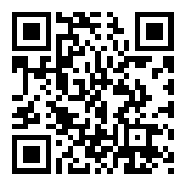
CSE 121 Lesson 4: for Loops
Matt Wang & Brett Wortzman
Autumn 2024
Abby | Afifah | Ailsa | Alice | Aliyan | Arohan
Chloë | Christopher | Dalton | Derek | Elizabeth | Ethan
Hanna | Hannah | Heather | Hibbah | Janvi | Jasmine
Judy | Julia | Kelsey | Lucas | Luke | Mahima
Maitreyi | Maria | Merav | Minh | Neha | Ronald
Ruslana | Sahej | Sam | Samrutha | Sushma | Vivian
Yijia | Zachary
TAs:
sli.do #cse121
Today’s playlist: 121 24au lecture tunes

Slide 2
Announcements & Reminders
P0 due last night– congratulations!!
C1 releasing later today (due Tuesday, October 15th)
Feedback for Creative Project 0 released yesterday!
Resubmission Cycle 0 (R0) opening tomorrow (due Thursday, October 17th)
Reminder: IPL is open!
in-person at MGH 334, uses a tool called “MyDigitalHand”
many hours: e.g. 12:30-9:30 today! (see schedule for more)

Slide 3
Resubmissions (or “resubs”)
Each week, you may resubmit one Programming Assignment or Creative Project with no penalty. The grade of your resubmission will completely replace your previous grade.
This is a huge opportunity: you get to resubmit your work after we grade it and give you feedback! Please take advantage of this :)
(if you miss an assignment and/or only finish it late – use a resub!)

Slide 4
Resubmissions (or “resubs”)
Some logistics:
there are 8 total resub cycles this quarter (and… 8 assignments…)
an assignment is only eligible for resubmission for 3 cycles after feedback is released
To resubmit, you should:
set the submission you want to be graded as “Final”
submit a Google form to confirm your resubmission
you must fill out the form before the deadline for your resub to count!

Slide 5
Last Time…
Variables
Container that stores a specific data type
Must declare & initialize!
Manipulate, modify, reuse ♻
Strings
Sequence of characters treated as one, yet can be indexed as individual parts
char, represents a single character
// declare AND initialize
int version = 5;
L | a | u | f | e | y | !
0 | 1 | 2 | 3 | 4 | 5 | 6

Slide 6
Suppose s contains the String "bubble gum". Which option below would result in s containing "Gumball" instead?
s.substring(7) + "ball";
s = s.substring(7, 9) + "ball";
s = s.charAt(7).toUpperCase() + "ball";
s = s.substring(7, 8).toUpperCase() + s.substring(8) + "ball";
b | u | b | b | l | e |  | g | u | m
0 | 1 | 2 | 3 | 4 | 5 | 6 | 7 | 8 | 9

Slide 7
🐞 Debugging – Live!
In P0, we asked you to do some debugging.
This is arguably the most important skill when programming – especially because programming is a social activity!
Let’s do some live debugging :)

Slide 8
(PCM) for loops!
For loops are our first control structure
A syntactic structure that controls the execution of other statements.

Slide 9
(PCM) for loops! 2
for (int counter = 1; counter <= 5; counter++) {
System.out.println("I love CSE 121!");
}

Slide 10
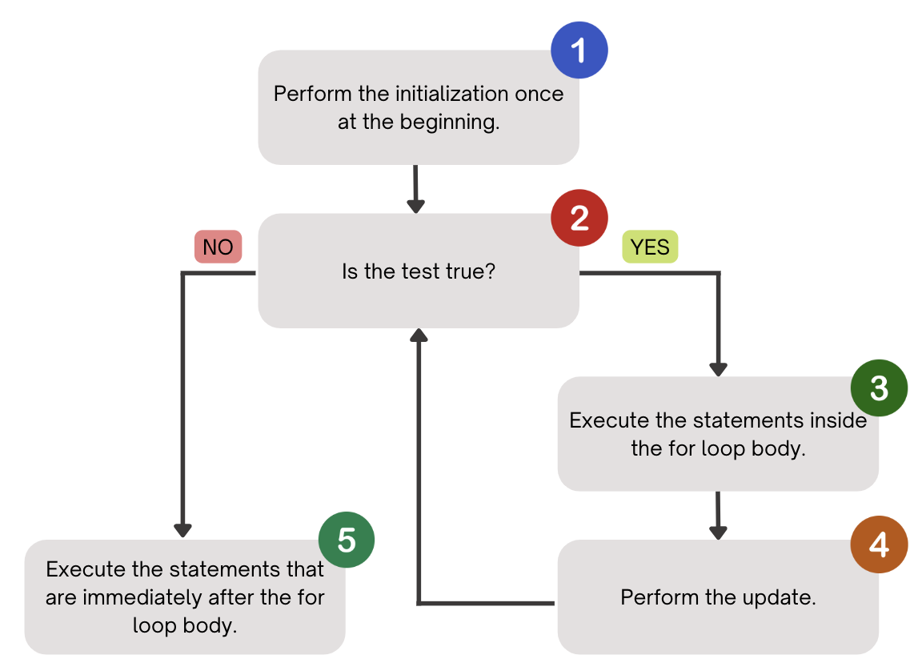
(PCM) for loops! 3

Slide 11
(PCM) for loops! 4
counter
1
2
4
1
2
3
4
5
6
for (int counter = 1; counter <= 5; counter++) {
System.out.println("I love CSE 121!");
}
3
5
I love CSE 121!
I love CSE 121!
I love CSE 121!
I love CSE 121!
I love CSE 121!

Slide 12
What output does the following code produce?
for (int i = 1; i <= 6; i++) {
System.out.println(i + " squared = " + i * i);
}
A.
i squared = i * i
i squared = i * i
i squared = i * i
i squared = i * i
i squared = i * i
i squared = i * i
B.
i squared = i * i
i squared = i * i
i squared = i * i
i squared = i * i
i squared = i * i
i squared = i * i
i squared = i * i
C.
1 squared = 1
2 squared = 4
3 squared = 9
4 squared = 16
5 squared = 25
6 squared = 36
D.
1 squared = 1
2 squared = 4
3 squared = 9
4 squared = 16
5 squared = 25
6 squared = 36
7 squared = 49

Slide 13
(PCM) String traversals
// For some String s
for (int i = 0; i < s.length(); i++) {
// do something with s.charAt(i)
}

Slide 14
Fencepost Pattern 1
Some task where one piece is repeated n times, and another piece is repeated n-1 times and they alternate
h-u-s-k-i-e-s

Slide 15
Fencepost Pattern 2
Some task where one piece is repeated n times, and another piece is repeated n-1 times and they alternate
h-u-s-k-i-e-s

Slide 16
Reminders
P0 due last night– congratulations!!
C1 releasing later today (due Tuesday, October 15th)
Feedback for Creative Project 0 released yesterday!
Resubmission Cycle 0 (R0) opening tomorrow (due Thursday, October 17th)
Reminder: IPL is open!
in-person at MGH 334, uses a tool called “MyDigitalHand”
many hours: e.g. 12:30-9:30 today! (see schedule for more)

