Slide 1
CSE 121 Lesson 3: Characters & Strings, Variables, Debugging
Matt Wang & Brett Wortzman
Autumn 2024
Abby | Afifah | Ailsa | Alice | Aliyan | Arohan
Chloë | Christopher | Dalton | Derek | Elizabeth | Ethan
Hanna | Hannah | Heather | Hibbah | Janvi | Jasmine
Judy | Julia | Kelsey | Lucas | Luke | Mahima
Maitreyi | Maria | Merav | Minh | Neha | Ronald
Ruslana | Sahej | Sam | Samrutha | Sushma | Vivian
Yijia | Zachary
TAs:
sli.do #cse121
Today’s playlist: 121 24au lecture tunes

Slide 2
Announcements, Reminders
P0 was released on Wed and is due Tues, Oct 8th
Quiz 0 scheduled for Oct 24th (about 3 weeks away)
More details will be released in the coming weeks!
Prep includes practice quizzes, section materials, etc.
Helpful website resources
Grading Rubrics (P0 rubric will be out tonight!)
Ed shortcuts
Search Site button!

Slide 3
Beautiful Bugs (1/x)
\ /
'-^'-'^-'
.:--.--:.
/ | | | \
/\ | /\
| '.:.' |
A beetle just passed by...
Wow! After all that rain, a worm came up!
__
__ |..|
__ _ / \____/ /
/_____/ \_______/
\(")/
-( )-
-( )-
/(_)\
This is a cute ant.
Caterpillar :O
.--.--.--.--.--\___/
(__(__(__(__(__(0_0)
'' '' '' '' '' 'o'

Slide 4
Beautiful Bugs (2/x)
Oh no! A Spider!
/\\ /\\
// \\ / \\
// \\/ \\
// /\ || /\ \\
// //\\00//\\ \\
_// _// vv \\_ \\_
Good thing it's just a Daddy Long Legs!
"Wha..what is that??"
_
/_\
/=
|=
|= \o/
______/= |
""""""" /\
|
###
_--#######--_
_--#######--_
_--#######--_
_--#######--_
#○#○#
| |
\\ \\
\\ \\
##\\##\\##0
##############-
##############-
##//##//##0
// //
// //
WATCH OUT FLY!!!
Two caterpillars are racing!
\_/-.--.--.--.--.--. \____/--.--.--.--.--.--.
(")__)__)__)__)__)__) (>口<)#__)__)__)__)__)__)
^ "" "" """" "" "" 、、、、、 ^ ^ "" "" "" "" "" "" 、、、、、
<<<<<<<<<<<<<<<<<<<< <'--<<<<<<<<<<<<<<<<<<<

Slide 5
Beautiful Bugs (3/x)
A Centipede EWWW
(((((((
ooooooo<
(((((((
That centipede better not exceed 100 characters in length!
\ |
\ \ __----------------------------------------------------_
\_ \/ \
\__| _ _ _ _ _ _ _ _ _ _ _ _ _ _ _ _ _ _ _ _ _ _ _ _ _ _ _ _|
\_|_|_|_|_|_|_|_|_|_|_|_|_|_|_|_|_|_|_|_|_|_|_|_|_|_|_|_|/
\ \ \ \ \ \ \ \ \ \ \ \ \ \ \ \ \ \ \ \ \ \ \ \ \ \ \ \
Milipede Mervin:
____________________\/
/////////////////////\
Centipede!
\/
[][][][][][][][][][][][][]:
''''''''''''''''''''''''''

Slide 6
Beautiful Bugs (4/x)
RHINO BEETLE ᕦ(ò_óˇ)ᕤ
//-----\\
// \\
\\
\\
\\
\\_____
| \______________
| ( )
| (_____________)
\______/ O ( )
\ ___(_____________)
\______/ \ \
\/ / \ \
/ \ \
/ \ \
Is that a rhino or a beetle?
It's a rhino beetle!
^
/| __-----___-----------__
/ / / / \
/ \__/ [:] _/___ |
< __--' '--------------|
\____----' _____ \
\__---/--- \----_____\______/
___/ \___ \___

Slide 7
Beautiful Bugs (5/x)
No problem! Spider(man) is here!!
/ / \ \
/ / \ \
/ / __ \ \
| | /00\ | |
\ \____\ /____/ /
\______| |______/
______/ \______
/ __/ \/ \__ \
/ / | /\ | \ \
| | \____/ | |
\ \ / /
\ \ / /
OH NO! Is that the evil roach??
|____\_\__\____ ______
________\\_/__ /
/ | \ /
| | 8D |=====
\__________|___/ \
_____________// \______ \
| / / /

Slide 8
Beautiful Bugs (6/x)
\\
(O)(O)(O)(O)(O") 🍓🍇🍎🍐🍊🍭🧀🍉
''''''''''''
This is the very hungry caterpillar!
\ \ \ \ \
█████████<
/ / / / /
Spider 🕷️!!!
(\_/)
(o.o)
/> 🕸️<\
.-=---.
.'-==-.-=.
:-..- ..= .
:=. -.= -. . (🔘)🔘)
:.- .=.. -=. // //
_'.'___.-=-=___/'//
_'. /'/
__'. //
'..-=_____...---''O/ 🍦
"I think I just like plain old vanilla. 🤤"
extremely Lonely Cricket
V
東東東
//\\/\

Slide 9
Beautiful Bugs (7/x)
/T/\T\
/=/ \=\
|=| \=\
V __|=|__
_/ /===\ \_
__ /=======\ __
_/ /===========\ \_
___ /=============\_ __
/ //=================\\ \
_/ //===================\\ \_
//=====================\\
//\ ⚈ ◕ ⚈ ◕ ⚈ ◕ ⚈ ◕ ⚈ ◕ /\\
// \___________________/ \\
\\ L ⅃ //
\\ //
{ } { }
SUPER SCORPION is here to save the day!
A vibrant butterfly!
___ ___
|🟥 \ / 🟥|
|🟡 \ | | / 🟡|
\ 🟥 \ \_/ / 🟥 /
\ 🟡 \ / \ / 🟡 /
\ 🟥 \| |/ 🟥 /
\_🟡__| |__🟡_/
/| |\
/🟦| |🟦\
/ 🟣| |🟣 \
/ 🟦 | | 🟦 \
| 🟣 |_| 🟣 |
|_🟦_/ \_🟦_|

Slide 10
Beautiful Bugs (8/x)
\ /
\\ //
\\ ( 👁️👁️) //
\\ | | //
| |
| |
| |
| |
|
Fly man Lowkey weird
but he chill fr
Hey! Look! A scarab with his dung ball
屎屎屎
屎屎屎屎屎屎屎--虫虫虫虫
屎屎屎屎屎屎屎屎屎——虫虫虫虫
屎屎屎屎屎屎屎屎屎 虫虫虫 虫虫
屎屎屎屎屎屎屎屎屎 \ 虫虫虫虫虫
屎屎屎屎屎屎屎 / \⟍ 虫
屎屎屎 / \ ⟍

Slide 11
Beautiful Bugs (9/x)
OH NO, and its the worst bug of them all!...
HelloBugs.java:31: error:HelloBugs.java:31: error:
HelloBugs.java:31: error:HelloBugs.java:31: error:HelloBugs.java:31: error:
HelloBugs.java:31: error:HelloBugs.java:31: error:HelloBugs.java:31
HelloBugs.java:31: error:HelloBugs.java:31: error:HelloBugs.java:31
HelloBugs.java:31: error:HelloBugs.java:31: error:HelloBugs.java:31: error:
HelloBugs.java:31: error:HelloBugs.java:31: error:

Slide 12
And on accessibility… (1/2)
Loved your reflection responses here! Some common themes:
not previously knowing how blind people code (or use computers)
screenreaders are very fast
keyboard-only navigation seems challenging
debugging (and programming) is already so hard!
emphasizing that accessibility (and inclusion) matters!
“it’s the small things that matter”
companies should care too!
very impressed by the speaker’s perseverance and determination
follow-up: is this fair?

Slide 13
And on accessibility… (2/2)
We then asked you: is C0 accessible for a blind developer?
Broad spectrum of answers, but most of you said no. Some reasons:
in looking at ASCII art:
the caption is not enough context for a blind user
the screenreader would not interact well with the actual art
caption could be low-quality or wrong!
doing the assignment would be even harder
how to implement the various requirements (especially spacing?)
does Ed have the same accessibility features? (Matt says: no)
assignment may be fundamentally inaccessible!

Slide 14
So, what?
Broadly speaking: the digital world is inaccessible (but that’s changing)!
Making things accessible requires active effort & learning.
In CSE 121, we don’t have the full knowledge yet to make accessible ASCII art (or Java programs, applications, video games, websites, …)
However, we encourage you to:
think about accessibility when you make things with computers
keep on learning more! UW is a global leaders in digital accessibility
e.g. at UW: CSE 493E: Accessibility, CREATE, AccessComputing

Slide 15
Variables – Manipulation
Notice – this doesn't really make any mathematical sense!
That's because, in Java, = is assignment, not equality!
They’re made to be manipulated, modified, re-used!
int myFavoriteNumber = 7;
int doubleFV = myFavoriteNumber * 2;
myFavoriteNumber = myFavoriteNumber + 3;
Notes:
declare and initialize
Arithmetic with variables and place into another one
A variable… varies! It can change value.
Use one variable to set another one: it’s possible!

Slide 16
New Operators! (1/3)
myFavoriteNumber = myFavoriteNumber + 3;
This pattern is so common, we have a shorthand for it!
myFavoriteNumber += 3;
Note: this works for both numeric addition and string concatenation!

Slide 17
New Operators! (2/3)
The shorthands -=, *=, /=, and %= exist too!
myFavoriteNumber /= 3;
Should this work for integers? Doubles? Strings?

Slide 18
New Operators! (3/3)
There are even shorter operators for “incrementing” and “decrementing”!
myFavoriteNumber++; // equal to myFavoriteNumber += 1;
myFavoriteNumber--; // equal to myFavoriteNumber -= 1;
Should this work for integers? Doubles? Strings?

Slide 19
What do a, b, and c hold after this code is executed?
int a = 10;
int b = 30;
int c = a + b;
c -= 10;
a = b + 5;
b /= 2;
10, 30, 40
35, 15, 30
35, 15.5, 30
20, 15, 30

Slide 20
(PCM) Type Casting in Java
Casting – a way to convert one data type to another!
Implicit casting: integer to double (example: 30 * 1.0 )
Explicit casting: using (typename) syntax:
double pi = 3.14;
int piTrunc = (int) pi; // stores 3

Slide 21
Suppose s contains the String "bubble gum". Which option below would result in s containing "Gumball" instead?
s.substring(7) + "ball";
s = s.substring(7, 9) + "ball";
s = s.charAt(7).toUpperCase() + "ball";
s = s.substring(7, 8).toUpperCase() + s.substring(8) + "ball";
b | u | b | b | l | e |  | g | u | m
0 | 1 | 2 | 3 | 4 | 5 | 6 | 7 | 8 | 9

Slide 22
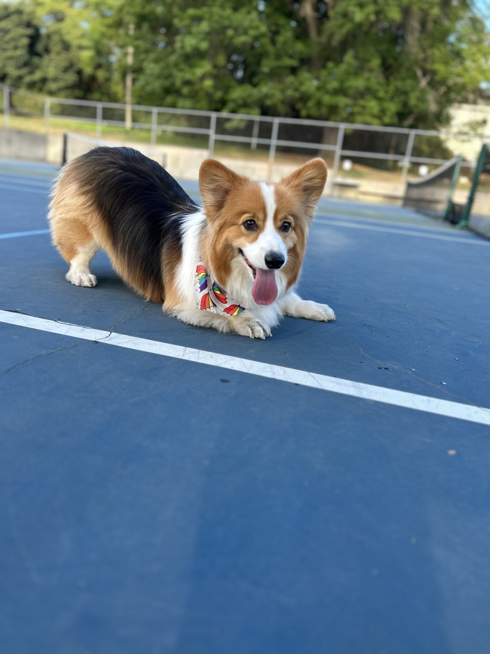
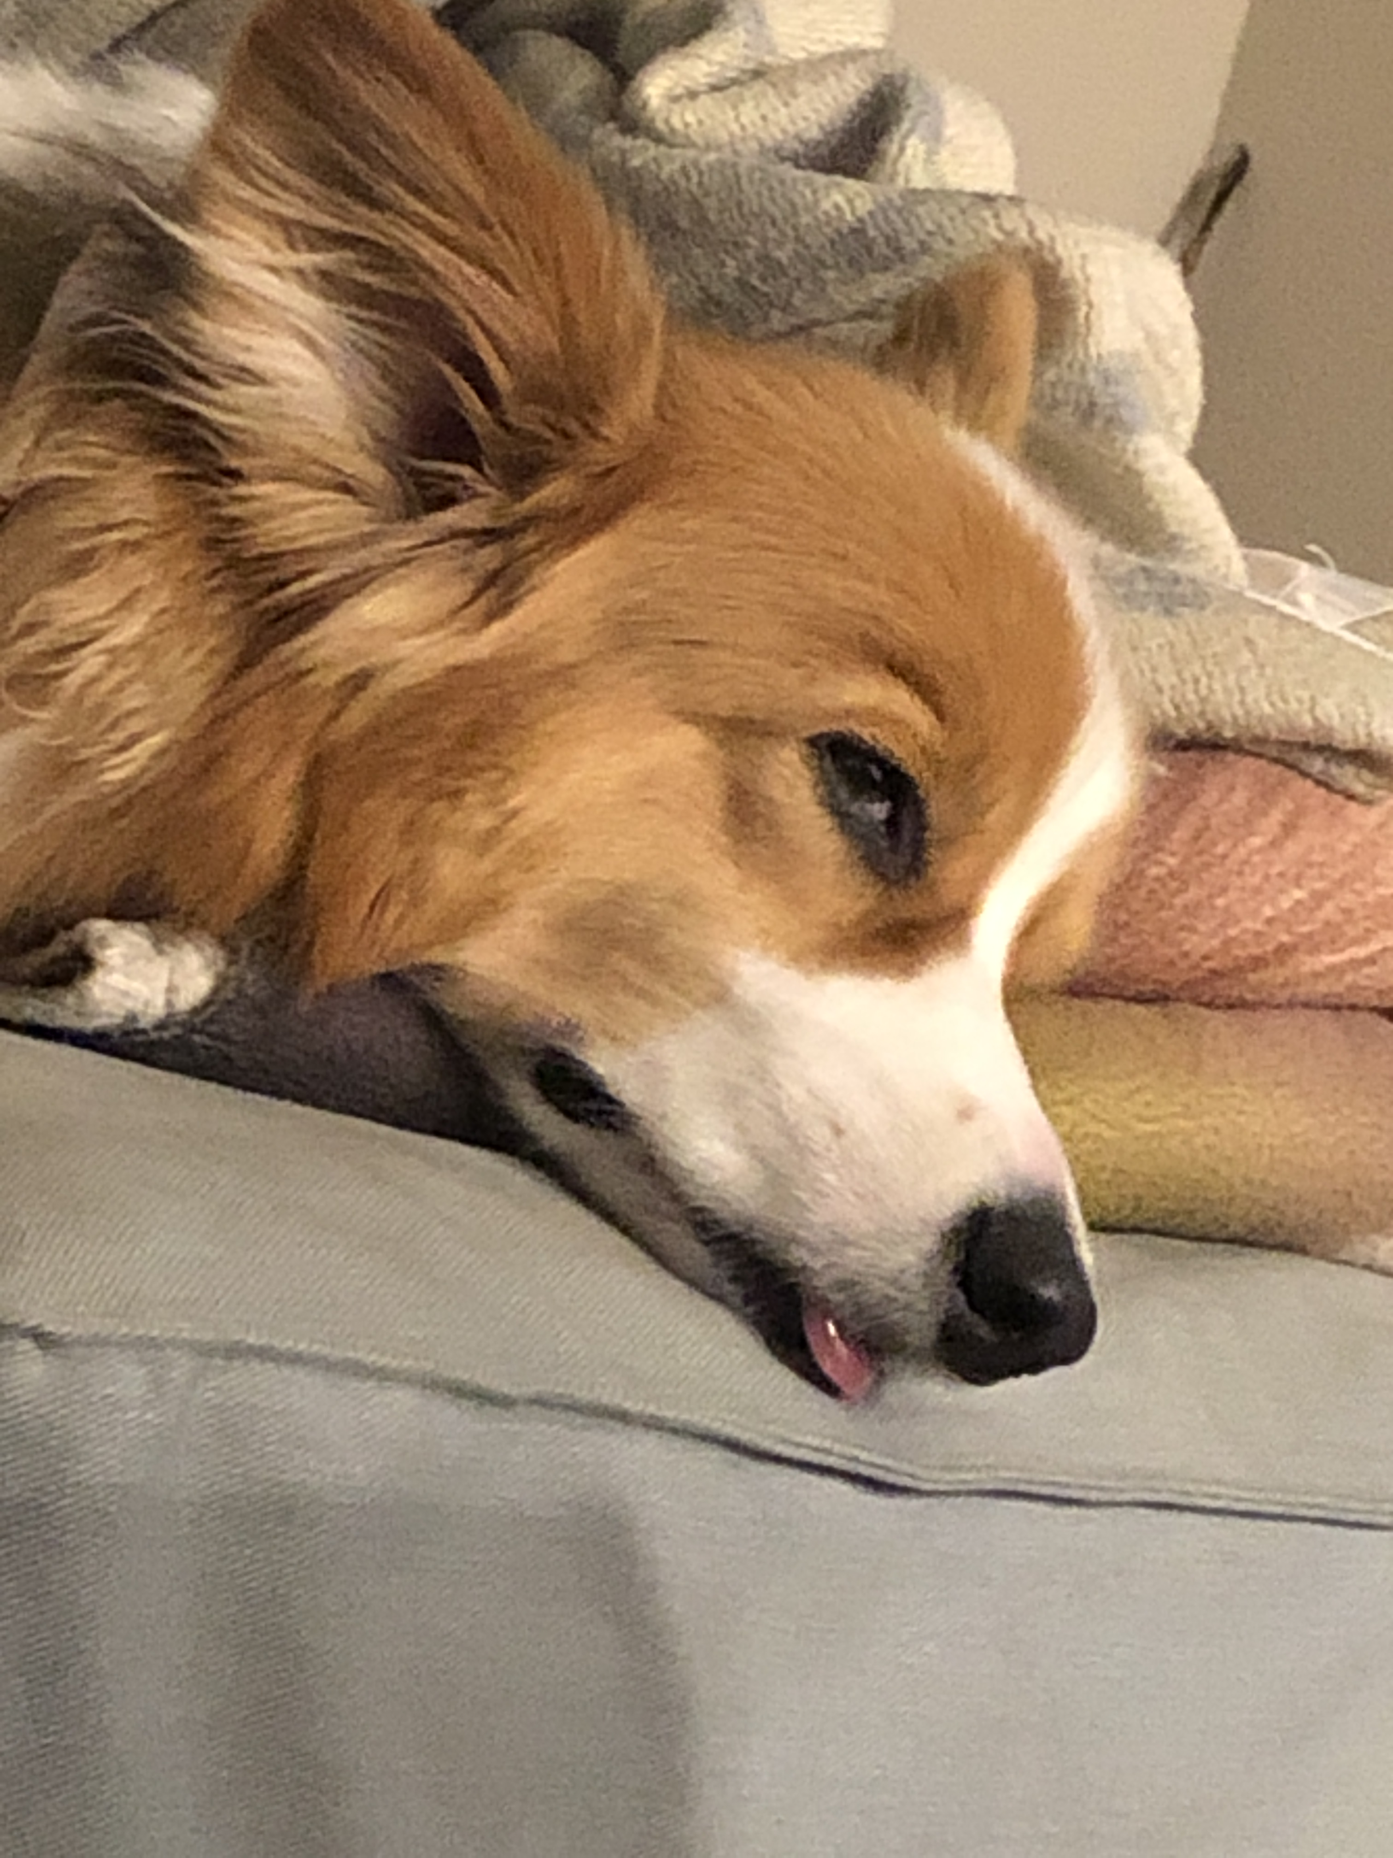
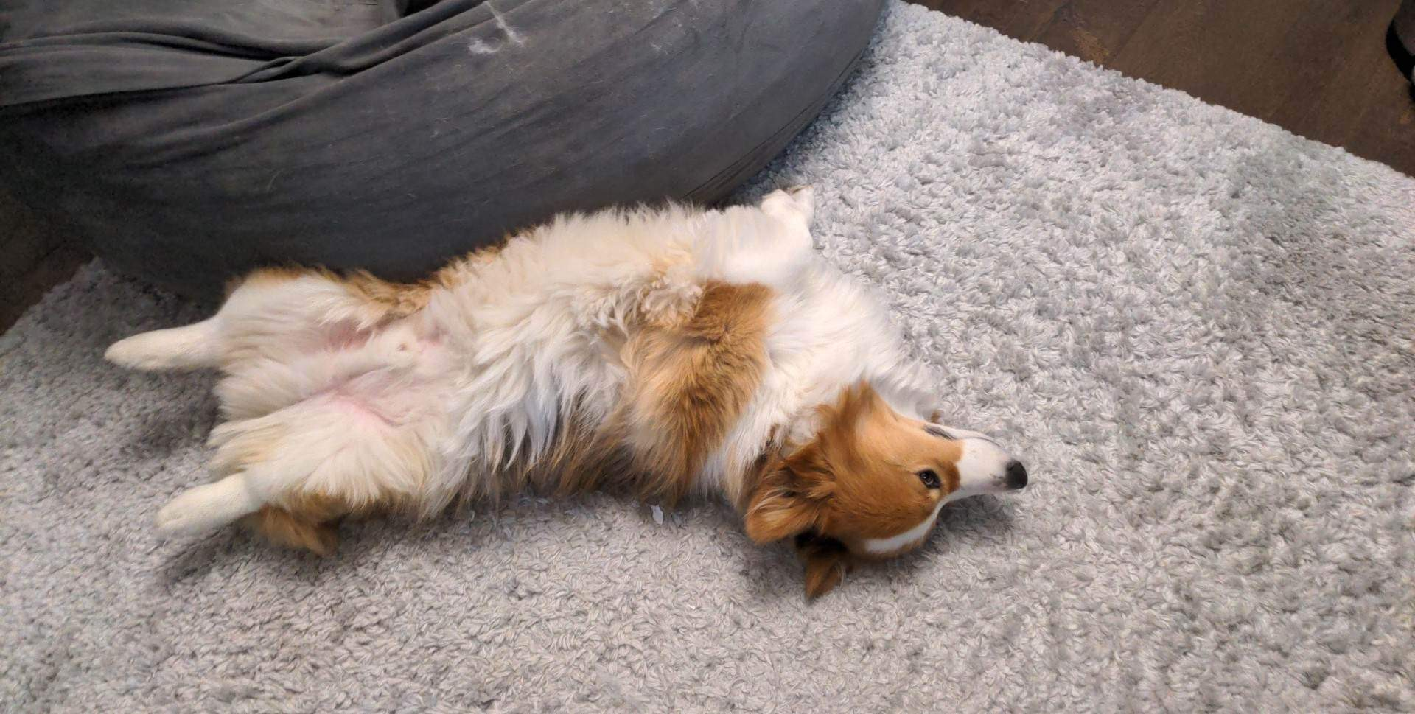
Interlude: Gumball

Slide 23
(PCM) String Methods Usage: <string variable>.<method>(…)
Method | Description
length() | Returns the length of the string.
charAt(i) | Returns the character at index i of the string
indexOf(s) | Returns the index of the first occurrence of s in the string; returns -1 if s doesn't appear in the string
substring(i, j) or substring(i) | Returns the characters in this string from i (inclusive) to j (exclusive); if j is omitted, goes until the end of the string
contains(s) | Returns whether or not the string contains s
equals(s) | Returns whether or not the string is equal to s (case-sensitive)
equalsIgnoreCase(s) | Returns whether or not the string is equal to s ignoring case
toUpperCase() | Returns an uppercase version of the string
toLowerCase() | Returns a lowercase version of the string
Notes:
Bomb = may get error if indexing int is out of bounds (e.g. negative index, or larger than the length of the string)
Safety guy = should return without error in usual case

Slide 24
Reminders
P0 was released on Wed and is due Tues, Oct 8th
Quiz 0 scheduled for Oct 24th (about 3 weeks away)
Helpful website resources
Grading Rubrics (P0 rubric will be out tonight!)
Ed shortcuts
Search Site button!
Questions? Come to office hours!
today: Matt (12:30-1:20) + IPL until 6:30

