Slide 1
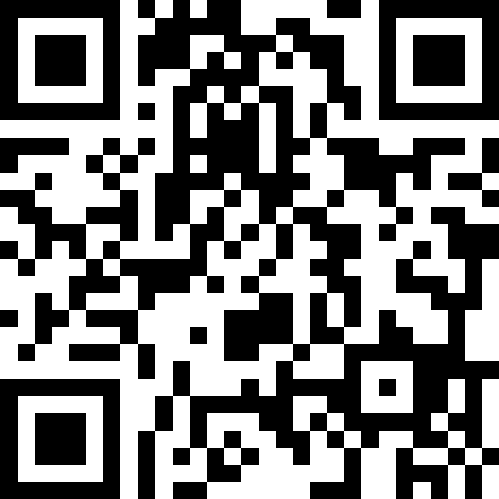
CSE 121 Lesson 19: Final Exam Review & Victory Lap
Matt Wang & Brett Wortzman
Autumn 2024
Abby | Afifah | Ailsa | Alice | Aliyan | Arohan
Chloë | Christopher | Dalton | Derek | Elizabeth | Ethan
Hanna | Hannah | Heather | Hibbah | Janvi | Jasmine
Judy | Julia | Kelsey | Lucas | Luke | Mahima
Maitreyi | Maria | Merav | Minh | Neha | Ronald
Ruslana | Sahej | Sam | Samrutha | Sushma | Vivian
Yijia | Zachary
TAs:
sli.do #cse121
Today’s playlist: 121 24au lecture tunes

Slide 2
Announcements, Reminders
R7 (+ extra resub) due Thu, Dec 12th – all assignments eligible!
today is the last day for IPL + instructor office hours
Final Exam: Wednesday, Dec 11th from 12:30-2:20 in KNE 120 + 130
TA-led Review Session: Monday, Dec 9th from 2:30-4:00 in SMI 120
other exam reminders:
please look at seating charts and let us know ASAP if you’re not there!
review Exam page of website (which includes many resources)

Slide 3
Evaluations and Awards
Please give us feedback!
Course Evals are due Sunday, Dec 8th at 11:59 PM
A Section evaluation link
B Section evaluation link
TA Evals are also due Sunday, Dec 8th at 11:59 PM
Bob Bandes TA Award nominations open! (nominate your fave TAs!)

Slide 4
Exam Review Preamble
Acknowledging: live exam review can be stressful (and feel rushed)!
Today’s goal:
practicing a strategy for starting a programming problem
not writing code (though, I’ll do a bit of that anyways)
I’ll give you about 5 minutes with a spec: all I want you to think about is how you’d solve this problem. Do not write any code!

Slide 5
Applications of CS
or “What can I do with what I learned?” – outside of just “write code”:
Detect and prevent toxicity online & recognize disinformation
Help deaf & hard-of-hearing people identify sounds
Develop a programming language that celebrates the world’s languages
Build battery-free robots & put them on insects (and... track murder hornets?)
Computational knitting & carpentry
Create an interactive atlas of millions of refugee experiences
Fix Olympic badminton & identify cheating in chess
and so much more!

Slide 6
… including your projects! (1/2)
Computational Biology & Medicine (P2, P3)
fun fact: Matt did some DNA sequencing (P3+++) in grad school at UCLA!
at UW: Chris Thachuk, Linda Shapiro, Sara Mostafavi, Su-In Lee; BIME & Med!
Computational Art (C0, C1)
UW CSE has many unique intersections of CS + art!
e.g. “Cultural-Centric Computational Embroidery” (CSE + iSchool)
e.g. “Computational Illusion Knitting” and “How to Knit Objects Weird” (CSE)
e.g. “WasteBanned: Supporting zero waste fashion design” (CSE)

Slide 7
… including your projects! (2/2)
Games & Graphics (C1, C3):
at UW: many labs in CSE and iSchool’s GAMER group
fun fact: Foldit (from UW) is a crowd-sourced game for protein folding!
David Baker shared this year’s Nobel Prize in Chemistry, in part for this work!
Social Computing (P1, C2):
at UW: Amy Zhang’s Social Futures Lab + so much of iSchool!
and many side quests (in lecture, section, PCM): accessibility (e.g. UW CREATE), weather forecasting, chatbots, software tools, and lots of math

Slide 8
“Closing” the loop on P3 reflections (1/x)
Y’all listed many other applications of CS too! Some common themes:
environmental and climate science
this is a fascinating and important topic – especially with AI & e-waste
history & archaeology
spicy: the Vesuvius challenge (reconstruct scrolls from volcanic remains)
astronomy and astrophysics
how did we take a picture of a black hole? (see: Katie Bouman!)
sports analytics
particularly famously, baseball & sabermetrics

Slide 9
“Closing” the loop on P3 reflections (2/x)
“For example, computer science is used in Charli XCX's "Brat" because there is a substantial amount of autotune involved in the album. Computer science is used in mixing new sounds and using the recorded audio to generate an auto-tuned version of the song.”
CS + music is actually huge and very fascinating – Matt’s first-ever internship was implementing audio processing filters. Super cool!!

Slide 10
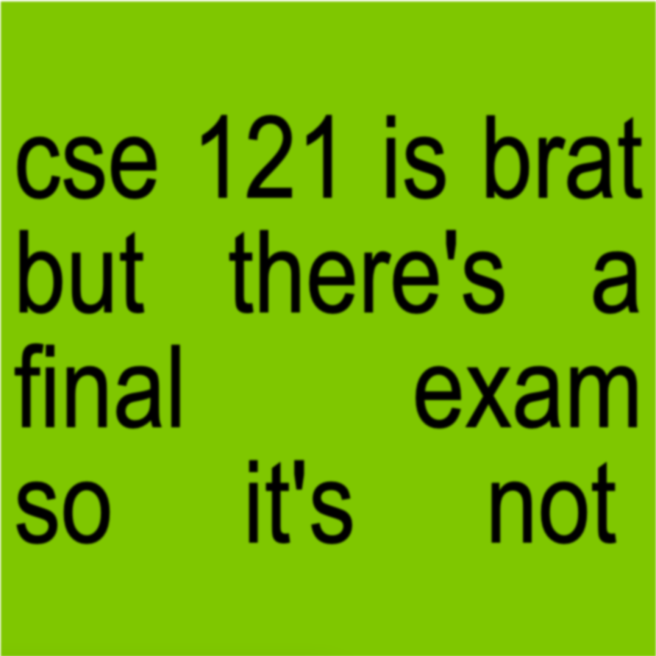
CSE 121 is Brat :)

Slide 11
“Closing” the loop on P3 reflections (3/x)
We also asked you to reflect on your journey learning CS!
Impossible to adequately summarize them all, but the biggest theme was combating myths about computer science:
what programming & computer science is
what makes computer science hard (it’s not just syntax!!)
what you need to be a “good” programmer (not always math!!)
what programmers & computer scientists look like
that one bad experience means you’ll always be bad at it

Slide 12
“Closing” the loop on P3 reflections (4/x)
We also chuckled at some of your answers:
“I thought computer science would be really boring and I did not want to take it, but it was required for my degree.
… However, after being in this course and having amazing professors who made it more fun, I think computer science is a lot more fun.”

Slide 13
“Closing” the loop on P3 reflections (5/x)
“pretty rad, W TA's”
“it was nice. it made me stay up some nights and dream about the solution to some projects (also known as nightmares)”
“… from creating art, to helping patients, and unsuccessfully trying to get Matt Laufey tickets, this class demonstrates everyday uses for computer science."

Slide 14
“Closing” the loop on P3 reflections (6/x)
“Had a good time, assignments are genuinely fun to do, professors are fun people as well. Easy to talk to. Surprisingly, not scary.”
“The professors and the TAs [..] looked like they wanted to be there, which is appreciated when I really didn't want to go to class or was unmotivated to finish my homework and I could just imagine Matt being all sad.”
“sad to say goodbye to matt and brett, but i will never forget this! o7"

Slide 15
Future Courses
More 12X!
Course | Overview
CSE 122 | Introduction to Computer Programming II
CSE 123 | Introduction to Computer Programming III
or “What can I do next?”
Non-majors
Course | Overview
CSE 154 | Intro. to web programming (several languages)
CSE 160 | Intro programming, data analysis (Python)
CSE 163 | Intermediate programming, data analysis (Python)
CSE 180 | Introduction to data science (Python)
CSE 373 | Data structures and algorithms (in Java)
CSE 374 | Low-level programming and tools (C/C++)
CSE 412 | Intro to Data Visualization
CSE 416 | Intro. to Machine Learning
Majors
Course | Overview
CSE 311 | Mathematical foundations
CSE 331 | Software design/implementation
CSE 340 | Interaction programming (mobile apps)
CSE 341 | Programming languages (!!)
CSE 351 | Low-level computer organization/abstraction
Other tech-related majors: Informatics, ACMS, HCDE, Electrical & Computer Engineering, …
See: https://www.cs.washington.edu/academics/ugrad/current-students and https://www.cs.washington.edu/academics/ugrad/nonmajor-options/nonmajor-courses

Slide 16
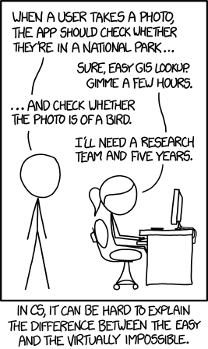
Frequently Asked Questions
How can I get better at programming?
Practice!
How can I learn to X?
Search online, read books, look at examples :)
What should I work on next?
Anything you can think of! (Here are some ideas)
Beware: it’s hard to tell what’s easy and what’s hard.
Should I learn another language? Which one?
That depends–what do you want to do?
What’s the best programming language?
😠 (take CSE 341 or CSE 413)

Slide 17
Aside: Cute Programming Language Logos

Slide 18
Winter Project: Tic Tac Toe (1/2)
Build your own Tic Tac Toe game and “AI”! (one of the TA’s choice ideas)
How would you represent a Tic Tac Toe game in Java? (hint: arrays will be very, very helpful!)
Write a method that tells you if a Tic Tac Toe game is won (or playable).
Write a method that gets input from the user and “makes” a move.
Wrap it all up – into a nice two-player game!

Slide 19
Winter Project: Tic Tac Toe (2/2)
Wait, there’s more!
Make some “AI” that…
just makes a random valid move (you should be able to beat this!)
tries to make a “good” move (~ some if statements)
never loses
Tic Tac Toe is a “solved game”: a perfect player will never lose.
Or, extend this idea to other grid-based games!
similar-ish: connect four, checkers, battleship
much harder: sudoku, chess, go, othello

Slide 20
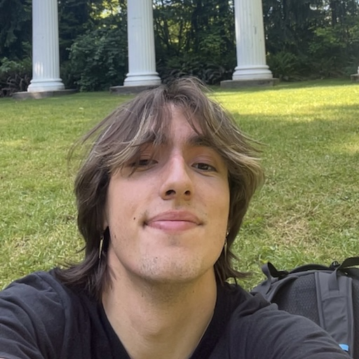
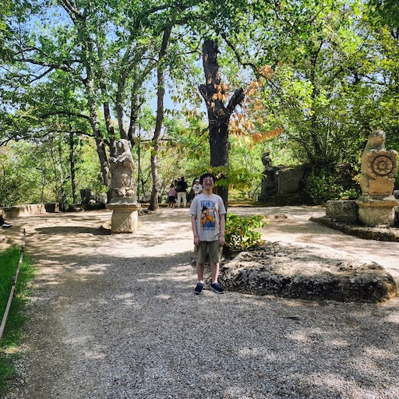
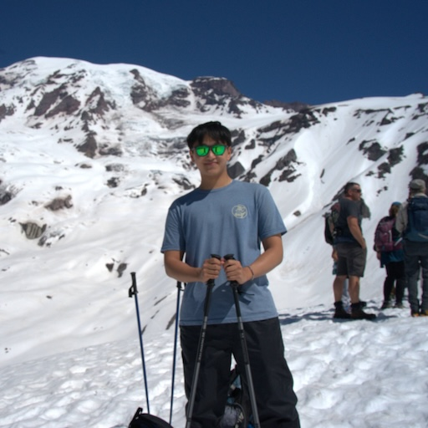
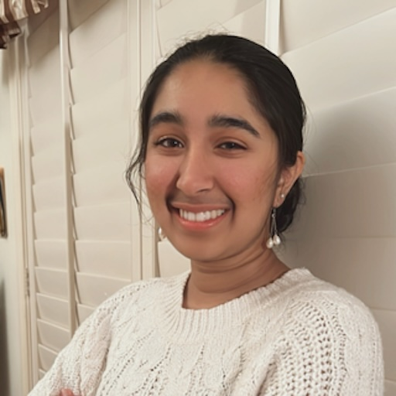
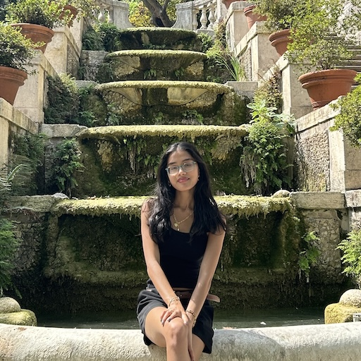
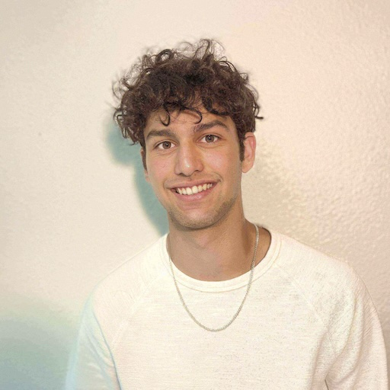
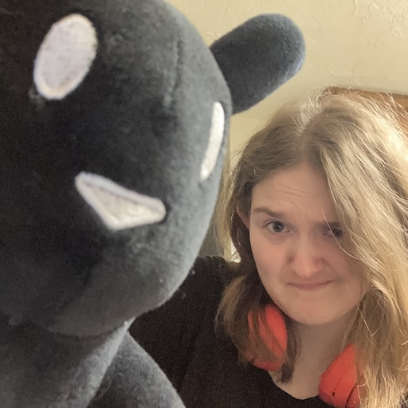
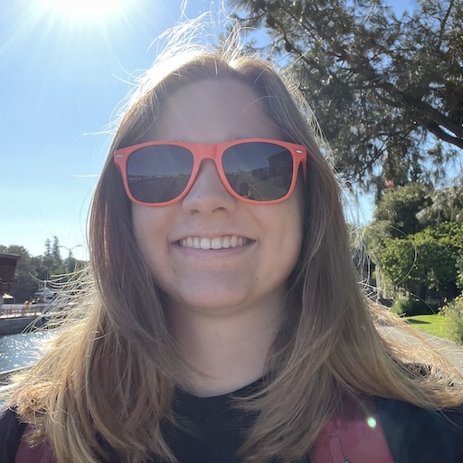
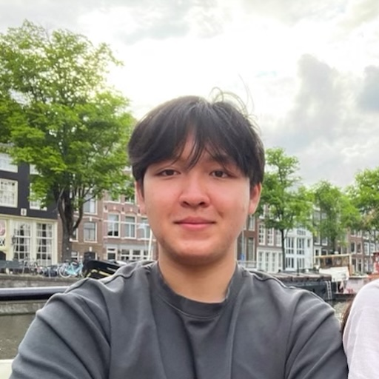
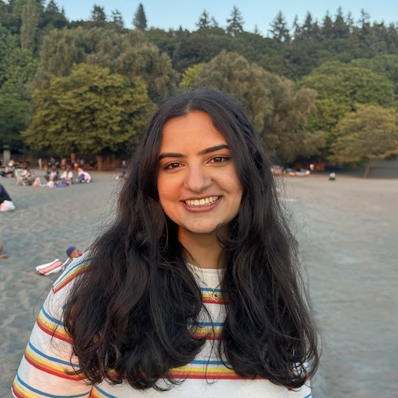
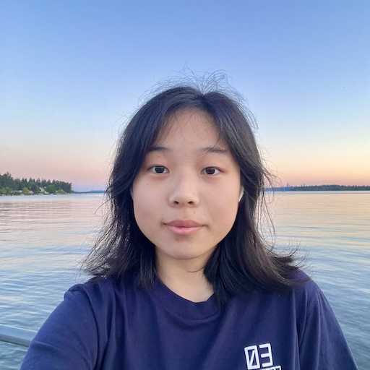
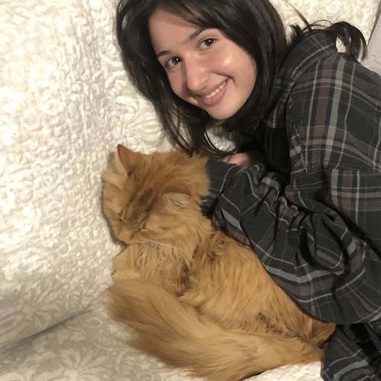
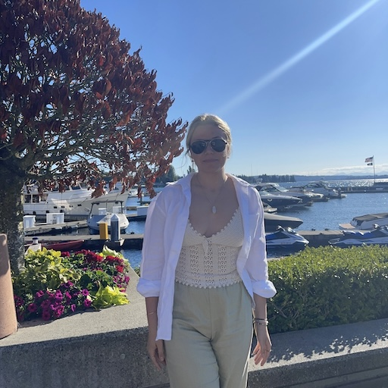
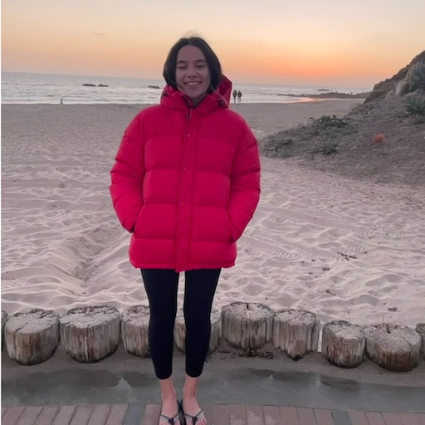
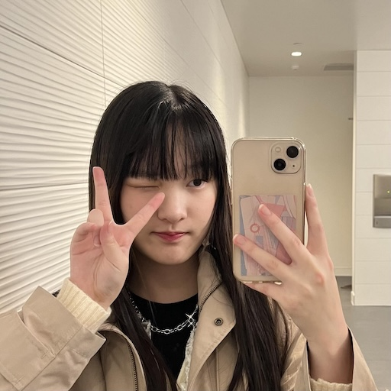
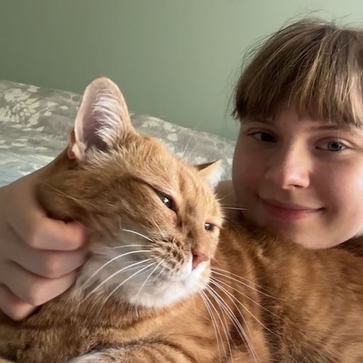
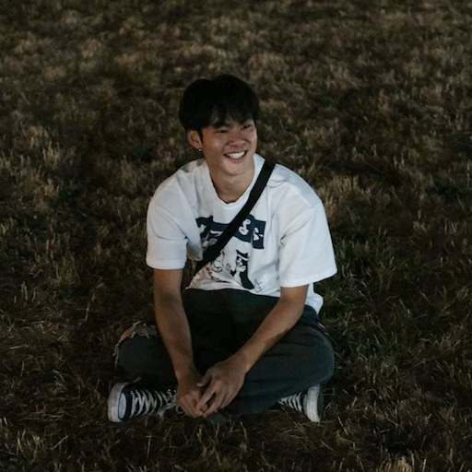
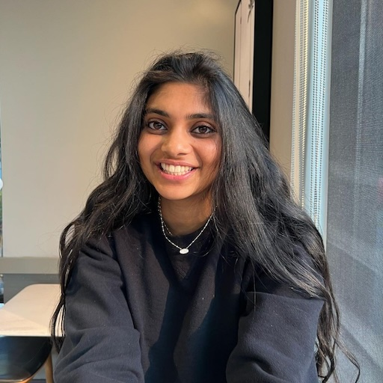
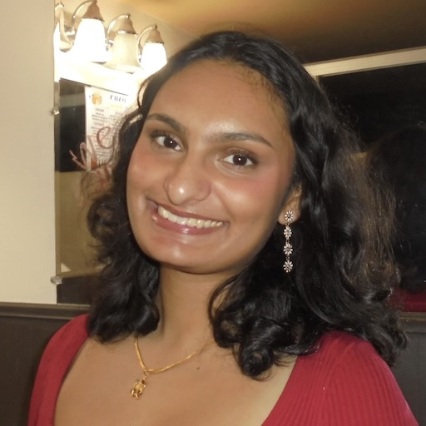
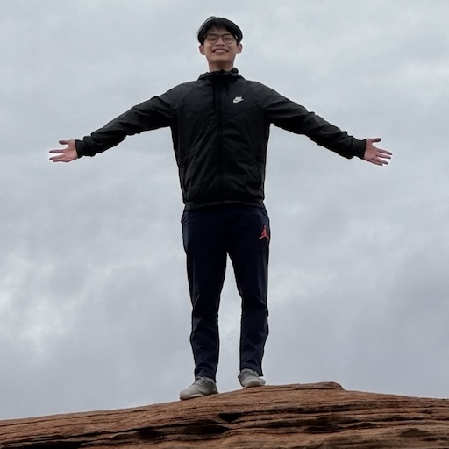
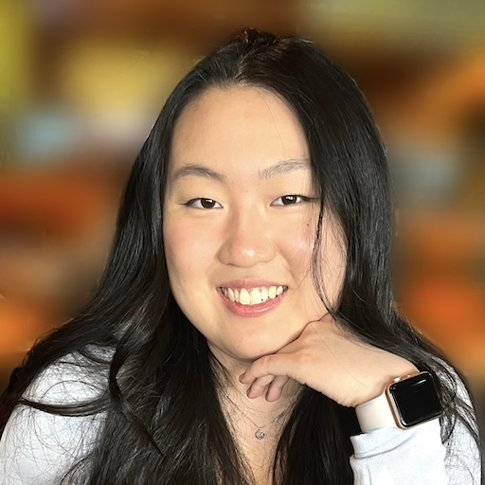
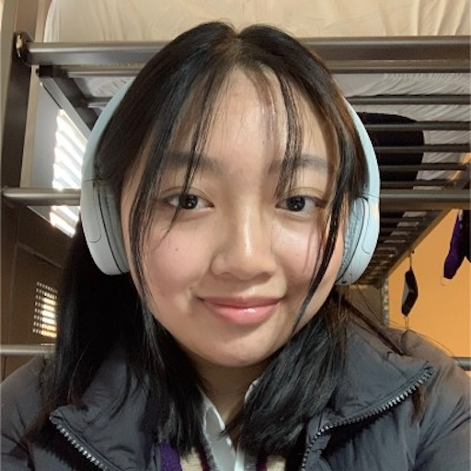
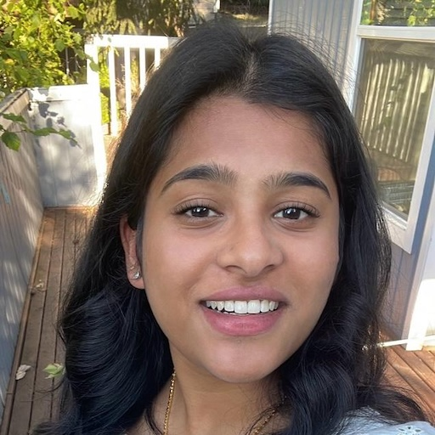
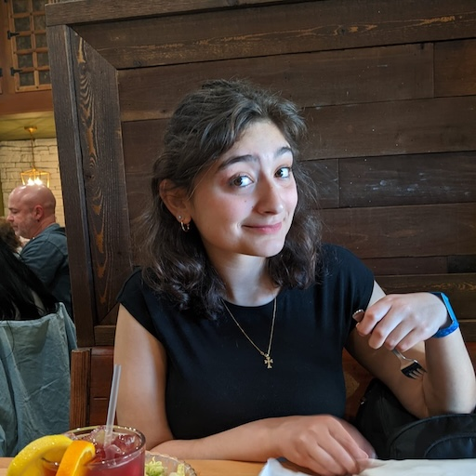
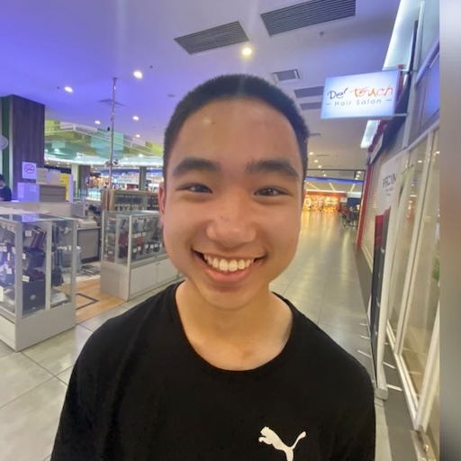
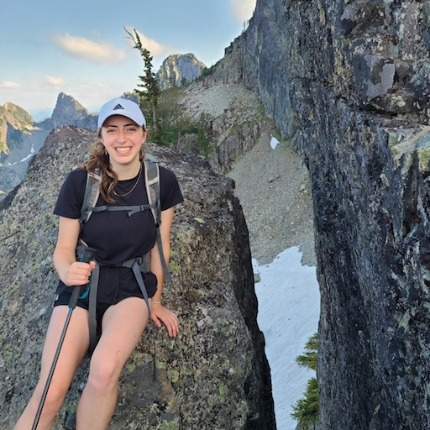
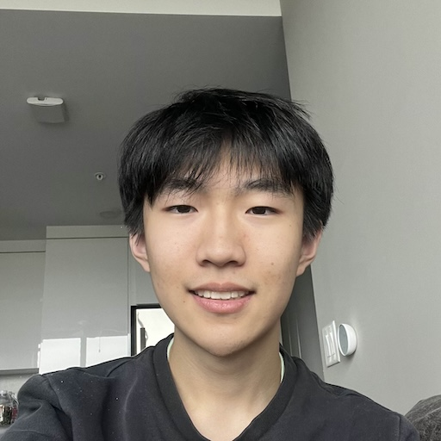
Thank your lovely TAs!!!!!!

Slide 21
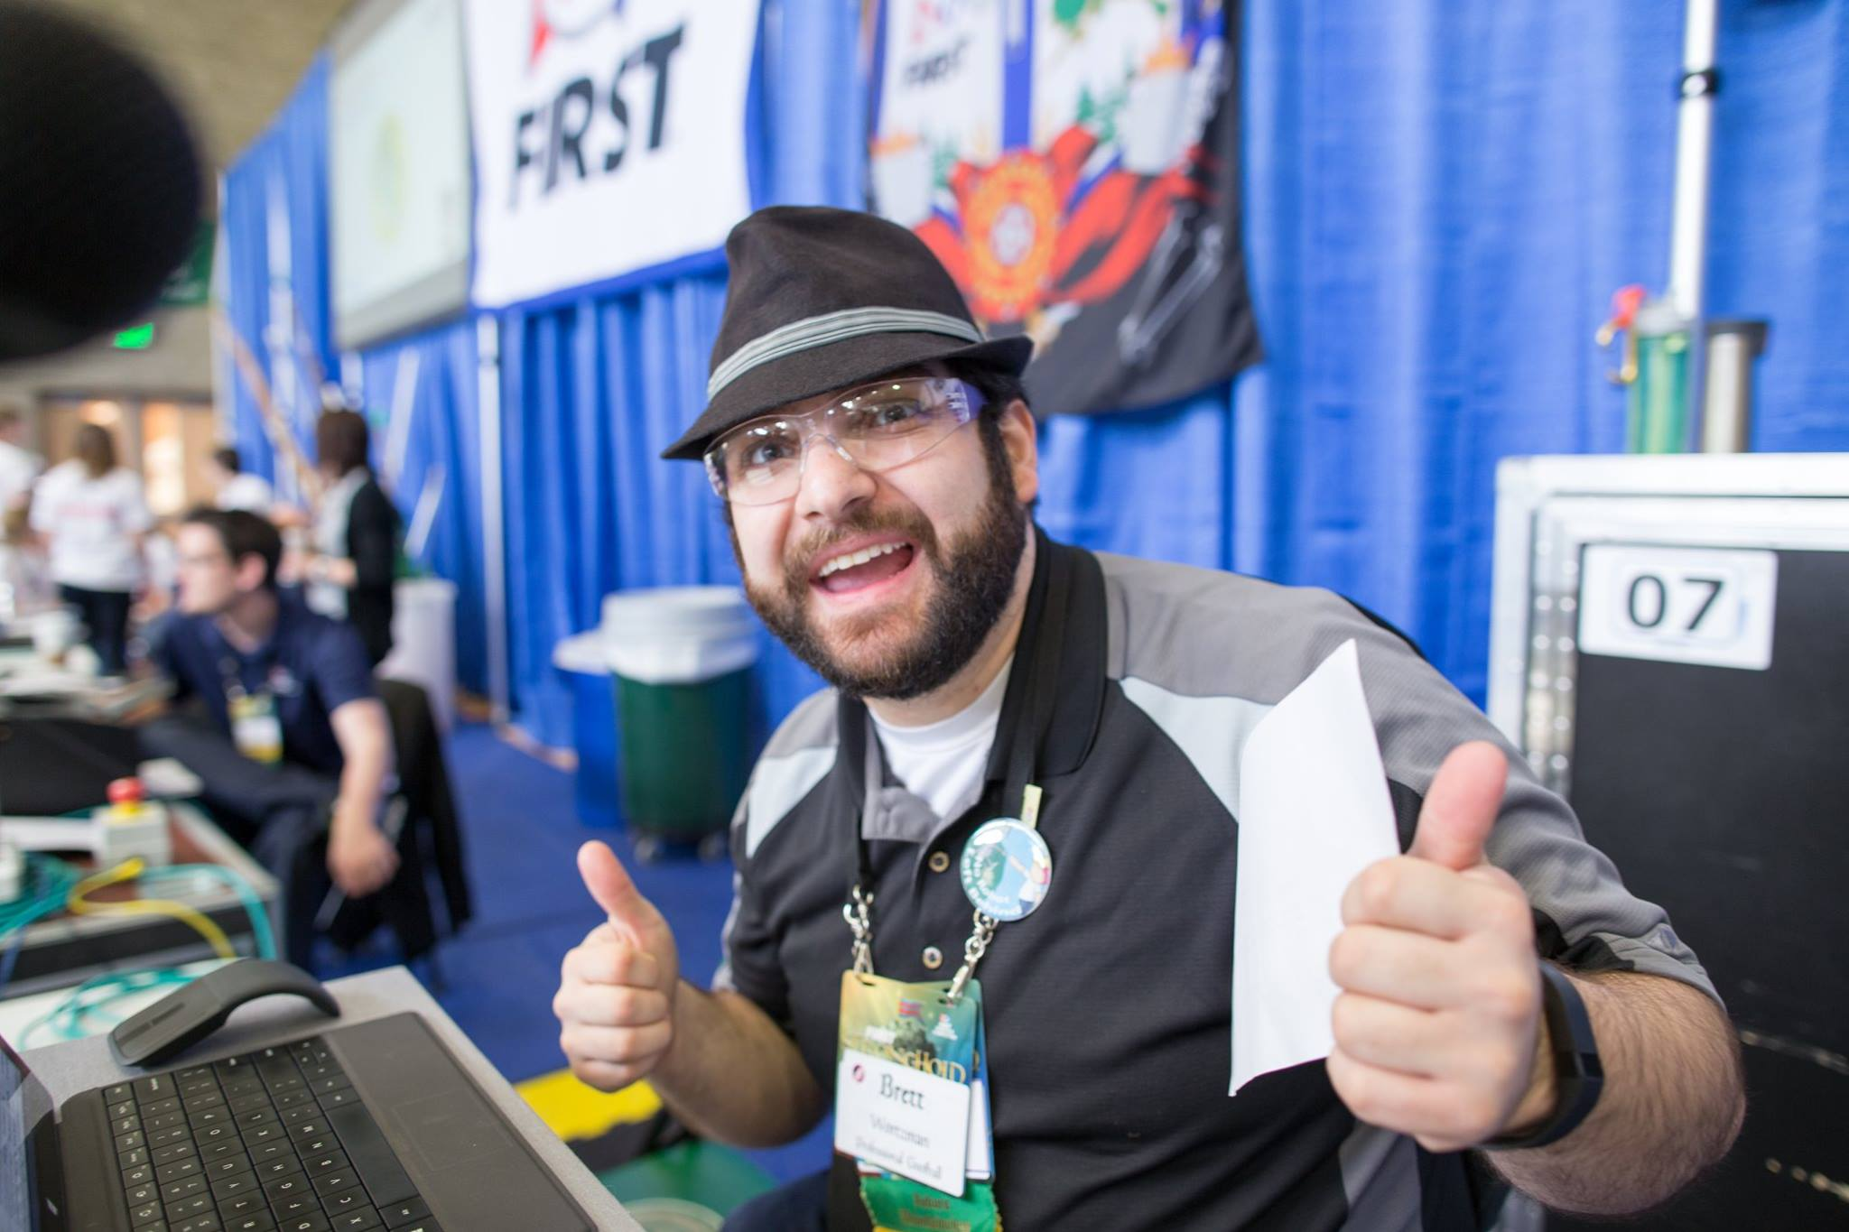
Thank you!
Ask Us (Almost) Anything!
sli.do #cse121

