Slide 1
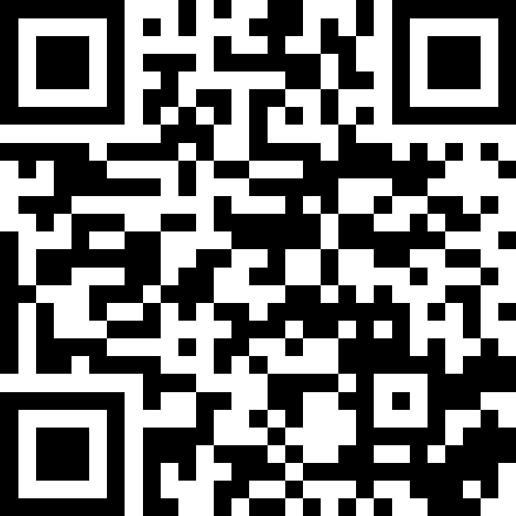
CSE 121 Lesson 18: Final Exam Review (Part 1)
Matt Wang & Brett Wortzman
(& Alice & Ronald?!)
Autumn 2024
Abby | Afifah | Ailsa | Alice | Aliyan | Arohan
Chloë | Christopher | Dalton | Derek | Elizabeth | Ethan
Hanna | Hannah | Heather | Hibbah | Janvi | Jasmine
Judy | Julia | Kelsey | Lucas | Luke | Mahima
Maitreyi | Maria | Merav | Minh | Neha | Ronald
Ruslana | Sahej | Sam | Samrutha | Sushma | Vivian
Yijia | Zachary
TAs:
sli.do #cse121
Today’s playlist: 121 24au lecture tunes

Slide 2
Announcements, Reminders
P3 and R6 due tomorrow (Thursday, Dec 5th)
R7 out tomorrow, due Thursday, Dec 12th — all assignments eligible
Extra resub (if you have it) is also due Thursday, Dec 12th
IPL closes Friday, Dec 6th
My (Matt’s) last office hour is also Friday, Dec 6th
:’)
We will send a mega-announcement on Ed with all these details & even more – please keep an eye out for it!

Slide 3
More on the Exam
Final Exam: Wednesday, June 5th from 2:30-4:20 in KNE 120 and 130
new: KNE 120 (right next door). sorry for the confusion! seating charts soon!
Practice resource reminder
Exam page of course website (including rules & practice resources)
Exam Resource Bank – summarizing review for all topics on exam
Also see: TA-written exam tips page!
TA-led Review Session: details TBD (live + recorded)
split into doing a practice final and going over strategies & solutions
will post on Ed once we know more details

Slide 4
Pause - Foreshadowing
Later today, we will do 1-2 exam review problems together, on paper.
If you don’t have scratch paper, please raise your hand now; a TA will give you some over the next 5 or so minutes.

Slide 5
In reading P2 reflections…
We loved reading your P2 reflections!!! Some neat points I saw:
general consensus to disregard insurance
'… the assignment is called "prioritizing patients", not "maximizing profits"'
disagreement on how we should zip codes, if at all!
some said: don’t discriminate based on location (or proxies for wealth)
others said: important context (e.g. logistics, or supporting rural patients)
many great suggestions on what to change/include
e.g. prior conditions, disability status, family history, healthcare availability
also: reweighting/grading existing parameters (e.g. pain level and age)

Slide 6
…and C3 reflections!
So many lovely reflections on accessibility (and awesome extensions)
Synthesizing some summaries serendipitously:
disability is a wide spectrum
many mentioned not previously thinking about cognitive disabilities
“a-ha!” moments with color blindness/vision deficiencies (>4% of people!)
accessibility helps everyone (e.g. subtitles, graphics options)
with what we know now, it’d be hard to make our C3 accessible!
Many also said they had lots of fun :))

Slide 7
A broader takeaway
Some themes underlying P2 & C3’s reflections (and more!):
Technology is not separate from people – or issues people face!
Solving these issues is hard!
many issues don’t have straightforward resolutions, e.g. in P2
many issues are technically challenging, e.g. in C3
First step is starting the conversation, but it’s not the last.
We’ll talk quite a bit more about “what’s next” on Friday!

Slide 8
Evaluations and Awards
I hope I’ve convinced you … we read everything you write!!
Please give us feedback!
Course Evals are due Sunday, Dec 8th at 11:59 PM
TA Evals are also due Sunday, Dec 8th at 11:59 PM
Feedback is incredibly helpful – especially as Matt will do 121 in 25wi!
Bob Bandes TA Award nominations open!
thought your TA was the goat? write them a short nomination!!
fun fact: one of our current TAs won the award last year!! (>260 TAs!)
fun fact 2: some of our faculty won the award when they were TAs

Slide 9
TA-led Final Exam Review: Ronald!
"Hello!!!! I’ve been TA’ing since I was a freshman, and I’m very happy to be on the 121 team this quarter. Interests: tennis, volleyball, baking, cooking, guitar, singing, photography, machine learning (esp computer vision), video games + probably some that I missed.
According to y’all (in the IPL):
“helped me understand how to change a double to an int in a very helpful way”
“Explained all concepts very well!”
“I was able to get good information on how to work on debugging”

