Slide 1
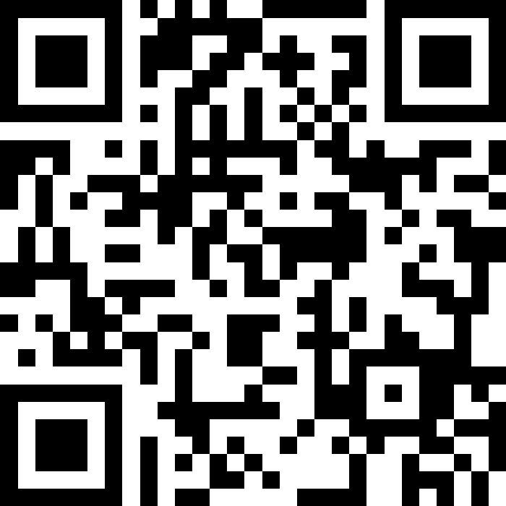
CSE 121 Lesson 17: Putting It Even More Together
Matt Wang & Brett Wortzman
Autumn 2024
Abby | Afifah | Ailsa | Alice | Aliyan | Arohan
Chloë | Christopher | Dalton | Derek | Elizabeth | Ethan
Hanna | Hannah | Heather | Hibbah | Janvi | Jasmine
Judy | Julia | Kelsey | Lucas | Luke | Mahima
Maitreyi | Maria | Merav | Minh | Neha | Ronald
Ruslana | Sahej | Sam | Samrutha | Sushma | Vivian
Yijia | Zachary
TAs:
sli.do #cse121
Today’s playlist: 121 24au lecture tunes

Slide 2
Announcements & Reminders
P3 due Tuesday, Dec 3rd at 11:59pm
note: we will only be able to give you feedback after R7 is due
R6 released, due Thursday, Dec 5th at 11:59pm
new: all assignments will be eligible for resubmission on R7!
Scheduling shenanigans for next week…
No CSE 121 lectures or quiz sections
Matt will still have M (in-person) & W (hybrid) office hours!
Brett will not have office hours
IPL open on Mon & Tue (same schedule, reduced # of TAs), closed on Wed

Slide 3
Final Exam Details (1/2)
Final Exam: Wednesday, December 11th from 12:30-2:20 in KNE 130*
In-person, on paper, with assigned seating
No collaboration – should be completed individually
Not open book
We will provide you one “reference sheet”, and
You may bring one 8.5x11-inch page of notes, handwritten or typed, double-sided
Will have 6 problems, all similar in style to the quizzes
Focus is on behavior (not code style) – minor syntax errors are allowed

Slide 4
Final Exam Details (2/2)
Last week will be focused on Final Exam review and preparation
Many resources will be available, including:
dedicated lecture time for final exam review!
dedicated section time for final exam review!
multiple previous actual finals + practice finals
final exam review session (details TBD)
IPL will not be open during finals week, so plan ahead!
Will follow up with an Ed announcement (+ resource bank)
Let’s look at the website page now :)

Slide 5
(2D)ays Above Average: readData()
How many days' data would you like to input? 3
Next day's data:
Temperature in Seattle? 44
Temperature in Tacoma? 40
Temperature in Bothell? 43
Next day's data:
Temperature in Seattle? 42
Temperature in Tacoma? 40
Temperature in Bothell? 44
Next day's data:
Temperature in Seattle? 42
Temperature in Tacoma? 41
Temperature in Bothell? 43
…
 | Seattle | Tacoma | Bothell
1 | 44 | 40 | 43
2 | 42 | 40 | 44
3 | 42 | 41 | 43

Slide 6
(2D)ays Above Average: computeAverages()
How many days' data would you like to input? 3
…
The average values for each location were [42.666666666666664, 40.333333333333336, 43.333333333333336]
 | Seattle | Tacoma | Bothell
1 | 44 | 40 | 43
2 | 42 | 40 | 44
3 | 42 | 41 | 43
42.667 | 40.333 | 43.333
Average of Seattle temperatures
(44 + 42 + 42) / 3

Slide 7
Ed time :)
(for those looking at just the slides – the rest of this lecture was doing the in-class lesson!)

