Slide 1
CSE 121 Lesson 15: 2D Arrays
Matt Wang & Brett Wortzman
Autumn 2024
Abby | Afifah | Ailsa | Alice | Aliyan | Arohan
Chloë | Christopher | Dalton | Derek | Elizabeth | Ethan
Hanna | Hannah | Heather | Hibbah | Janvi | Jasmine
Judy | Julia | Kelsey | Lucas | Luke | Mahima
Maitreyi | Maria | Merav | Minh | Neha | Ronald
Ruslana | Sahej | Sam | Samrutha | Sushma | Vivian
Yijia | Zachary
TAs:
sli.do #cse121
Today’s playlist: 121 24au lecture tunes

Slide 2
Announcements, Reminders
C3 released Wednesday, due Tuesday, November 19th
R5 released yesterday, due Thursday, November 21st
last chance for P1
Quiz 2 next Thursday, November 21st
topics: everything up until Wednesday (i.e. not today’s material)
next Wednesday’s PCM + class is secretly quiz prep :)
practice quizzes :)
Ed post on post-section work’s extra resub today!
more logistics on final next Friday (after Quiz 2)!

Slide 3
(PCM) 2D Arrays (1/3)
An array of arrays!
The ElementType of the array is another array itself!
Your first example of “nested data structures”
There will be more in CSE 122!
int[][]
String[][]
double[][]
boolean[][]
char[][]

Slide 4
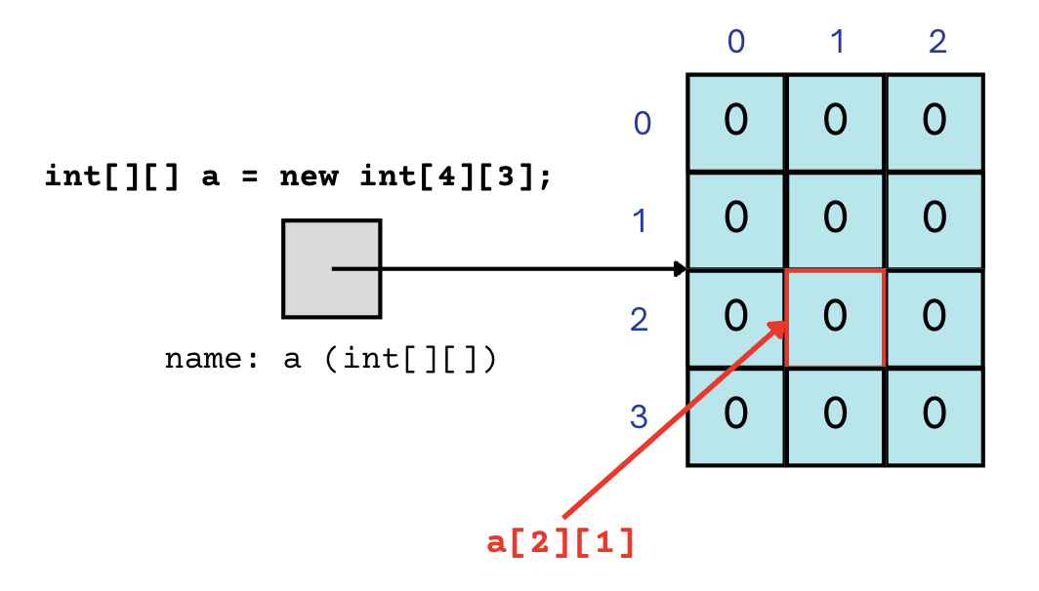
(PCM) 2D Arrays (2/3)
An array of arrays!
The two dimensions are “rows” and “columns”
0
1
2
0
int[] a = new int[4][3];
1
2
3

Slide 5
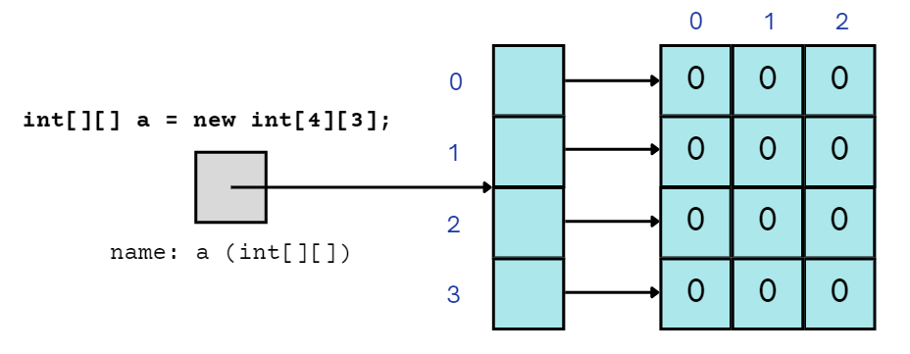
(PCM) 2D Arrays (3/3)
A slightly more accurate view…
reference semantics
0
1
2
0
int[] a = new int[4][3];
1
2
3

Slide 6
(PCM) 2D Array Traversals
for each row…
for (int i = 0; i < list.length; i++) {
for (int j = 0; j < list[i].length; j++) {
// do something with list[i][j]
}
}
for each element within a row…

Slide 7
Arrays Utility Class
Method | Description
Arrays.toString(array); | Returns a String representing the array, such as "[10, 30, -25, 17]"
Arrays.equals(array1, array2); | Returns true if the two arrays contain the same elements in the same order
Arrays.deepToString(array); | Returns a String representing the array; if the array contains other arrays as elements, the String represents their contents, and so on. For example, "[[99, 151], [30, 5]]"
Arrays.deepEquals(array1, array2); | Returns true if the two arrays contain the same elements in the same order; if the array(s) contain other arrays as elements, their contents are tested for equality, and so on.

Slide 8
Applications of 2D Arrays
Matrices
Useful in various applications requiring complex math!
Fundamental to machine learning & AI
P3 is a real-life application of this!
Board games
e.g., chess/checkerboard, tic tac toe, sudoku
Representing information in a grid or table
e.g., scorekeeping, gradebook, census data
Image processing

Slide 9
matrixAdd
23 | 96 | 18 | 4 | 64
45 | 40 | 18 | 44 | 34
92 | 13 | 77 | 71 | 12
93 | 169 | 84 | 83 | 103
136 | 115 | 91 | 143 | 81
119 | 77 | 98 | 105 | 13
70 | 73 | 66 | 79 | 39
91 | 75 | 73 | 99 | 47
27 | 64 | 21 | 34 | 1

Slide 10
matrixAdd
23 | 96 | 18 | 4 | 64
45 | 40 | 18 | 44 | 34
92 | 13 | 77 | 71 | 12
i: 0
j: 0
93 | 169 | 84 | 83 | 103
136 | 115 | 91 | 143 | 81
119 | 77 | 98 | 105 | 13
70 | 73 | 66 | 79 | 39
91 | 75 | 73 | 99 | 47
27 | 64 | 21 | 34 | 1

Slide 11
matrixAdd
23 | 96 | 18 | 4 | 64
45 | 40 | 18 | 44 | 34
92 | 13 | 77 | 71 | 12
i: 0
j: 0
93 | 169 | 84 | 83 | 103
136 | 115 | 91 | 143 | 81
119 | 77 | 98 | 105 | 13
70 | 73 | 66 | 79 | 39
91 | 75 | 73 | 99 | 47
27 | 64 | 21 | 34 | 1

Slide 12
matrixAdd
23 | 96 | 18 | 4 | 64
45 | 40 | 18 | 44 | 34
92 | 13 | 77 | 71 | 12
i: 0
j: 1
93 | 169 | 84 | 83 | 103
136 | 115 | 91 | 143 | 81
119 | 77 | 98 | 105 | 13
70 | 73 | 66 | 79 | 39
91 | 75 | 73 | 99 | 47
27 | 64 | 21 | 34 | 1

Slide 13
matrixAdd
23 | 96 | 18 | 4 | 64
45 | 40 | 18 | 44 | 34
92 | 13 | 77 | 71 | 12
i: 0
j: 2
93 | 169 | 84 | 83 | 103
136 | 115 | 91 | 143 | 81
119 | 77 | 98 | 105 | 13
70 | 73 | 66 | 79 | 39
91 | 75 | 73 | 99 | 47
27 | 64 | 21 | 34 | 1

Slide 14
matrixAdd
23 | 96 | 18 | 4 | 64
45 | 40 | 18 | 44 | 34
92 | 13 | 77 | 71 | 12
i: 0
j: 3
93 | 169 | 84 | 83 | 103
136 | 115 | 91 | 143 | 81
119 | 77 | 98 | 105 | 13
70 | 73 | 66 | 79 | 39
91 | 75 | 73 | 99 | 47
27 | 64 | 21 | 34 | 1

Slide 15
matrixAdd
23 | 96 | 18 | 4 | 64
45 | 40 | 18 | 44 | 34
92 | 13 | 77 | 71 | 12
i: 0
j: 4
93 | 169 | 84 | 83 | 103
136 | 115 | 91 | 143 | 81
119 | 77 | 98 | 105 | 13
70 | 73 | 66 | 79 | 39
91 | 75 | 73 | 99 | 47
27 | 64 | 21 | 34 | 1

Slide 16
matrixAdd
23 | 96 | 18 | 4 | 64
45 | 40 | 18 | 44 | 34
92 | 13 | 77 | 71 | 12
i: 1
j: 0
93 | 169 | 84 | 83 | 103
136 | 115 | 91 | 143 | 81
119 | 77 | 98 | 105 | 13
70 | 73 | 66 | 79 | 39
91 | 75 | 73 | 99 | 47
27 | 64 | 21 | 34 | 1

Slide 17
matrixAdd
23 | 96 | 18 | 4 | 64
45 | 40 | 18 | 44 | 34
92 | 13 | 77 | 71 | 12
i: 1
j: 1
93 | 169 | 84 | 83 | 103
136 | 115 | 91 | 143 | 81
119 | 77 | 98 | 105 | 13
70 | 73 | 66 | 79 | 39
91 | 75 | 73 | 99 | 47
27 | 64 | 21 | 34 | 1

Slide 18
matrixAdd
23 | 96 | 18 | 4 | 64
45 | 40 | 18 | 44 | 34
92 | 13 | 77 | 71 | 12
i: 1
j: 2
93 | 169 | 84 | 83 | 103
136 | 115 | 91 | 143 | 81
119 | 77 | 98 | 105 | 13
70 | 73 | 66 | 79 | 39
91 | 75 | 73 | 99 | 47
27 | 64 | 21 | 34 | 1

Slide 19
matrixAdd
23 | 96 | 18 | 4 | 64
45 | 40 | 18 | 44 | 34
92 | 13 | 77 | 71 | 12
i: 1
j: 3
93 | 169 | 84 | 83 | 103
136 | 115 | 91 | 143 | 81
119 | 77 | 98 | 105 | 13
70 | 73 | 66 | 79 | 39
91 | 75 | 73 | 99 | 47
27 | 64 | 21 | 34 | 1

Slide 20
matrixAdd
23 | 96 | 18 | 4 | 64
45 | 40 | 18 | 44 | 34
92 | 13 | 77 | 71 | 12
i: 1
j: 4
93 | 169 | 84 | 83 | 103
136 | 115 | 91 | 143 | 81
119 | 77 | 98 | 105 | 13
70 | 73 | 66 | 79 | 39
91 | 75 | 73 | 99 | 47
27 | 64 | 21 | 34 | 1

Slide 21
matrixAdd
23 | 96 | 18 | 4 | 64
45 | 40 | 18 | 44 | 34
92 | 13 | 77 | 71 | 12
i: 2
j: 0
93 | 169 | 84 | 83 | 103
136 | 115 | 91 | 143 | 81
119 | 77 | 98 | 105 | 13
70 | 73 | 66 | 79 | 39
91 | 75 | 73 | 99 | 47
27 | 64 | 21 | 34 | 1

Slide 22
matrixAdd
23 | 96 | 18 | 4 | 64
45 | 40 | 18 | 44 | 34
92 | 13 | 77 | 71 | 12
i: 2
j: 1
93 | 169 | 84 | 83 | 103
136 | 115 | 91 | 143 | 81
119 | 77 | 98 | 105 | 13
70 | 73 | 66 | 79 | 39
91 | 75 | 73 | 99 | 47
27 | 64 | 21 | 34 | 1

Slide 23
matrixAdd
23 | 96 | 18 | 4 | 64
45 | 40 | 18 | 44 | 34
92 | 13 | 77 | 71 | 12
i: 2
j: 2
93 | 169 | 84 | 83 | 103
136 | 115 | 91 | 143 | 81
119 | 77 | 98 | 105 | 13
70 | 73 | 66 | 79 | 39
91 | 75 | 73 | 99 | 47
27 | 64 | 21 | 34 | 1

Slide 24
matrixAdd
23 | 96 | 18 | 4 | 64
45 | 40 | 18 | 44 | 34
92 | 13 | 77 | 71 | 12
i: 2
j: 3
93 | 169 | 84 | 83 | 103
136 | 115 | 91 | 143 | 81
119 | 77 | 98 | 105 | 13
70 | 73 | 66 | 79 | 39
91 | 75 | 73 | 99 | 47
27 | 64 | 21 | 34 | 1

Slide 25
matrixAdd
23 | 96 | 18 | 4 | 64
45 | 40 | 18 | 44 | 34
92 | 13 | 77 | 71 | 12
i: 2
j: 4
93 | 169 | 84 | 83 | 103
136 | 115 | 91 | 143 | 81
119 | 77 | 98 | 105 | 13
70 | 73 | 66 | 79 | 39
91 | 75 | 73 | 99 | 47
27 | 64 | 21 | 34 | 1

Slide 26
matrixAdd
23 | 96 | 18 | 4 | 64
45 | 40 | 18 | 44 | 34
92 | 13 | 77 | 71 | 12
93 | 169 | 84 | 83 | 103
136 | 115 | 91 | 143 | 81
119 | 77 | 98 | 105 | 13
70 | 73 | 66 | 79 | 39
91 | 75 | 73 | 99 | 47
27 | 64 | 21 | 34 | 1

Slide 27
(2D)ays Above Average: readData()
How many days' data would you like to input? 3
Next day's data:
Temperature in Seattle? 44
Temperature in Tacoma? 40
Temperature in Bothell? 43
Next day's data:
Temperature in Seattle? 42
Temperature in Tacoma? 40
Temperature in Bothell? 44
Next day's data:
Temperature in Seattle? 42
Temperature in Tacoma? 41
Temperature in Bothell? 43
…
 | Seattle | Tacoma | Bothell
1 | 44 | 40 | 43
2 | 42 | 40 | 44
3 | 42 | 41 | 43

Slide 28
(2D)ays Above Average: readData()
How many days' data would you like to input? 3
Next day's data:
Temperature in Seattle? 44
Temperature in Tacoma? 40
Temperature in Bothell? 43
Next day's data:
Temperature in Seattle? 42
Temperature in Tacoma? 40
Temperature in Bothell? 44
Next day's data:
Temperature in Seattle? 42
Temperature in Tacoma? 41
Temperature in Bothell? 43
…
 | Seattle | Tacoma | Bothell
1 | 44 | 40 | 43
2 | 42 | 40 | 44
3 | 42 | 41 | 43

Slide 29
(2D)ays Above Average: readData()
How many days' data would you like to input? 3
Next day's data:
Temperature in Seattle? 44
Temperature in Tacoma? 40
Temperature in Bothell? 43
Next day's data:
Temperature in Seattle? 42
Temperature in Tacoma? 40
Temperature in Bothell? 44
Next day's data:
Temperature in Seattle? 42
Temperature in Tacoma? 41
Temperature in Bothell? 43
…
 | Seattle | Tacoma | Bothell
1 | 44 | 40 | 43
2 | 42 | 40 | 44
3 | 42 | 41 | 43

Slide 30
(2D)ays Above Average: readData()
How many days' data would you like to input? 3
Next day's data:
Temperature in Seattle? 44
Temperature in Tacoma? 40
Temperature in Bothell? 43
Next day's data:
Temperature in Seattle? 42
Temperature in Tacoma? 40
Temperature in Bothell? 44
Next day's data:
Temperature in Seattle? 42
Temperature in Tacoma? 41
Temperature in Bothell? 43
…
 | Seattle | Tacoma | Bothell
1 | 44 | 40 | 43
2 | 42 | 40 | 44
3 | 42 | 41 | 43

Slide 31
(2D)ays Above Average: readData()
How many days' data would you like to input? 3
Next day's data:
Temperature in Seattle? 44
Temperature in Tacoma? 40
Temperature in Bothell? 43
Next day's data:
Temperature in Seattle? 42
Temperature in Tacoma? 40
Temperature in Bothell? 44
Next day's data:
Temperature in Seattle? 42
Temperature in Tacoma? 41
Temperature in Bothell? 43
…
 | Seattle | Tacoma | Bothell
1 | 44 | 40 | 43
2 | 42 | 40 | 44
3 | 42 | 41 | 43

Slide 32
(2D)ays Above Average: readData()
How many days' data would you like to input? 3
Next day's data:
Temperature in Seattle? 44
Temperature in Tacoma? 40
Temperature in Bothell? 43
Next day's data:
Temperature in Seattle? 42
Temperature in Tacoma? 40
Temperature in Bothell? 44
Next day's data:
Temperature in Seattle? 42
Temperature in Tacoma? 41
Temperature in Bothell? 43
…
 | Seattle | Tacoma | Bothell
1 | 44 | 40 | 43
2 | 42 | 40 | 44
3 | 42 | 41 | 43

Slide 33
(2D)ays Above Average: readData()
How many days' data would you like to input? 3
Next day's data:
Temperature in Seattle? 44
Temperature in Tacoma? 40
Temperature in Bothell? 43
Next day's data:
Temperature in Seattle? 42
Temperature in Tacoma? 40
Temperature in Bothell? 44
Next day's data:
Temperature in Seattle? 42
Temperature in Tacoma? 41
Temperature in Bothell? 43
…
 | Seattle | Tacoma | Bothell
1 | 44 | 40 | 43
2 | 42 | 40 | 44
3 | 42 | 41 | 43

Slide 34
(2D)ays Above Average: readData()
How many days' data would you like to input? 3
Next day's data:
Temperature in Seattle? 44
Temperature in Tacoma? 40
Temperature in Bothell? 43
Next day's data:
Temperature in Seattle? 42
Temperature in Tacoma? 40
Temperature in Bothell? 44
Next day's data:
Temperature in Seattle? 42
Temperature in Tacoma? 41
Temperature in Bothell? 43
…
 | Seattle | Tacoma | Bothell
1 | 44 | 40 | 43
2 | 42 | 40 | 44
3 | 42 | 41 | 43

Slide 35
(2D)ays Above Average: readData()
How many days' data would you like to input? 3
Next day's data:
Temperature in Seattle? 44
Temperature in Tacoma? 40
Temperature in Bothell? 43
Next day's data:
Temperature in Seattle? 42
Temperature in Tacoma? 40
Temperature in Bothell? 44
Next day's data:
Temperature in Seattle? 42
Temperature in Tacoma? 41
Temperature in Bothell? 43
…
 | Seattle | Tacoma | Bothell
1 | 44 | 40 | 43
2 | 42 | 40 | 44
3 | 42 | 41 | 43

Slide 36
(2D)ays Above Average: readData()
How many days' data would you like to input? 3
Next day's data:
Temperature in Seattle? 44
Temperature in Tacoma? 40
Temperature in Bothell? 43
Next day's data:
Temperature in Seattle? 42
Temperature in Tacoma? 40
Temperature in Bothell? 44
Next day's data:
Temperature in Seattle? 42
Temperature in Tacoma? 41
Temperature in Bothell? 43
…
 | Seattle | Tacoma | Bothell
1 | 44 | 40 | 43
2 | 42 | 40 | 44
3 | 42 | 41 | 43

Slide 37
(2D)ays Above Average: computeAverages()
How many days' data would you like to input? 3
…
The average values for each location were [42.666666666666664, 40.333333333333336, 43.333333333333336]
 | Seattle | Tacoma | Bothell
1 | 44 | 40 | 43
2 | 42 | 40 | 44
3 | 42 | 41 | 43
42.667 | 40.333 | 43.333
Average of Seattle temperatures
(44 + 42 + 42) / 3

