Slide 1
CSE 121 Lesson 14: More Arrays and Reference Semantics
Matt Wang & Brett Wortzman
Autumn 2024
Abby | Afifah | Ailsa | Alice | Aliyan | Arohan
Chloë | Christopher | Dalton | Derek | Elizabeth | Ethan
Hanna | Hannah | Heather | Hibbah | Janvi | Jasmine
Judy | Julia | Kelsey | Lucas | Luke | Mahima
Maitreyi | Maria | Merav | Minh | Neha | Ronald
Ruslana | Sahej | Sam | Samrutha | Sushma | Vivian
Yijia | Zachary
TAs:
sli.do #cse121
Today’s playlist: 121 24au lecture tunes

Slide 2
Reminders & Announcements
C3 released tonight, due Tuesday, November 19th
R4 closes tomorrow (last chance for C1)
Quiz 2 next Thursday, November 21st
topics: everything up until arrays (incl. today’s material)
Practice quiz out later this week
Bonus resub for PSW coming later this week
In the future: Final Exam (Wednesday, December 11th from 12:30 – 2:20 PM)
more logistical details coming soon!

Slide 3
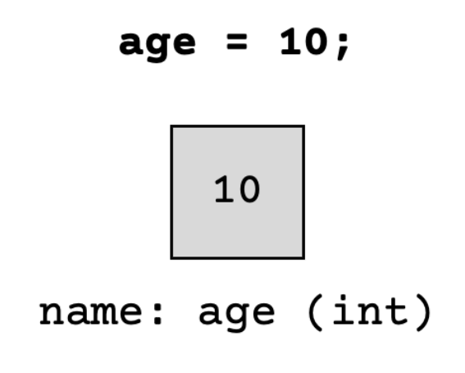
(PCM) Value Semantics vs. Reference Semantics
Applies when working with primitive types
Variables/parameters hold a copy of the actual value
Applies when working with objects
Variables/parameters hold a reference to the object

Slide 4
(PCM) Value Semantics vs. Reference Semantics
int a = 3;
int b = a;
a = 99;
int[] list1 = {4, 8, 15, 16, 23};
int[] list2 = list1;
list1[1] = 99;

Slide 5
Without knowing what someMethod does, what are the possible values of num?
int num = 42;
someMethod(num);
System.out.println(num);
anything!
just 42

Slide 6
Without knowing what anotherMethod does, what are the possible values of nums[0]?
int[] nums = {42, 43, 44};
anotherMethod(nums);
System.out.println(nums[0]);
anything!
just 42

Slide 7
(PCM) Value Semantics vs. Reference Semantics
boolean test = true;
flipValue(test);
public static void flipValue(boolean b) {
b = !b;
}
boolean[] tests =
{true, true, false, true, false, false};
flipValues(tests);
public static void flipValues(boolean[] b) {
for (int i = 0; i < b.length; i++) {
b[i] = !b[i];
}
}

Slide 8
(PCM) null
The absence of a reference!
Sort of like a "zero-equivalent" for references!
Default value for “object types” (e.g. Random, Scanner…)
NullPointerExceptions are an error that happen when you ask null to “do something”
call .toUpperCase() on null? NullPointerException!
get .nextInt() from null? NullPointerException!
many, many more

Slide 9
null: the “billion dollar mistake”
From Sir Tony Hoare (“inventor” of null, Turing award winner):
“I call it my billion-dollar mistake… […] But I couldn’t resist the temptation to put in a null reference, simply because it was so easy to implement. This has led to innumerable errors, vulnerabilities, and system crashes, which have probably caused a billion dollars of pain and damage in the last forty years.” (quote from 2009 talk)

Slide 10
(PCM) avoiding NullPointerException
if (strs[i] != null) {
System.out.println(strs[i].toUpperCase());
} else {
System.out.println("element " + i + " is null.");
}

