Slide 1
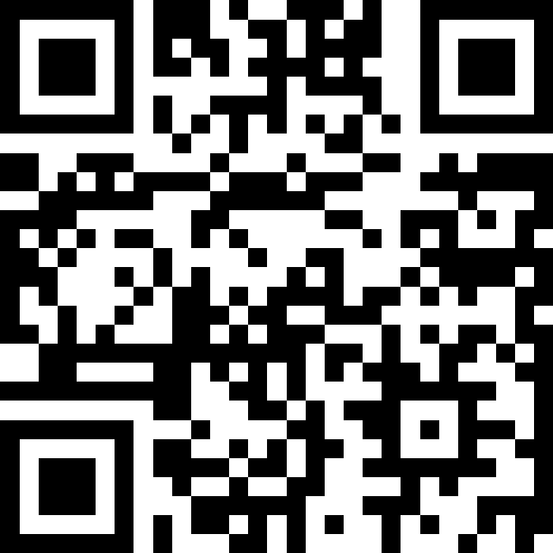
CSE 121 Lesson 13: Arrays
Matt Wang & Brett Wortzman
Autumn 2024
Abby | Afifah | Ailsa | Alice | Aliyan | Arohan
Chloë | Christopher | Dalton | Derek | Elizabeth | Ethan
Hanna | Hannah | Heather | Hibbah | Janvi | Jasmine
Judy | Julia | Kelsey | Lucas | Luke | Mahima
Maitreyi | Maria | Merav | Minh | Neha | Ronald
Ruslana | Sahej | Sam | Samrutha | Sushma | Vivian
Yijia | Zachary
TAs:
sli.do #cse121
Today’s playlist: 121 24au lecture tunes

Slide 2
Announcements, Reminders
P2 due next Tuesday, November 12th
R4 released, due next Thursday November 14th
Quiz 2 in 2 weeks (Thursday, November 21st)
will include everything up to next Wed’s lecture
Quiz 1 grades almost certainly before Quiz 2
but, no promises on earlier :( sorry!
IPL closed for Veteran’s Day (November 11th)

Slide 3
Feedback & Closing the Loop: The Good
🎃-----nehaa24------🎃
|👾 Friend # 1: daltonbo
|👾 Friend # 2: rkorol
--------------------
🎃-----samkoro------🎃
|👾 Friend # 1: yethanli
|👾 Friend # 2: zachwu5
|👾 Friend # 3: mahimu
|👾 Friend # 4: qsun05
--------------------
🎃-----ali1726------🎃
|👾 Friend # 1: tan7271
|👾 Friend # 2: deliu
|👾 Friend # 3: hzpan8
--------------------
🎃-----mxw------🎃
|👾 Friend # 1:
--------------------
Your TAs (esp. quiz sections & IPL) :)
Practice Quizzes & Problems
Pre-class materials
Lectures (esp. live coding & interaction)
Assignments
Ed discussion board
Classroom vibes & peer engagement
Being funny (sometimes?) & empathetic

Slide 4
Feedback & Closing the Loop: Suggestions
Time management & pace in lecture, including longer time spent coding
overall agree – we’re on it!
Even more practice quizzes (& problems)!
stay tuned! (esp. for the final)
but also: more practice quizzes != doing better!
More debugging & code quality, but split on whether it should be in lecture or not
we’re thinking about this! & talking to TAs
Network visualization:
nehaa24's friends:
✦ daltonbo
✦ rkorol
samkoro's friends:
✦ yethanli
✦ zachwu5
✦ mahimu
✦ qsun05
ali1726's friends:
✦ tan7271
✦ deliu
✦ hzpan8
mxw's friends:
✦ None :( womp womp

Slide 5
Feedback & Closing the Loop: Practice (1/2)
Network visualization:
✨ʕ •ᴥ•ʔ nehaa24's 2 friends✨
*--daltonbo
*--rkorol
🧡💛💚💙💜
✨ʕ •ᴥ•ʔ samkoro's 4 friends✨
*--yethanli
*--zachwu5
*--mahimu
*--qsun05
🧡💛💚💙💜
✨ʕ •ᴥ•ʔ ali1726's 3 friends✨
*--tan7271
*--deliu
*--hzpan8
🧡💛💚💙💜
✨ʕ •ᴥ•ʔ mxw's 0 friends✨
🧡💛💚💙💜
Practice can happen…
in structured environments (e.g. quiz section, IPL)
in unstructured environments (e.g. on your own)
Practice problems! (in order of relevance)
Practice quizzes, section problems
“Extra Review” problems
Pre-class & Lecture Problems
PracticeIt

Slide 6
Feedback & Closing the Loop: Practice (2/2)
But: what we care about in this class is transfer: how can you use your knowledge on new tasks.
won’t ask you exactly what’s on the practice quiz
more practice quizzes has diminishing returns
what programming in real life looks like!
Find yourself hitting a wall with practice (or on work)? A sign that you should be doing something different!
Advice: reflect on what’s working & talk to someone (office hours, IPL, or your bestie)
User😎: nehaa24
Friend(s)🍀: daltonbo, rkorol
User😎: samkoro
Friend(s)🍀: yethanli, zachwu5, mahimu, qsun05
User😎: ali1726
Friend(s)🍀: tan7271, deliu, hzpan8
User😎: mxw
Friend(s)🍀: No FRIEND😳

Slide 7
Feedback & Closing the Loop: in closing…
╭───────────────────────.★.🍎.─╮
✦ nehaa24
- daltonbo
- rkorol
╰─.🍎.★.───────────────────────╯
╭───────────────────────.★.🍏.─╮
✦ samkoro
- yethanli
- zachwu5
- mahimu
- qsun05
╰─.🍏.★.───────────────────────╯
╭───────────────────────.★.🍎.─╮
✦ ali1726
- tan7271
- deliu
- hzpan8
╰─.🍎.★.───────────────────────╯
╭───────────────────────.★.🍏.─╮
✦ mxw
╰─.🍏.★.───────────────────────╯
Reading specifications carefully is a skill!
“Fun” fact: Matt has to read specs too…
Make use of the IPL!
not just for homework help!
some times are busier than others … plan for this!
And finally, please keep giving us feedback!

Slide 8
and one last C2 that made me chuckle
What the emoji means:
*-------------------------------*
| 😎: User |
| 🤝: Users friends |
| ❌: Fake friends |
*-------------------------------*
-----------------------------\
😎jachi's friends
🤝 hconeybe
🤝 hibbahk
❌ gumball
_____________________________/
-----------------------------\
😎juliak24's friends
🤝 hhemps
🤝 eshira
🤝 sahejk
❌ gumball
_____________________________/
-----------------------------\
😎gumball's friends
🤝 nwang913
🤝 swofferh
🤝 tradams
🤝 aaw01
🤝 sdokka
🤝 jachi
❌ juliak24
_____________________________/
-----------------------------\
😎mxw's friends
❌
_____________________________/
(mxw has no friends + are fake somehow !? 😔❌)

Slide 9
(PCM) Arrays
Elements must all be the same type
Indices (starting at 0)
Must decide size when created!
arr.length to get arr's length
Arrays.toString(arr) to get a nice String version

Slide 10
(PCM) Array Traversal Pattern
for (int i = 0; i < arr.length; i++) {
// do something with arr[i]
}

Slide 11
How can we get the last element of an array arr?
arr[arr.length()]
arr[length()]
arr[arr.length]
arr[arr.length() - 1]
arr[arr.length - 1]

Slide 12
What would the array a store at the end of this arrayMystery method if {-20, 20, 26, 32, 50, 3} was passed in?
public static void arrayMystery(int[] a) {
for (int i = a.length - 1; i >= 1; i--) {
if (a[i] > a[i - 1] + 10) {
a[i - 1] = a[i - 1] + 5;
}
}
}
{-20, 20, 26, 32, 50, 3}
{-15, 25, 31, 37, 55, 8}
{-15, 25, 31, 37, 50, 3}
{-15, 20, 26, 37, 50, 3}

Slide 13
Tracing through {-20, 20, 26, 32, 50, 3}
public static void arrayMystery(int[] a) {
for (int i = a.length - 1; i >= 1; i--) {
if (a[i] > a[i - 1] + 10) {
a[i - 1] = a[i - 1] + 5;
}
}
}

