Slide 1
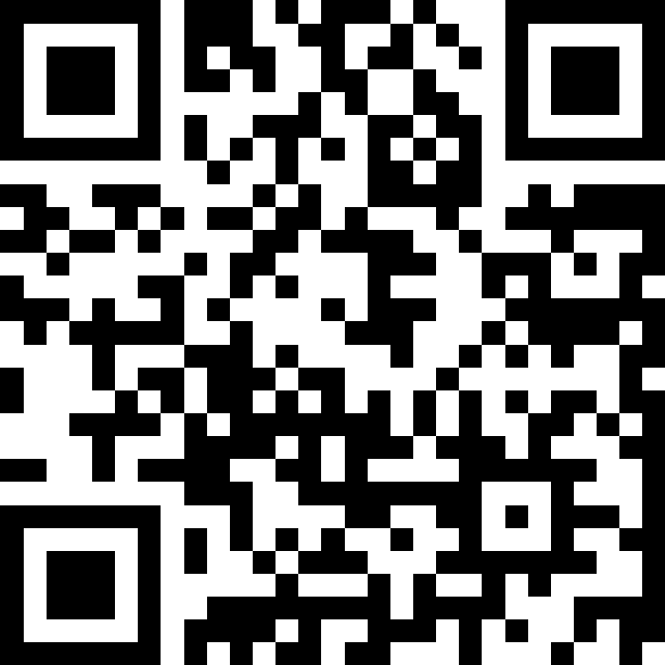
CSE 121 Lesson 10: User Input (Scanner) and while loops
Matt Wang & Brett Wortzman
Autumn 2024
Abby | Afifah | Ailsa | Alice | Aliyan | Arohan
Chloë | Christopher | Dalton | Derek | Elizabeth | Ethan
Hanna | Hannah | Heather | Hibbah | Janvi | Jasmine
Judy | Julia | Kelsey | Lucas | Luke | Mahima
Maitreyi | Maria | Merav | Minh | Neha | Ronald
Ruslana | Sahej | Sam | Samrutha | Sushma | Vivian
Yijia | Zachary
TAs:
sli.do #cse121
Today’s playlist: 121 24au lecture tunes

Slide 2
The typical announcements & reminders
Creative Project 2 (C2) due tonight (October 30th)
Resubmission Cycle 2 (R2) due tomorrow (October 31st)
Eligible: C0, P0, C1, P1
R3 opens tomorrow, due November 7th; eligible: P0, C1, P1, C2
Programming Assignment 2 (P2) open Friday (November 1st), due November 12th
Quiz 1 next week (November 7th); topics include up through today
more practice materials & resources coming soon!

Slide 3
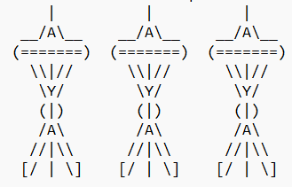
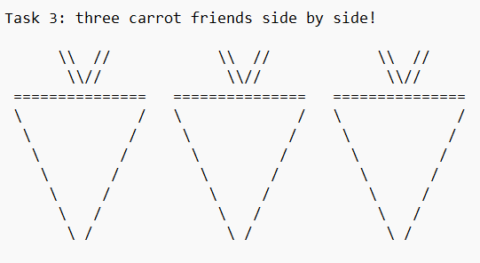
Some C1 Art!

Slide 4
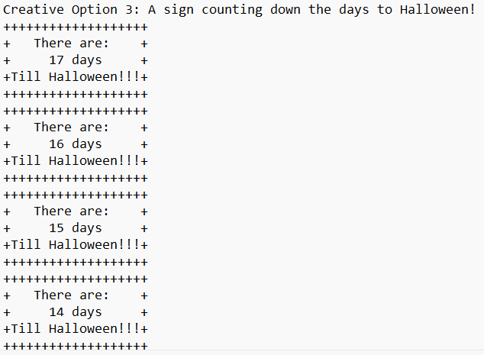
Some C1 Art!

Slide 5
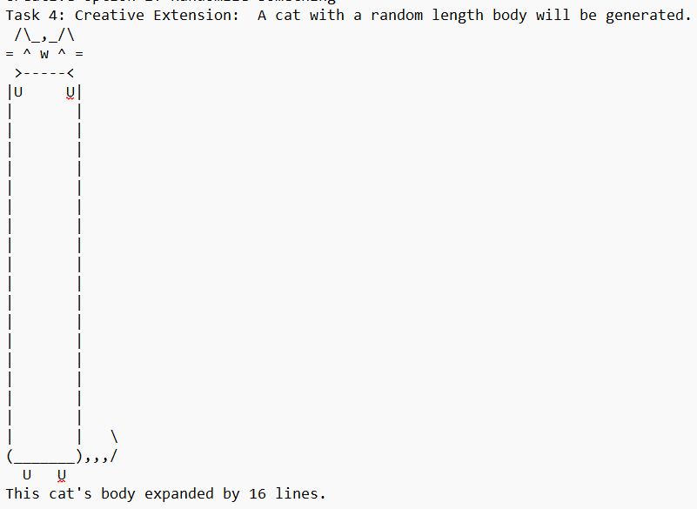
Some C1 Art!

Slide 6
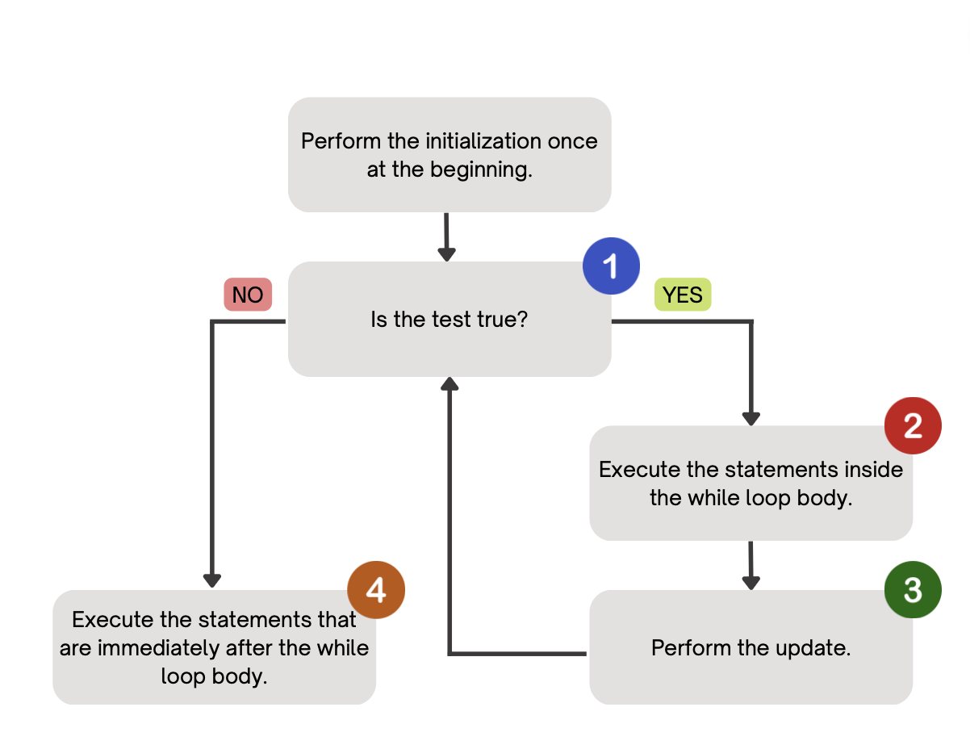
(PCM) While Loops
Repeatedly executes its body as long as the logical test is true.

Slide 7
for loops vs. while loops ⚔️
For loops and while loops are quite similar! This is the first (but certainly not the last) time where you need to decide which to use!
There’s not always a “correct” answer, but some advice:
thinking of definite versus indefinite conditions
phrasing the problem out loud!
“I will do __ X times” or “for each __ I will __” : sounds like a for!
“I will do __ until __” or “while __ is true, do” : sounds like a while!

Slide 8
for loops are while loops!!! (1/2)
for (int i = 0; i < bigYikes; i++) {
// ...
}
int i = 0;
while (i < bigYikes) {
// ...
i++;
}

Slide 9
for loops are while loops!!! (2/2)
for (int i = 0; i < bigYikes; i++) {
// ...
}
int i = 0;
while (i < bigYikes) {
// ...
i++;
}
*as a technical note, these aren’t exactly the same – there are some minor technical details that are different, most notably the scope of i

Slide 10
How would you describe what the variable x calculates?
The largest value rolled
The smallest value rolled
The last value rolled
The first value rolled
The sum of all values rolled
Error
-1
int roll = -1; // "priming" the loop
int x = -1;
while (roll != lucky) {
roll = randy.nextInt(sides) + 1;
if (x < roll) {
x = roll;
}
}
System.out.println(roll + ": my lucky number!");

Slide 11
(PCM) Scanner
An object that we can use to read in input
In the java.util “package”!
Methods | Description
nextInt() | Reads the next token from the user as an int and returns it.
nextDouble() | Reads the next token from the user as a double and returns it.
next() | Reads the next token from the user as a String and returns it.
nextLine() | Reads an entire line from the user as a String and returns it.

Slide 12
(PCM) Tokens
A unit of user input, as read by the Scanner
Tokens are separated by whitespace (spaces, tabs, new lines)
23 John Smith
42.0 "Hello world" $2.50 " 19

Slide 13
When calling the following method, which of these user inputs would not cause an error? (choose multiple)
public static void cornbear() {
Scanner console = new Scanner(System.in);
int amt = console.nextInt();
String firstName = console.next();
String secondName = console.next();
double price = console.nextDouble();
}
6 Lucy’s Treats $12.48
3 Oatmilk Latte 16.47
2 The Hunger Games 21.98
4 Gigis 900.24
2 Grammy Awards 90095

Slide 14
Fencepost Pattern
Some task where one piece is repeated n times, and another piece is repeated n-1 times and they alternate
L-a-u-f-e-y-!

Slide 15
Quick Meals for Thought (Names)
What assumptions are we making here?
String firstName = console.next();
String lastName = console.next();
All first and last names have no spaces
All people only have one first or last name
All people have at least one first or last name
Interesting readings: Falsehoods Programmers Believe About Names, For Afghans, Name and Birthdate Census Questions Are Not So Simple

Slide 16
Quick Meals for Thought (Inputs)
Another assumption: all computer users have a keyboard & mouse!
many blind & low-vision users only use keyboards (no mice)
some users cannot use keyboards and use alternatives
e.g. “switch access” – famously used by Stephen Hawking
This isn’t “just” about disability:
your user might be on a phone, tablet, gaming console, or “smart” TV!
your user could be using text-to-speech!
your user’s keyboard or mouse might be broken!

