Slide 1
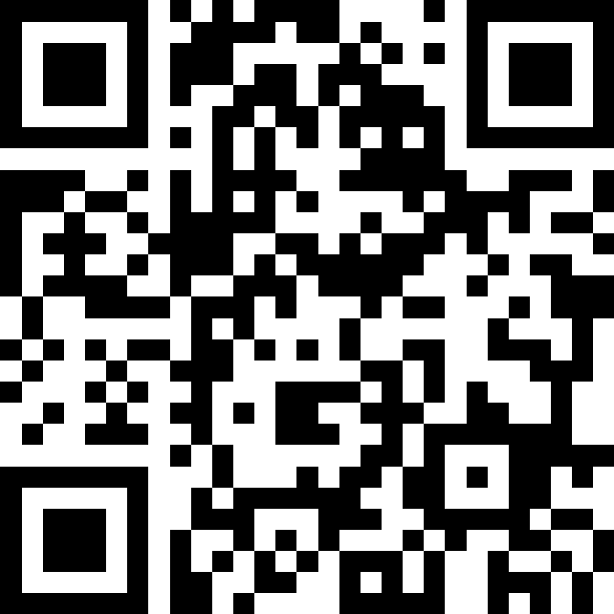
CSE 121 Lesson 1: Printing, Strings, and Variables
Matt Wang & Brett Wortzman
Autumn 2024
Abby | Afifah | Ailsa | Alice | Aliyan | Arohan
Chloë | Christopher | Dalton | Derek | Elizabeth | Ethan
Hanna | Hannah | Heather | Hibbah | Janvi | Jasmine
Judy | Julia | Kelsey | Lucas | Luke | Mahima
Maitreyi | Maria | Merav | Minh | Neha | Ronald
Ruslana | Sahej | Sam | Samrutha | Sushma | Vivian
Yijia | Zachary
TAs:
sli.do #cse121
Today’s playlist: 121 24au lecture tunes

Slide 2
Announcements, Reminders
Check out website for links to all activities, materials
Creative Project 0 will be out tonight, due Wed Oct 2
Section Work 0 (survey) extended to Sun Sep 29
one-time extension (see: website instructions on forms)
important Google Forms works for 121
New Ed materials: Sandbox
Matt’s office hours are out (incl. one today at 12:30)

Slide 3
Aside: office hours as a resource!
The IPL (TA office hours) will open on Monday (Sep 30)
one of the best parts of the course!!
but: TAs are instructed to not just give you the answer!
why not? you wouldn’t be learning!
e.g. “my code doesn’t work” versus “I tried X, expected Y, but got Z. Any thoughts on what to try next?”
Will get another announcement in Ed about this soon!

Slide 4
Intro Survey – things we’re excited for!
“Just learning the basics of how to code honestly. It's something I've always wanted to learn and I'm excited to jump in.”
“I have never taken a CS class, so I really don't know what to expect. I'm excited to learn and to see if I'm interested in this field.”
“Learning Java and how I can use this language to help others”
“Writing codes that can do cool stuff (I don't know what cool stuff I'm referring to tho)”
“Being able to problem solve while being creative”
“Learning how to code and meet friends!!”

Slide 5
Reassuring worries from intro survey (1/3)
Common: responses along the lines of…
“not knowing Java beforehand”
“I'm most nervous about my lack of experience with computer science.”
“I don't know at all how to code in Java.”
“Having zero experience in coding or comp sci.”
“Not having enough experience to succeed.”
We’re all in the same boat here, and you’re in the right place! This class expects zero prior knowledge.

Slide 6
Reassuring worries from intro survey (2/3)
Difficulty, workload, pace, & falling behind
recognizing that programming can be difficult (if it was easy: why have a class?)
as a result, have built many support systems (section, IPL, office hours, Ed, etc.)
if you feel like you’re struggling: reach out early!
especially with pace of quarter system
Grades, competitiveness, this class being a “weed-out” class
explicitly not the goal of this class
course designed against this (minimum grade guarantees, resubmissions, etc.)

Slide 7
Reassuring worries from intro survey (3/3)
Time management
can be tricky – especially if you’re starting college this quarter!
biggest advice: start early (and give yourself time to ask for help)
Struggling with technology / not being a computer person / Ed is new
this can be hard (and is important)! if you’re confused – please ask!
along the way, we’ll teach some small skills (e.g. searching “smart”, shortcuts)
Not being a math or STEM “person”
in our opinion, everybody can be a math or STEM person :)
fun fact: some of our CSE professors were originally completely different majors!!

Slide 8
Finding groups?
A good chunk of people asked about finding study groups!
Some thoughts:
as you’ll see today, we do lots of pair/group learning in class. vibe well with someone? ask them to study :)
say hi to folks in section, office hours, and the IPL!
sit beside someone!

Slide 9
Some fun things about y’all…
“I also do arigumi!”
“I deadlift 600lbs”
“I slept through an earthquake.”
“I'm platinum 1 in Valorant”
“I am a certified rescue scuba diver!”
“I've kissed a stingray before.”
“I am in the Pixar movie Cars.”

Slide 10
… and some fun facts!
“Platypuses are venomous”
“That giraffes have blue tongues?”
“Scotland's national animal is the unicorn.” (x2!!)
“Australia is wider than the moon”
“Lighters were invented before matches”
“The probability of you getting killed by a cow is low, but never zero”
“one billion lions could totally beat the sun”

Slide 11
Syllabus Agenda (6/7)
About us
About this course
Learning objectives
Other similar courses
Course components
Our learning model
Tools and resources
Course Website
Ed
Assessment and grading
Collaboration

Slide 12
Assessment
Our goal in the course is for you to gain proficiency of the concepts and skills we teach
We assess your proficiency by asking you to apply the concepts and skills on tasks or problems
By necessity, we are assessing your work as a proxy for your proficiency

Slide 13
Grading (1/2)
Grades should reflect proficiency in course objectives.
All assignments, quizzes, and exams will be graded with an “E/S/N” grade:
E (Excellent)
S (Satisfactory)
N (Not Yet)

Slide 14
Grading (2/2)
E/S/N grades per assessment type:
Programming Assignment: 4 (4 assignments, 16 total)
Creative Projects: 1 (4 projects, 4 total)
Quizzes: 3 (3 quizzes, 9 total)
Final Exam: 6
We also “drop” your lowest 2 quiz/final exam grades.
For more information – see syllabus!

Slide 15
Resubmissions
Learning takes time and doesn’t always happen on the first try!
Each week, one previous assignment or project can be resubmitted.
Must be accompanied by write-up explaining change (reflection!)
Grade on your resubmission replaces original grade
Assignments eligible to resubmit for only 3 “cycles” after feedback released
We’ll discuss this more when our first assignment is graded; also, see syllabus!

Slide 16
Syllabus Agenda (7/7)
About us
About this course
Learning objectives
Other similar courses
Course components
Our learning model
Tools and resources
Course Website
Ed
Assessment and grading
Collaboration

Slide 17
Collaboration Policy
When we assess your work in this class, we need to know that it’s yours. Unless otherwise specified, all graded work must be completed individually.
Some rules to highlight:
do not share your own solution code or view solution code from any source – including but not limited to other students, tutors, or the internet
do not use AI tools (e.g. ChatGPT) on graded work in any capacity
See syllabus for more details (this is very important to understand).

Slide 18
Activities in Class
Goal: To get you actively participating in your learning!
May ask you to think and volunteer a suggestion
May ask you poll in with a response (via slido)
Not graded but strongly encouraged to maximize your learning and use of class time!
Common Format: Think, Pair, Share
Question is posed
Think about the question on your own
Pair up with your neighbor and discuss the question
Focus on how you arrived at your answers, whether they're the same or different!
Share what you discussed with the rest of the class!

Slide 19
Think Pair Share: different hello worlds
How many lines of output would the following code produce?
System.out.println("hello");
System.out.print("moi");
System.out.print("bonjour");
System.out.println("pryvit");
System.out.print("nihao");
System.out.println("hola");
1
2
3
5
6

Slide 20
Escape Sequences
escape sequence: A special sequence of characters used to represent certain special characters in a string.
\" to produce " in a String
\\ to produce \ in a String
\n to produce a new line character (or line break) in a String
And there are more!

Slide 21
🍓🌮☕ Food for Thought 🥑🍱🧋
An occasional module where we talk about bigger-picture ideas in computer science related to our lecture topic(s) of the week.
Goals:
1. give you “conversational familiarity” with CS terminology
2. see how CS interacts with other fields and people!
3. point you in the direction of more CSE (or adjacent) classes
Note: not tested content. Just food for thought :)

Slide 22
What's in a (variable) name or String?
Switch over to Ed and do some experiments (with a partner)! Then, report back on sli.do.
What types of characters are “allowed” in Strings?
What types of characters are “allowed” in variable names?
sli.do #cse121

Slide 23
Dessert for Thought!
This is the beginning of a very interesting rabbit hole! But also, a decision made by the Java designers.
You will also make decisions like these!
for example, what is a “valid name”?
something to reflect on as you learn more about CS…

Slide 24
Announcements, Reminders (again)
Check out website for links to all activities, materials
Creative Project 0 will be out tonight, due Wed Oct 2
Section Work 0 (survey) extended to Sun Sep 29
one-time extension (see: website instructions on forms)
important Google Forms works for 121
New Ed materials: Sandbox
Matt’s office hours are out (incl. one today at 12:30)

