Slide 1
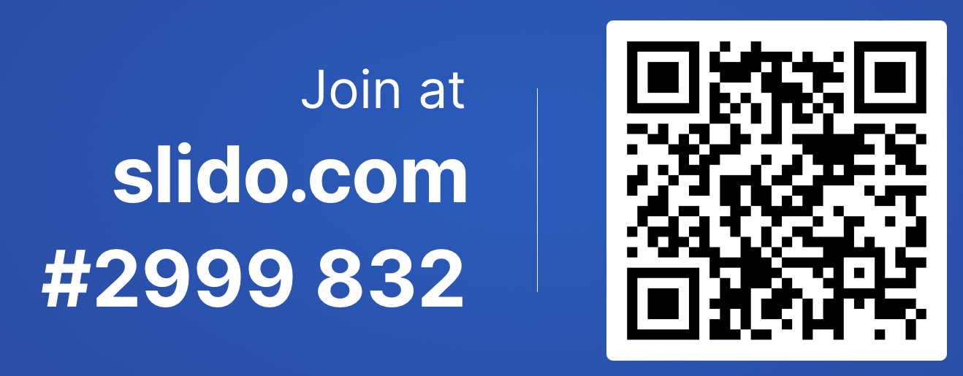
CSE 121
Elba Garza
Winter 2023

Slide 2
Announcements, Reminders
Programming Assignment 2 out soon; due February 21st
Quiz Retakes on Tuesday, February 14th 💘:
Retake Form out; due Sunday Feb 12th at 11:59 PM
Eligible Quizzes:
Quiz 0
Quiz 1 (Grades out by tonight 🤞)

Slide 3
Last Time
Conditionals
while loops

Slide 4
Plan for Today
User Input
Scanner class
Methods:
.next() - asking the user for one singular token as input.
Token: a unit of input separated by some whitespace (e.g. space, tab, newline!)
.nextLine() - input that can be multiple words, separated by spaces!
.nextInt() - asking the user for an int value as input
.nextDouble() - asking the user for a double value as input
If methods don’t receive correct input → Exception!

