Slide 1
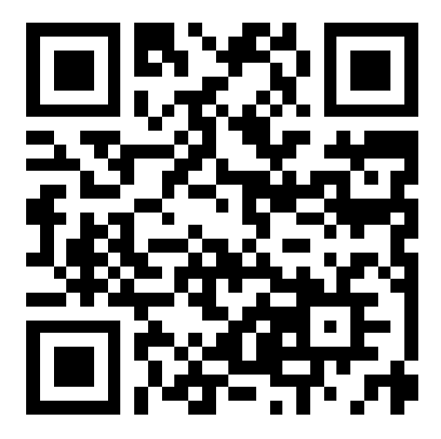
CSE 121 – Lesson 8
Kai Daniels
Summer 2023
Music: 🌸k-pop girlies playlist🌸
sli.do #cse121

Slide 2
Announcements, Reminders
Programming Assignment 1 Election Sim due yesterday! Slay!
Creative Project 2 released later today, due next Tuesday 7/25 @ 11:59 PM
Resub 2 is due tomorrow 7/20 11:59 PM
Quiz 1 (Take-home): next Monday 7/24
Will be on: Methods (Param & Returns), Conditionals, While Loops, Scanner
Final exam August 8/16 4:30 – 6:30 PM in PAA A102
If you have a conflict reach out-reach out ASAP – the expectation is you all can make that time.

Slide 3
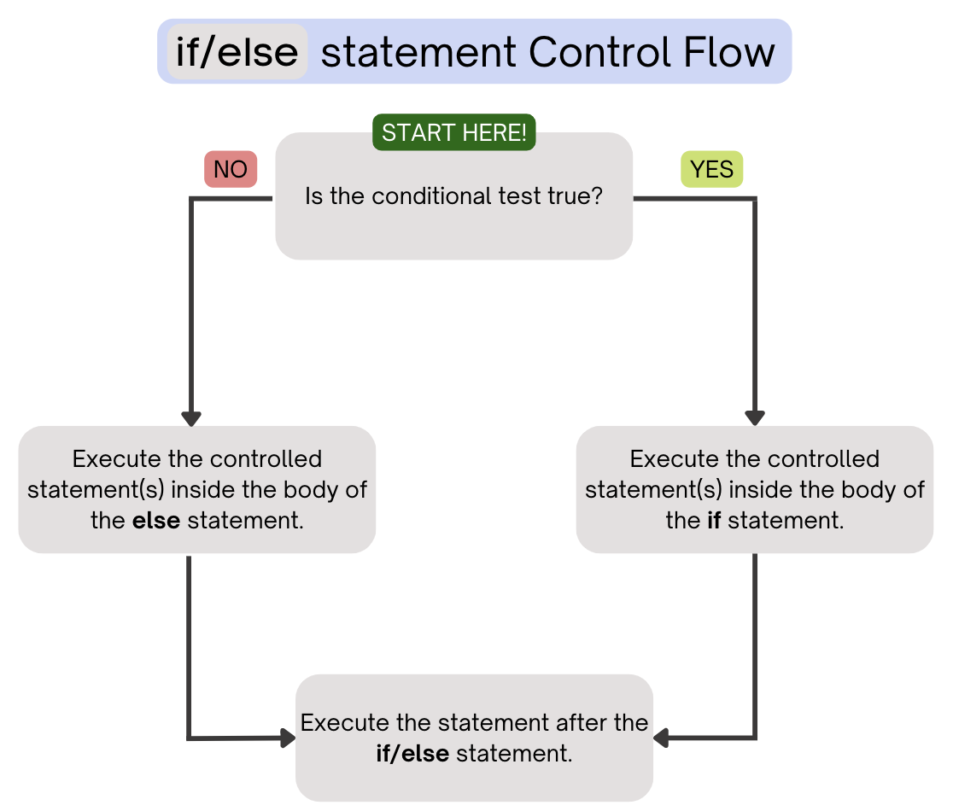
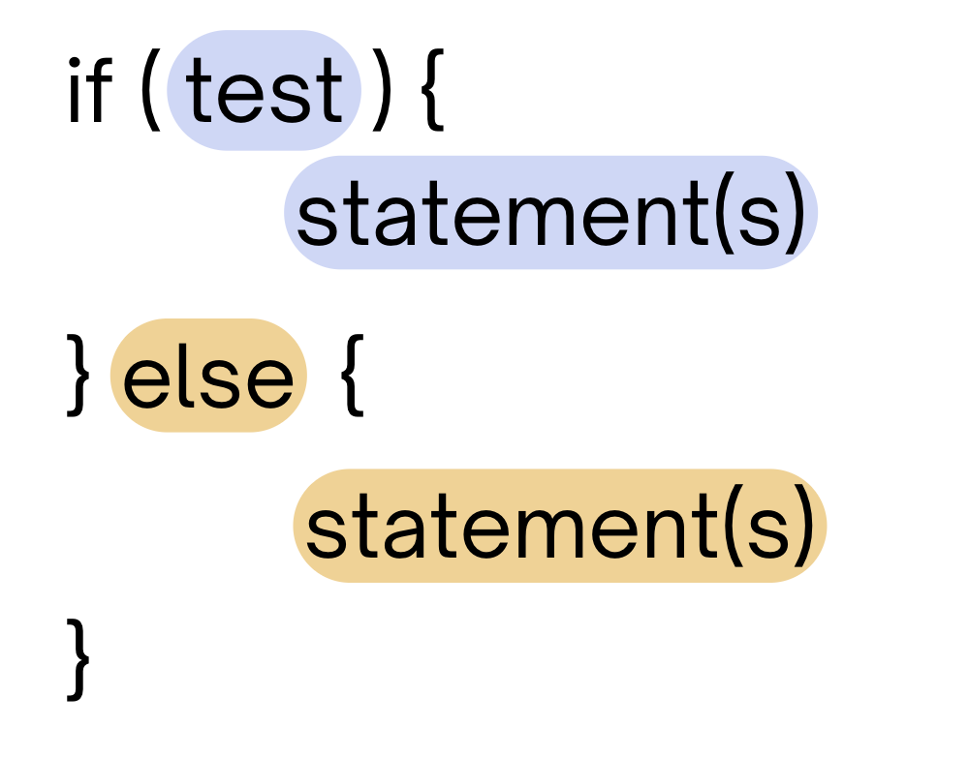
(Last Time) Conditionals
Executes a block of statements if the test is true, executes another block of statements if the test is false

Slide 4
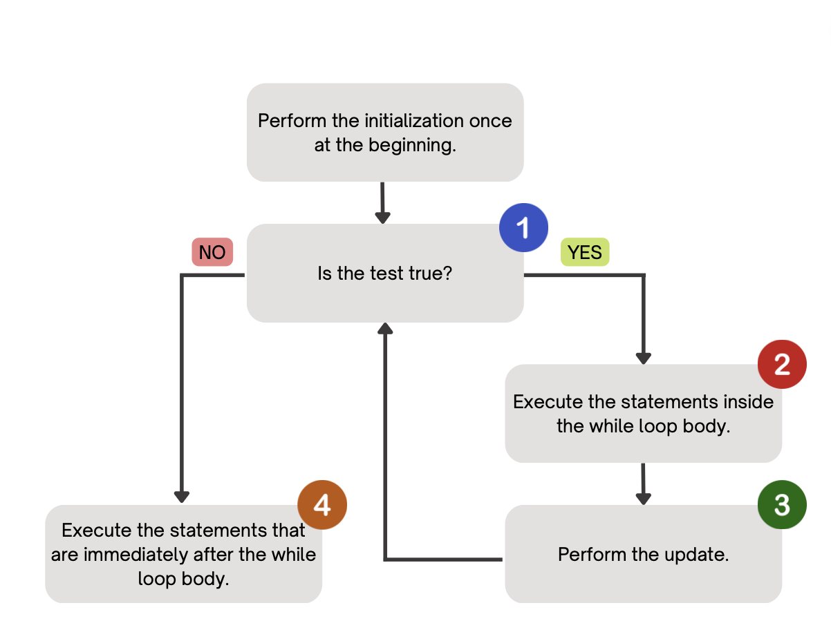
(Last Time) While Loops
Repeatedly executes its body as long as its logical test is true.

