Slide 1
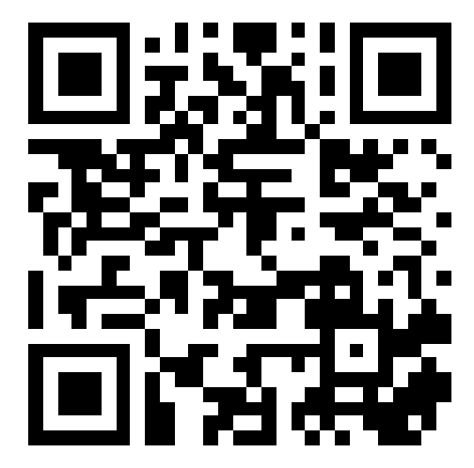
CSE 121 – Lesson 7
Kai Daniels
Summer 2023
Music: 🌸k-pop girlies playlist🌸
sli.do #cse121

Slide 2
Announcements, Reminders
Programming Assignment 1 Election Simulator released Wed, due next Tuesday 7/18 @ 11:59 PM
Don’t need content from this week for it, but are free to use it
Resub 1 was due last night, Resub 2 out and due next Thurs
Quiz 1 (Take-home): July 7/24
I recommend practicing writing these out them typing them up
Will be on: Methods (Param & Returns), Conditionals, While Loops, Scanner
Final exam August 8/16 4:30 – 6:30 PM in PAA A102
If you have a conflict reach out reach out ASAP (not all will be granted)!

Slide 3
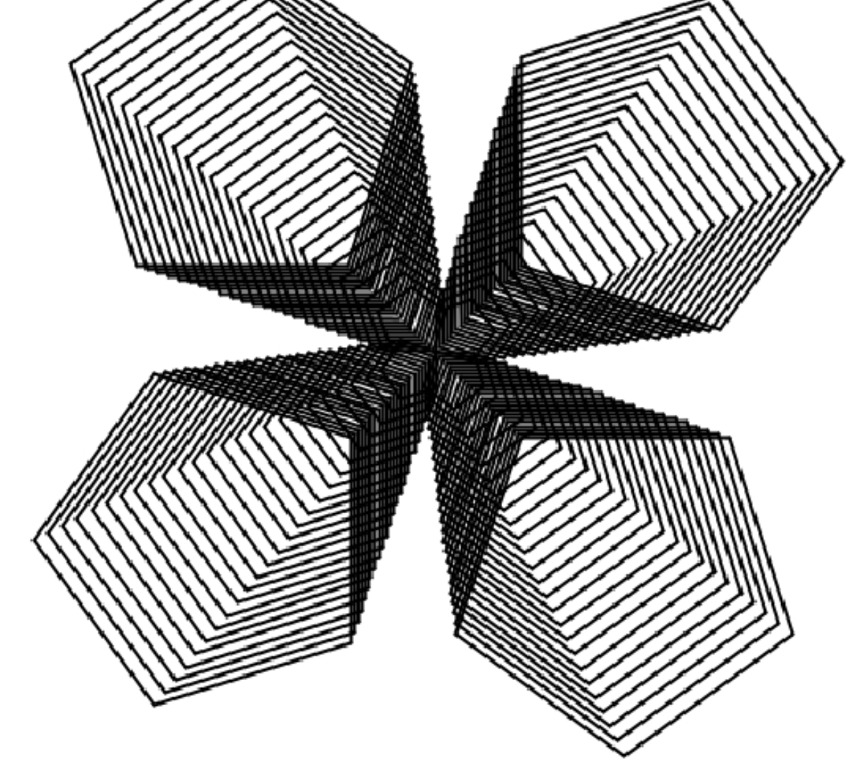
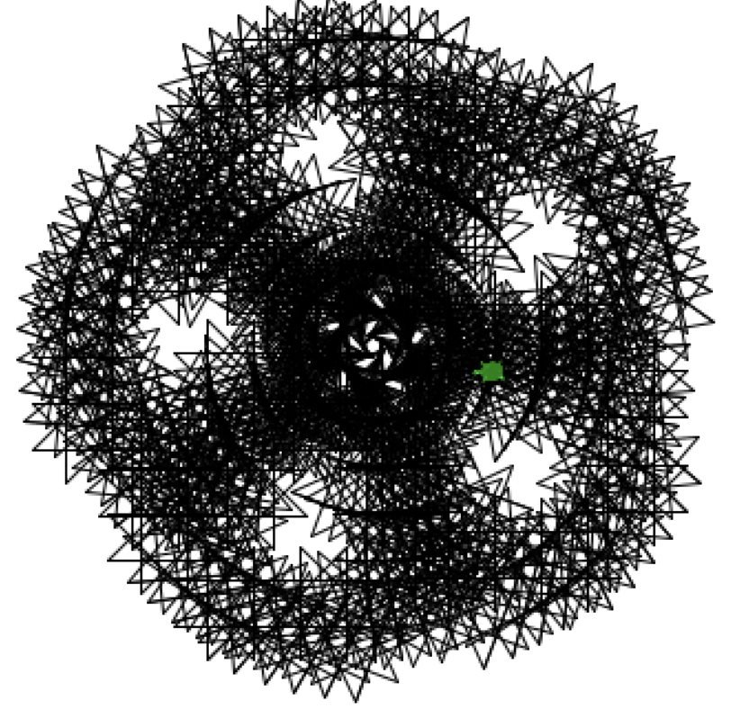
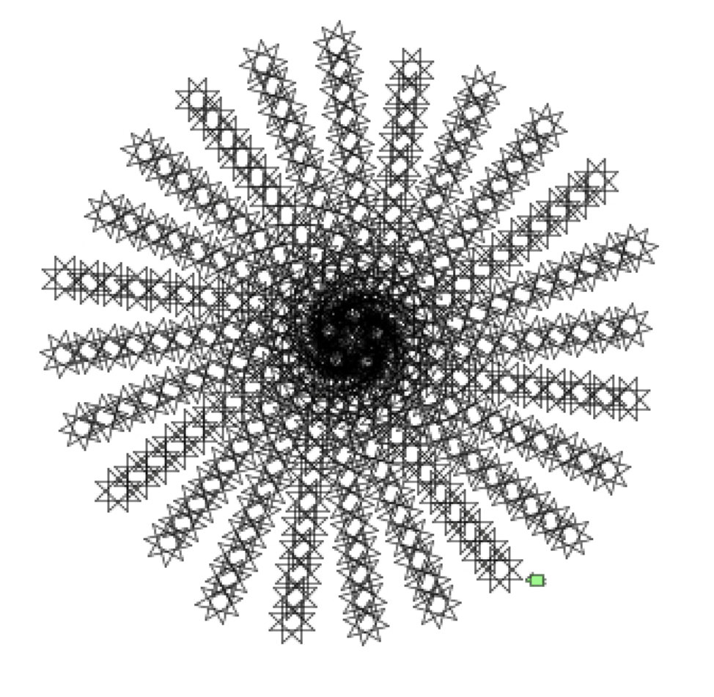
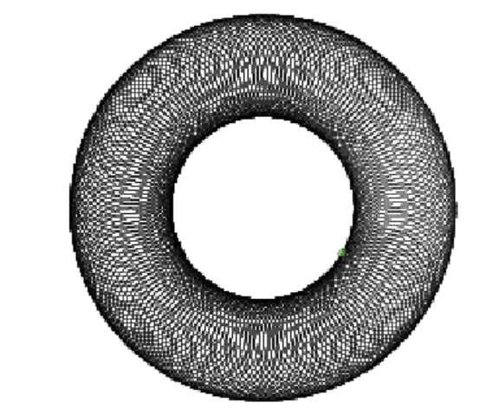
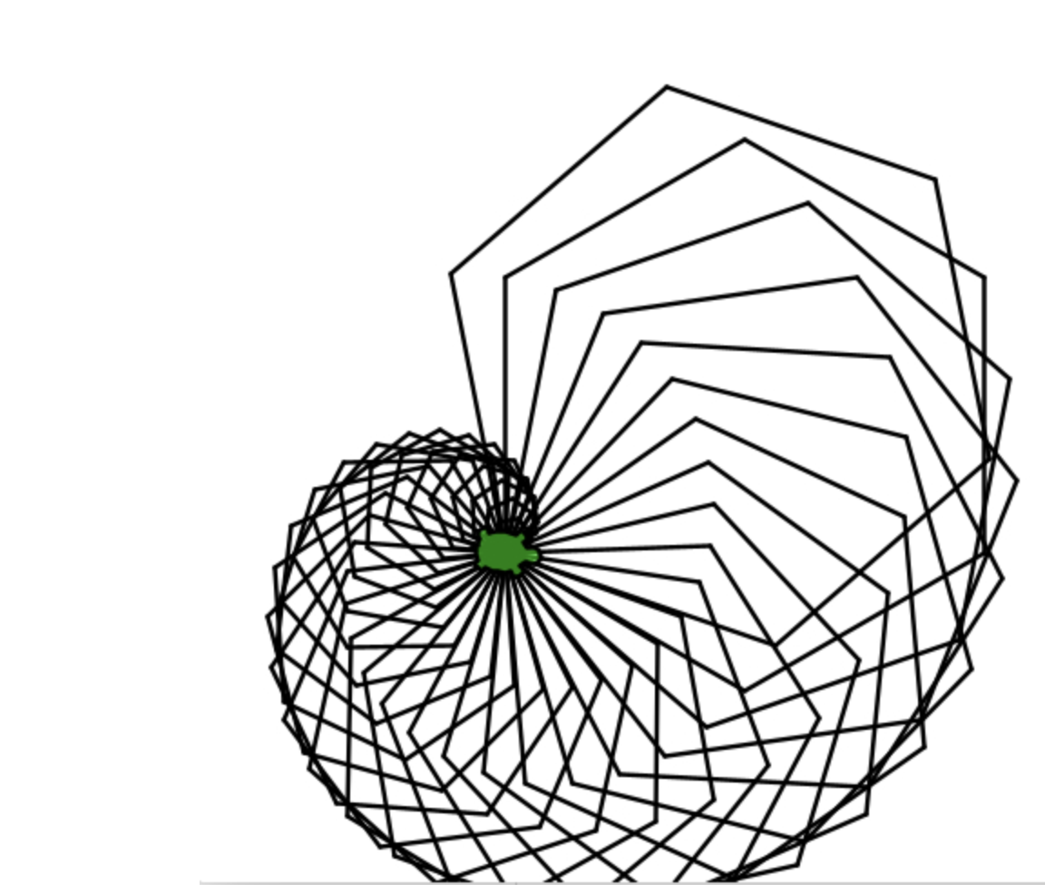
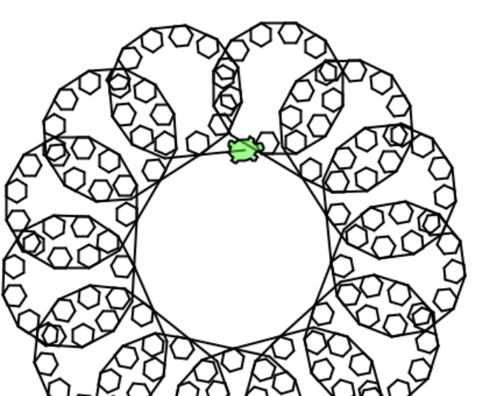
Creative Project Showcase!

Slide 4
Sli.do question
would it be more efficient to put the println statement of sum within the rollDice method, instead of having to write it out several times in the main method?

Slide 5
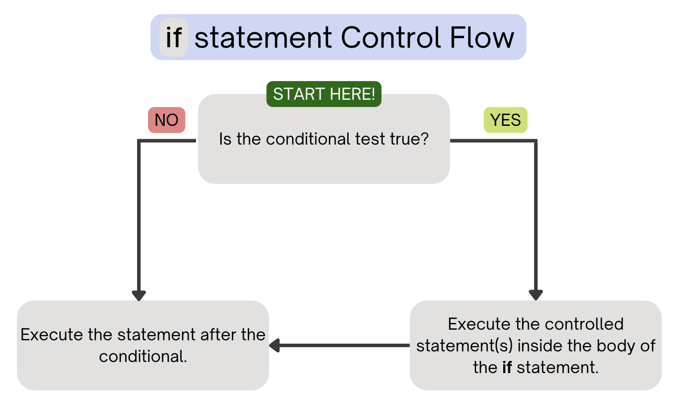
(PCM) Conditionals
Executes a block of statements only if the test is true

Slide 6
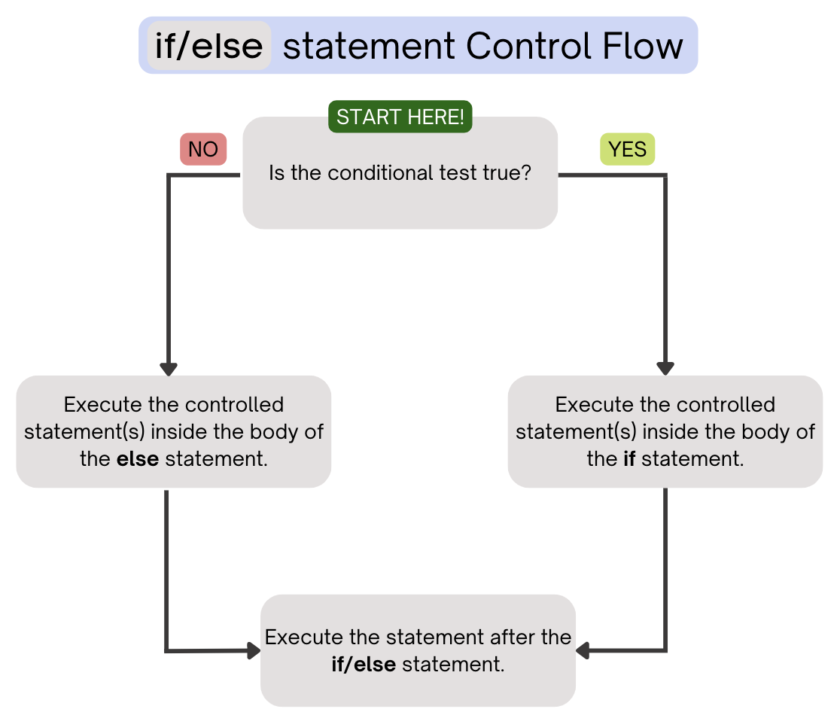
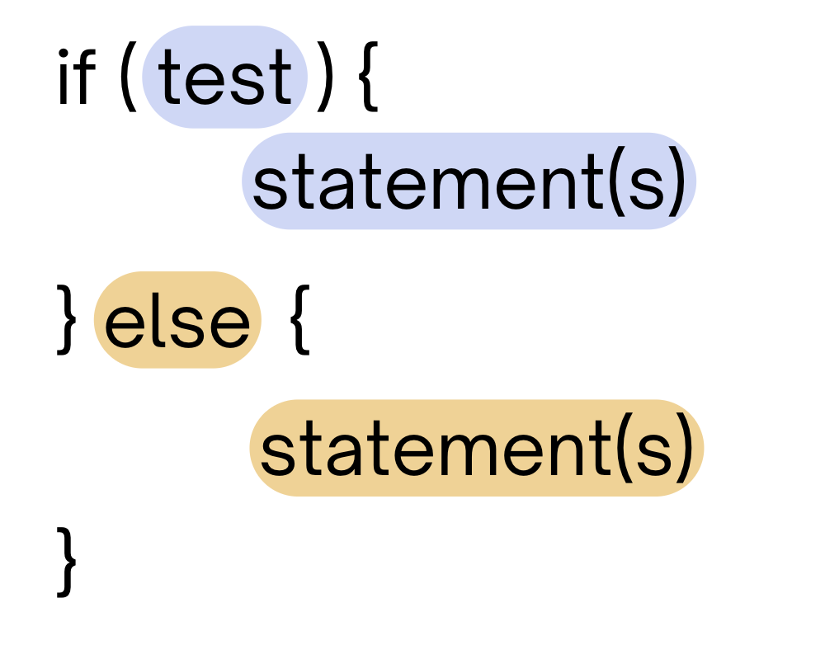
(PCM) Conditionals
Executes a block of statements if the test is true, executes another block of statements if the test is false

Slide 7
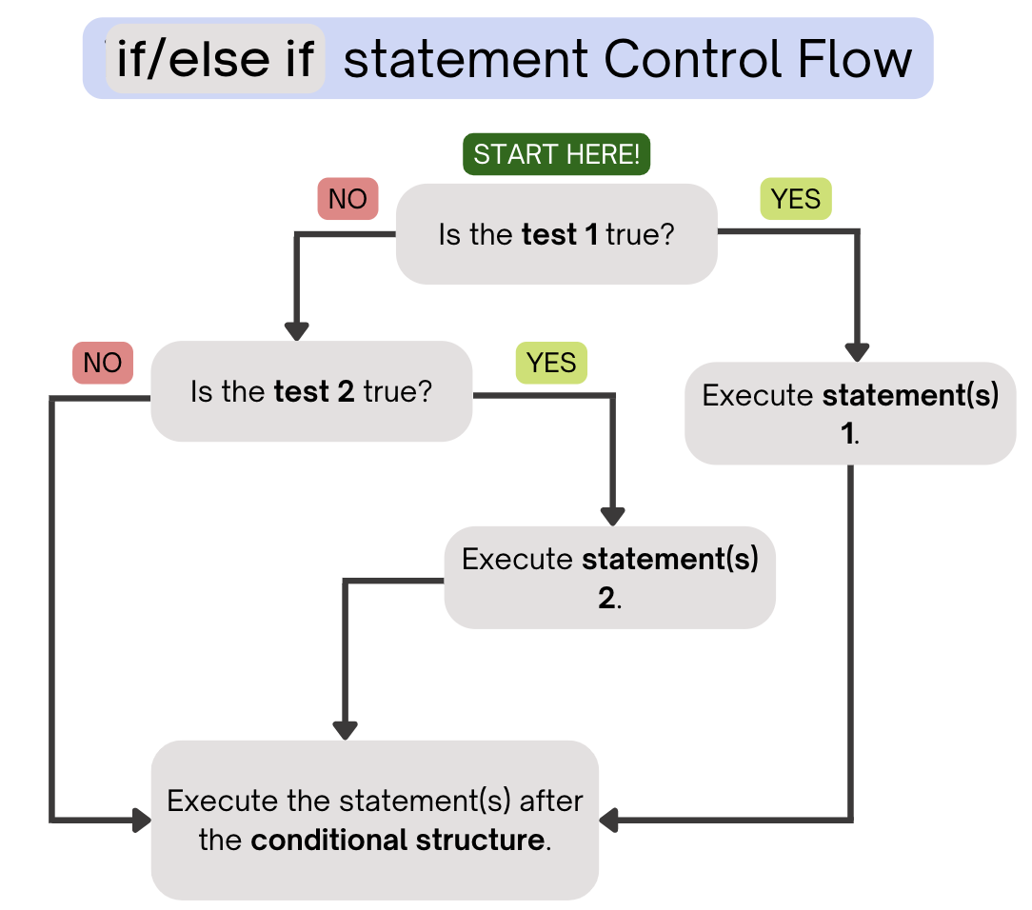
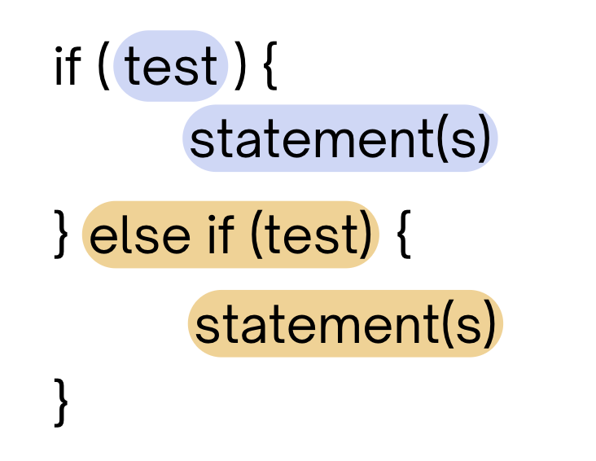
(PCM) Conditionals
Chooses between a block of statements to execute out of multiple choices, depending on which test it passes
If it ends in an else, exactly one block will be executed.
If it ends in an else if, at most one block will be executed, but the code also may not execute any blocks of statements.

Slide 8
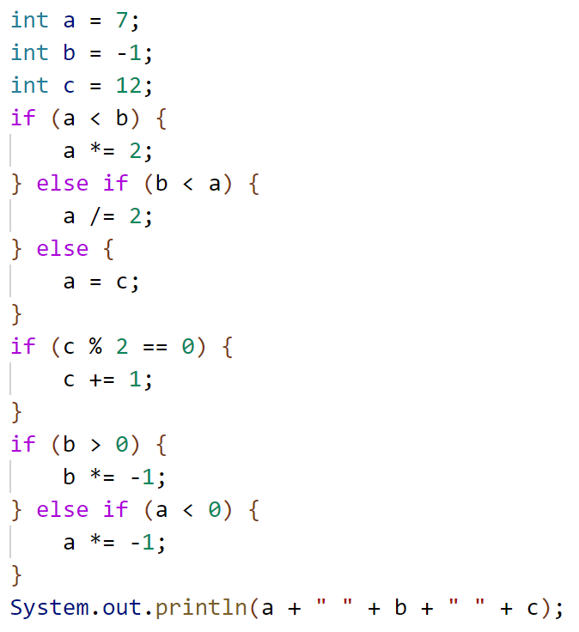
What is the output produced by executing this code?
A. 7 -1 12
B. -3 -1 13
C. 3 -1 13
D. 12 1 12
E. -14 1 13

Slide 9
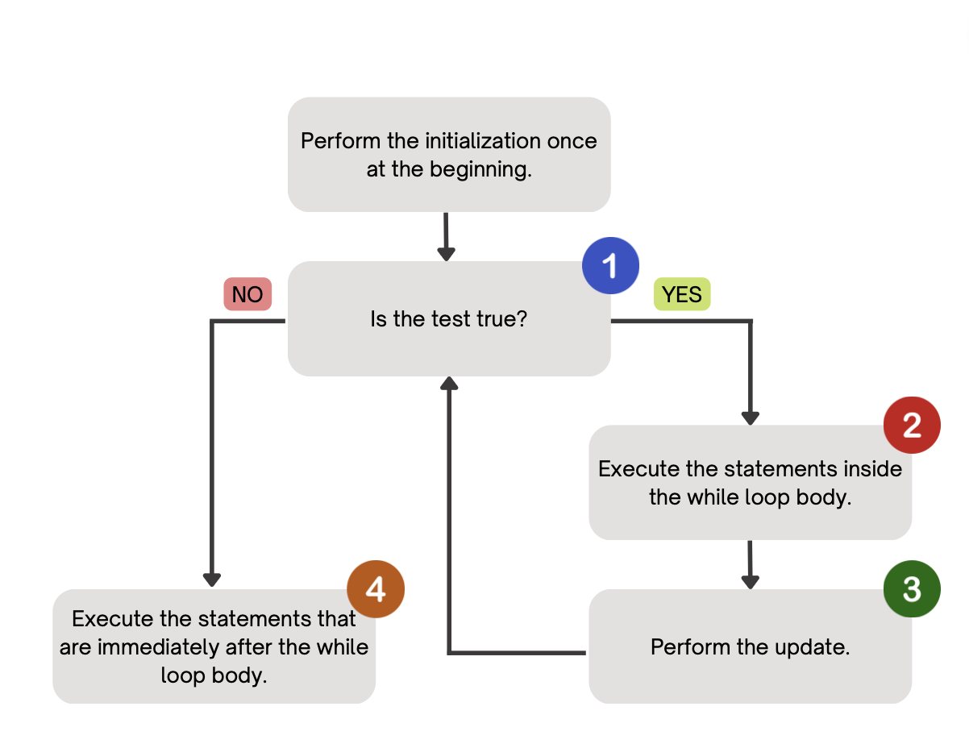
(PCM) While Loops
Repeatedly executes its body as long as its logical test is true.

