Slide 1
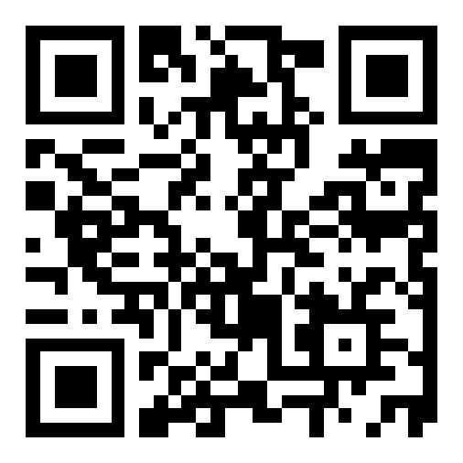
CSE 121 – Lesson 6
Kai Daniels
Summer 2023
Music: 🌸k-pop girlies playlist🌸
sli.do #cse121

Slide 2
Announcements, Reminders
Creative Project 1 due yesterday
Programming Assignment 1 out later today, due next Tuesday 11:59 PM
Quiz 0 was Monday! Got through your first quiz!
Final exam date confirmed:
August 16th (8/16) 4:30 - 6:30 PM
110 minute exam
More details will be posted on the Exams page later this quarter

Slide 3
(PCM) Returns
Returns allow us to send values out of a method
public static <type> myMethod(int num) {
System.out.print(num + " is the best!");
... return <value of correct type>
}
Calling a method that returns a value…
<type> result = myMethod(42);
Evaluates the expression
Returns this value to where the method is called from
Method immediately exits

Slide 4
(Recall) String Methods Usage: <string variable>.<method>(…)
Method | Description
length() | Returns the length of the string.
charAt(i) | Returns the character at index i of the string
indexOf(s) | Returns the index of the first occurrence of s in the string; returns -1 if s doesn't appear in the string
substring(i, j) or substring(i) | Returns the characters in this string from i (inclusive) to j (exclusive); if j is omitted, goes until the end of the string
contains(s) | Returns whether or not the string contains s
equals(s) | Returns whether or not the string is equal to s (case-sensitive)
equalsIgnoreCase(s) | Returns whether or not the string is equal to s ignoring case
toUpperCase() | Returns an uppercase version of the string
toLowerCase() | Returns a lowercase version of the string
Notes:
Bomb = may get error if indexing int is out of bounds (e.g. negative index, or larger than the length of the string)
Safety guy = should return without error in usual case

Slide 5
String example
String s = "gumball";
s = s.substring(7, 8).toUpperCase() + s.substring(8) + "ball";

Slide 6
Example of returns: Math class
Methods | Returns
Math.abs(value) | Absolute value of value
Math.ceil(value) | value rounded up
Math.floor(value) | value rounded down
Math.max(value1, value2) | Larger of the two given values
Math.min(value1, value2) | Smaller of the two given values
Math.round(value) | value rounded to the nearest whole number
Math.sqrt(value) | Square root of value
Math.pow(base, exp) | base to the exp power

Slide 7
Math example
double value = 823.577564893;
double roundedValue = (double) Math.round(value * 100) / 100;

Slide 8
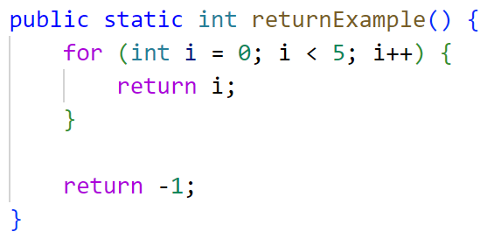
What is the output of this program?
A. 0
B. 4
C. 5
D. -1
Notes:
A

