Slide 1
CSE 121 – Lesson 4
Kai Daniels
Summer 2023
Music: 🌸k-pop girlies playlist🌸
sli.do #cse121

Slide 2
Announcements, Reminders
Programming Assignment 0 is due tonight
Creative Project 1 out later today
R0 open last week, due Thursday (7/06) 11:59 PM
R1 open Thursday (7/06), due Thursday (7/13) 11:59 PM
Feedback for C0 was released yesterday
Start tracking your grades in our Minimum Grade Guarantee Calculator
Quiz 0 [Take-home] Monday (7/10) due 11:59 PM

Slide 3
Last time: for loops!
For loops are our first control structure
A syntactic structure that controls the execution of other statements.

Slide 4
Fencepost Pattern
Some task where one piece is repeated n times, and another piece is repeated n-1 times and they alternate
g-u-m-b-a-l-l

Slide 5
Fencepost Pattern
Some task where one piece is repeated n times, and another piece is repeated n-1 times and they alternate
g-u-m-b-a-l-l

Slide 6
(PCM) Nested for loops
for (int outerLoop = 1; outerLoop <= 5; outerLoop++) {
System.out.println("outer loop iteration #" + outerLoop);
for (int innerLoop = 1; innerLoop <= 3; innerLoop++) {
System.out.println(" inner loop iteration #" + innerLoop);
}
// at this point, innerLoop is OUT OF SCOPE!
System.out.println(innerLoop);
}

Slide 7
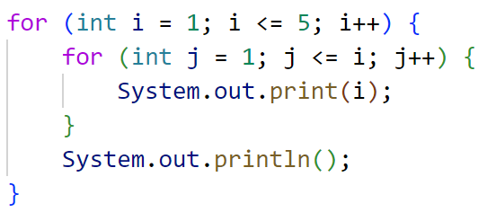
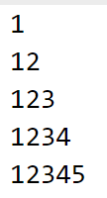
What output is produced by the following code?
A. B. C C.

Slide 8
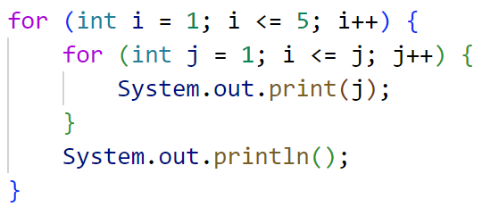
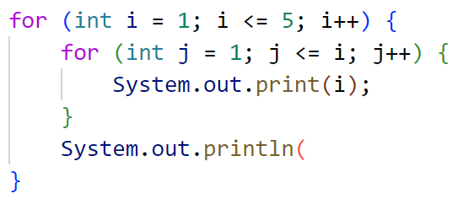
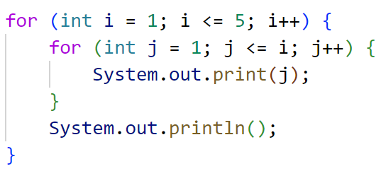
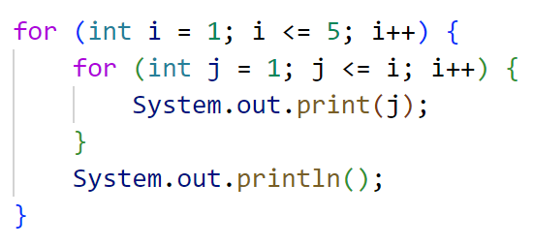
What code produces the following output?
A.
B.
C.
D.
Notes:
A – Incorrect, syntax issue
B – Correct
C – the condition is i<=j for the inner loop, so it won’t ever execute after the first iteration
D – almost correct, but has i++ in inner loop instead of j++

Slide 9
(PCM) Random
A Random object generates pseudo-random numbers.
The Random class is found in the java.util package
import java.util.*;
Method | Description
nextInt() | Returns a random integer
nextInt(max) | Returns a random integer in the range [0, max), or in other words, 0 to max-1 inclusive
nextDouble() | Returns a random real number in the range [0.0, 1.0)

Slide 10
Pseudo-Randomness
Computers generate numbers in a predictable way using mathematical formulas.
Input may include current time, mouse position, etc.
True randomness is hard to achieve – we rely on natural processes
e.g., atmospheric noise, lava lamps

