Slide 1
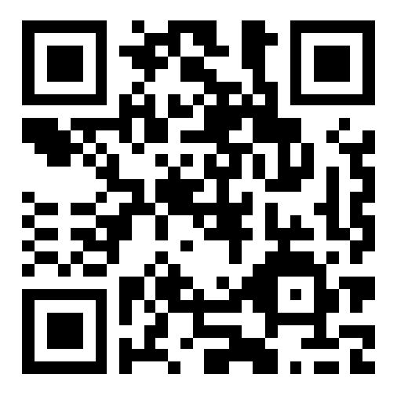
CSE 121 – Lesson 2
Kai Daniels
Summer 2023
Music: 🌸k-pop girlies playlist🌸
sli.do #cse121

Slide 2
Announcements, Reminders
Programming Assignment 0: Code Reviews was released Wed, due next Wed July 5th 11:59 PM
Creative Project 0 feedback released next Tues, July 4
Quiz 0: Monday, July 10 (take-home)
Resubmission start next week, more on that later

Slide 3
Last Time…
Expressions
Data types (int, double, boolean, String)
Operators (+, -, /, *, %)
Logical Operators (!, &&, ||, ==, !=, >, >=, <, <=)
Variables
Container that stores a specific data type
Must declare & initialize!
Manipulate, modify, reuse ♻
// declare AND initialize
int version = 5;

Slide 4
(PCM) Strings and chars
String = sequence of characters treated as one, yet can be indexed to get individual parts
Zero-based indexing 💣
Side note: new data type!
char, represents a single character, so we use single quotes
Strings are made up of chars!
g | u | m | b | a | l | l
0 | 1 | 2 | 3 | 4 | 5 | 6
Notes:
Bomb = indexing issues can be source of many errors! Fence-post life.

Slide 5
(PCM) String Methods Usage: <string variable>.<method>(…)
Method | Description
length() | Returns the length of the string.
charAt(i) | Returns the character at index i of the string
indexOf(s) | Returns the index of the first occurrence of s in the string; returns -1 if s doesn't appear in the string
substring(i, j) or substring(i) | Returns the characters in this string from i (inclusive) to j (exclusive); if j is omitted, goes until the end of the string
contains(s) | Returns whether or not the string contains s
equals(s) | Returns whether or not the string is equal to s (case-sensitive)
equalsIgnoreCase(s) | Returns whether or not the string is equal to s ignoring case
toUpperCase() | Returns an uppercase version of the string
toLowerCase() | Returns a lowercase version of the string
Notes:
Go to Ed, show that similar how we can ask the Turtle variable to do something, we can ask our string variable to do things as well

Slide 6
Suppose s contains the String "bubble gum". Which option below would result in s containing "Gumball" instead?
s.substring(7) + "ball";
s = s.substring(7, 9) + "ball";
s = s.charAt(7).toUpperCase() + "ball";
s = s.substring(7, 8).toUpperCase() + s.substring(8) + "ball";
s = s.substring(7, 8).toUpperCase() + s.substring(7, 10) + "ball";
String s = “bubble gum”;
b | u | b | b | l | e |  | g | u | m
0 | 1 | 2 | 3 | 4 | 5 | 6 | 7 | 8 | 9

Slide 7
(PCM) for loops!
For loops are our first control structure
A syntactic structure that controls the execution of other statements.

Slide 8
(PCM) for loops!
for (int counter = 1; counter <= 5; counter++) {
System.out.println("I love CSE 121!");
}

Slide 9
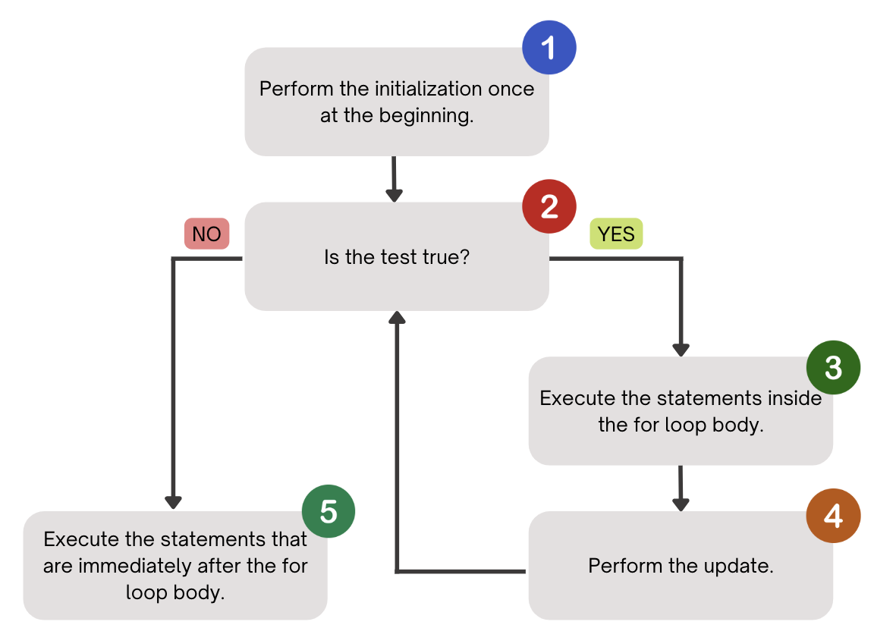
(PCM) for loops!

Slide 10
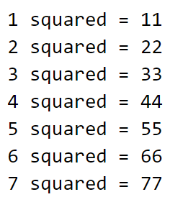
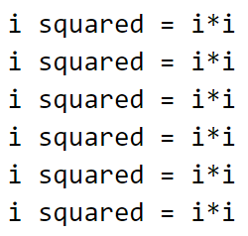
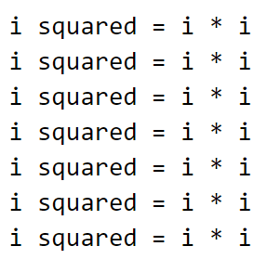
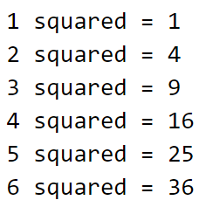
What output does the following code produce?
A. B. C. D.

Slide 11
(PCM) String traversals
// For some String s
for (int i = 0; i < s.length(); i++) {
// do something with s.charAt(i)
}

Slide 12
Fencepost Pattern
Some task where one piece is repeated n times, and another piece is repeated n-1 times and they alternate
g-u-m-b-a-l-l

Slide 13
Fencepost Pattern
Some task where one piece is repeated n times, and another piece is repeated n-1 times and they alternate
g-u-m-b-a-l-l

