Slide 1
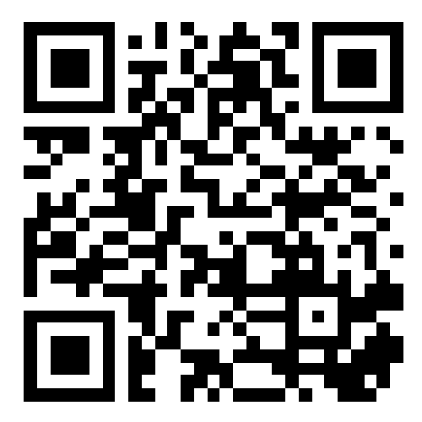
CSE 121 – Lesson 2
Kai Daniels
Summer 2023
Music: 🌸k-pop girlies playlist🌸
sli.do #cse121

Slide 2
Announcements, Reminders
Creative Project 0 was due yesterday (Jun 27) @ 11:59 PM
Programming Assignment 0 released later today (due Wed, July 5th bc holiday)
IPL is open! - Schedule and instructions can be found on course website.
Just joined CSE 121? Resubmission policy is your friend! See more in syllabus.
Reminder: Pre-Class Work and Section work are not graded! (but you should do them anyway 😉)

Slide 3
PCM Recap: Data Types & Expressions
Types: int, double, String, boolean
Expressions: Operators
Beware of precedence! (order of operations)

Slide 4
(PCM) Data Types in Java
In programming, you’re dealing with data…
ints (whole numbers)
doubles (real numbers)
Strings
booleans (true or false)

Slide 5
(PCM) Operators (for numerical & String values)
Numerical:
+ Addition
- Subtraction
* Multiplication
/ Division
% Modulo or “Mod”
Strings
+ Concatenation
Booleans
! Logical Not
&& Logical And
|| Logical Or
<, >, <=, >=, ==, !=

Slide 6
(PCM) Precedence
Parentheses
Multiplication, Modulo, Division
Addition (and Concatenation), Subtraction
If multiple operators at the same level?
Evaluate subexpressions from left to right!

Slide 7
Example
1 + 2 * 3
1 + 6
7
(1 + 2) * 3
3 * 3
9

Slide 8
Work on Expressions/Types Practice Problems Part 1
Ed lesson linked from the course calendar
Work with the folks around you!
TAs and I will be walking around to help

Slide 9
Questions?

Slide 10
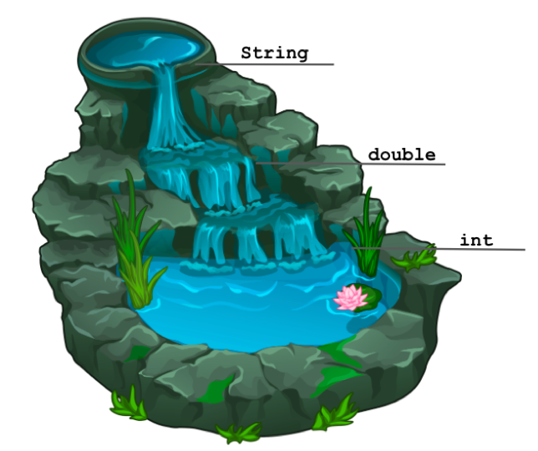
(PCM) Mixing Types
When mixing types in an expression, Java will convert one type to the other and then perform the operation “normally”
ints can be converted to doubles
Both ints and doubles can be converted to Strings

Slide 11
Example 2
2 + 2 + "hello" + 3 * 5 + 10
2 + 2 + "hello" + 15 + 10
4 + "hello" + 15 + 10
"4hello" + 15 + 10
"4hello15" + 10
"4hello1510"

Slide 12
Work on Expressions/Types Practice Problems
Part 2
Ed lesson linked from the course calendar
Work with the folks around you!
TAs and I will be walking around to help

Slide 13
Questions?

Slide 14
(PCM) Boolean Operators
! Logical Not
< > <= >= Relational Operators
== != Relational Operators (equality)
&& Logical And
|| Logical Or

Slide 15
(PCM) Precedence (updated)
Logical not
Parentheses
Multiplication, Modulo, Division
Addition (and Concatenation), Subtraction
Relational operators
Equality operators
Logical and
Logical or

Slide 16
Example 3
1 + 2 * 3 != (1 + 2) * 3
1 + 2 * 3 != 3 * 3
1 + 6 != 3 * 3
1 + 6 != 9
7 != 9
true

Slide 17
Work on Expressions/Types Practice Problems
Part 3
Ed lesson linked from the course calendar
Work with the folks around you!
TAs and I will be walking around to help

Slide 18
Questions?

Slide 19
(PCM) Variables
Now that we know about different types and data, we can learn about how to store it!
Java allows you to create variables within a program. A variable has
A type
A name
(Potentially) a value it is storing
Declaration: int x;
Initialization: x = 30;
Or all in one line:
int x = 30;

Slide 20
(PCM) Variables
Notice – this doesn't really make any mathematical sense!
That's because, in Java, = is assignment, not equality!
They’re made to be manipulated, modified, re-used!
int myFavoriteNumber = 7;
int doubleFV = myFavoriteNumber * 2;
myFavoriteNumber = myFavoriteNumber + 3;
Notes:
declare and initialize
Arithmetic with variables and place into another one
A variable… varies! It can change value.
Use one variable to set another one: it’s possible!

Slide 21
New Operators!
myFavoriteNumber = myFavoriteNumber + 3;
This type of pattern is so common, we have an even shorter way we can write it!
myFavoriteNumber += 3;
You can do the same for -=, *=, /=, and %=
And there are even shorter versions for incrementing and decrementing! myFavoriteNumber++; myFavoriteNumber--;

Slide 22
What do a, b, and c hold after this code is executed?
int a = 10;
int b = 30;
int c = a + b;
c -= 10;
a = b + 5;
b /= 2;
10, 30, 40
35, 15, 30
35, 15.5, 30
20, 15, 30

