Slide 1
CSE 121 – Lesson 13
Justin Ung
Summer 2023
Music: 🌸k-pop girlies playlist🌸
No sli.do today <3

Slide 2
Announcements, Reminders
Programming Assignment 3 Its Data Time released, due next Tuesday
Resub 4 due yesterday, Resub 5 out now due next Thurs
Quiz 2 (Take-home): Monday Aug 7th (8/7)
Topics: File I/O (Scanner, PrintStream), Arrays, Reference Semantics
Reminder: Final exam Wednesday Aug 16 4:30 – 6:30 PM in PAA A102
Left-Handed Seating Request form posted on Ed due Aug 7th EOD

Slide 3
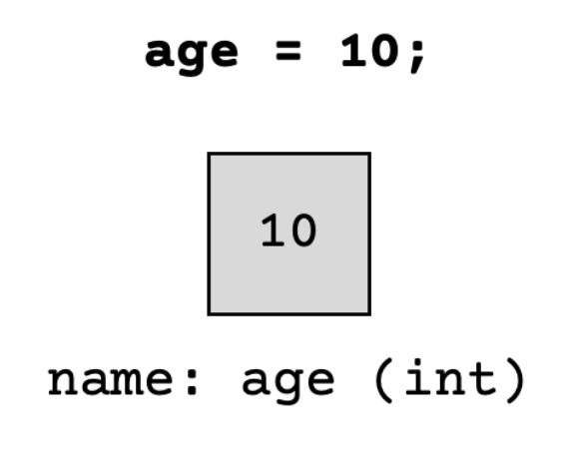
(PCM) Value Semantics vs. Reference Semantics
Applies when working with primitive types
Variables/parameters hold a copy of the actual value
Applies when working with objects
Variables/parameters hold a reference to the object

Slide 4
(PCM) Value Semantics vs. Reference Semantics
int a = 3;
int b = a;
a = 99;
int[] list1 = {4, 8, 15, 16, 23};
int[] list2 = list1;
list1[1] = 99;

Slide 5
(PCM) Value Semantics vs. Reference Semantics
boolean test = true;
flipValue(test);
public static void flipValue(boolean b) {
b = !b;
}
boolean[] tests =
{true, true, false, true, false, false};
flipValues(tests);
public static void flipValues(boolean[] b) {
for (int i = 0; i < b.length; i++) {
b[i] = !b[i];
}
}

Slide 6
Array Patterns!

Slide 7
(PCM) Counting Elements that Meet a Condition
"one" | "two" | "three" | "six" | "seven" | "eight" | "ten"
public static int evenLength(String[] list) {
int countEven = 0;
for (int i = 0; i < list.length; i++) {
if ( ) {
countEven++;
}
}
return countEven;
}

Slide 8
(PCM) Counting Elements that Meet a Condition
"one" | "two" | "three" | "six" | "seven" | "eight" | "ten"
public static int evenLength(String[] list) {
int countEven = 0;
for (int i = 0; i < list.length; i++) {
if (list[i].length() % 2 == 0) {
countEven++;
}
}
return countEven;
}

Slide 9
(PCM) Modifying Elements of an Array
4 | 8 | 15 | 16 | 23 | 42
public static void clamp(int min, int max, int[] list) {
for (int i = 0; i < list.length; i++) {
if ( > max) {
= max;
} else if ( < min) {
= min;
}
}
}

Slide 10
(PCM) Modifying Elements of an Array
4 | 8 | 15 | 16 | 23 | 42
public static void clamp(int min, int max, int[] list) {
for (int i = 0; i < list.length; i++) {
if (list[i] > max) {
list[i] = max;
} else if (list[i] < min) {
list[i] = min;
}
}
}

Slide 11
(PCM) Searching for an Element
"one" | "two" | "three" | "six" | "seven" | "eight" | "ten"
public static int indexOfIgnoreCase(String phrase, String[] list) {
for (int i = 0; i < list.length; i++) {
if ( ) {
return ;
}
}
return ;
}

Slide 12
(PCM) Searching for an Element
"one" | "two" | "three" | "six" | "seven" | "eight" | "ten"
public static int indexOfIgnoreCase(String phrase, String[] list) {
for (int i = 0; i < list.length; i++) {
if (list[i].equalsIgnoreCase(phrase)) {
return i;
}
}
return -1;
}

Slide 13
(PCM) Shifting Elements
9.6 | -88.0 | 4.815 | 0.009 | 7.0184 | 42.9
public static void rotateRight(double[] list) {
double lastElement = list[list.length - 1];
for (int i = list.length - 1; i > 0; i--) {
list[i] = list[i - 1];
}
}

Slide 14
(PCM) Shifting Elements
9.6 | -88.0 | 4.815 | 0.009 | 7.0184 | 42.9
public static void rotateRight(double[] list) {
double lastElement = list[list.length - 1];
for (int i = list.length - 1; i > 0; i--) {
list[i] = list[i - 1];
}
list[0] = lastElement;
}

Slide 15
(PCM) Looking at Multiple Elements in an Array
0 | 1 | 9 | 1 | 0
public static boolean isPalindrome(int[] list) {
for (int i = 0; i < list.length / 2; i++) {
if (list[i] != list[list.length - 1 - i]) {
return ;
}
}
return ;
}

Slide 16
(PCM) Looking at Multiple Elements in an Array
0 | 1 | 9 | 1 | 0
public static boolean isPalindrome(int[] list) {
for (int i = 0; i < list.length / 2; i++) {
if (list[i] != list[list.length - 1 - i]) {
return false;
}
}
return true;
}

Slide 17
(PCM) Array of Counters or "Tallying"
8 3 0 1 2 2 0 7 2
public static int[] numCount(Scanner input) {
int[] counts = ;
while (input.hasNextInt()) {
int num = input.nextInt();
}
return counts;
}

Slide 18
(PCM) Array of Counters or "Tallying"
8 3 0 1 2 2 0 7 2
public static int[] numCount(Scanner input) {
int[] counts = new int[10];
while (input.hasNextInt()) {
int num = input.nextInt();
counts[num]++; }
return counts;
}

Slide 19
(PCM) Common Ideas in Array Patterns
Loop bounds
Direction of traversal
Indexing into an array

