Slide 1
CSE 121 – Lesson 12
Kai Daniels
Summer 2023
Music: 🌸k-pop girlies playlist🌸
sli.do #cse121

Slide 2
Announcements, Reminders
Programming Assignment 2 due yesterday, Programming Assignment 3 Its Data Time out later today due next Tuesday
C3 will be a take home final
Resub 4 due tomorrow
Quiz 2 (Take-home): Monday Aug 7th (8/7)
Topics: File I/O (Scanner, PrintStream), Arrays, Reference Semantics
Reminder: Final exam Wednesday Aug 16 4:30 – 6:30 PM in PAA A102
Left-Handed Seating Request form posted on Ed due Aug 7th EOD

Slide 3
(PCM) Arrays
Elements (must all be the same type)
Indices (starting at 0)
Must decide size when created
arr.length to get arr's length
Arrays.toString(arr) to get a nice String version

Slide 4
(PCM) Array Traversal Pattern
for (int i = 0; i < arr.length; i++) {
// do something with arr[i]
}

Slide 5
How can we get the last element of an array arr?
arr[arr.length()]
arr[length()]
arr[arr.length]
arr[arr.length() -1]
arr[arr.length - 1]

Slide 6
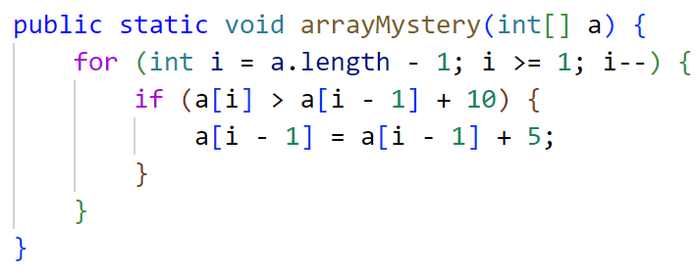
What would the array a store at the end of this arrayMystery method if {-20, 20, 26, 32, 50, 3} was passed in?
{-20, 20, 26, 32, 50, 3}
{-15, 25, 31, 37, 55, 8}
{-15, 25, 31, 37, 50, 3}
{-15, 20, 26, 37, 50, 3}

Slide 7
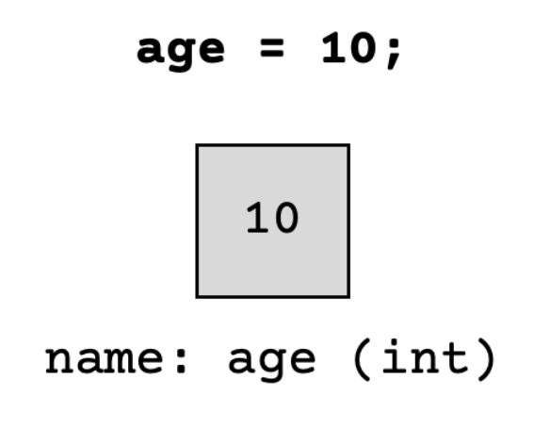
(PCM) Value Semantics vs. Reference Semantics
Applies when working with primitive types
Variables/parameters hold a copy of the actual value
Applies when working with objects
Variables/parameters hold a reference to the object

Slide 8
(PCM) Value Semantics vs. Reference Semantics
int a = 3;
int b = a;
a = 99;
int[] list1 = {4, 8, 15, 16, 23};
int[] list2 = list1;
list1[1] = 99;

Slide 9
(PCM) Value Semantics vs. Reference Semantics
boolean test = true;
flipValue(test);
public static void flipValue(boolean b) {
b = !b;
}
boolean[] tests =
{true, true, false, true, false, false};
flipValues(tests);
public static void flipValues(boolean[] b) {
for (int i = 0; i < b.length; i++) {
b[i] = !b[i];
}
}

Slide 10
public static void main(String[] args) {
int x = 0;
int[] a = new int[4];
x++;
mystery(x, a);
System.out.println(x + " " + Arrays.toString(a));
x++;
mystery(x, a);
System.out.println(x + " " + Arrays.toString(a));
}
public static void mystery(int x, int[] a) {
x++;
a[x]++;
System.out.println(x + " " + Arrays.toString(a));
}
Four lines of output would be produced by this code. What would those four lines be?

Slide 11
public static void main(String[] args) {
int x = 0;
int[] a = new int[4];
x++;
mystery(x, a);
System.out.println(x + " " + Arrays.toString(a));
x++;
mystery(x, a);
System.out.println(x + " " + Arrays.toString(a));
}
public static void mystery(int x, int[] a) {
x++;
a[x]++;
System.out.println(x + " " + Arrays.toString(a));
}

