Slide 1
CSE 121 – Lesson 1
Kai Daniels
Summer 2023
Music: 🌸k-pop girlies playlist🌸
sli.do #cse121

Slide 2
Announcements, Reminders
Check out course website for links to all activities, materials
Creative Project 0 has been released
Due 6/27, 11:59PM
Can post on Ed for questions!
The IPL will open on Monday (June 26, 12:30 PM)

Slide 3
Escape Sequences
escape sequence: A special sequence of characters used to represent certain special characters in a string.
\" to produce " in a String
\\ to produce \ in a String
\n to produce a new line character (or line break) in a String
And there are more!

Slide 4
Activities in Class
Goal: To get you actively participating in your learning!
May ask you to think and volunteer a suggestion
May ask you poll in with a response (via slido)
Not graded but strongly encouraged to maximize your learning and use of class time!

Slide 5
Activities in Class
Goal: To get you actively participating in your learning!
May ask you to think and volunteer a suggestion
May ask you poll in with a response (via slido)
Not graded but strongly encouraged to maximize your learning and use of class time!
Common Format: Think, Pair, Share
Question is posed
Think about the question on your own
Pair up with your neighbor and discuss the question
Focus on how you arrived at your answers, whether they're the same or different!
Share what you discussed with the rest of the class!

Slide 6
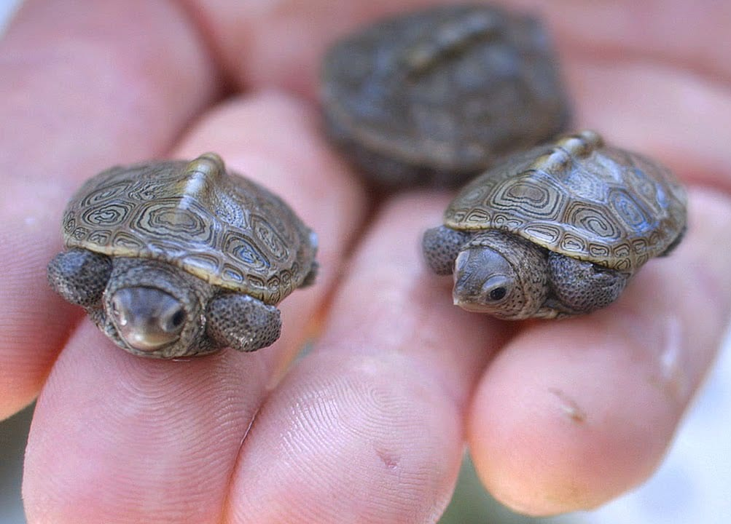
🐢 Turtle Time!
Image from: https://wp.wwu.edu/turtles/tag/adorable/

Slide 7
🐢 Turtles!
Turtle donatello = new Turtle();
Method | Description
forward(n) | Moves the turtle forward by n steps
backward(n) | Moves the turtle backward by n steps
right(d) | Turns the turtle right by d degrees
left(d) | Turns the turtle left by d degrees
speed(ms) | Sets the number of milliseconds it takes for the turtle to perform an action (e.g., if ms is 1000, then it will take the turtle 1000 ms = 1 second to perform an action like moving forward or turning).
up() | Picks up the turtle's pen so it doesn’t draw when it moves
down() | Puts the turtle's pen down so it draws when it moves
width(w) | Sets the width of the turtle's pen to w pixels wide
penColor(c) | Sets the color of the turtle's pen to c

Slide 8
Activities in Class
Goal: To get you actively participating in your learning!
May ask you to think and volunteer a suggestion
May ask you poll in with a response (via slido)
Not graded but strongly encouraged to maximize your learning and use of class time!
Common Format: Think, Pair, Share
Question is posed
Think about the question on your own
Pair up with your neighbor and discuss the question
Focus on how you arrived at your answers, whether they're the same or different!
Share what you discussed with the rest of the class!

Slide 9
Assuming we have created a Turtle named Donatello, what do you think the following commands would end up drawing?
donatello.left(90);
donatello.forward(30);
donatello.right(135);
donatello.forward(40);
donatello.left(135);
donatello.forward(30);
A circle
A triangle
The letter M
The letter N
A star

