Slide 1
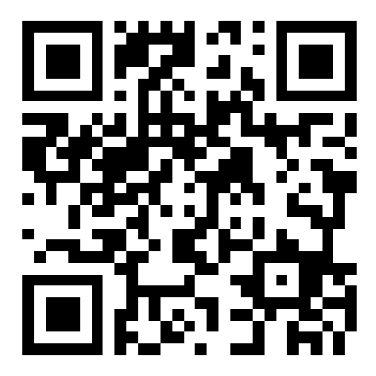
Welcome to CSE 121!
Kai Daniels
Summer 2023
Music: k-pop girlies playlist
sli.do #cse121

Slide 2
Agenda
About me
About this course
Learning objectives
Other similar courses
Course components
Our learning model
Tools and resources
Course Website
Ed
Assessment and grading
Collaboration

Slide 3
Agenda
About me
About this course
Learning objectives
Other similar courses
Course components
Our learning model
Tools and resources
Course Website
Ed
Assessment and grading
Collaboration

Slide 4
Hi, I’m Kai! (he/they)
Part-Time Lecturer for the Allen School
UW CSE alum
BS in CSE
Minor in INFO
Incoming Software Engineer at Microsoft
I have two cats

Slide 5
My two cats:

Slide 6
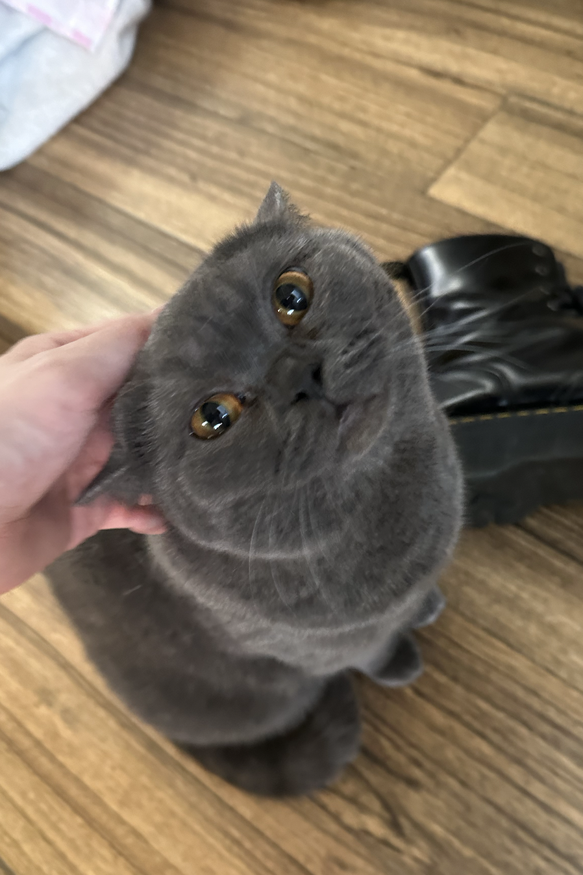
My two cats:

Slide 7
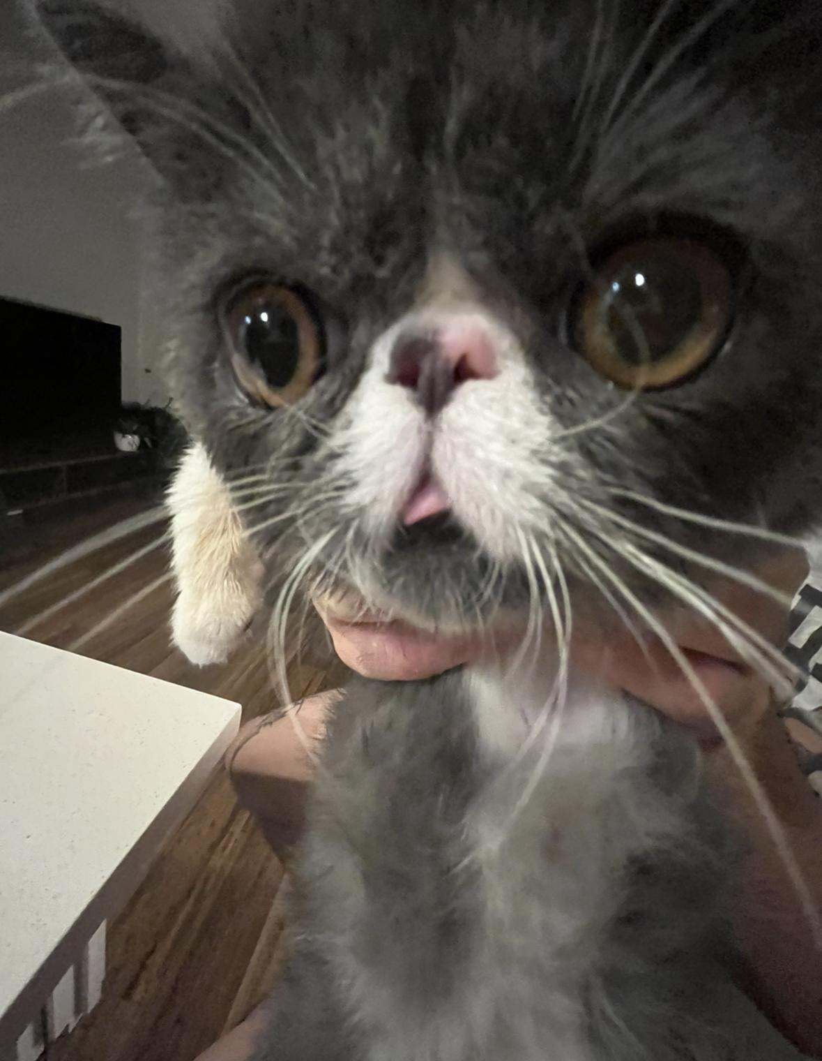
My two cats:

Slide 8
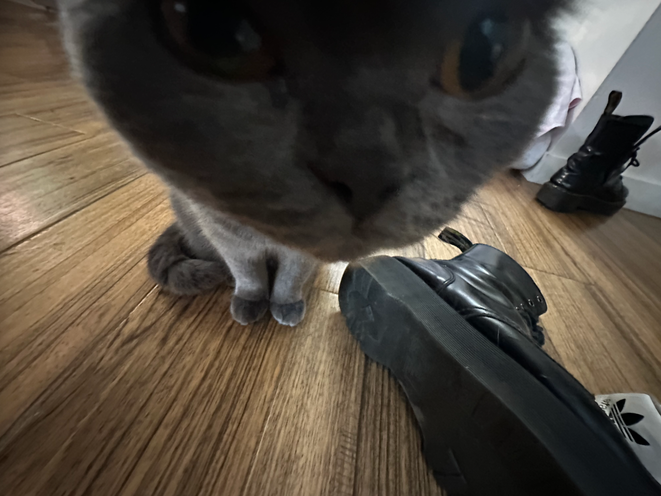
My two cats:

Slide 9
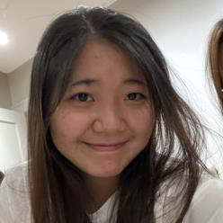
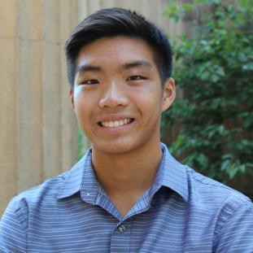
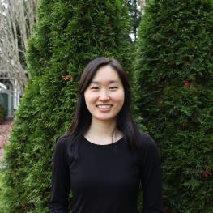
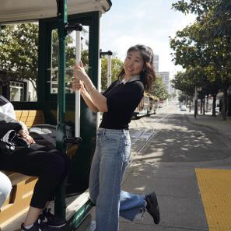
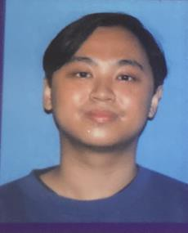
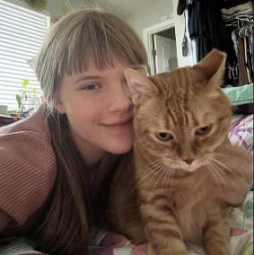
Meet your 10 TAs!
Lesson 0 - Su 2023
5
Notes:
Get to know your TAs!
They will be your main reference point for getting help with course content
They make the courses run, they grade everything, they will run section, get to know them!
It is much harder to succeed in this class without talking with or getting help from the TAs

Slide 10
Agenda
About me
About this course
Learning objectives
Other similar courses
Course components
Our learning model
Tools and resources
Course Website
Ed
Assessment and grading
Collaboration
Notes:
Asking questions in class can be scary, if you have a question raise your hand!
But if you don’t want to do that - there are still wants you can actively engage with the class

Slide 11
How to use sli.do?
1. Scan the QR Code with your phone or go to https://app.sli.do/event/uiggNa1276YjTX6oEM3qSV
(link will change for future lectures)
2. Ask a question!
3. There will also be polls and questions I may ask here
sli.do #cse121

Slide 12
Go ahead and ask a question!
sli.do #cse121

Slide 13
Learning Objectives
or, “What will I learn in this class?”
Functionality/Behavior: Write functionally correct Java programs that meet a provided specification and/or solve a specified problem
Functional Decomposition: Break down problems into subproblems that are modular and reusable, and define methods to represent those subproblems
Control Structures: Select and apply control structures (e.g. methods, loops, conditionals) to manage the flow of control and information in programs
Data Abstraction: Select and apply basic data abstractions (e.g. variables,
parameters, arrays, classes) to manage and manipulate data in programs
Code Quality: Define programs that are well-written, readable, maintainable, and conform to established standards
Notes:
It is okay if you do not have them memorized, but everything will come back to this
Notice how only one of these five things we are evaluating you on is about your code producing “correct” output
This class e

Slide 14
Other Similar Courses
Course | Good choice if…
CSE 121 | You’ve never programmed before AND You are, or want to be, in a major such as CS, CE, ECE, Info, etc. that requires Java programming
CSE 122 | You’ve done some programming (roughly one course worth) in any programming language AND You are, or want to be, in a major such as CS, CE, ECE, Info, etc. that requires Java programming
CSE 123 | You’ve taken CSE 122 AND You are, or want to be, in a major such as CS, CE, ECE, Info, etc. that requires Java programming
CSE 160 | You’ve never programmed before AND You’re interested in data science and analysis OR You’d rather learn Python than Java* OR You are, or want to be, in a major such as Physics, Bio, Stat, etc. where analyzing data through programming is useful
Other courses of interest: CSE 154, CSE 163
See Guided Self-Placement and Introductory Courses for more info
Notes:
Let’s talk about this class in the context of others -
If you have never touched programming ever before or maybe just a little, this is the right place for you
This class is meant for absolute novices
When I took this class many years ago - I expected it to be the case where everybody was dark screen nerds that had been coding since birth but thats not the case! Your peers are in the same boat as you, get to know them!
If this course is maybe not the most appropriate fit for you given your background, I encourage you to switch to 122 or 123!

Slide 15
Course Components
Meetings
LECTURES
(x15)
We’re here!
Introduce concepts, practice ideas, discuss applications.
Pre-class materials to prepare for class each day. Due before class.
Notes:
Lectures on W and F; has pre-class work due before class
This is so when I talk about something like a for loop or variables, you have an idea of what I’m referring to even if you don’t know how to use it perfectly (basically put all the boring stuff before class)
We do not take attendance, it is only in your own interest to show up to lecture, take notes, and actively participate
It’s worth noting that there are a good amount of students here that are non-matriculated (high school, lifetime learners, etc)
University classes require you to keep pace and organize your own time effectively, and my best advice for staying on top of your work is to not let yourself fall behind - come to lecture, attend section, ask questions on Ed, and get help at the IPL/Office hours.
I believe in all of you!

Slide 16
Course Components
Meetings
LECTURES
(x15)
SECTIONS
(x15)
We’re here!
Introduce concepts, practice ideas, discuss applications.
Pre-class materials to prepare for class each day. Due before class.
Held in person
More practice, reviews, applications
TA advice, how to be an effective student
Preparation for quizzes / exams
Notes:
Sections - going to be smaller scale but much more hands on work with TAs
This is where you can get real practice, prep for exams and quizzes, and TA advice about navigating this class
Not recorded

Slide 17
Course Components
Meetings
LECTURES
(x15)
SECTIONS
(x15)
We’re here!
Introduce concepts, practice ideas, discuss applications.
Pre-class materials to prepare for class each day. Due before class.
Held in person
More practice, reviews, applications
TA advice, how to be an effective student
Preparation for quizzes / exams
Assessments
PROGRAMMING ASSIGNMENTS
(x4)
Structured assignments
Programming in Java
Applying & implementing course concepts
Notes:
Programming Assignments are structured assignments that we use to assess some of those foundational ideas we want you to grasp
They have stricter requirements, are generally more “substantive” and will also be our way to measure your technical progress throughout the course

Slide 18
Course Components
Meetings
LECTURES
(x15)
SECTIONS
(x15)
We’re here!
Introduce concepts, practice ideas, discuss applications.
Pre-class materials to prepare for class each day. Due before class.
Held in person
More practice, reviews, applications
TA advice, how to be an effective student
Preparation for quizzes / exams
Assessments
PROGRAMMING ASSIGNMENTS
(x4)
CREATIVE PROJECTS
(x4)
Structured assignments
Programming in Java
Applying & implementing course concepts
More open-ended
assignments
Explore new ideas and applications
Notes:
We understand that coding is a very open ended thing, so we want to give you flexibility to “play” with coding
Creative projects are open ended assignments allow you to explore coding more! Summer quarter is a little bit different, however, as we have 9 weeks instead of 10 and no finals week, so one of the later assignments will be modified. More on that later

Slide 19
Course Components
Meetings
LECTURES
(x15)
SECTIONS
(x15)
We’re here!
Introduce concepts, practice ideas, discuss applications.
Pre-class materials to prepare for class each day. Due before class.
Held in person
More practice, reviews, applications
TA advice, how to be an effective student
Preparation for quizzes / exams
Assessments
PROGRAMMING ASSIGNMENTS
(x4)
CREATIVE PROJECTS
(x4)
QUIZZES
(x3)
Structured assignments
Programming in Java
Applying & implementing course concepts
More open-ended
assignments
Explore new ideas and applications
Take home quizzes
No retakes
Added infrastructure
Notes:
There will be three quizzes throughout the quarter
They will be take home quizzes, all of which are are on the course calendar on the website so you can begin planning around those.
These quizzes are meant to be taken individually, and will not have the opportunity to retake
These are meant to soften the weight of something like a final (better than something like 60% of your grade being the final or midterm/final, which is how intro CSE used to be)

Slide 20
Course Components
Meetings
LECTURES
(x15)
SECTIONS
(x15)
We’re here!
Introduce concepts, practice ideas, discuss applications.
Pre-class materials to prepare for class each day. Due before class.
Held in person
More practice, reviews, applications
TA advice, how to be an effective student
Preparation for quizzes / exams
Assessments
PROGRAMMING ASSIGNMENTS
(x4)
CREATIVE PROJECTS
(x4)
QUIZZES
(x3)
EXAM
(x1)
Structured assignments
Programming in Java
Applying & implementing course concepts
More open-ended
assignments
Explore new ideas and applications
Take home quizzes
No retakes
Added infrastructure
Culminating exam
Date TBD (most likely last week)
Notes:
Finally, an in person exam will be on the last week of the quarter, most likely on the Wednesday
Will evaluate the entire quarter, and will be conducted in person and written on paper. With this in mind, you should consider practicing writing code and problems on paper throughout the quarter in section or at home as you will be expected to do so on the final
Not meant to tank your grade, will be about the weight of two ish quizzes

Slide 21
Agenda
About me
About this course
Learning objectives
Other similar courses
Course components
Our learning model
Tools and resources
Course Website
Ed
Assessment and grading
Collaboration
10

Slide 22
11
Notes:
Who knows who this is?
Raise your hand if you know how to ride a bike?
Now raise your hand if you learned how to ride a bike by watching videos twice a week about what parts of the bike do what and how to turn and pedal correctly via GoPro etc
Traditional learning model is you watching me work through problems, you are following and nodding and like oh this is great and then you get to the quiz where you have to do it yourself and you are like… shit
You learn through having to physically do it and redo it and redo it over and over. Active learning! This is why PCM is so important!

Slide 23
How Learning Works
Learning requires active participation in the process. It’s not as simple as sitting
and listening to someone talk at you.
Requires deliberate practice in learning by doing
Benefits from collaborative learning

Slide 24
How Learning Works
Learning requires active participation in the process. It’s not as simple as sitting
and listening to someone talk at you.
Requires deliberate practice in learning by doing
Benefits from collaborative learning
Hybrid classroom model
Asks you to do some preparation before class in the form of readings and practice problems.
Should take ~20 minutes a day
Class will start with brief recap, then pick up
where the reading and practice problems leave off.

Slide 25
How Learning Works
Learning requires active participation in the process. It’s not as simple as sitting
and listening to someone talk at you.
Requires deliberate practice in learning by doing
Benefits from collaborative learning
Hybrid classroom model
Asks you to do some preparation before class in the form of readings and practice problems.
Should take ~20 minutes a day
Class will start with brief recap, then pick up
where the reading and practice problems leave off.
Pre-class materials and attendance are ungraded, but
It’s okay if you find them challenging! That means
you are learning!

Slide 26
Metacognition
Metacognition: asking questions about your solution process.
Examples:
While debugging: explain to yourself why you’re making this change to your
program.
Before running your program: make an explicit prediction of what you expect to see.
When coding: be aware when you’re not making progress, so you can take a break
or try a different strategy.
When designing:
Explain the tradeoffs with using a different data structure or algorithm.
If one or more requirements change, how would the solution change as a result?
Reflect on how you ruled out alternative ideas along the way to a solution.
When studying: what is the relationship of this topic to other ideas in the course?
Notes:
Who has heard of metacognition
Metacognition is thinking about the way you think
Once you figure out how you learn best how you study best etc - you will be much more successful
Rubber duck debugging

Slide 27
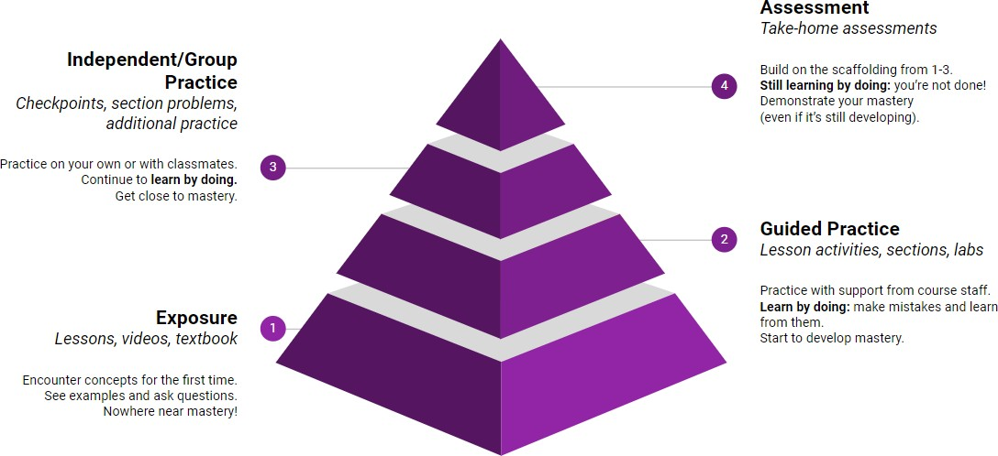
Learning in CSE 121 (or anywhere)

Slide 28
Course Culture and Support
Currently around 70 students enrolled!
Wide range of backgrounds, interests, and goals
Everyone is new to programming
Support and help each other!
Form study groups
If you have a question, others almost certainly do too

Slide 29
Course Culture and Support: Getting Help
Discussion Board
Feel free to make a public or private post on Ed
We encourage you to answer other peoples’ questions! A great way to learn

Slide 30
Course Culture and Support: Getting Help
Discussion Board
Feel free to make a public or private post on Ed
We encourage you to answer other peoples’ questions! A great way to learn
Introductory Programming Lab (Office Hours)
TAs can help you face to face in office hours, and look at your code
You can go to the IPL with any course questions, not just assignments
Notes:
My biggest mistake when I took this course was not using the IPL when I took 142, but I set up camp there in 143
IPL is amazing, across the board we get great feedback on that
Possibly hybrid for weekends and monday night because we understand that many people here are high school students, or have a job, etc

Slide 31
Course Culture and Support: Getting Help
Discussion Board
Feel free to make a public or private post on Ed
We encourage you to answer other peoples’ questions! A great way to learn
Introductory Programming Lab (Office Hours)
TAs can help you face to face in office hours, and look at your code
You can go to the IPL with any course questions, not just assignments
Section
Work through related problems, get to know your TA who is here to support you

Slide 32
Course Culture and Support: Getting Help
Discussion Board
Feel free to make a public or private post on Ed
We encourage you to answer other peoples’ questions! A great way to learn
Introductory Programming Lab (Office Hours)
TAs can help you face to face in office hours, and look at your code
You can go to the IPL with any course questions, not just assignments
Section
Work through related problems, get to know your TA who is here to support you
Email
We prefer that all content and logistic questions go on the Ed discussion board (even if you
make them private). ~100 of you >>> 10 of us!
For serious personal circumstances, you can email Kai directly. It never hurts to email me, but if it’s a common logistic question, I may ask you to post on the discussion board.

Slide 33
Course Culture and Support
Policies designed with flexibility in mind
Resubmissions/Retakes, lecture recordings
But life and the world still happen…
Please reach out ASAP if you’re struggling or have circumstances that
require extra support
Lesson 0 - Su 2023
17

Slide 34
The World Around CSE 121
Our goal is to give you a great CSE 121 experience
But CSE 121 does not exist in a vacuum – there’s a lot going on in the world
right now that can impact your education
We’ve designed course policies for maximum flexibility: ability to
resubmit assignments and take home quizzes
But we cannot cover every individual situation
Please reach out if you need accommodations of any kind to deal with these unfamiliar situations
Notes:
Shit happens, if you are dealing with extraneous circumstances reach out to me and the worst I can say is “that’s what resubmissions are for”

Slide 35
Agenda
About me
About this course
Learning objectives
Other similar courses
Course components
Our learning model
Tools and resources
Course Website
Ed
Assessment and grading
Collaboration

Slide 36
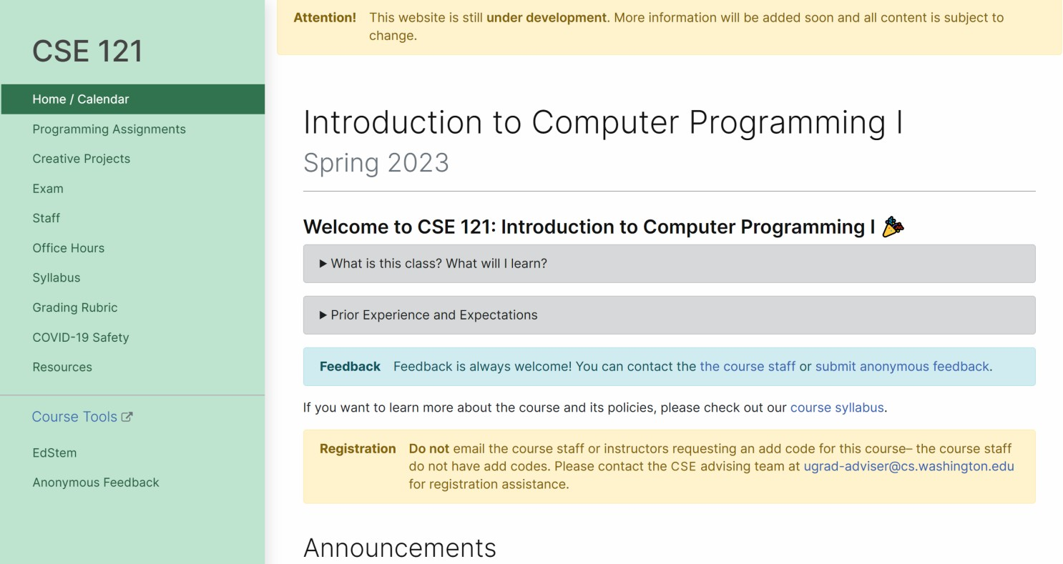
Course Website
cs.uw.edu/121
Primary source of course information (not Canvas)
Calendar will contain links to (almost) all resources
Notes:
Central place for all information you will need, bookmark this
Calendar will be your best friend

Slide 37
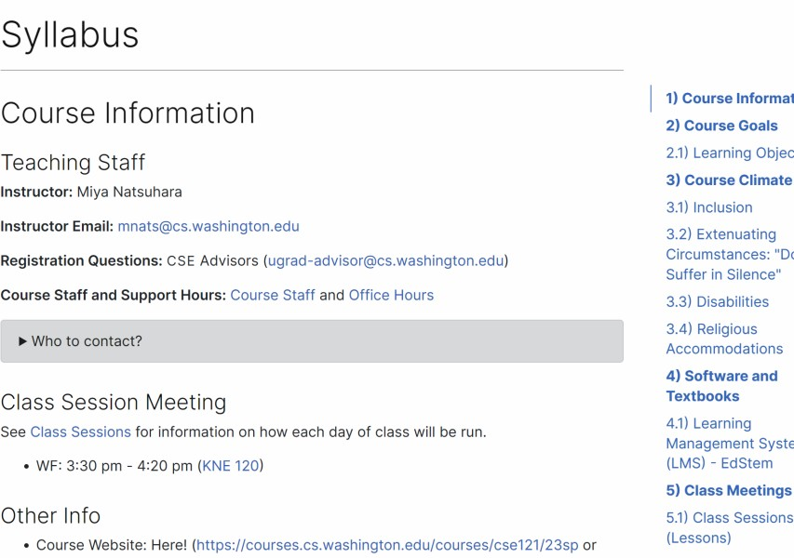
Course Website
Please review the syllabus ASAP.
Notes:
Syllabus is our contract with each other
It will answer all your questions, it will be heartbreaking if I get an email week 8 asking “what is a resubmission and how can I use it?”

Slide 38
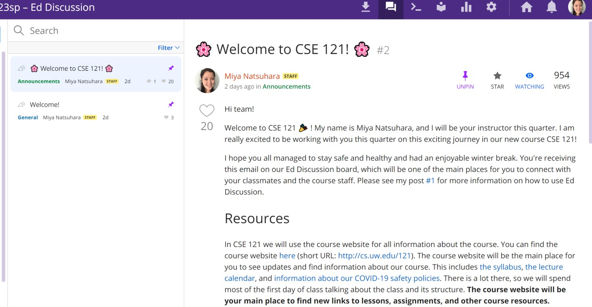
Ed
Our online learning platform
Lessons, sections, quizzes all here
Intro and walkthrough in Section 0
22

Slide 39
Other Course Tools
Canvas
My Digital Hand
Queueing in office hours
Gradebook
Lecture recordings
IntelliJ
Sli.do
Develop offline
Visual debugger
In-class activities (ungraded)
No account needed

Slide 40
Agenda
About me
About this course
Learning objectives
Other similar courses
Course components
Our learning model
Tools and resources
Course Website
Ed
Assessment and grading
Collaboration

Slide 41
Assessment and Grading
Our goal in the course is for you to gain proficiency of the concepts and skills we teach
We assess your proficiency by asking you to apply the concepts and skills on tasks or problems
By necessity, we are assessing your work as a proxy for your proficiency
25
Notes:
I cannot pry open your brain and see what is going on inside of that
We are assessing your work as a proxy

Slide 42
Resubmission/Retakes
Learning takes time, and doesn’t always happen on the first try!
Each week, one previous Programming Assignment or Creative Project can be resubmitted
Must be accompanied by write up explaining changes.
Grade on resubmission replaces original grade.
An assignment is only eligible for resubmission within 3 weeks of its original due date.
See syllabus for more details
26
Notes:
We are going to be using a growth mindset
Coding in the real world does not happen in a singular event, it is an iterative process of building and collaborating and improving already existing code. We understand that the first time you attempt an assignment, that is not representative of the understanding and quality of work you are capable of!
In an ideal world, I would let you all resubmit all assignments as many times as you want and I would not have to assign a grade at all. But unfortunately, we have 9 weeks and UW administration breathing down my neck for a number assessment of your class performance - so this is the best balance of those factors that we can do
For this exact reason, each week you will be able to resubmit one assignment for full credit
This means that if you did not submit it the week its due, and you resubmit it and get almost perfect, in your final grade calculation we will only consider the almost perfect submission.
Each resub will have TA feedback and grades
Notice we have a cap of 3 weeks of its original due date, don’t want week 1 turned in week 10
This is a bit more of a flexible rule, so if you are trying to resubmit something past the 3 week date please reach out to me and we can see if that is feasible.
Your grade CAN go down
This course is designed to encourage you to have the ability to resubmit each assignment once - that is the ideal way you should navigate this course and using a resubmission for an assignment twice will mean you cannot resubmit another one.
For this reason, there are no late days and no assignments submitted late will be accepted. If you submit it late, and send me an email saying oh I forgot can I please submit it late, I will respond with “use your resubmission.”
Submissions have a small grace period, I will not disclose what it is, but if you are a few seconds past the due date that is fine.

Slide 43
Grading
Grades should reflect your proficiency in the course objectives
All assignments will be graded
E (Excellent),
S (Satisfactory),
or N (Not yet)
Under certain circumstances, a grade of U (Unassessable) may be assigned
Final grades will be assigned based on the amount of work at each level
See the syllabus for more details
27
Notes:
We use an additive grade model in this class, what that means is that in this class you start at the bottom and every assignment you do can only ever increase your grade.
Seniors taking this class, what this means if you hit the point in the quarter where you have done enough work to get a minimum grade of 2.0 - you could just not show up to the final and you would be fine.
The more work you submit, that can only ever increase your grade

Slide 44
Agenda
About me
About this course
Learning objectives
Other similar courses
Course components
Our learning model
Tools and resources
Course Website
Ed
Assessment and grading
Collaboration
31

Slide 45
Collaboration Policy
Learning is hard, but it’s easier when you learn from each other
You are encouraged to form study groups, work together on practice and review, and discuss your ideas and approaches at a high level
In general, share ideas and work together, but don’t copy work. Never send someone else
your code or solution write up.
If you discuss your ideas with others, you must cite them
All work you submit for grading must be predominantly and substantially your own
Withdrawal policy
See the syllabus for more details
32
Notes:
I wish it was the case where I could just tell you things and you’d get it, but learning isn’t like that
Collaboration is a fundamental part of computer science - the internet would not exist without open sourcing and collaboration of code
That being said, this is still a class and any work you submit must be predominantly and substantially your own
There will be desperate times in the quarter where you will be tempted to copy and paste code you found from the internet or ask your friend to send you their code (from this quarter or a past quarter). DO NOT DO IT! It is NOT worth it.
We are not printing out your code and reviewing it in a dark room and a candle to see if it matches up - this is one of the most advanced and prestigious CS institutions in the world.
You are going up against an institution of computer scientists with some of the most sophisticated software in the world for identifying similarities. You will lose that battle.
If you think the capabilities of AI and chatGPT are cool, you’d be amazed at what the developers of those very same tools are able to do to detect the usage of AI and chatGPT. This is not a high school English class with an underpaid single teacher - this is an academic powerhouse that has every capability to detect and report academic misconduct. Do not do it.
The entire course is designed so anybody can succeed in it regardless of prior coding knowledge - you’ll have resubmissions, open book quizzes, dropped lowest grades on quizzes, all day office hours and 24/7 monitored Ed discussion boards which TAs are super responsive on. You have the most resources available of any class in the entire University of Washington - please use them instead of cheating.
I also understand that we all make mistakes and have lapses of judgements sometimes, so if you have that moment of weakness and you submit something at 11:58 and then the next morning realizing that was a mistake - you can invoke the withdrawal policy no questions asked nothing reported.

Slide 46
Help Us Improve!
CSE 121 is super new!
We worked hard to build a course we think will be effective and supportive and help you succeed
We probably didn’t get it all right
We appreciate your patience and understanding if we need to make adjustments during the quarter
Please give us lots of feedback!
Post on Ed and/or use the Anonymous Feedback Tool
33

Slide 47
To Ed!
Let’s write our first lines of code
33

Slide 48
“Homework” for Next Time
First assignment will be released today - but I don’t expect you to be able to finish it all
TODO this week
Get started on C0 (your first assignment)
Go meet your TA and classmates in Thursday’s quiz section
⭐️ Complete the pre-class material for Friday (see calendar)
Read over the Syllabus on the Website

