Slide 1
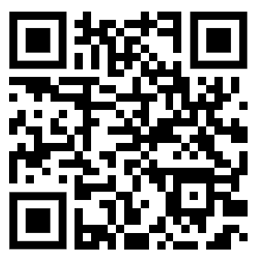
CSE 121 – Lesson 9
Miya Natsuhara
Spring 2023
Music: 121 23sp Lecture Vibes 🌸
TAs:
Jasmine
Shananda
Vidhi
Larry
Jacqueline
Afifah
Atharva
Julia
Anju
Lydia
Jonus
Hugh
Mia
Archit
Grace
Kailye
Joshua
James
Justin
Aishah
Claire
Lydia
Kai
sli.do #cse121

Slide 2
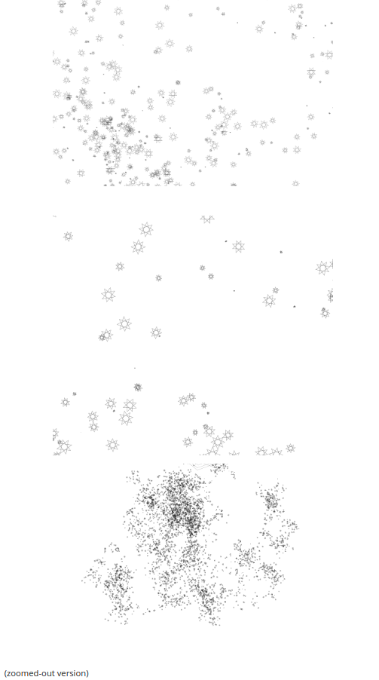
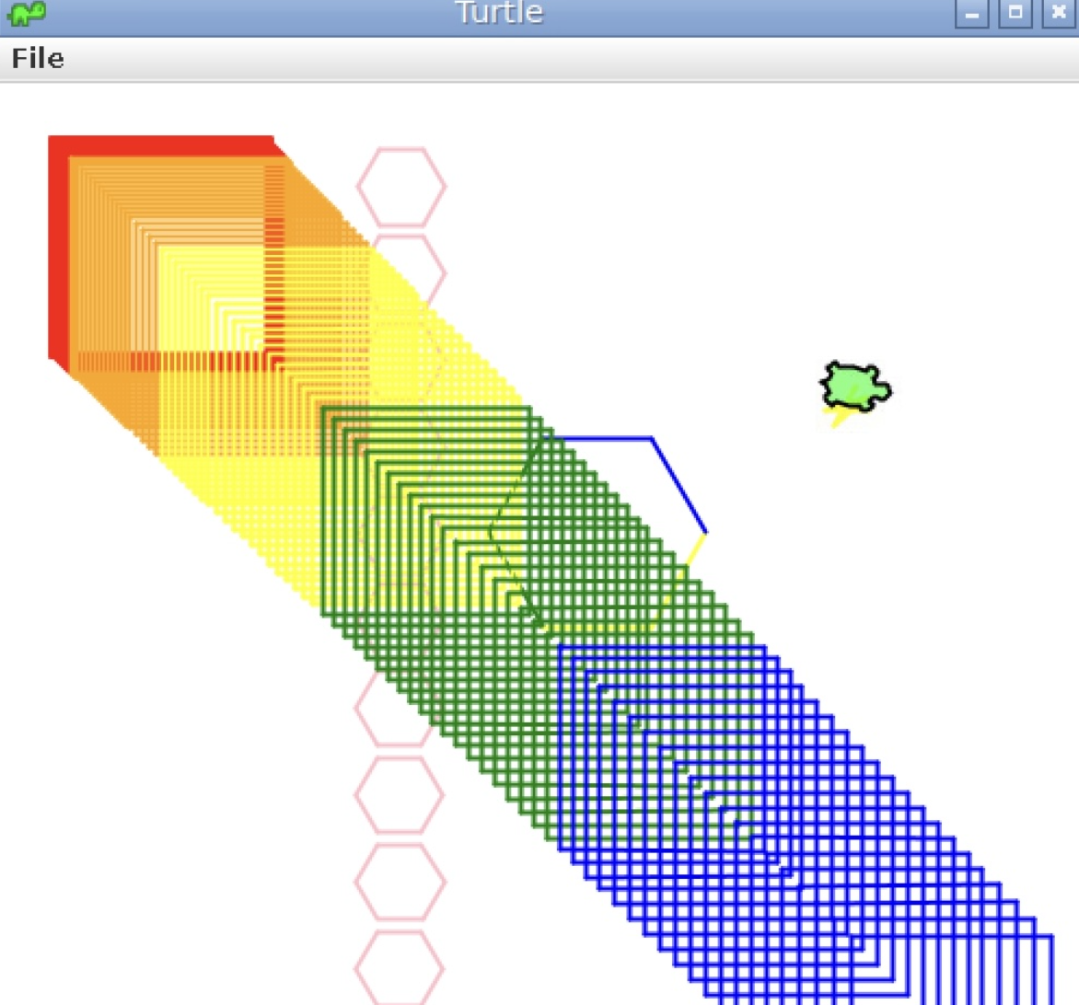
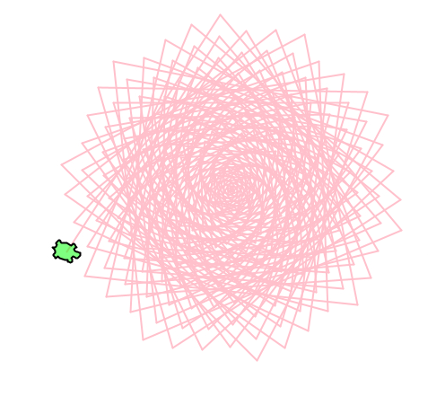
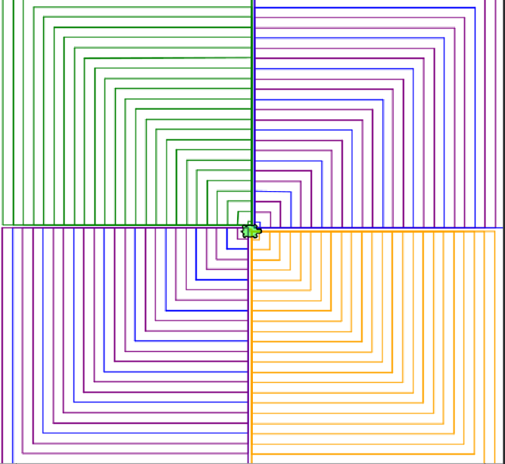
Creative Project Showcase!

Slide 3
Announcements, Reminders
Creative Project 2 released
Due Tuesday, May 2
Resubmission Cycle 2 form released
Note: this is the last time C0 is eligible for resubmission.
Quiz 0 Retakes possible 5/2, 5/9
Grades for Quiz 0 Retakes will be released all at once
Quiz 1 on Thursday, May 4 in quiz section
Mid-Quarter Formative Feedback with Ken Yasuhara for part of class on Wednesday, May 3

Slide 4
Common Problem-Solving Strategies
Analogy – Is this similar to another problem you've seen?
Brainstorming – Consider steps to solve problem before jumping into code
Try to do an example "by hand" → outline steps
Solve sub-problems – Is there a smaller part of the problem to solve?
Debugging – Does your solution behave correctly?
What is it doing?
What do you expect it to do?
What area of your code controls that part of the output?
Iterative Development – Can we start by solving a different problem that is easier?

Slide 5
Metacognition
Metacognition: thinking about how you think
Asking questions about your solution process
Examples
While debugging: explain to yourself why you're making this change to your program
Before running your program: make an explicit prediction of what you expect to see
When coding: be aware of when you're not making progress, so you can take a break or try a different strategy
When studying: What is the relationship of this topic to other ideas in the course?

Slide 6
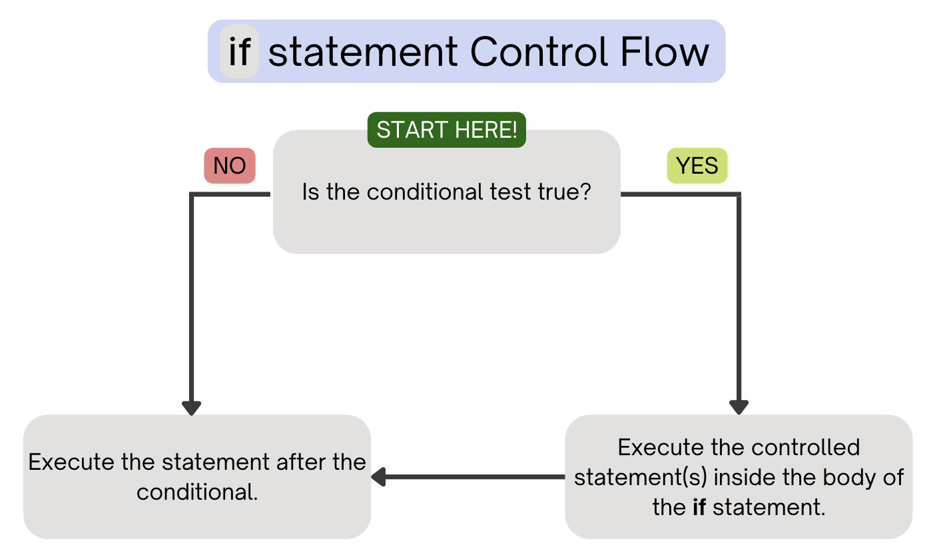
(PCM) Conditionals
Executes a block of statements only if the test is true

Slide 7
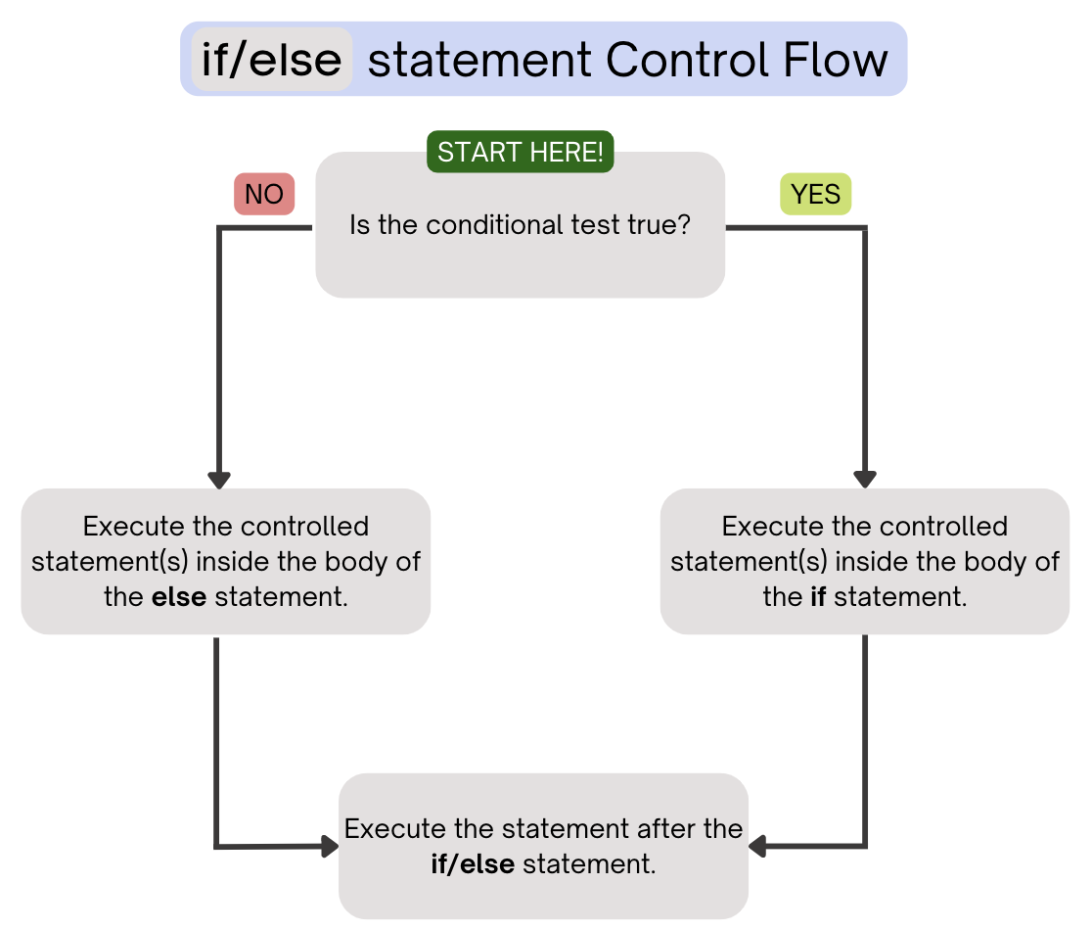
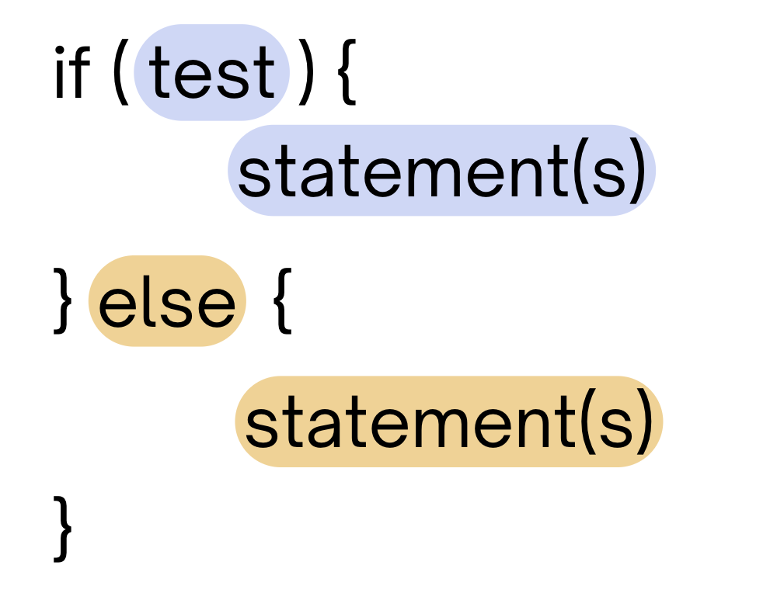
(PCM) Conditionals
Executes a block of statements if the test is true, executes another block of statements if the test is false

Slide 8
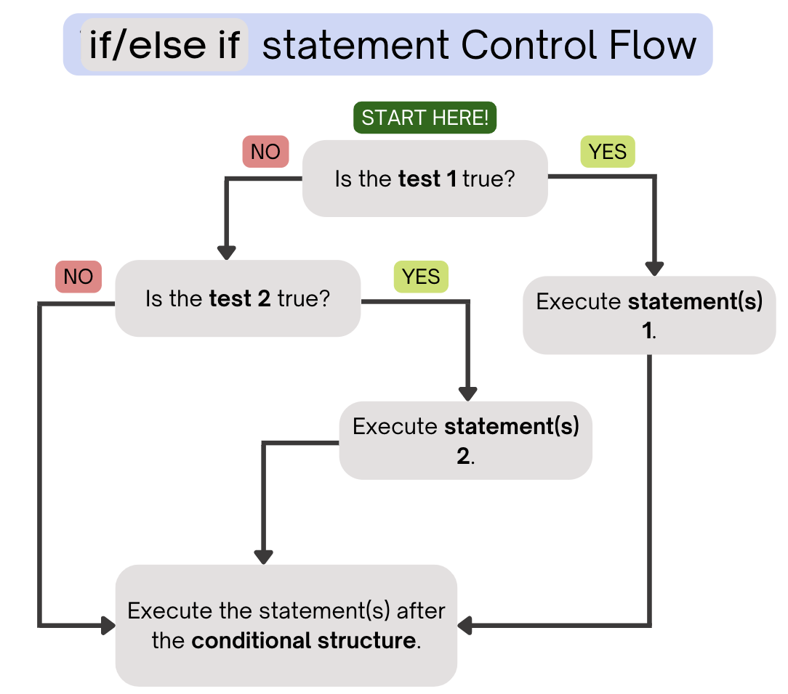
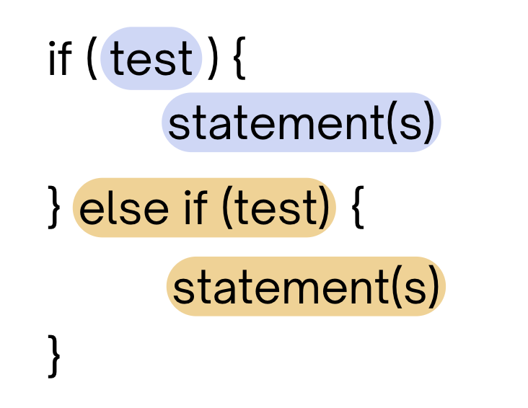
(PCM) Conditionals
Chooses between a block of statements to execute out of multiple choices, depending on which test it passes
If it ends in an else, exactly one block will be executed.
If it ends in an else if, at most one block will be executed, but the code also may not execute any blocks of statements.

Slide 9
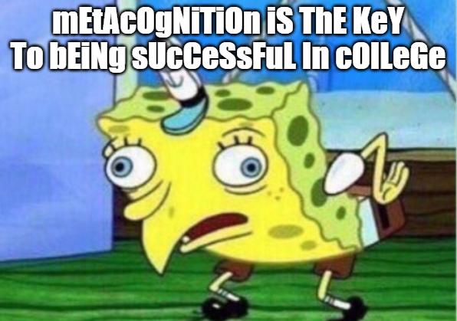

Slide 10
Common Problem-Solving Strategies
Analogy – Is this similar to another problem you've seen?
Brainstorming – Consider steps to solve problem before jumping into code
Try to do an example "by hand" → outline steps
Solve sub-problems – Is there a smaller part of the problem to solve?
Debugging – Does your solution behave correctly?
What is it doing?
What do you expect it to do?
What area of your code controls that part of the output?
Iterative Development – Can we start by solving a different problem that is easier?

Slide 11
Common Problem-Solving Strategies
Analogy – Is this similar to another problem you've seen?
Brainstorming – Consider steps to solve problem before jumping into code
Try to do an example "by hand" → outline steps
Solve sub-problems – Is there a smaller part of the problem to solve?
Debugging – Does your solution behave correctly?
What is it doing?
What do you expect it to do?
What area of your code controls that part of the output?
Iterative Development – Can we start by solving a different problem that is easier?

Slide 12
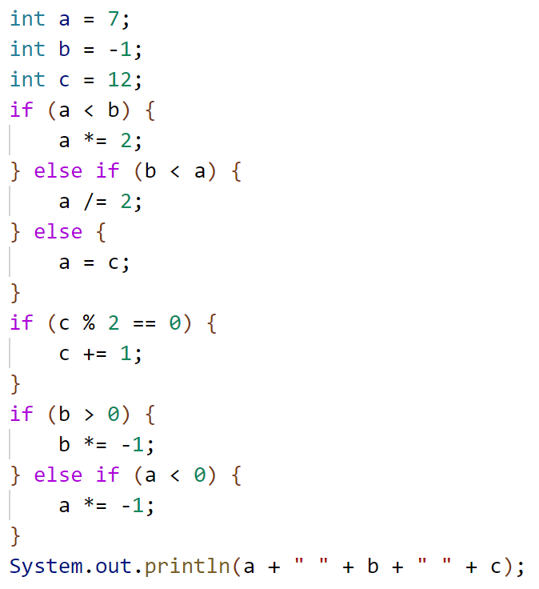
What is the output produced by executing this code?
A. 7 -1 12
B. -3 -1 13
C. 3 -1 13
D. 12 1 12
E. -14 1 13

