Slide 1
CSE 121 – Lesson 8
Miya Natsuhara
Spring 2023
Music: 121 23sp Lecture Vibes 🌸
TAs:
Jasmine
Shananda
Vidhi
Larry
Jacqueline
Afifah
Atharva
Julia
Anju
Lydia
Jonus
Hugh
Mia
Archit
Grace
Kailye
Joshua
James
Justin
Aishah
Claire
Lydia
Kai
sli.do #cse121

Slide 2
Announcements, Reminders
Programming Assignment 1 is due tonight, Wed April 26
Creative Project 2 will be released later today
Retakes
First round yesterday went smoothly!
Quiz 0 also eligible for retake on 5/2 and 5/9
Quiz 1 scheduled for Thursday next week, May 2
Wednesday May 3: Mid-term Formative Feedback

Slide 3
Common Problem-Solving Strategies
Analogy – Is this similar to another problem you've seen?
Brainstorming – Consider steps to solve problem before jumping into code
Try to do an example "by hand" → outline steps
Solve sub-problems – Is there a smaller part of the problem to solve?
Debugging – Does your solution behave correctly?
What is it doing?
What do you expect it to do?
What area of your code controls that part of the output?
Iterative Development – Can we start by solving a different problem that is easier?

Slide 4
Metacognition
Metacognition: thinking about how you think
Asking questions about your solution process
Examples
While debugging: explain to yourself why you're making this change to your program
Before running your program: make an explicit prediction of what you expect to see
When coding: be aware of when you're not making progress, so you can take a break or try a different strategy
When studying: What is the relationship of this topic to other ideas in the course?

Slide 5
(PCM) Returns
Returns allow us to send values out of a method
public static <type> myMethod(int num) {
System.out.print(num + " is the best!");
... return <value of correct type>
}
Calling a method that returns a value…
<type> result = myMethod(42);
Evaluates the expression
Returns this value to where the method is called from
Method immediately exits

Slide 6
(Recall) String Methods Usage: <string variable>.<method>(…)
Method | Description
length() | Returns the length of the string.
charAt(i) | Returns the character at index i of the string
indexOf(s) | Returns the index of the first occurrence of s in the string; returns -1 if s doesn't appear in the string
substring(i, j) or substring(i) | Returns the characters in this string from i (inclusive) to j (exclusive); if j is omitted, goes until the end of the string
contains(s) | Returns whether or not the string contains s
equals(s) | Returns whether or not the string is equal to s (case-sensitive)
equalsIgnoreCase(s) | Returns whether or not the string is equal to s ignoring case
toUpperCase() | Returns an uppercase version of the string
toLowerCase() | Returns a lowercase version of the string
Notes:
Bomb = may get error if indexing int is out of bounds (e.g. negative index, or larger than the length of the string)
Safety guy = should return without error in usual case

Slide 7
String example
String s = "gumball";
s = s.substring(7, 8).toUpperCase() + s.substring(8) + "ball";

Slide 8
Example of returns: Math class
Methods | Returns
Math.abs(value) | Absolute value of value
Math.ceil(value) | value rounded up
Math.floor(value) | value rounded down
Math.max(value1, value2) | Larger of the two given values
Math.min(value1, value2) | Smaller of the two given values
Math.round(value) | value rounded to the nearest whole number
Math.sqrt(value) | Square root of value
Math.pow(base, exp) | base to the exp power

Slide 9
Math example
double value = 823.577564893;
double roundedValue = (double) Math.round(value * 100) / 100;

Slide 10
What is the correct implementation of a maxDatingAge method?
A.
B.
C.
D.

Slide 11
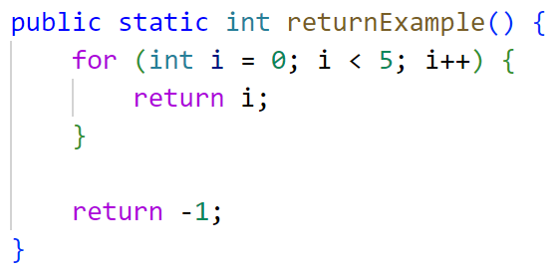
What is the output of this program?
A. 0
B. 4
C. 5
D. -1

