Slide 1
CSE 121 – Lesson 6
Miya Natsuhara
Spring 2023
Music: 121 23sp Lecture Vibes 🌸
TAs: Jasmine Atharva
Mia Archit Grace Kailye Joshua James
Justin Aishah Claire Lydia Kai
Shananda Julia
Vidhi Anju
Larry Lydia
Jacqueline Jonus
Afifah
Hugh
sli.do #cse121

Slide 2
Announcements, Reminders
Programming Assignment 1 will be released later today
Due Tuesday, April 25
Resubmission Cycle 1 will be released tomorrow, due Thurs April 27
Feedback released tomorrow for
Programming Assignment 0
Resubmission Cycle 0
Quiz 0: tomorrow, April 20 during section
Lesson 6 - Spring 2023
2

Slide 3
Last Time
Nested for loops
Syntax & conventions: (i, j, k)
Applications
Random
nextInt(int max): returns random int value [0, max)
i.e. between 0 and max-1
Lesson 6 - Winter 2023
3

Slide 4
(PCM) Methods
Writing our own methods allow us to define our own statements / commands in Java!
Naming conventions for methods are the same as variables: camelCased
public static void myMethod() {
/***
Your code here
**/
}
Lesson 6 - Spring 2023
4

Slide 5
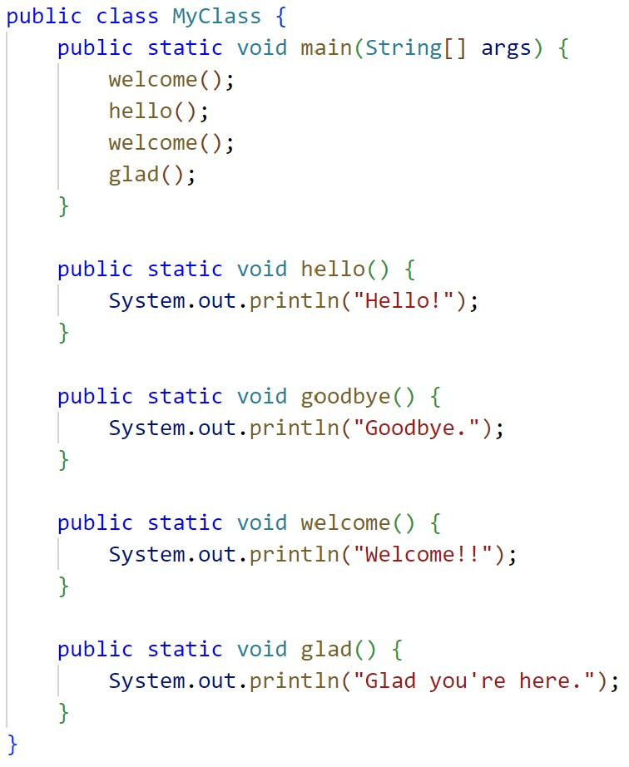
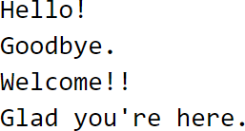
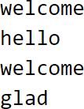
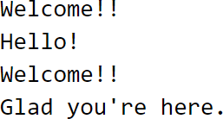
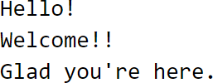
What is the output of this program?
A. C.
B.
D.
Lesson 6 - Spring 2023
5

Slide 6
Scope
The part of a program where a variable exists.
From its declaration to the end of the { } braces
Ex: a variable declared in a for loop only exists in that loop
Ex: a variable declared in a method exists only in that method
public static void example() { System.out.println("hello"); int x = 3;
for (int i = 1; i <= 10; i++) {
System.out.println(x);
}
i's scope
x's scope
}
Lesson 6 - Spring 2023
6

Slide 8
Class Constants
A fixed value visible to the whole program (the entire class).
Value can be set only at declaration; cannot be reassigned (so the value is constant)
public static final type NAME_OF_CONSTANT = expression;
Lesson 6 - Spring 2023
8

