Slide 1
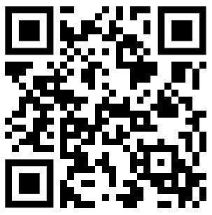
CSE 121 – Lesson 19
Miya Natsuhara
Spring 2023
Music: 121 23sp Lecture Vibes 🌸
TAs:
Jasmine
Shananda
Vidhi
Larry
Jacqueline
Afifah
Atharva
Julia
Anju
Lydia
Jonus
Hugh
Mia
Archit
Grace
Kailye
Joshua
James
Justin
Aishah
Claire
Lydia
Kai
sli.do #cse121

Slide 2
Announcements, Reminders
Gumball (& friends) Visit on Monday, June 5 1:00pm-3:00pm
Final Exam: Thursday, June 8 2:30pm-4:20pm
Bob Bandes TA Award Nominations Open!
Course Evaluations open now, and close Sunday June 4 at 11:59pm
Currently at about 16% response rate!
Resubmission Cycle 7 is our last resubmission cycle and will close on Thursday, June 8 at 11:59pm
Minimum Grade Estimator

Slide 3
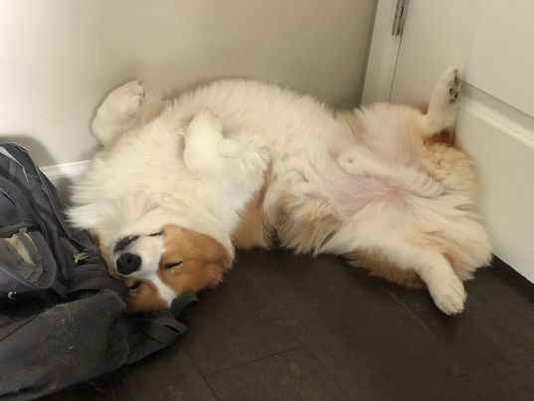
You did it!!

Slide 4
Learning Objectives
or, “What did I learn in this class?”
Computational Thinking Create an algorithm to solve a given problem and express that algorithm in a structured way (e.g. pseudocode)
Comprehension Trace and predict the behavior of programs and systems
Code Writing Write functionally correct Java programs that meet a provided specification using control structures, primitive data types, and basic data abstractions
Communication Clearly and effectively describe the behavior of a given code snippet
Debugging Identify errors in a method’s behavior & implement fixes for identified errors
Decomposition Solve problems by breaking them into subproblems and recombining the solutions using techniques such as methods
Ethics/Impact Describe ethical and sociotechnical issues related to software and technology and explain how their choices as programmers can impact those issues

Slide 5
(Optional) Quines
A quine is a computer program which takes no input and produces a copy of its own source code as its only output.

Slide 6
(Optional) Quines
public class Quine {
public static void main(String[] args){
char q = 34; // Quotation mark character
String[] l = { // Array of source code
"public class Quine",
"{",
" public static void main(String[] args)",
" {",
" char q = 34; // Quotation mark character",
" String[] l = { // Array of source code",
" ",
" };",
" for (int i = 0; i < 6; i++) // Print opening code",
" System.out.println(l[i]);",
" for (int i = 0; i < l.length; i++) // Print string array",
" System.out.println(l[6] + q + l[i] + q + ',');",
" for (int i = 7; i < l.length; i++) // Print this code",
" System.out.println(l[i]);",
" }",
"}",
};
for (int i = 0; i < 6; i++) // Print opening code
System.out.println(l[i]);
for (int i = 0; i < l.length; i++) // Print string array
System.out.println(l[6] + q + l[i] + q + ',');
for (int i = 7; i < l.length; i++) // Print this code
System.out.println(l[i]);
}
}
A quine in Java!
You can understand all of the code constructs and syntax used here!
(Even if you would never have written code like this yourself)

Slide 7
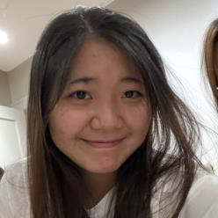
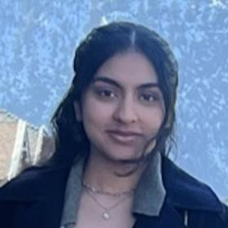
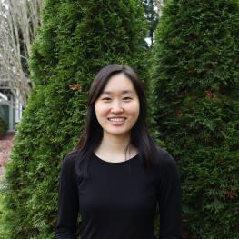
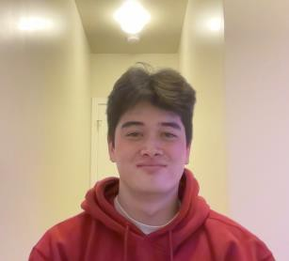
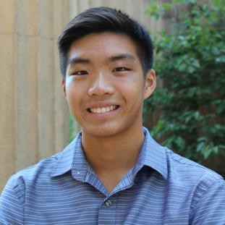
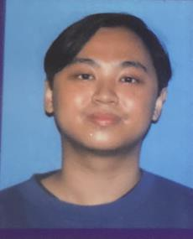
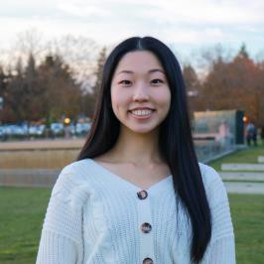
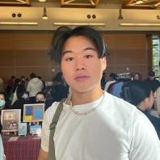
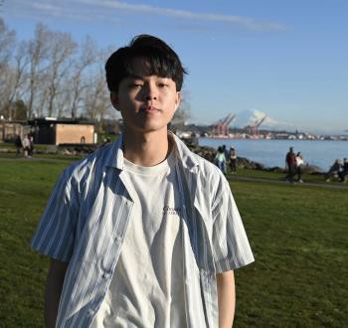
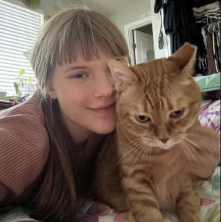
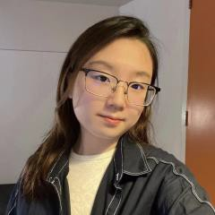
Thank your TAs!
Lesson 0 -WSpinritnegr 22002233
5

Slide 8
Thank you!
This is still a very new course! We are always looking for feedback on how to improve the class for you and for future students! Thank you for your patience and understanding as we continue to improve these new assignments, resources, and examples.
We really value your feedback!
Let us know what is or isn't working for you!
Something that went well in another course? Tell us about it!
…Please fill out course evals by Sunday June 4 at 11:59pm to provide feedback about the course!

Slide 9
Applications of CS
or “What can I do with what I learned?”
Detect and prevent toxicity online
Digitize basketball players
Help DHH people identify sounds
Figure out how to best distribute relief funds
Recognize disinformation online
Make movies
Improve digital collaboration
Fix Olympic badminton & Identintify cheating in chess
And so much more!

Slide 10
Future Courses
Course | Overview
CSE 122 | Introduction to Computer Programming II
CSE 123 | Introduction to Computer Programming III
or “What can I do next?”
Majors
Non-majors
Course | Overview
CSE 311 | Mathematical foundations
CSE 351 | Low-level computer organization/abstraction 😉
CSE 331 | Software design/implementation
CSE 341 | Programming languages
CSE 340 | Interaction programming
Course | Overview
CSE 154 | Intro. to web programming (several languages)
CSE 163 | Intermediate programming, data analysis (Python)
CSE 180 | Introduction to data science (Python)
CSE 373 | Data structures and algorithms (non-majors)
CSE 374 | Low-level programming and tools (C/C++)
CSE 416 | Intro. to Machine Learning
Other tech-related majors: Informatics, ACMS, Electrical & Computer Engineering, …
See: https://www.cs.washington.edu/academics/ugrad/current-students and https://www.cs.washington.edu/academics/ugrad/nonmajor-options/nonmajor-courses

Slide 11
Frequently Asked Questions
How can I get better at programming?
Practice!
How can I learn to X?
Search online, read books, look at examples :)
What should I work on next?
Anything you can think of! (Here are some ideas)
Beware: it’s hard to tell what’s easy and what’s hard.
Should I learn another language? Which one?
That depends–what do you want to do?
What’s the best programming language?
😠 (take CSE 341 or CSE 413)

Slide 12
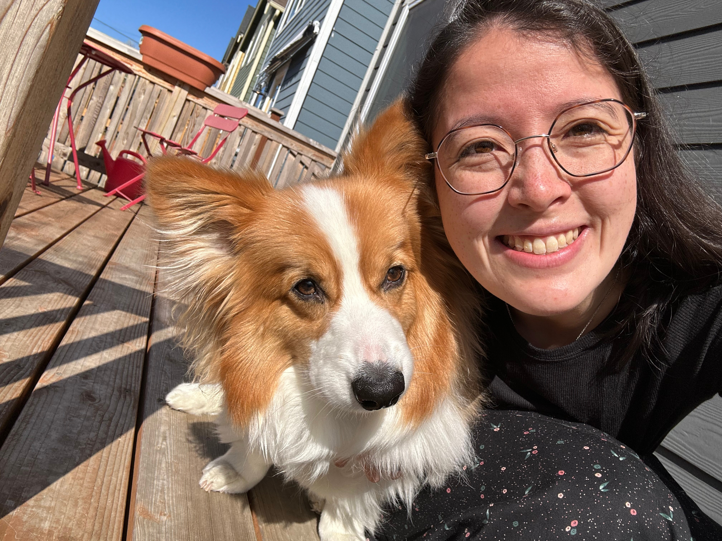
Thank you!
Ask Me (Almost) Anything!

