Slide 1
CSE 121 – Lesson 16
Miya Natsuhara
Spring 2023
Music: 121 23sp Lecture Vibes 🌸
TAs:
Jasmine
Shananda
Vidhi
Larry
Jacqueline
Afifah
Atharva
Julia
Anju
Lydia
Jonus
Hugh
Mia
Archit
Grace
Kailye
Joshua
James
Justin
Aishah
Claire
Lydia
Kai
sli.do #cse121

Slide 2
Announcements, Reminders
P3 will be released later today – last assignment!
Focus on arrays!
No resubmissions due to the timing at the end of the quarter
Gumball Visit on Monday, June 5 1:00pm-3:00pm
Final Exam: Thursday, June 8 2:30pm-4:20pm
Left-Handed Seating Request form posted on Ed and closes Mon 5/29 EOD

Slide 3
Final Exam Details
Final Exam: Thursday, June 8 2:30pm-4:20pm
In-person, on paper, with assigned seating
No collaboration – should be completed individually
You may bring in one 8.5x11-inchinch sheet of notes, handwritten or typed, double-sided
Focused on behavior (not style)
You should make every attempt to write correct Java syntax
Final Exam Review Session Tuesday, June 6 4:30pm-7:00pm in GUG220

Slide 4
(PCM) Arrays
Elements (must all be the same type)
Indices (starting at 0)
Must decide size when created
arr.length to get arr's length
Arrays.toString(arr) to get a nice String version

Slide 5
(PCM) Array Traversal Pattern
for (int i = 0; i < arr.length; i++) {
// do something with arr[i]
}

Slide 6
How can we get the last element of an array arr?
arr[arr.length()]
arr[length()]
arr[arr.length]
arr[arr.length() -1]
arr[arr.length - 1]

Slide 7
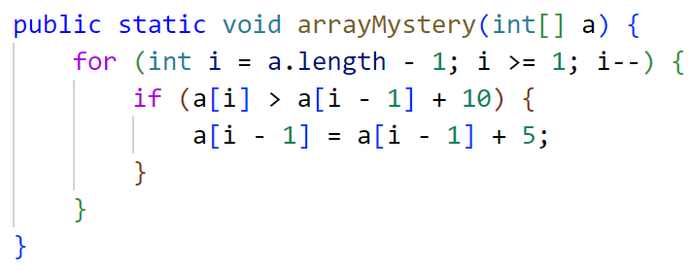
What would the array a store at the end of this arrayMystery method if {-20, 20, 26, 32, 50, 3} was passed in?
{-20, 20, 26, 32, 50, 3}
{-15, 25, 31, 37, 55, 8}
{-15, 25, 31, 37, 50, 3}
{-15, 20, 26, 37, 50, 3}

