Slide 1
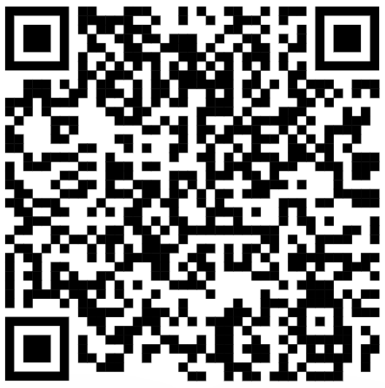
CSE 121 – Lesson 9
Miya Natsuhara
Autumn 2023
Music: 121 23au Lecture Tunes 🌦️
TAs:
Trey Sebastian
Annie
Jasmine
Christian
Lucas
Logan
Jacob
Christina
Colton
Janvi
Arkita
Vidhi
Ritesh
Hibbah
Julia
Sahej
Anju
Jonus
Lydia
Luke
Andras
Archit
Ayesha
Vinay
Maria
Shreya
Andy
Nicolas
Shayna
Hannah
Aishah
Kriti
Minh
Vivian
Nicole
Simon
Jessie
Lydia
Yijia
sli.do #cse121

Slide 2
Announcements, Reminders
Creative Project 2 released – due Tuesday, Oct 31 🎃
Resubmission Cycle 2 form released
Note: this is the last time C0 is eligible for resubmission.
Quiz 1 on Thursday, Nov 2 in quiz section
Mid-Quarter Formative Feedback with Ken Yasuhara for part of class on Wednesday, Nov 1

Slide 3
Common Problem-Solving Strategies
Analogy – Is this similar to another problem you've seen?
Brainstorming – Consider steps to solve problem before jumping into code
Try to do an example "by hand" → outline steps
Solve sub-problems – Is there a smaller part of the problem to solve?
Debugging – Does your solution behave correctly?
What is it doing?
What do you expect it to do?
What area of your code controls that part of the output?
Iterative Development – Can we start by solving a different problem that is easier?

Slide 4
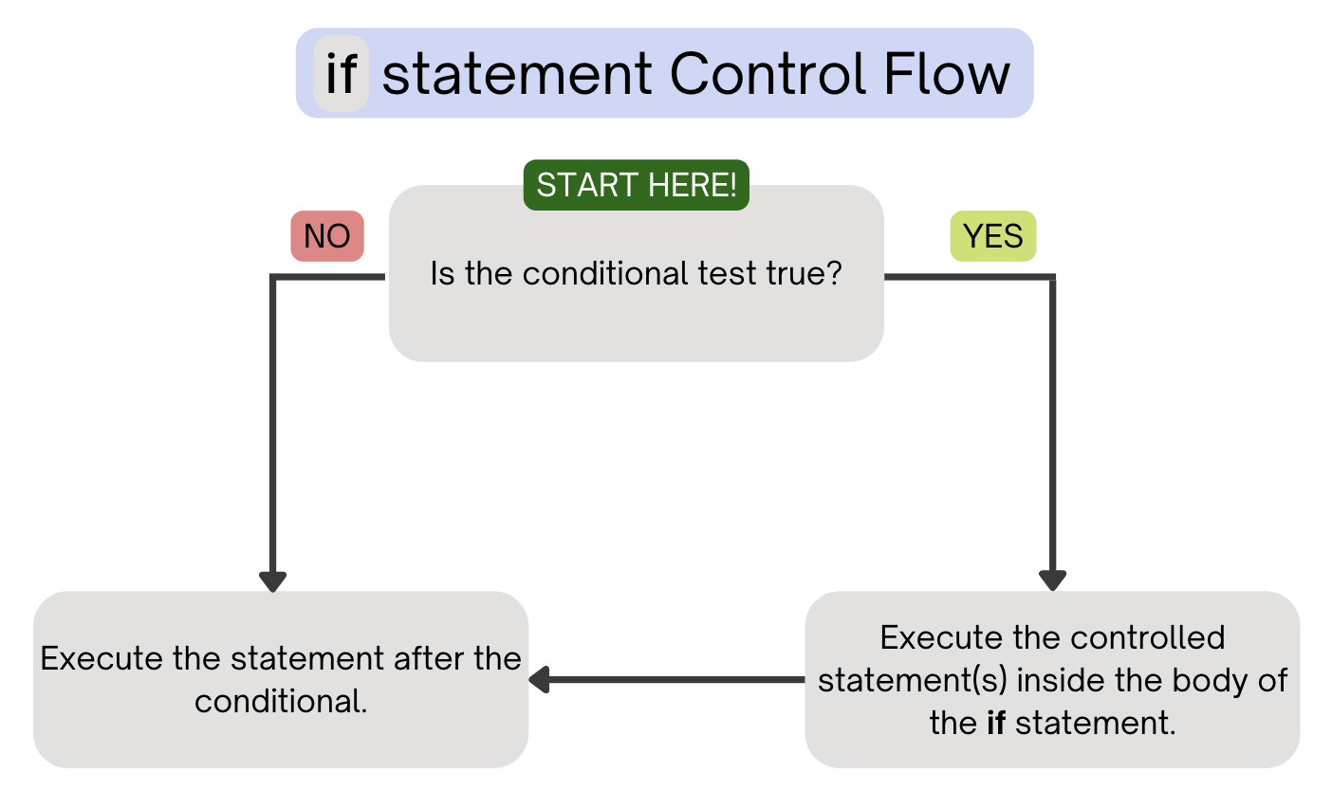
(PCM) Conditionals
Executes a block of statements only if the test is true

Slide 5
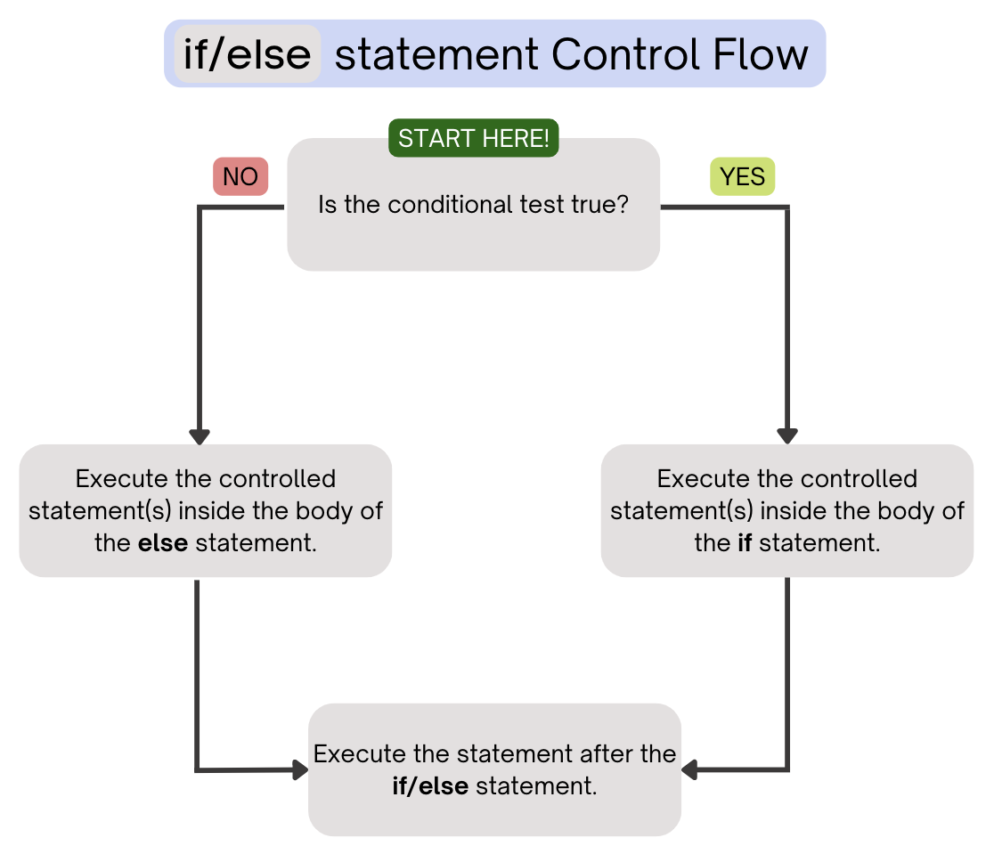
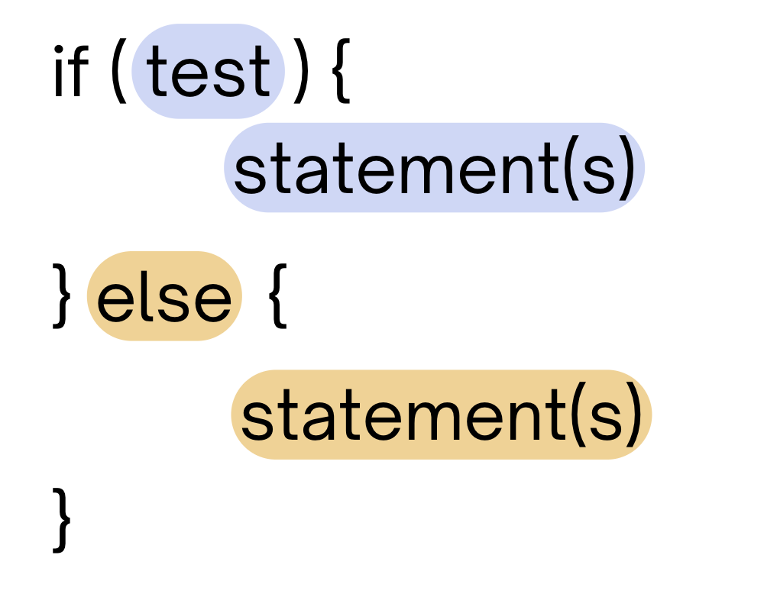
(PCM) Conditionals
Executes a block of statements if the test is true, executes another block of statements if the test is false

Slide 6
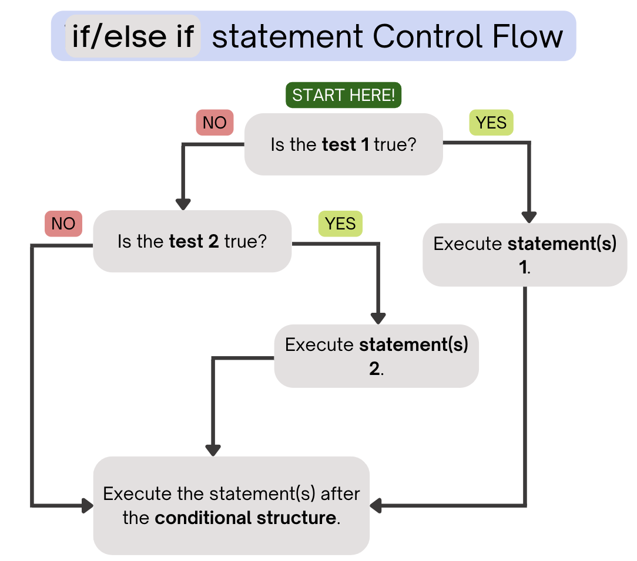
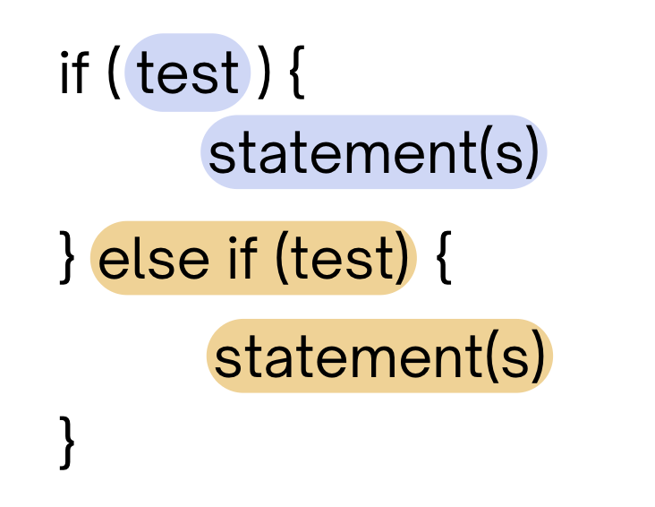
(PCM) Conditionals
Chooses between a block of statements to execute out of multiple choices, depending on which test it passes
If it ends in an else, exactly one block will be executed.
If it ends in an else if, at most one block will be executed, but the code also may not execute any blocks of statements.

Slide 7
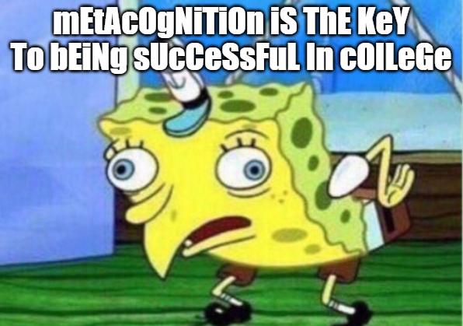

Slide 8
Common Problem-Solving Strategies
Analogy – Is this similar to another problem you've seen?
Brainstorming – Consider steps to solve problem before jumping into code
Try to do an example "by hand" → outline steps
Solve sub-problems – Is there a smaller part of the problem to solve?
Debugging – Does your solution behave correctly?
What is it doing?
What do you expect it to do?
What area of your code controls that part of the output?
Iterative Development – Can we start by solving a different problem that is easier?

Slide 9
Common Problem-Solving Strategies
Analogy – Is this similar to another problem you've seen?
Brainstorming – Consider steps to solve problem before jumping into code
Try to do an example "by hand" → outline steps
Solve sub-problems – Is there a smaller part of the problem to solve?
Debugging – Does your solution behave correctly?
What is it doing?
What do you expect it to do?
What area of your code controls that part of the output?
Iterative Development – Can we start by solving a different problem that is easier?

Slide 10
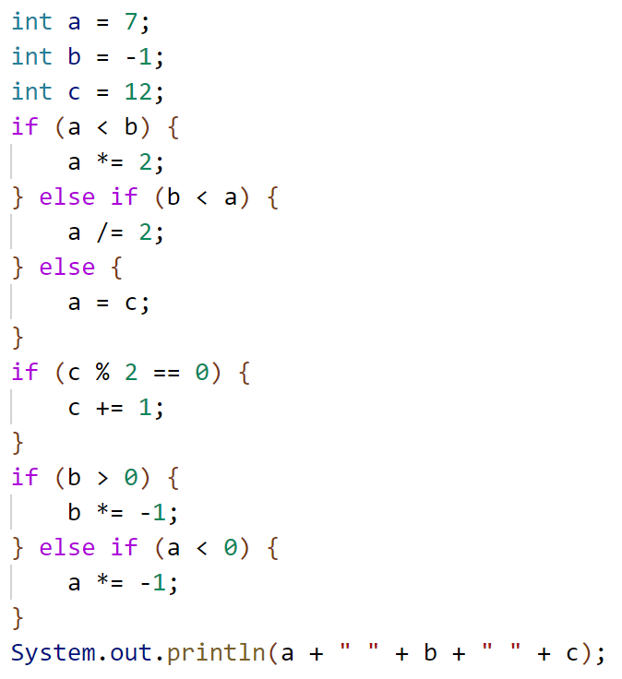
What is the output produced by executing this code?
A. 7 -1 12
B. -3 -1 13
C. 3 -1 13
D. 12 1 12
E. -14 1 13

