Slide 1
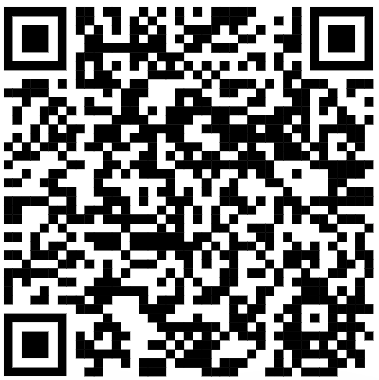
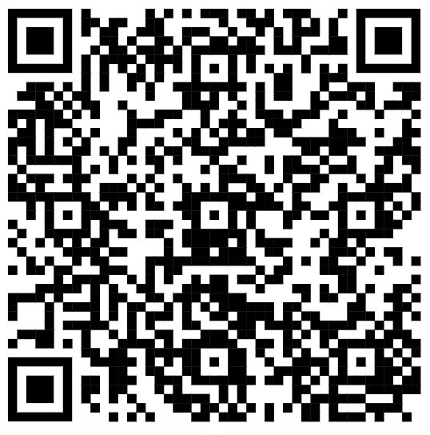
CSE 121 – Lesson 8
Miya Natsuhara
Autumn 2023
Music: 121 23au Lecture Tunes 🌦️
bonus!
(open story)
TAs:
Trey Sebastian
Annie
Jasmine
Christian
Lucas
Logan
Jacob
Christina
Colton
Janvi
Arkita
Vidhi
Ritesh
Hibbah
Julia
Sahej
Anju
Jonus
Lydia
Luke
Andras
Archit
Ayesha
Vinay
Maria
Shreya
Andy
Nicolas
Shayna
Hannah
Aishah
Kriti
Minh
Vivian
Nicole
Simon
Jessie
Lydia
Yijia
sli.do #cse121

Slide 2
Announcements, Reminders
Programming Assignment 1 was due last night
Creative Project 2 will be released later today
Quiz 1 scheduled for Thursday next week, Nov 2
Wednesday Nov 1: Mid-term Formative Feedback in class

Slide 3
Common Problem-Solving Strategies
Analogy – Is this similar to another problem you've seen?
Brainstorming – Consider steps to solve problem before jumping into code
Try to do an example "by hand" → outline steps
Solve sub-problems – Is there a smaller part of the problem to solve?
Debugging – Does your solution behave correctly?
What is it doing?
What do you expect it to do?
What area of your code controls that part of the output?
Iterative Development – Can we start by solving a different problem that is easier?

Slide 4
Metacognition
Metacognition: thinking about how you think
Asking questions about your solution process
Examples
While debugging: explain to yourself why you're making this change to your program
Before running your program: make an explicit prediction of what you expect to see
When coding: be aware of when you're not making progress, so you can take a break or try a different strategy
When studying: What is the relationship of this topic to other ideas in the course?

Slide 5
(PCM) Returns
Returns allow us to send values out of a method
public static <type> myMethod(int num) {
System.out.print(num + " is the best!");
... return <value of correct type>
}
Calling a method that returns a value…
<type> result = myMethod(42);
Evaluates the expression
Returns this value to where the method is called from
Method immediately exits

Slide 6
(Recall) String Methods Usage: <string variable>.<method>(…)
Method | Description
length() | Returns the length of the string.
charAt(i) | Returns the character at index i of the string
indexOf(s) | Returns the index of the first occurrence of s in the string; returns -1 if s doesn't appear in the string
substring(i, j) or substring(i) | Returns the characters in this string from i (inclusive) to j (exclusive); if j is omitted, goes until the end of the string
contains(s) | Returns whether or not the string contains s
equals(s) | Returns whether or not the string is equal to s (case-sensitive)
equalsIgnoreCase(s) | Returns whether or not the string is equal to s ignoring case
toUpperCase() | Returns an uppercase version of the string
toLowerCase() | Returns a lowercase version of the string
Notes:
Bomb = may get error if indexing int is out of bounds (e.g. negative index, or larger than the length of the string)
Safety guy = should return without error in usual case

Slide 7
String example
String s = "bubblegum";
s = s.substring(7, 8).toUpperCase() + s.substring(8) + "ball";

Slide 8
Example of returns: Math class
Methods | Returns
Math.abs(value) | Absolute value of value
Math.ceil(value) | value rounded up
Math.floor(value) | value rounded down
Math.max(value1, value2) | Larger of the two given values
Math.min(value1, value2) | Smaller of the two given values
Math.round(value) | value rounded to the nearest whole number
Math.sqrt(value) | Square root of value
Math.pow(base, exp) | base to the exp power

Slide 9
Math example
double value = 823.577564893;
double roundedValue = (double) Math.round(value * 100) / 100;

Slide 10
What is the correct implementation of a maxDatingAge method?
A.
B.
C.
D.

Slide 11
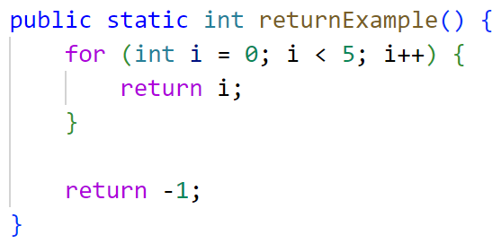
What value is returned from this method?
A. 0
B. 4
C. 5
D. -1

