Slide 1
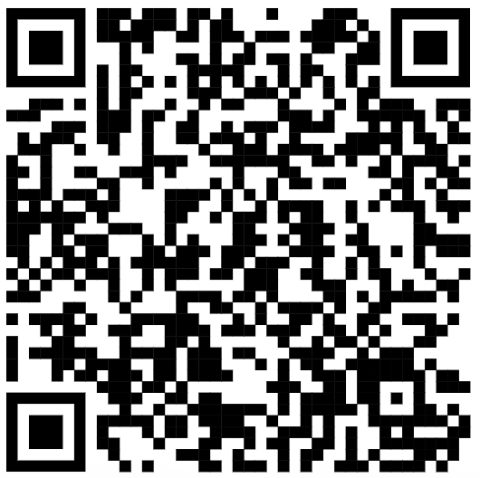
CSE 121 – Lesson 7
Miya Natsuhara
Autumn 2023
Music: 121 23au Lecture Tunes 🌦️
TAs:
Trey Sebastian
Annie
Jasmine
Christian
Lucas
Logan
Jacob
Christina
Colton
Janvi
Arkita
Vidhi
Ritesh
Hibbah
Julia
Sahej
Anju
Jonus
Lydia
Luke
Andras
Archit
Ayesha
Vinay
Maria
Shreya
Andy
Nicolas
Shayna
Hannah
Aishah
Kriti
Minh
Vivian
Nicole
Simon
Jessie
Lydia
Yijia
sli.do #cse121

Slide 2
Announcements, Reminders
Programming Assignment 1 is out, due Tues Oct 24
Start early!
Math Problems case study video walkthrough posted
Resubmission Cycle 1 released yesterday, due Thurs Oct 26
Quiz 0
I will get grades out as soon as I can – goal is before Quiz 1

Slide 3
(PCM) Parameters
A value passed to a method by its caller
public static void myMethod(int num) {
System.out.print(num + " is the best!");
...
}
Calling a method with a parameter…
myMethod(42);

Slide 4
(Review) Scope
The part of a program where a variable exists.
From its declaration to the end of the { } braces
Ex: a variable declared in a for loop only exists in that loop
Ex: a variable declared in a method exists only in that method
public static void example() {
System.out.println("hello");
int x = 3;
for (int i = 1; i <= 10; i++) {
System.out.println(x);
}
}
i's scope
x's scope
Lesson 6 - Spring 2023
6

Slide 5
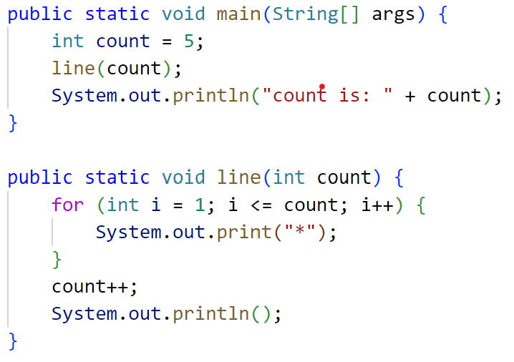
What will be the last line of output after this code has executed?
A. count is: 5
B. count is: 6
C. count is: 1
D. I'm lost

Slide 6
public class Scope {
public static void main(String[] args) {
int val = 1;
mOne(val); // Prints "One: 1"
val = -1;
mTwo(val); // Prints "Two: -2"
mThree(val); // Prints "One: -1"
// "Three: 2"
}
// Method mOne()
public static void mOne(int val) {
System.out.println("One: " + val);
}
// Method mTwo()
public static void mTwo(int val) {
val = val * 2;
System.out.println("Two: " + val);
}
// Method mThree()
public static void mThree(int val) {
mOne(val);
val = val + 3;
System.out.println("Three: " + val);
}
}

Slide 7
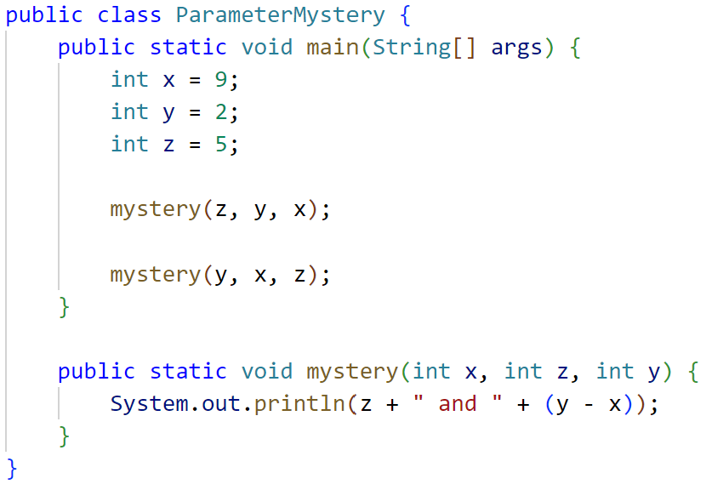
What is the output of this program?
A. 2 and 4 9 and 3
B. 5 and -7 5 and -7
C. 9 and -3
5 and -7
D. I'm lost

