Slide 1
CSE 121 – Lesson 5
Miya Natsuhara
Autumn 2023
Music: 121 23au Lecture Tunes 🌦️
TAs:
Trey Sebastian
Annie
Jasmine
Christian
Lucas
Logan
Jacob
Christina
Colton
Janvi
Arkita
Vidhi
Ritesh
Hibbah
Julia
Sahej
Anju
Jonus
Lydia
Luke
Andras
Archit
Ayesha
Vinay
Maria
Shreya
Andy
Nicolas
Shayna
Hannah
Aishah
Kriti
Minh
Vivian
Nicole
Simon
Jessie
Lydia
Yijia
sli.do #cse121

Slide 2
Announcements, Reminders
Creative Project 1 is out, due Tues October 17
Resubmission Cycle 0 released yesterday, due Thurs October 19
Even if you're not resubmitting – read your feedback!!
Quiz 0: Thursday, Oct 19 during section
Quiz logistics announcement
Office Hour Problems (Miya's OH)

Slide 3
Last time: for loops!
For loops are our first control structure
A syntactic structure that controls the execution of other statements.

Slide 4
Fencepost Pattern
Some task where one piece is repeated n times, and another piece is repeated n-1 times and they alternate
g-u-m-b-a-l-l

Slide 5
Fencepost Pattern
Some task where one piece is repeated n times, and another piece is repeated n-1 times and they alternate
g-u-m-b-a-l-l

Slide 6
(PCM) Nested for loops
for (int outerLoop = 1; outerLoop <= 5; outerLoop++) {
System.out.println("outer loop iteration #" + outerLoop);
for (int innerLoop = 1; innerLoop <= 3; innerLoop++) {
System.out.println(" inner loop iteration #" + innerLoop);
}
System.out.println(outerLoop);
}

Slide 7
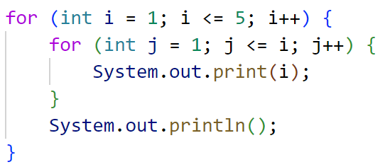
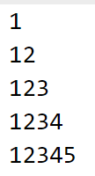
What output is produced by the following code?
A. B. C.

Slide 8
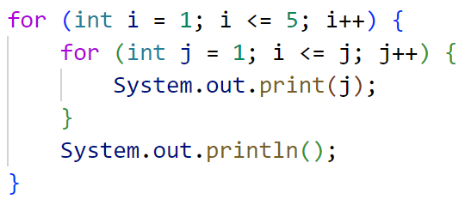
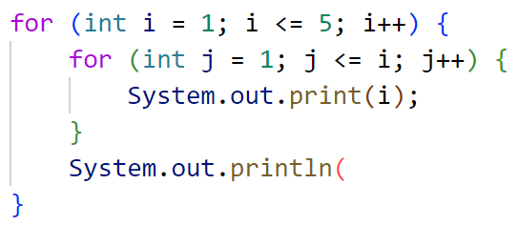
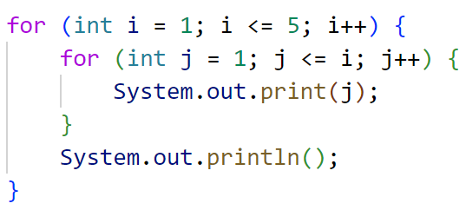
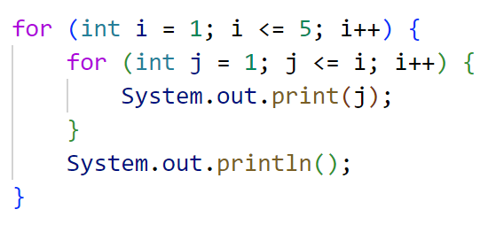
What code produces the following output?
A.
B.
C.
D.

Slide 9
Pseudo-Randomness
Computers generate numbers in a predictable way using mathematical formulas.
Input may include current time, mouse position, etc.
True randomness is hard to achieve – we rely on natural processes
e.g., atmospheric noise, lava lamps

Slide 10
(PCM) Random
A Random object generates pseudo-random numbers.
The Random class is found in the java.util package
import java.util.*;
Method | Description
nextInt() | Returns a random integer
nextInt(max) | Returns a random integer in the range [0, max), or in other words, 0 to max-1 inclusive
nextDouble() | Returns a random real number in the range [0.0, 1.0)

Slide 11
(PCM) Math
Calling:
Math.<method>(…)
Method | Description
Math.abs(value) | Returns the absolute value of value
Math.ceil(value) | Returns value rounded up
Math.floor(value) | Returns value rounded down
Math.max(value1, value2) | Returns the larger of the two values
Math.min(value1, value2) | Returns the smaller of the two values
Math.round(value) | Returns value rounded to the nearest whole number
Math.sqrt(value) | Returns the square root of value
Math.pow(base, exp) | Returns base raised to the exp power

