Slide 1
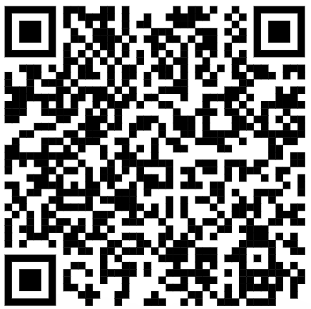
CSE 121 – Lesson 4
Miya Natsuhara
Autumn 2023
Music: 121 23au Lecture Tunes 🌦️
TAs:
Trey Sebastian
Annie
Jasmine
Christian
Lucas
Logan
Jacob
Christina
Colton
Janvi
Arkita
Vidhi
Ritesh
Hibbah
Julia
Sahej
Anju
Jonus
Lydia
Luke
Andras
Archit
Ayesha
Vinay
Maria
Shreya
Andy
Nicolas
Shayna
Hannah
Aishah
Kriti
Minh
Vivian
Nicole
Simon
Jessie
Lydia
Yijia
sli.do #cse121

Slide 2
Announcements, Reminders
C1 releasing later today (due Tues, Oct 17)
Feedback for Creative Project 0 released yesterday
Use the Grade Checker tool to track your grades!
Quiz 0: Thursday, October 19 during section.
Bring device to take quiz on! (e.g., laptop, surface)
Resubmission form for R0 releasing tomorrow (due Thurs, Oct 19)
Remember – IPL is in person! (For async help, use the message board)
Final Exam has been scheduled: Wednesday, Dec 13 12:30 – 2:20pm
Code Quality Guide updated!

Slide 3
Resubmissions
In general, you may revise resubmit a given Programming Assignment or Creative Project each week based on the feedback you receive with no penalty. The grade of your resubmission will completely replace your previous grades for that assignment.
Logistics:
One resubmission per week
An assignment is only eligible for resubmission the 3 cycles after its feedback is posted
There are 8 resubmission cycles this quarter (all listed on the course calendar)
To use a resubmission, you will need to:
Set the submission you want to be graded as "Final"
Fill out a form listing some information (Name, assignment, what you changed, etc.)

Slide 4
Last Time…
Variables
Container that stores a specific data type
Must declare & initialize!
Manipulate, modify, reuse ♻
Strings
Sequence of characters treated as one, yet can be indexed as individual parts
char, represents a single character
// declare AND initialize
int version = 5;
g | u | m | b | a | l | l
0 | 1 | 2 | 3 | 4 | 5 | 6

Slide 5
🐞 Debugging
We also started to think about debugging with the last activity in class on Friday (BuggyMadLibs.java)
Bugs happen – debugging is a natural part of programming!
Ways to approach debugging?
Notes:
Tracing error messages
Playing "java"
Narrow down the scope of the bug
Println debugging! (more to come on this today)

Slide 6
(PCM) for loops!
For loops are our first control structure
A syntactic structure that controls the execution of other statements.

Slide 7
(PCM) for loops!
for (int counter = 1; counter <= 5; counter++) {
System.out.println("I love CSE 121!");
}

Slide 8
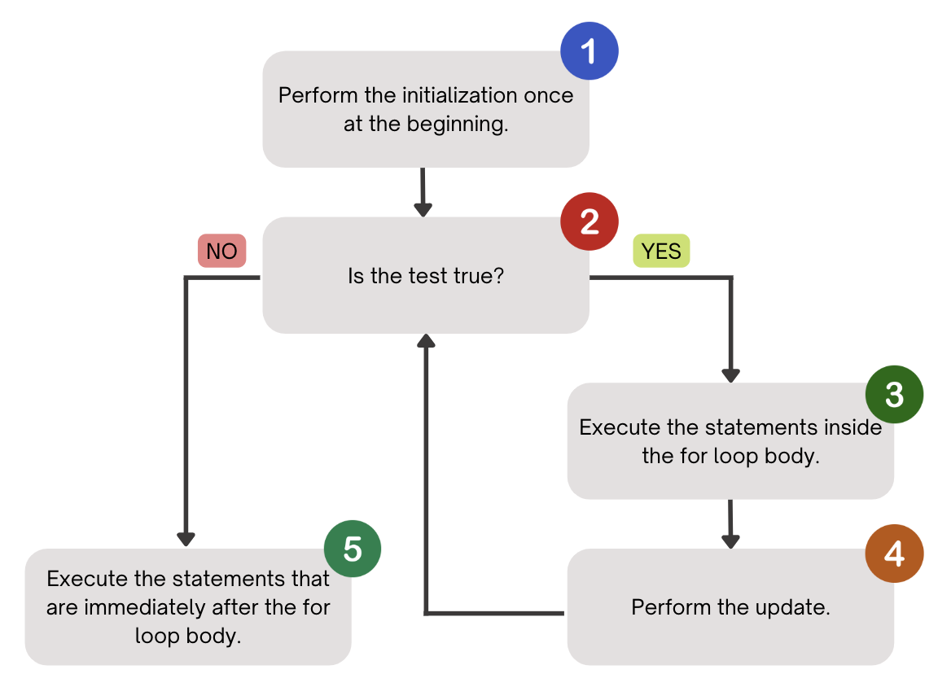
(PCM) for loops!

Slide 9
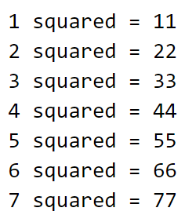
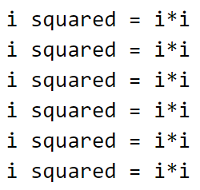
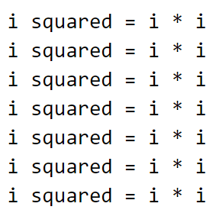
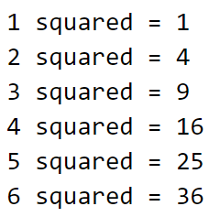
What output does the following code produce?
A. B. C. D.

Slide 10
(PCM) String traversals
// For some String s
for (int i = 0; i < s.length(); i++) {
// do something with s.charAt(i)
}

Slide 11
Fencepost Pattern
Some task where one piece is repeated n times, and another piece is repeated n-1 times and they alternate
g-u-m-b-a-l-l

Slide 12
Fencepost Pattern
Some task where one piece is repeated n times, and another piece is repeated n-1 times and they alternate
g-u-m-b-a-l-l

