Slide 1
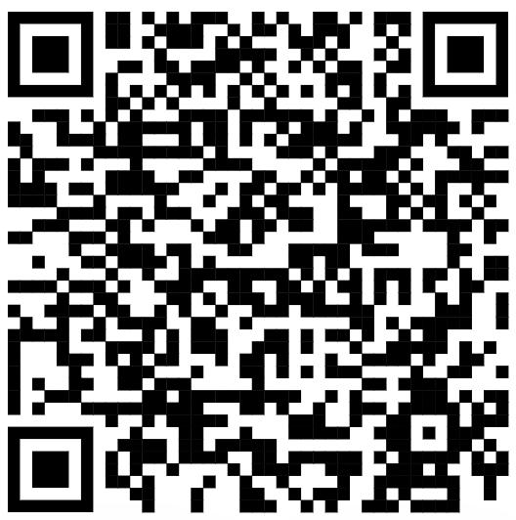
CSE 121 – Lesson 2
Miya Natsuhara
Autumn 2023
Music: 121 23au Lecture Tunes 🌦️
TAs:
Trey Sebastian
Annie
Jasmine
Christian
Lucas
Logan
Jacob
Christina
Colton
Janvi
Arkita
Vidhi
Ritesh
Hibbah
Julia
Sahej
Anju
Jonus
Lydia
Luke
Andras
Archit
Ayesha
Vinay
Maria
Shreya
Andy
Nicolas
Shayna
Hannah
Aishah
Kriti
Minh
Vivian
Nicole
Simon
Jessie
Lydia
Yijia
sli.do #cse121

Slide 2
Announcements, Reminders
Creative Project 0 due tonight (Oct 4) @ 11:59 PM
Programming Assignment 0 released later today (due Tues, Oct 10)
IPL is open! - Schedule and instructions can be found on course website.
Just joined CSE 121? Resubmission policy is your friend! See more in syllabus.
Reminder: Pre-Class Work and Section work are not graded! (but you should do them anyway 😉)

Slide 3
PCM Recap: Data Types & Expressions
Types: int, double, String, boolean
Expressions: Operators
Beware of precedence! (order of operations)

Slide 4
(PCM) Data Types in Java
In programming, you’re dealing with data…
ints (whole numbers)
doubles (real numbers)
Strings
booleans (true or false)

Slide 5
(PCM) Operators (for numerical & String values)
Numerical:
+ Addition
- Subtraction
* Multiplication
/ Division
% Modulo or “Mod”
<, >, <=, >=, ==, !=
Strings
+ Concatenation
Booleans
! Logical Not
&& Logical And
|| Logical Or

Slide 6
(PCM) Precedence
Parentheses
Multiplication, Modulo, Division
Addition (and Concatenation), Subtraction
If multiple operators at the same level?
Evaluate subexpressions from left to right!

Slide 7
Example
1 + 2 * 3
(1 + 2) * 3

Slide 8
Work on Expressions/Types Practice Problems Part 1
Ed lesson linked from the course calendar
Work with the folks around you!
TAs and I will be walking around to help
5 + 2 * 4
1 + 2 / 3
6 * 5 % 7

Slide 9
Questions?

Slide 10
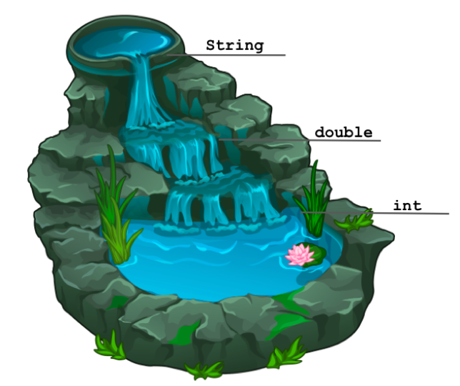
(PCM) Mixing Types
When mixing types in an expression, Java will convert one type to the other and then perform the operation “normally”
ints can be converted to doubles
Both ints and doubles can be converted to Strings

Slide 11
Example 2
2 + 2 + "hello" + 3 * 5 + 10

Slide 12
Work on Expressions/Types Practice Problems
Part 2
Ed lesson linked from the course calendar
Work with the folks around you!
TAs and I will be walking around to help
5 * 3 + 1.0
8 / 3 * 2.0
8.0 / 3 * 2
"Hello" + "world"
1 + "2" + 3
1 + 2 + "3"
1 + "2" + (3 + 4)

Slide 13
Questions?

Slide 14
(PCM) Boolean Operators
! Logical Not
< > <= >= Relational Operators
== != Relational Operators (equality)
&& Logical And
|| Logical Or

Slide 15
(PCM) Precedence (updated)
Logical not
Parentheses
Multiplication, Modulo, Division
Addition (and Concatenation), Subtraction
Relational operators
Equality operators
Logical and
Logical or

Slide 16
Example 3
1 + 2 * 3 != (1 + 2) * 3

Slide 17
Work on Expressions/Types Practice Problems
Part 3
Ed lesson linked from the course calendar
Work with the folks around you!
TAs and I will be walking around to help
5 * 3 < 12
10 % 3 == 10 / 3
5 < 9 || (7 != 7)
!(1 + 2 == 3 && 10 % 4 > 2)

Slide 18
Questions?

Slide 19
Questions?

Slide 20
Variables
Now that we know about different types and data, we can learn about how to store it!
Java allows you to create variables within a program. A variable has
A type
A name
(Potentially) a value it is storing
Declaration: int x;
Initialization: x = 30;
Or all in one line:
int x = 30;

