Slide 1
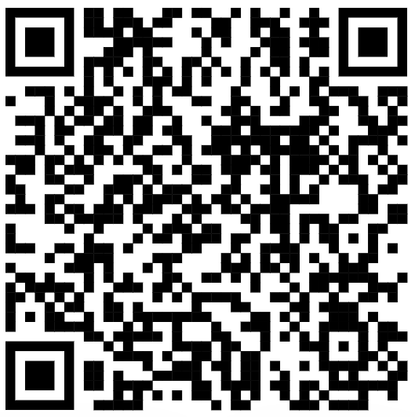
CSE 121 – Lesson 18
Miya Natsuhara
Autumn 2023
Music: 121 23au Lecture Tunes 🌦️
TAs:
Trey Sebastian
Annie
Jasmine
Christian
Lucas
Logan
Jacob
Christina
Colton
Janvi
Arkita
Vidhi
Ritesh
Hibbah
Julia
Sahej
Anju
Jonus
Lydia
Luke
Andras
Archit
Ayesha
Vinay
Maria
Shreya
Andy
Nicolas
Shayna
Hannah
Aishah
Kriti
Minh
Vivian
Nicole
Simon
Jessie
Lydia
Yijia
sli.do #cse121

Slide 2
Announcements, Reminders
Resubmission Cycle 7 update: all assignments eligible for resubmission
Closes on Thursday, Dec 14
Gumball (& friends) Visit on Monday, Dec 11 1:00pm-3:00pm around Drumheller Fountain & Rainier Vista
TA-led Final Exam Review Session Tuesday, Dec 12 4:30pm-7:00pm in ARC147
Final Exam: Wednesday, Dec 13 12:30pm-2:20pm
Seating charts have been posted!
Bob Bandes TA Award Nominations Open!
Course Evaluations open now, and close Sunday Dec 10 at 11:59pm
Currently at about 16% response rate!

Slide 3
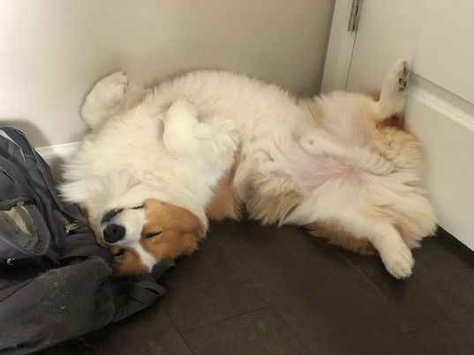
You did it!!

Slide 4
Learning Objectives
or, “What will I learn in this class?”
Computational Thinking
Code Comprehension
Code Writing
Communication
Testing
Debugging
Ethics / Impact

Slide 5
(Optional) Using String[] args!
String[] args is just a parameter to our main method…but we never call main, so how do we pass anything to args?
When we run our program from the terminal, we can pass "command-line arguments" to the main method, and they become the contents of args
javac MyProgram.java
java MyProgram these 7 words will go in args

Slide 6
(Optional) Quines
A quine is a computer program which takes no input and produces a copy of its own source code as its only output.

Slide 7
(Optional) Quines
public class Quine {
public static void main(String[] args){
char q = 34; // Quotation mark character
String[] l = { // Array of source code
"public class Quine",
"{",
" public static void main(String[] args)",
" {",
" char q = 34; // Quotation mark character",
" String[] l = { // Array of source code",
" ",
" };",
" for (int i = 0; i < 6; i++) // Print opening code",
" System.out.println(l[i]);",
" for (int i = 0; i < l.length; i++) // Print string array",
" System.out.println(l[6] + q + l[i] + q + ',');",
" for (int i = 7; i < l.length; i++) // Print this code",
" System.out.println(l[i]);",
" }",
"}",
};
for (int i = 0; i < 6; i++) // Print opening code
System.out.println(l[i]);
for (int i = 0; i < l.length; i++) // Print string array
System.out.println(l[6] + q + l[i] + q + ',');
for (int i = 7; i < l.length; i++) // Print this code
System.out.println(l[i]);
}
}
A quine in Java!
You can understand all of the code constructs and syntax used here!
(Even if you would never have written code like this yourself)

Slide 8
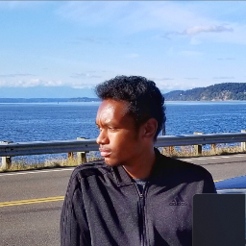
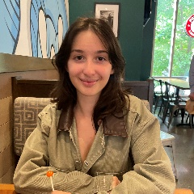
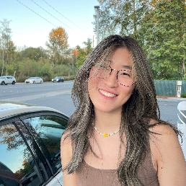
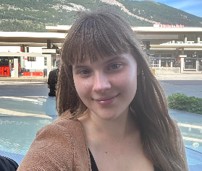
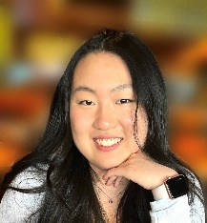
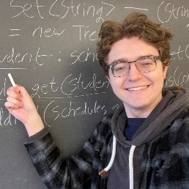
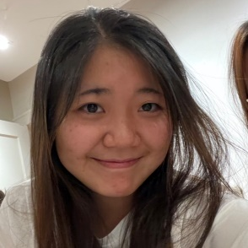
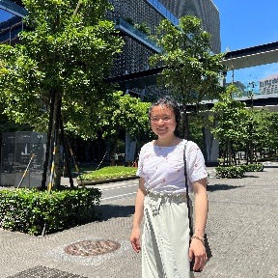
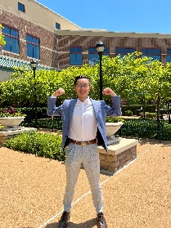
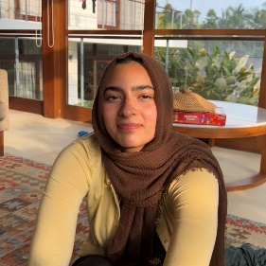
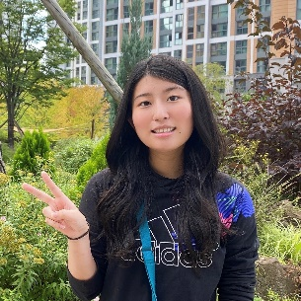
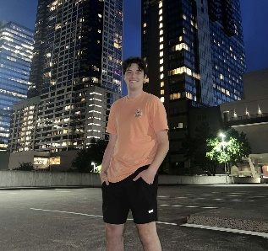
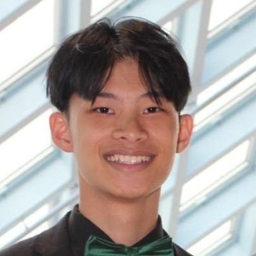
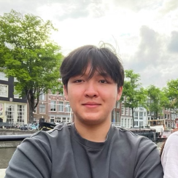
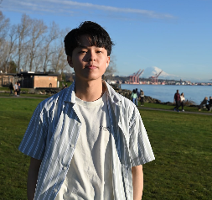
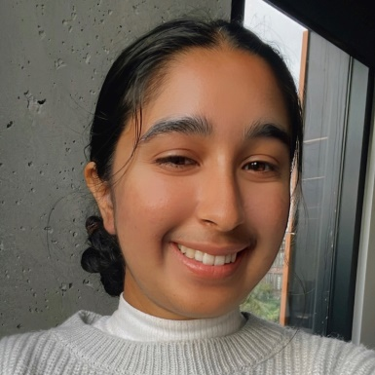
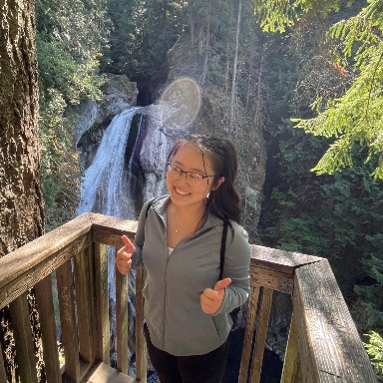
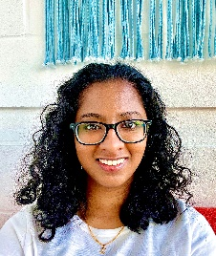
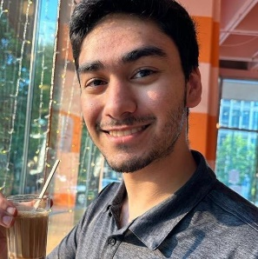
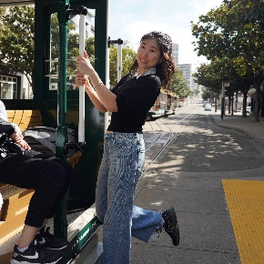
Thank your TAs!

Slide 9
Thank you!
This is still a very new course! We are always looking for feedback on how to improve the class for you and for future students! Thank you for your patience and understanding as we continue to improve these new assignments, resources, and examples.
We really value your feedback!
Let us know what is or isn't working for you!
Something that went well in another course? Tell us about it!
…Please fill out course evals by Sunday Dec 10 at 11:59pm to provide feedback about the course!

Slide 10
Applications of CS
or “What can I do with what I learned?”
Detect and prevent toxicity online
Digitize basketball players
Help DHH people identify sounds
Figure out how to best distribute relief funds
Recognize disinformation online
Make movies
Improve digital collaboration
Fix Olympic badminton & Identintify cheating in chess
And so much more!

Slide 11
Future Courses
Course | Overview
CSE 122 | Introduction to Computer Programming II
CSE 123 | Introduction to Computer Programming III
or “What can I do next?”
Majors
Non-majors
Course | Overview
CSE 311 | Mathematical foundations
CSE 351 | Low-level computer organization/abstraction 😉
CSE 331 | Software design/implementation
CSE 341 | Programming languages
CSE 340 | Interaction programming
Course | Overview
CSE 154 | Intro. to web programming (several languages)
CSE 163 | Intermediate programming, data analysis (Python)
CSE 180 | Introduction to data science (Python)
CSE 373 | Data structures and algorithms (non-majors)
CSE 374 | Low-level programming and tools (C/C++)
CSE 416 | Intro. to Machine Learning
Other tech-related majors: Informatics, ACMS, Electrical & Computer Engineering, …
See: https://www.cs.washington.edu/academics/ugrad/current-students and https://www.cs.washington.edu/academics/ugrad/nonmajor-options/nonmajor-courses

Slide 12
Frequently Asked Questions
How can I get better at programming?
Practice!
How can I learn to X?
Search online, read books, look at examples :)
What should I work on next?
Anything you can think of! (Here are some ideas)
Beware: it’s hard to tell what’s easy and what’s hard.
Should I learn another language? Which one?
That depends–what do you want to do?
What’s the best programming language?
😠 (take CSE 341 or CSE 413)

Slide 13
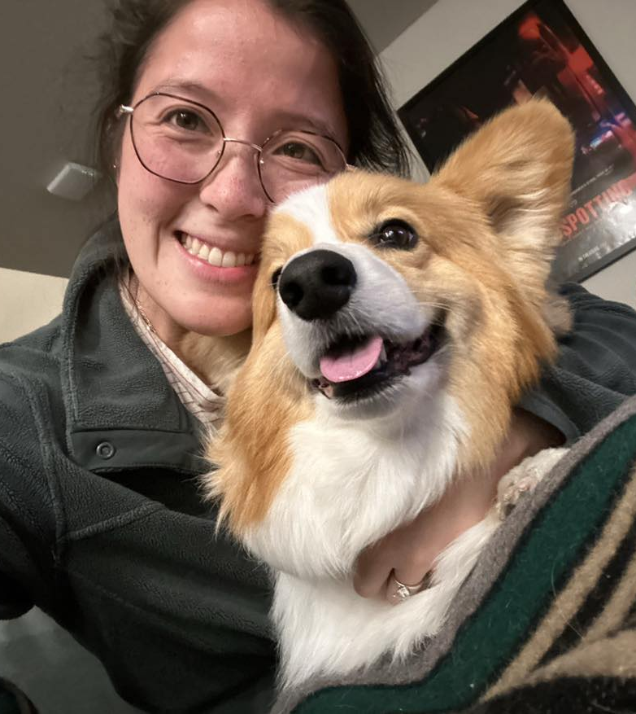
Thank you!
Ask Me (Almost) Anything!

