Slide 1
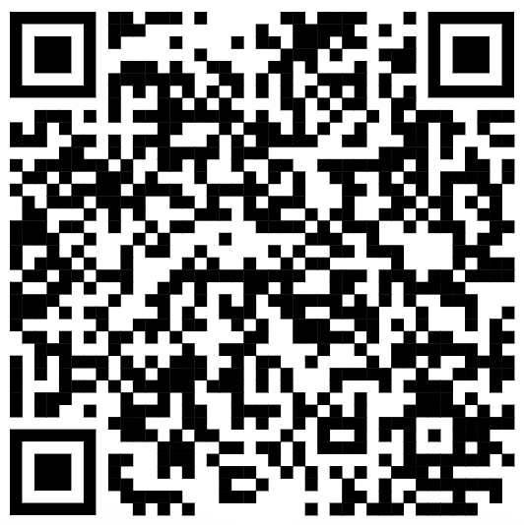
CSE 121 – Lesson 17
Miya Natsuhara
Autumn 2023
Music: 121 23au Lecture Tunes 🌦️
TAs:
Trey Sebastian
Annie
Jasmine
Christian
Lucas
Logan
Jacob
Christina
Colton
Janvi
Arkita
Vidhi
Ritesh
Hibbah
Julia
Sahej
Anju
Jonus
Lydia
Luke
Andras
Archit
Ayesha
Vinay
Maria
Shreya
Andy
Nicolas
Shayna
Hannah
Aishah
Kriti
Minh
Vivian
Nicole
Simon
Jessie
Lydia
Yijia
sli.do #cse121

Slide 2
Announcements, Reminders
P3 due tomorrow (Thursday, Dec 7)
Bob Bandes TA Award Nominations Open!
IPL closes Friday, Dec 8 at 6:30pm
Course evaluations for A and B lecture close Sunday, Dec 10
Please give us feedback!
TAs will be collecting feedback in quiz sections this week as well
Gumball (& friends) Visit on Monday, Dec 11 1:00pm-3:00pm
Final Exam: Wednesday, December 13 12:30pm-2:20pm
TA-led Final Review Session Tuesday, Dec 12 4:30pm-7:00pm in ARC 147

