Slide 1
CSE 121 – Lesson 14
Miya Natsuhara
Autumn 2023
Music: 121 23au Lecture Tunes 🌦️
TAs:
Trey Sebastian
Annie
Jasmine
Christian
Lucas
Logan
Jacob
Christina
Colton
Janvi
Arkita
Vidhi
Ritesh
Hibbah
Julia
Sahej
Anju
Jonus
Lydia
Luke
Andras
Archit
Ayesha
Vinay
Maria
Shreya
Andy
Nicolas
Shayna
Hannah
Aishah
Kriti
Minh
Vivian
Nicole
Simon
Jessie
Lydia
Yijia
sli.do #cse121

Slide 2
Announcements, Reminders
C3 deadline extended to Tuesday, Nov 28!
Gumball (& friends) Visit on Monday, December 11 1:00pm-3:00pm
Next week:
Tuesday: section cancelled
Wednesday: lecture optional (Lead TA Nic will be teaching!)
Thursday, Friday: University holidays (campus is closed)
IPL: reduced staffing Mon, Tues, Wed (maybe partial day); closed Thurs-Sun
Final Exam: Wednesday, Dec 13 12:30pm-2:20pm

Slide 3
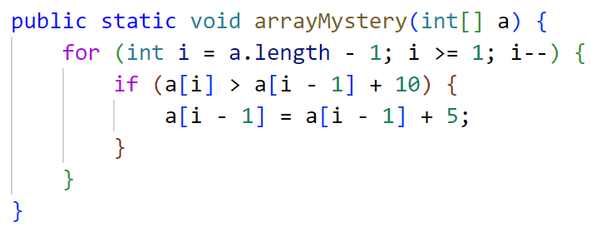
What would the array a store at the end of this arrayMystery method if {-20, 20, 26, 32, 50, 3} was passed in?
{-20, 20, 26, 32, 50, 3}
{-15, 25, 31, 37, 55, 8}
{-15, 25, 31, 37, 50, 3}
{-15, 20, 26, 37, 50, 3}

Slide 4
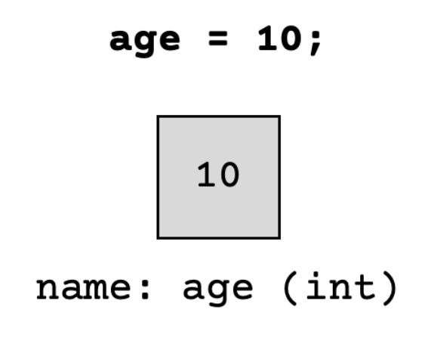
(PCM) Value Semantics vs. Reference Semantics
Applies when working with primitive types
Variables/parameters hold a copy of the actual value
Applies when working with objects
Variables/parameters hold a reference to the object

Slide 5
(PCM) Value Semantics vs. Reference Semantics
int a = 3;
int b = a;
a = 99;
int[] list1 = {4, 8, 15, 16, 23};
int[] list2 = list1;
list1[1] = 99;

Slide 6
(PCM) Value Semantics vs. Reference Semantics
boolean test = true;
flipValue(test);
public static void flipValue(boolean b) {
b = !b;
}
boolean[] tests =
{true, true, false, true, false, false};
flipValues(tests);
public static void flipValues(boolean[] b) {
for (int i = 0; i < b.length; i++) {
b[i] = !b[i];
}
}

Slide 7
(PCM) null
The absence of a reference!
Sort of like a "zero-equivalent" for references!
Default value for object types
NullPointerExceptions occur when you try to ask a reference do something, but there isn't a reference there…it's null!
"do something" such as get an element from an array, or call a method on an object)

Slide 8
public static void main(String[] args) {
int x = 0;
int[] a = new int[4];
x++;
mystery(x, a);
System.out.println(x + " " + Arrays.toString(a));
x++;
mystery(x, a);
System.out.println(x + " " + Arrays.toString(a));
}
public static void mystery(int x, int[] a) {
x++;
a[x]++;
System.out.println(x + " " + Arrays.toString(a));
}
Four lines of output would be produced by this code. What would those four lines be?

Slide 9
public static void main(String[] args) {
int x = 0;
int[] a = new int[4];
x++;
mystery(x, a);
System.out.println(x + " " + Arrays.toString(a));
x++;
mystery(x, a);
System.out.println(x + " " + Arrays.toString(a));
}
public static void mystery(int x, int[] a) {
x++;
a[x]++;
System.out.println(x + " " + Arrays.toString(a));
}

